Slide 1
pwc
PwC CHALLENGE 8.0 | ROUND 1 SUBMISSION
Designing a Better
Organization
An enterprise AI operating-model blueprint for StyleVerse Global. It automates
40% of routine work and protects all 28,000 roles while doing it.
“Our next phase of growth depends on designing a better organization.” — CEO, StyleVerse Global
Ranjana Mainani
Strategic consultant team, StyleVerse AI transformation

Slide 2
EXECUTIVE SUMMARY | 1 OF 2
82% of StyleVerse's work should involve AI. None of the 28,000 people should lose a job over it.
Revenue keeps growing at StyleVerse; profit hasn't kept pace. The gap comes from how slowly insight turns into action, because work — not talent — is misallocated across the business. We re-architect every role into three tiers, automate 40% of routine work, and move the capacity that frees up onto the customer-facing jobs that actually drive the 15% growth target.
54%
6,056
₹311 Cr
13.1%
of all work is routine once
weighted by headcount —
Exhibit 4's simple average
says 48%
FTE-equivalents released.
Zero-Layoff means
converted, not cut
in yearly value against a
₹200 Cr one-off spend.
Payback under 12 months
EBITDA margin by FY26, up
from 9.5% now, riding the
15% revenue growth target
WHAT WE FOUND
WHAT WE RECOMMEND
Every function has optimised itself in isolation, and the handoffs between them belong to nobody — that's the actual constraint, more than any one function's performance.
The 48% routine-work figure in Exhibit 4 is a plain average across six functions. Weight it by headcount and it becomes 54%, because the two biggest functions are also the most routine-heavy.
Retail Operations is the case's #2 priority by value, and dead last on readiness — 1.35 out of 5, fear at 4.3.
Scale Marketing & CX and Merchandising first. Retail Operations joins them, but only as a 20-store pilot — not a 200-store rollout on day one.
One federated CoE: a central hub for platform and standards, with squads embedded inside each function.
Governance isn't one policy for five brands. Maison Luxe needs to stay human-led; SpeedStyle can go AI-forward. Swap those two and you damage both.
All figures derived from case Exhibits 1–5. Assumptions: markdown reduction at 35% pass-through; return cost = 25% of item value; ₹1.2 L replacement cost per exit. See Appendix A3.
1

Slide 3
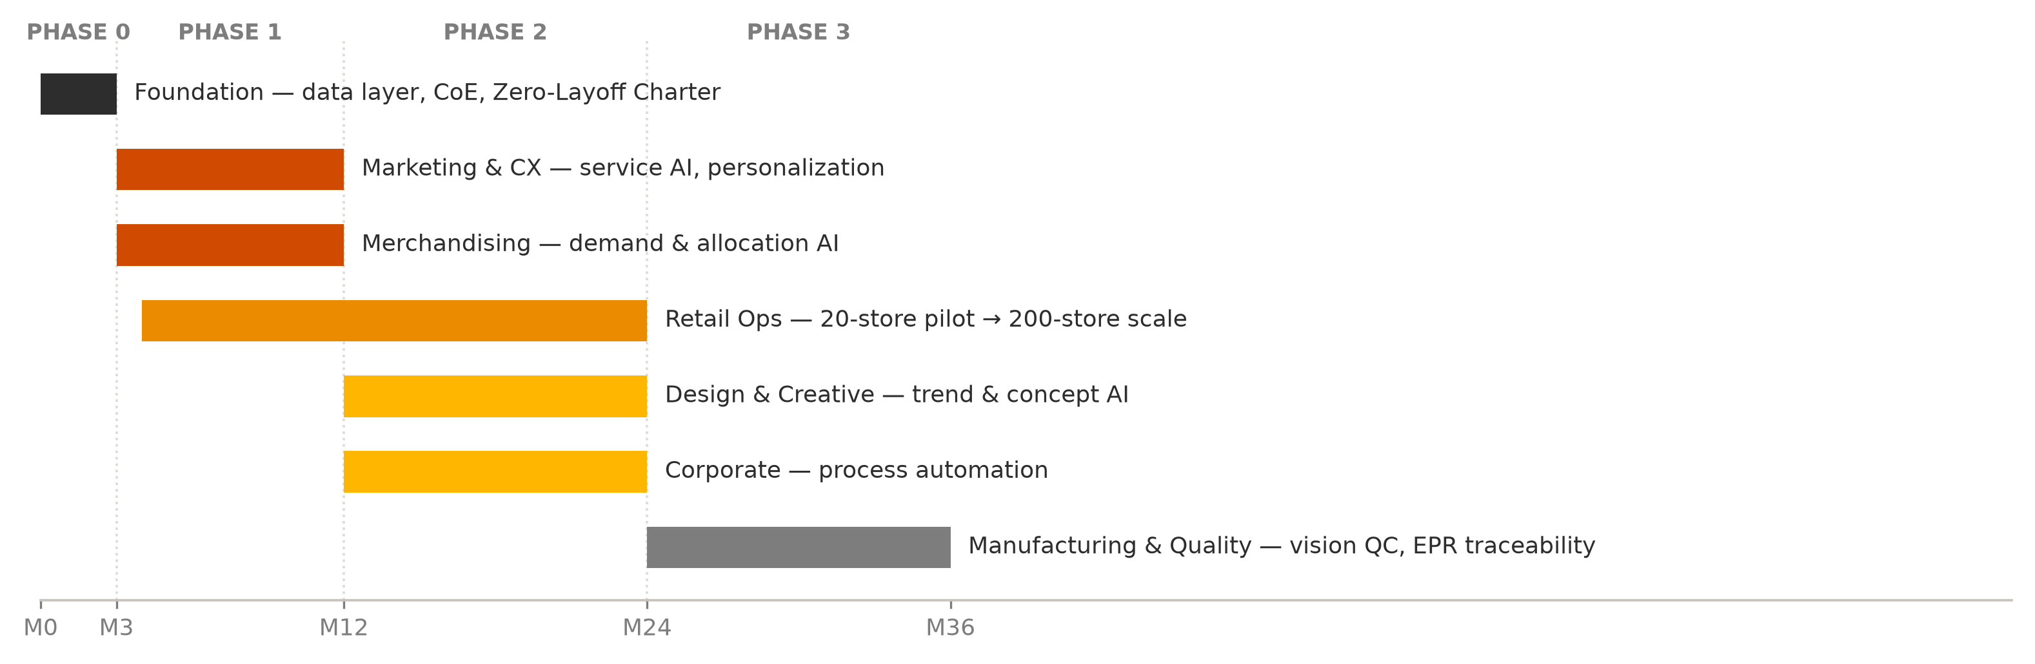
EXECUTIVE SUMMARY | 2 OF 2
Four deliverables, sequenced so trust comes before scale
Deliverable | Our answer | The number that proves it | Slide
1. Task audit | Three-gate test applied to every activity → 22% Automatable, 60% Augmentable, 18% Fundamentally Human | 6,056 FTE-equivalents released | B2–B3
2. Priority + operating model | Phase 1 = Marketing & CX, Merchandising, Retail Ops (pilot-first); federated hub-and-spoke CoE | Model reproduces leadership's own ranking | B4–B7
3. Workforce strategy | Four learning journeys, 12 → 40 learning hours, six new role families as redeployment destinations | Zero roles lost; 31% → 25% attrition | B8
4. Governance + change | Brand-differentiated AI policy, four-tier decision rights, Zero-Layoff Charter in month 1 | 100% of AI decisions tiered and logged | B9–B10
THE ROADMAP — TRUST FIRST, THEN SCALE
WHY THIS SEQUENCE
We start with the functions already comfortable with AI, so the first thing employees see is a win, not a threat.
Manufacturing has the largest headcount of any function and it still comes last. Fear there sits at 4.5 out of 5, digital skill at 1.8. Going in early would confirm exactly what people are afraid of.
Phase-1 selection scored on the five criteria named in the case: business impact, customer value, workforce size, automation potential and implementation feasibility.
2

Slide 4
BODY | B1 · DIAGNOSIS
Insight is taking too long to become action, and that lag is what's capping growth
SPEED
ACCURACY
SERVICE
PEOPLE
14 weeks
62%
88,000
42%
trend-to-store, against
<4 weeks for digitally
native competitors
forecast accuracy drives
26% unsold inventory and
₹380 Cr of markdowns
customer queries a month;
48 hrs to resolve; 58%
first-time fit accuracy
attrition in Retail Ops on
just 12 hours of structured
learning a year
Each function built its own systems and processes over the years. Nobody ended up owning the handoffs between them, so people bridge the gaps by hand, every single time.
Automate each function on its own and you'd just automate the silos — the fragmentation would still be there, only faster. Redesign has to happen at the level of the workflow, not the department.
THE PRIZE IS ALSO BIGGER THAN IT LOOKS
WHY THAT MATTERS
Exhibit 4's 48% is a plain average across six functions. Weight it by headcount instead — Manufacturing (11,000 people, 60% routine) and Retail (10,000, 55%) pull hardest — and it becomes 54.1%.
That 5.7-point gap works out to roughly 1,600 FTE-equivalents of routine work — more people than the entire Corporate function — that a plan built on the headline number simply misses. The platform, the reskilling budget, the redeployment pipeline: all of it ends up sized too small.
Source: case Exhibits 3 and 4. Weighted routine load = Σ(headcount × routine %) ÷ 28,000 = 54.1%.
3

Slide 5
BODY | B2 · DELIVERABLE 1
We ran every activity through the same three gates, so the calls hold up to scrutiny
GATE 1
GATE 2
GATE 3
Rule stability
Consequence of error
Human premium
Is the activity governed by stable, codifiable rules,
at high volume and low variance?
Would a mistake cause irreversible customer,
regulatory or brand harm?
Does the customer or the business specifically
value that a human did it?
Classification | Gate signature | What the human does | Design principle
Automatable | G1 yes · G2 low · G3 no | Sets the rules, handles exceptions, audits the output | AI executes; human owns the standard
Augmentable | G1 partial, or G2 high | Decides, using AI-prepared options and evidence | AI proposes; human disposes
Fundamentally Human | G3 yes, or G2 critical | Creates, judges, empathises, takes accountability | AI supplies inputs; never the output
WHERE WE PUSHED BACK ON EXHIBIT 4 (as the case invites us to)
Retail Operations: the 20% creative/strategic share in Exhibit 4 isn't fixed. Once AI takes stock look-ups and admin off associates' plates, we push that figure up to roughly 35% relationship work, deliberately, as a design choice.
Manufacturing is where routine and automatable pull apart. 60% of the work is routine, but quality inspection carries real safety and regulatory stakes (Gate 2). Most of it lands Augmentable — AI-assisted vision, human sign-off — rather than fully automated.
Classification applied to all six functions in case Exhibit 4; activity-level detail in Appendix A1.
4

Slide 6
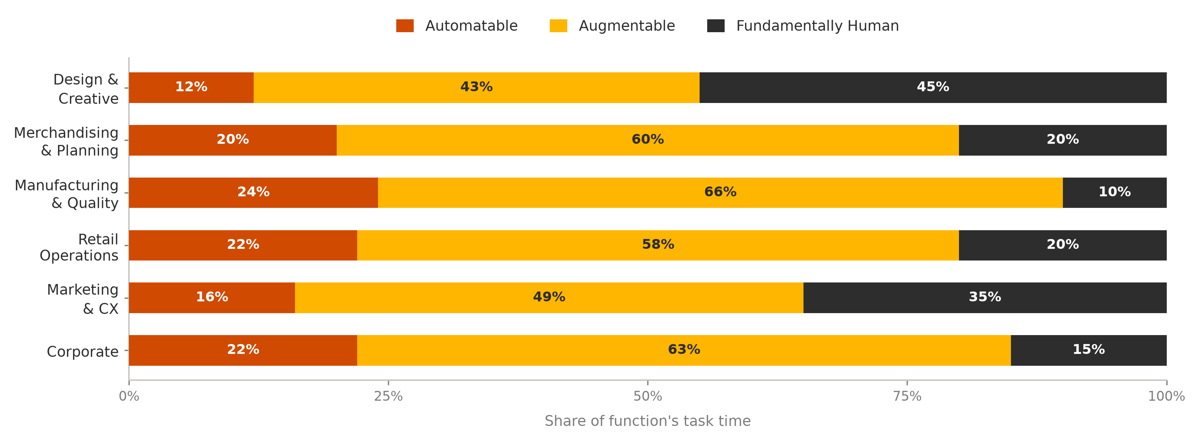
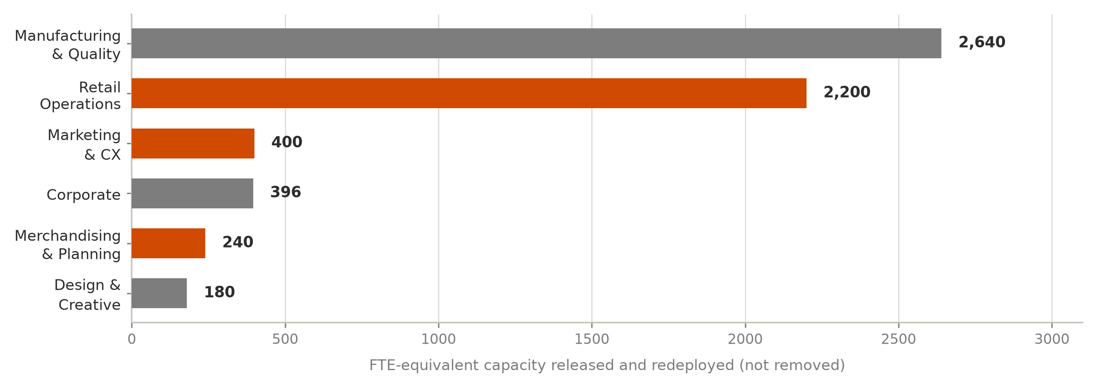
BODY | B3 · DELIVERABLE 1
How the 22/60/18 split plays out across six functions
TARGET STATE, ORGANISATION-WIDE
22%
Automatable
60%
Augmentable
18%
Fundamentally Human
Only that 22% runs on AI by itself. The 60% Augmentable slice is where people get faster and better at their jobs, and it's the biggest prize of the three by far.
THE ZERO-LAYOFF ARITHMETIC
Routine work adds up to 15,140 FTE-equivalents today. Automate 40% of that and 6,056 come free — 21.6% of the whole workforce.
None of that is a headcount cut. Zero-Layoff means the ₹200 Cr buys the same payroll doing better work, not a smaller payroll.
Automatable = 40% of routine work per the case constraint. Augmentable = residual routine + all judgment work. Fundamentally Human = all creative/strategic work.
5

Slide 7
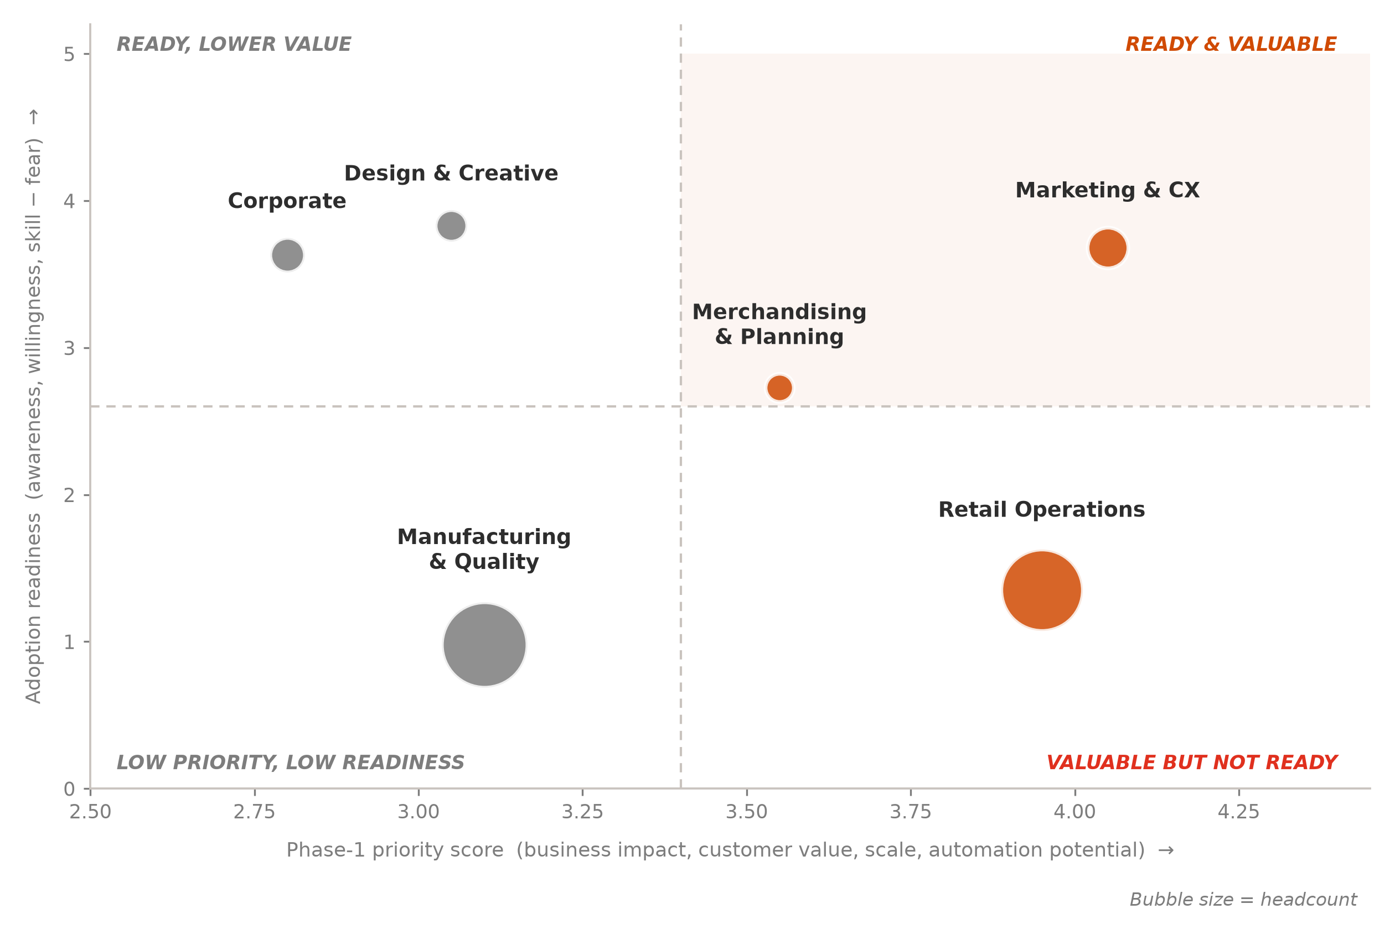
BODY | B4 · DELIVERABLE 2
Value alone can't set the sequence, because the highest-value function is also the least ready
Function | Score | Readiness | Case priority
Marketing & CX | 4.05 | 3.68 | Very High
Retail Operations | 3.95 | 1.35 | Very High
Merchandising & Planning | 3.55 | 2.73 | High
Manufacturing & Quality | 3.10 | 0.98 | Medium
Design & Creative | 3.05 | 3.83 | Medium
Corporate | 2.80 | 3.63 | Medium
Run the numbers independently and you land back on leadership's own ranking: both “Very High” functions come out #1 and #2, “High” comes out #3. The model isn't here to overrule that instinct — it's here to show why it's right, and by how much.
THE READINESS PARADOX
Retail Operations has 10,000 people across 200 stores and ranks #2 on value. Its readiness score is 1.35 out of 5, fear sits at 4.3. Rolling this out at full scale first isn't ambitious — it's a way to guarantee the programme's first headline is a failed pilot.
Priority score = 0.25×business impact + 0.20×customer value + 0.15×workforce scale + 0.20×automation potential + 0.20×feasibility. Readiness = mean(awareness, willingness, digital skill) − 0.5×(fear − 2.0). Scoring detail in Appendix A2.
6

Slide 8
BODY | B5 · DELIVERABLE 2
Phase 1: two functions scale, one function earns trust first
MARKETING & CUSTOMER EXPERIENCE
TARGET MOVEMENT
2,500 people · readiness 3.68 · SCALE NOW
48 hrs → under 6 hrs resolution
58% → 75% first-time fit accuracy
AI service agent deflects delivery, returns and size/fit queries; unified customer profile across five brands; generative campaign variants.
MERCHANDISING & PLANNING
TARGET MOVEMENT
1,200 people · readiness 2.73 · SCALE NOW
62% → 78% forecast accuracy
₹380 Cr → ₹247 Cr markdowns
Demand sensing on external signals (social, weather, events); AI allocation and size-curve optimisation; exception-based planning replaces spreadsheets.
RETAIL OPERATIONS
TARGET MOVEMENT
10,000 people · readiness 1.35 · PILOT FIRST
42% → 32% attrition in pilot stores
Associate selling time +30%
20-store pilot: voice stock look-up, AI clienteling prompts, auto-rostering. Scale to 200 stores only after adoption and sentiment gates are met.
Manufacturing & Quality has the largest routine load of any function and the lowest readiness score on the list. That's exactly why it waits for Phase 3, paired with EPR traceability work — where AI adds new compliance roles instead of touching the inspection jobs people already have.
Pilot gate: adoption ≥70% of associates using the tool weekly and no decline in employee sentiment before scaling beyond 20 stores.
7

Slide 9
BODY | B6 · DELIVERABLE 2
We're redesigning around the workflow. The org chart can mostly stay put.
TODAY — SEQUENTIAL HANDOFFS
FUTURE — ONE CONCURRENT WORKFLOW
Designer researches
trends manually
Merchandising reviews
historical sales
Multiple approval
cycles
Retail executes
with no context
Shared signal & decision layer
Design · Merchandising · Retail work on the same live view
14 weeks · 62% forecast accuracy
8 weeks · 78% forecast accuracy
Layer | What changes | Who owns it
Structure | Cross-functional Product & Customer squads replace function-only teams for the 3 Phase-1 workflows | Chief AI & Transformation Officer (new, reports to CEO)
Roles | Six new role families created as redeployment destinations; no role eliminated | Function heads with CHRO
Workflows | Approval cycles replaced by exception-based review — humans intervene where AI flags uncertainty | Squad leads, standards set by the AI CoE
Decision rights | Every AI-influenced decision assigned to one of four tiers with a named accountable human | AI Governance Council
THE ONE STRUCTURAL RULE WE DON'T BREAK
We don't deploy AI into a workflow that still needs a manual handoff to finish. Automate one side of a broken handoff and the handoff itself just becomes the new bottleneck — none of the cycle-time gain shows up. This is, more or less, exactly how StyleVerse ended up fragmented in the first place.
Cycle-time target of 8 weeks assumes concurrent design–merchandising review replaces three sequential approval cycles; benchmark competitors operate at under 4 weeks.
8

Slide 10
BODY | B7 · DELIVERABLE 2
Our recommendation: a federated hub-and-spoke CoE, centralised on standards, embedded on delivery
THE HUB
THE SPOKES
THE BRIDGE
AI Centre of Excellence
Embedded AI squads
AI Translators
~60 FTE
8–10 FTE each
~30, rotating
Owns the data platform, MLOps, reusable components, model risk, standards and talent development. Reports to the Chief AI & Transformation Officer.
One squad per Phase-1 function, sitting inside the business. Owns use cases end to end. Dual reporting: outcomes to the function head, standards to the hub.
Business people trained to specify and test use cases — drawn from existing employees, making this the first and most visible redeployment destination.
Model | Strength | Why it fails at StyleVerse
Fully centralised CoE | Consistent standards, no duplicated spend | Too far from five brands with genuinely different value propositions; becomes a queue
Fully embedded in functions | Fast, close to the business | Recreates the exact fragmentation the case describes — duplicated tools, no shared model risk
Federated hub-and-spoke ✓ | Shared platform and governance, local ownership of outcomes | Requires disciplined dual reporting — mitigated by a single standards charter
Here's what settles it. StyleVerse's current mess exists because functions each introduced “their own systems, processes and ways of working,” in the case's own words. Go fully embedded on AI and you'd repeat that mistake, only bigger: five brands training five sets of models on five sets of data, no shared governance, nobody learning from anybody else's mistakes.
CoE sizing assumption: ~60 hub FTE and 3 squads of 8–10 in Phase 1, funded from the ₹55 Cr use-case build and ₹60 Cr platform allocations. Roles filled substantially by internal redeployment.
9

Slide 11
BODY | B8 · DELIVERABLE 3
6,056 FTE-equivalents of capacity need a destination — we name six
From (routine work automated) | To (new role family) | What the role does | Scale
Retail associates — stock look-ups, billing, admin | Style Advisor | Clienteling, styling, repeat-purchase building | ~2,200
Planners — spreadsheet consolidation, sales pulls | Demand Scientist | Scenario planning, exceptions, model challenge | ~240
Service reps — delivery, returns, size/fit queries | Experience Specialist | Complex, high-value, multi-brand resolution | ~400
Manufacturing QC — repetitive inspection, reporting | Traceability & Compliance Analyst | EPR and circular-textiles traceability; supplier audit | ~2,640
Corporate — report preparation, data gathering | AI Translator / Process Owner | Specifies, tests and owns AI use cases | ~396
Designers — trend scanning, competitor collation | Concept Lead | More concepts per designer; EcoWeave expansion | ~180
FOUR LEARNING JOURNEYS · 12 → 40 HOURS PER EMPLOYEE
Journey | Who | Hours
AI Aware | All 28,000 | 16
AI Assisted | ~18,000 operational roles | 40
AI Enabled | ~8,000 judgment roles | 80
AI Builders | ~800 squads & translators | 200
KNOWLEDGE CAPTURE IS A RACE AGAINST ATTRITION
Average tenure in Retail is 1.7 years against 42% attrition. Institutional knowledge is already leaking out faster than anyone's writing it down.
So Phase 0 starts by pulling tacit know-how out of the longest-tenured functions — Corporate at 5.1 years, Design at 4.6 — into structured knowledge bases, before automation touches the roles that hold it.
In practice, Zero-Layoff means three things: a written redeployment guarantee, an internal talent marketplace that matches people to open roles by skill rather than job title, and a 90-day paid transition window where the learning journey finishes before the role actually changes.
Scale column = FTE-equivalents released per function (Appendix A1). Learning-hour targets benchmarked against the case's stated 12 hours per employee per year.
10

Slide 12
BODY | B9 · DELIVERABLE 4
One AI policy across five brands would damage the most valuable one
Brand | NPS | Brand promise | AI posture | Disclosure
Maison Luxe | 62 | Craftsmanship and human exclusivity | Back-office only — no generative design, no AI-written client contact | Human-crafted assurance
EcoWeave | 55 | Environmental responsibility | AI for traceability, EPR compliance and transparency reporting | Publish AI use openly
UrbanEdge | 48 | Seamless omnichannel | AI personalisation and service across channels | Disclosed at interaction
SpeedStyle | 35 | Speed and trend | AI-forward — trend sensing, generative concepts, service automation | Disclosed at interaction
ThreadBasics | 30 | Affordability and efficiency | Maximum service and supply-chain automation | Disclosed at interaction
AI DECISION RIGHTS — FOUR TIERS
Tier | Example | Control
1 Auto | Stock look-up, delivery status reply | Logged, sampled
2 Assisted | Allocation, campaign targeting | Human approves
3 Sign-off | Pricing, markdown, QC release | Named accountable owner
4 Prohibited | Hiring, exit, credit decisions | No AI involvement
TRUST, DATA, IP AND REGULATION
Data privacy: DPDP Act 2023 for India, GDPR for European operations — consent, purpose limitation and residency enforced in the platform, not per project.
IP: training-data provenance recorded for every model; no competitor imagery scraped; designer attribution retained on AI-assisted concepts.
Bias: sizing and recommendation models tested across body types and demographics before release, and quarterly thereafter.
Maison Luxe has the best NPS in the portfolio (62) and the lowest return rate (8%), and both numbers exist because customers believe a person made the product. Give it SpeedStyle's AI posture and you'd be automating away the exact thing people are paying for.
References: European Parliament. (2024). Regulation (EU) 2024/1689 (AI Act). Ministry of Electronics and IT. (2023). Digital Personal Data Protection Act, 2023. NIST. (2023). AI Risk Management Framework 1.0.
11

Slide 13
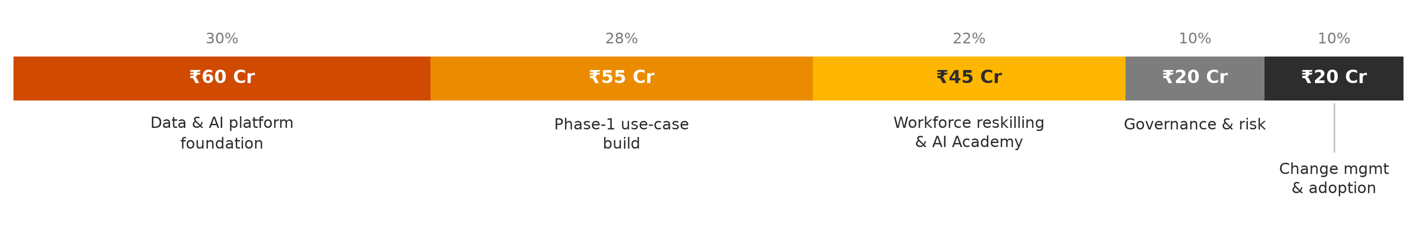
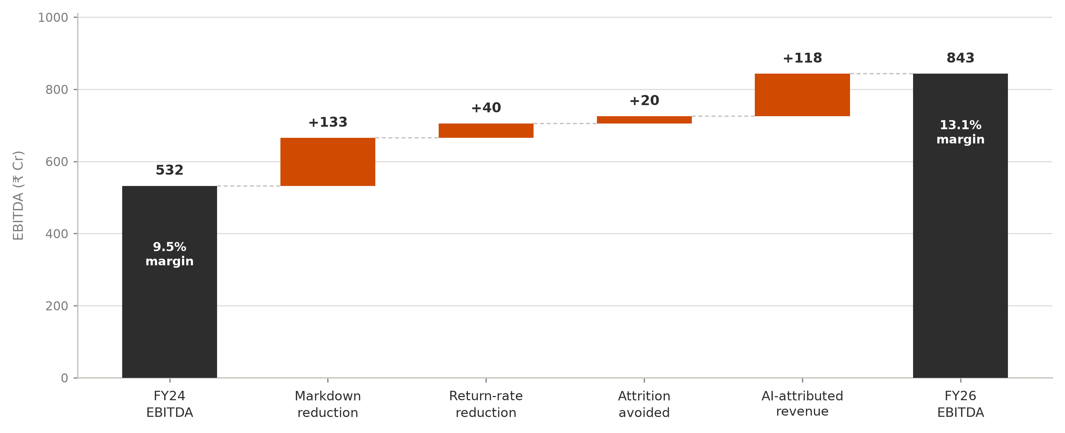
BODY | B10 · DELIVERABLE 4
Fear turns out to be measurable. That's why we treat it as the top delivery risk.
Function | Fear | Intervention
Manufacturing | 4.5 | Phase 3 entry; EPR roles announced before tooling
Retail Operations | 4.3 | 20-store pilot; associates co-design the tool
Merchandising | 3.0 | Planners become model challengers, not subjects
Marketing / Design / Corp. | ≤2.5 | Champion source — seed advocates into the above
FOUR MOVES, IN THIS ORDER
BELIEVE
Zero-Layoff Charter, board-backed, published month 1
BUILD
Learning journeys start before tools arrive, not after
BOND
500 AI Champions (~2%) from high-willingness functions
BEHAVE
Adoption written into KPIs; redeployment celebrated
THE ₹200 CRORE, ALLOCATED
The 22% going to people isn't a rounding error. Most transformations shortchange reskilling, then wonder why the technology worked but nobody's behaviour changed. Zero-Layoff only means something if the redeployment budget is real money.
THE VALUE THIS UNLOCKS
₹311 Cr annual run-rate
against a ₹200 Cr one-time spend. Payback lands under 12 months; EBITDA margin moves from 9.5% to 13.1%.
Value bridge assumptions: markdown reduction at 35% pass-through of the ₹380 Cr pool; return cost = 25% of item value; ₹1.2 L replacement cost per exit; 5pp of the 15% growth target attributed to AI at 42% gross margin. Full workings in Appendix A3.
12

Slide 14
APPENDIX | A1
Task audit — detail by function
Function | HC | Routine | Autom. | Augm. | Human | FTE released | Representative automatable activity
Design & Creative | 1,500 | 30% | 12% | 43% | 45% | 180 | Trend report collation, competitor scanning
Merchandising & Planning | 1,200 | 50% | 20% | 60% | 20% | 240 | Sales data pulls, spreadsheet consolidation
Manufacturing & Quality | 11,000 | 60% | 24% | 66% | 10% | 2,640 | Routine inspection logging, shift reporting
Retail Operations | 10,000 | 55% | 22% | 58% | 20% | 2,200 | Stock look-ups, transfers, admin reporting
Marketing & CX | 2,500 | 40% | 16% | 49% | 35% | 400 | Delivery/returns queries, segment builds
Corporate | 1,800 | 55% | 22% | 63% | 15% | 396 | Report preparation, data gathering
Total / weighted | 28,000 | 54.1% | 21.6% | 59.9% | 18.4% | 6,056 | —
Automatable = 40% × routine (case constraint). Augmentable = 60% × routine + all judgment work. Fundamentally Human = all creative/strategic work.
Note the weighted total row: the routine load of 54.1% differs from Exhibit 4's stated 48% because Exhibit 4 reports an unweighted mean across the six functions.
Derived from case Exhibits 3 and 4 via analysis/task_audit_model.py.
A1

Slide 15
APPENDIX | A2
Prioritisation scoring — full workings
Function | Business impact (25%) | Customer value (20%) | Workforce scale (15%) | Automation potential (20%) | Feasibility (20%) | Score | Rank
Marketing & CX | 4 | 5 | 3 | 3 | 5 | 4.05 | 1
Retail Operations | 4 | 5 | 5 | 4 | 2 | 3.95 | 2
Merchandising & Planning | 5 | 3 | 2 | 4 | 3 | 3.55 | 3
Manufacturing & Quality | 3 | 2 | 5 | 5 | 1 | 3.10 | 4
Design & Creative | 3 | 3 | 2 | 2 | 5 | 3.05 | 5
Corporate | 2 | 1 | 2 | 4 | 5 | 2.80 | 6
Scoring basis (1–5). Business impact — size of the addressable P&L pool. Customer value — effect on NPS, returns and resolution time. Workforce scale — headcount affected. Automation potential — automatable share × headcount. Feasibility — adoption readiness index from Exhibit 5.
Readiness index = mean(awareness, willingness, digital skill) − 0.5 × (fear − 2.0). Fear is weighted at 0.5 so it moderates rather than dominates: Design 3.83, Marketing 3.68, Corporate 3.63, Merchandising 2.73, Retail 1.35, Manufacturing 0.98.
Weights sum to 100%. Sensitivity: Retail overtakes Marketing for rank 1 if feasibility is weighted below 12%; the Phase-1 set of three is unchanged across all tested weightings.
A2

Slide 16
APPENDIX | A3
Value bridge — assumptions and calculations
Lever | Calculation | Value (₹ Cr)
Markdown reduction | ₹380 Cr pool × 35% pass-through. Forecast accuracy 62% → 78% implies error 38% → 22%, a 42% relative reduction; 35% applied conservatively. | 133
Return-rate reduction | SpeedStyle 28% → 22%, UrbanEdge 15% → 13%, ThreadBasics 18% → 16% on brand revenue; cost of a return assumed at 25% of item value. | 40
Attrition cost avoided | Organisation attrition 31% → 25% on 28,000 employees × ₹1.2 L blended replacement cost. | 20
AI-attributed revenue | 5pp of the 15% growth target attributed to AI-enabled speed and personalisation, valued at the 42% gross margin. | 118
Total annual run-rate | Against a ₹200 Cr one-time FY25 investment | 311
FY24 EBITDA works out to ₹5,600 Cr × 9.5% = ₹532 Cr. Add the ₹311 Cr and you get ₹843 Cr. Against FY26 revenue of ₹6,440 Cr (15% growth), that's a 13.1% margin.
One limitation worth stating plainly: these are directional planning estimates built only from the case exhibits, not audited figures. And under Zero-Layoff, no labour-cost saving is claimed anywhere in this bridge — the 6,056 FTE-equivalents released are redeployed, so their value shows up only through the business outcomes above.
All calculations reproducible via analysis/task_audit_model.py in the submission repository.
A3

Slide 17
APPENDIX | A4
Risk register and references
Risk | Likelihood | Mitigation
Retail adoption stalls despite the pilot | High | Gate scaling on adoption ≥70% and stable sentiment; associates co-design; champions seeded first
Data foundation slips, delaying every use case | Medium | Platform is Phase 0 and separately funded at ₹60 Cr; use cases contracted against data readiness milestones
Brand dilution from generative content | Medium | Brand-differentiated posture; Maison Luxe excluded from generative customer-facing AI entirely
Zero-Layoff commitment perceived as hollow | High | Written charter in month 1, redeployment guarantee, public reporting of redeployment counts
Regulatory exposure (EU AI Act, DPDP, EPR) | Medium | Four-tier decision rights, model register, provenance logging, quarterly bias testing
REFERENCES (APA)
• European Commission. (2022). EU strategy for sustainable and circular textiles. Publications Office of the European Union.
• European Parliament & Council of the European Union. (2024). Regulation (EU) 2024/1689 laying down harmonised rules on artificial intelligence (Artificial Intelligence Act).
• International Organization for Standardization. (2023). ISO/IEC 42001:2023 — Information technology, artificial intelligence, management system.
• Ministry of Electronics and Information Technology. (2023). Digital Personal Data Protection Act, 2023. Government of India.
• National Institute of Standards and Technology. (2023). Artificial intelligence risk management framework (AI RMF 1.0). U.S. Department of Commerce.
Industry statistics quoted in the deck (USD 1.7 tn market, 92 mn tonnes textile waste, 75 mn people employed) are taken from the case brief's industry overview.
A4

