Slide 1
TECHTONIC SEASON 8 · PROJECT NEXT
PULSE
Unilever's Always-On Brand Nervous System
A portfolio of AI products on one shared backbone — proven end-to-end on the Rexona armband moment, with a working prototype of the flagship product, Moment Studio.
#AIAtUnilever #TechDoneRight
Ranjana Mainani — Product Manager, Project NEXT
cases/2026-08-project-next-unilever-brand-lifecycle
Prototype: claude.ai/code/artifact/07a83b55-6cab-4866-937b-f4f79e9b7701

Slide 2
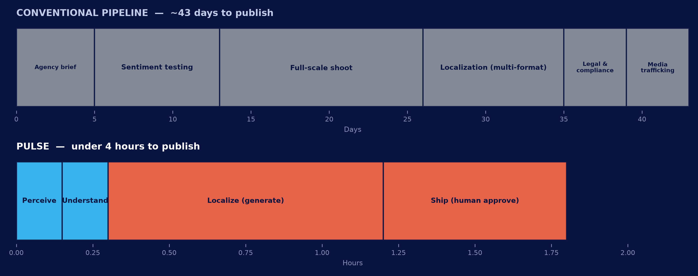
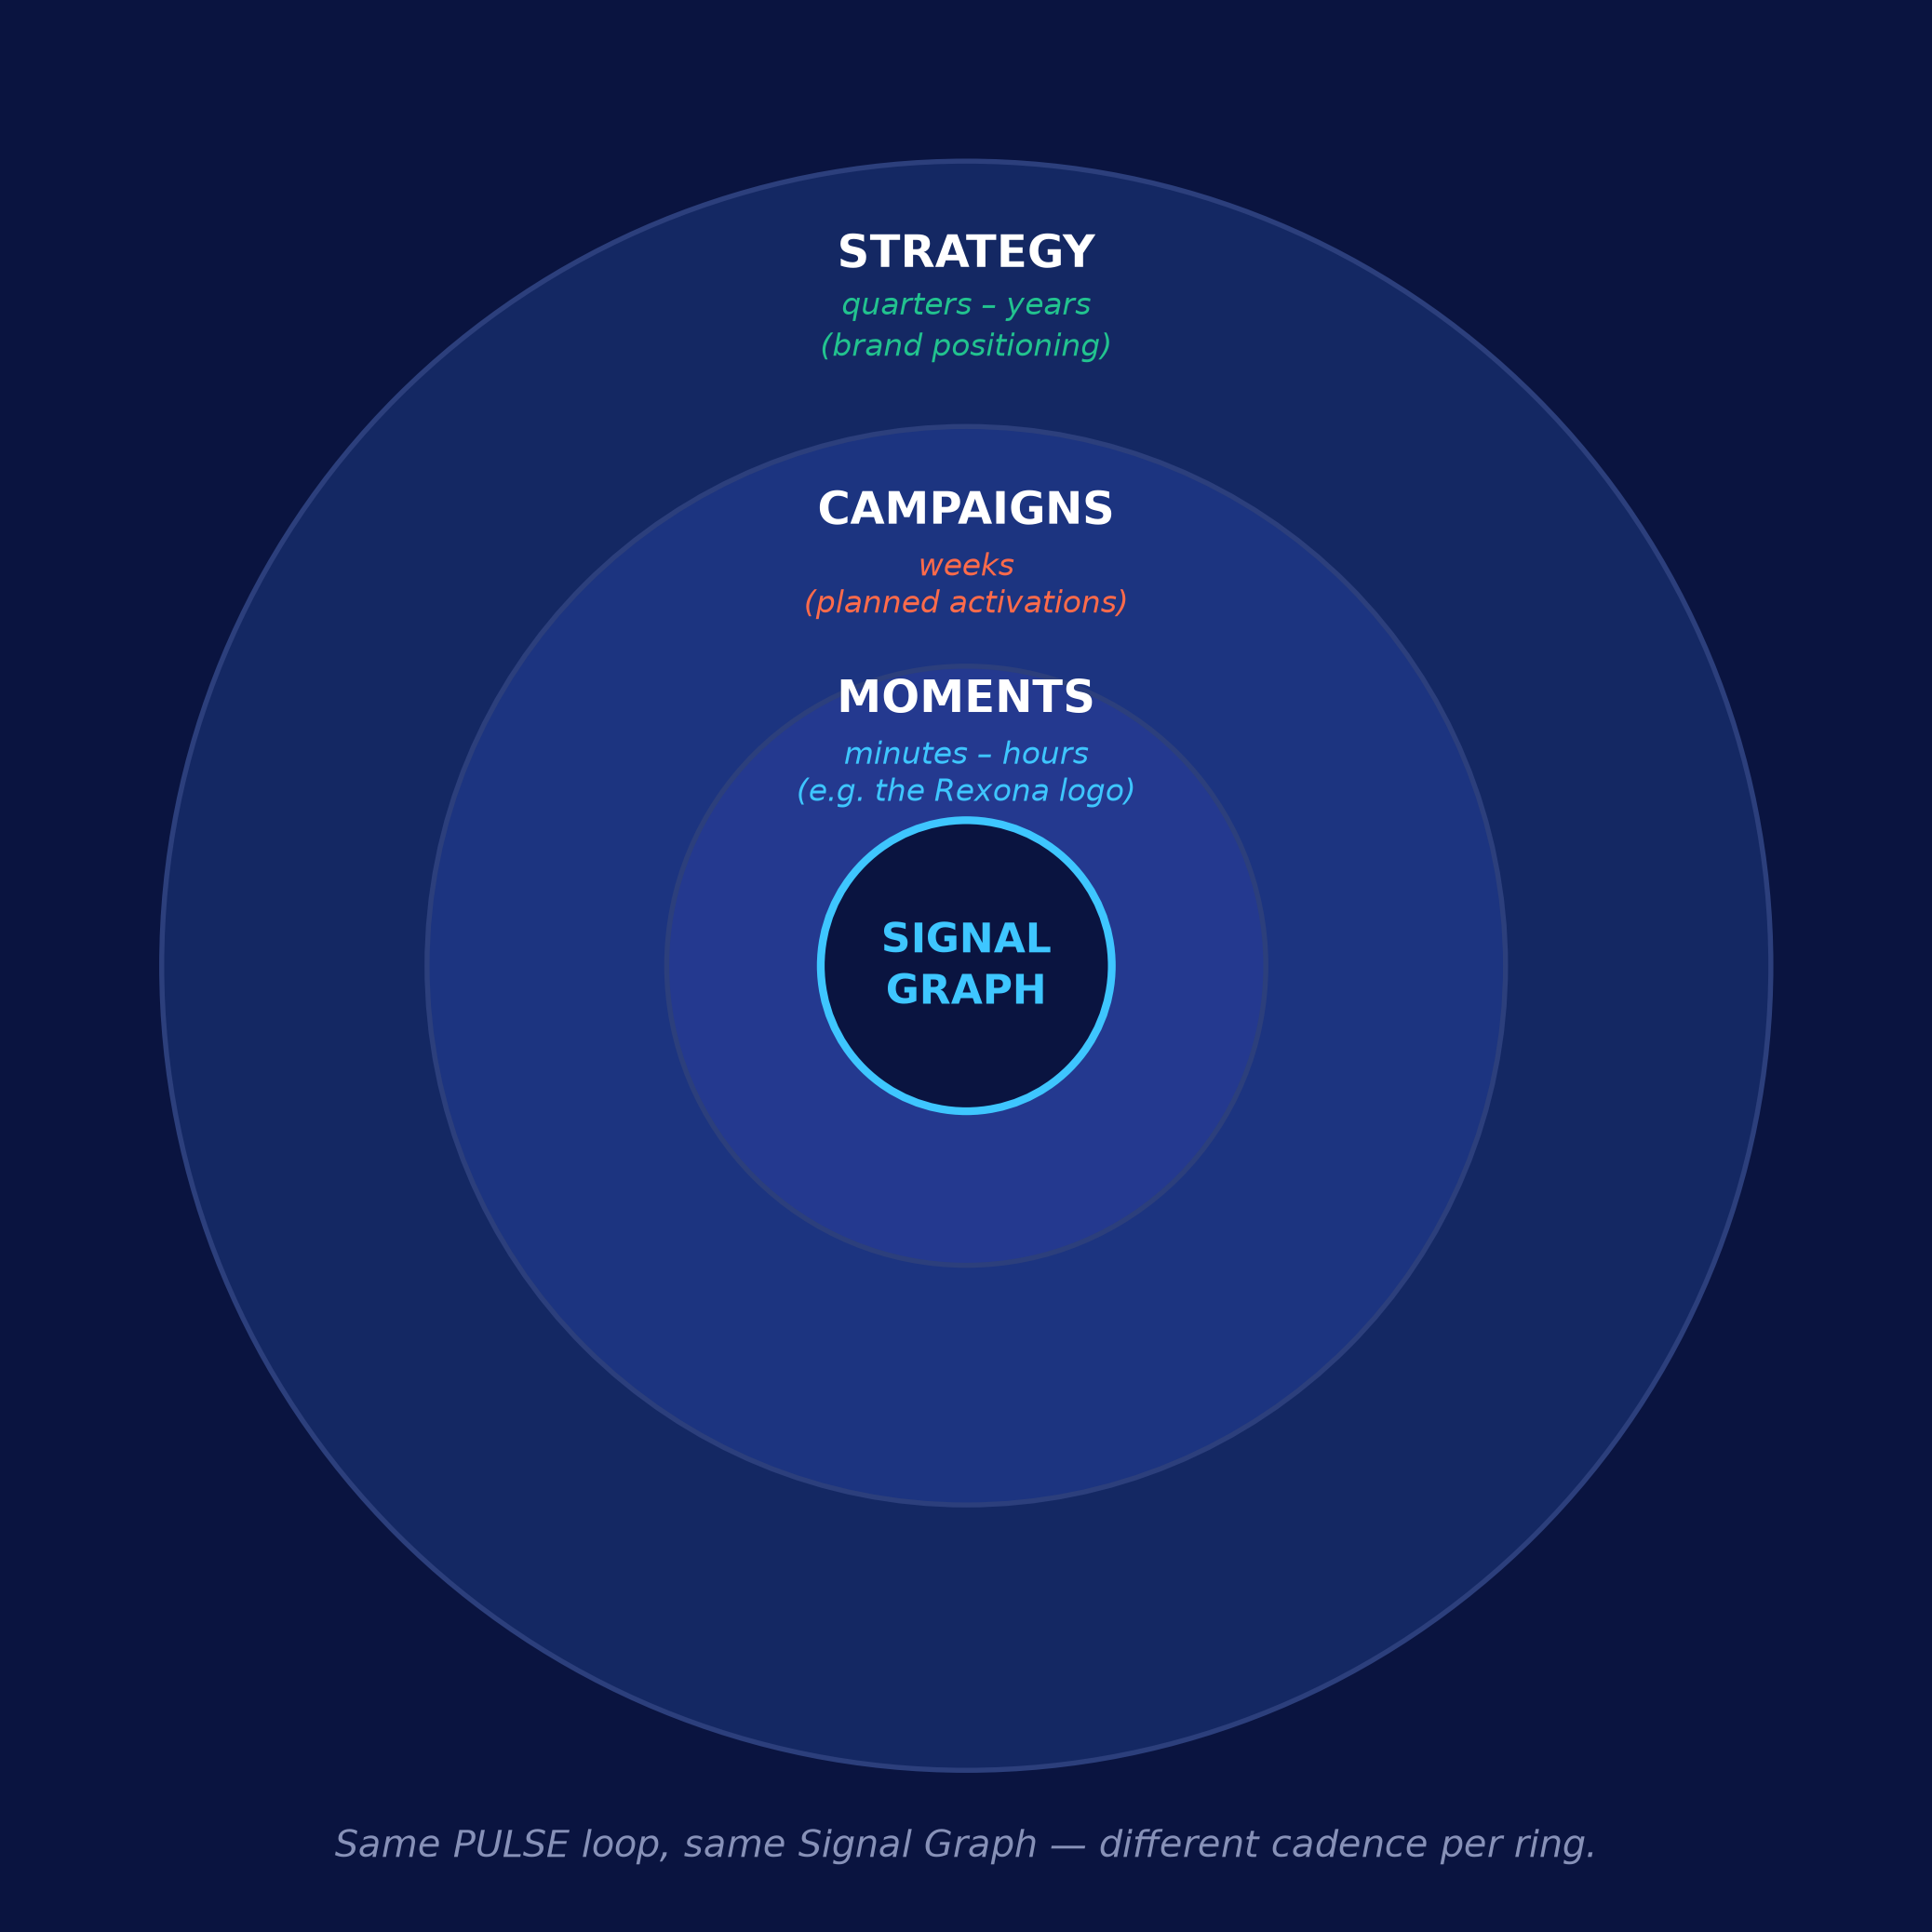
1 / 3 — SYNOPSIS & ANALYSIS
The gap isn't tooling. It's synthesis — and it costs us the whole moment.
Unilever already has social listening, web scraping and isolated AI pilots. They run independently, so a human manually stitches signal to publish — every time, across every stage of the lifecycle.
REDEFINING THE LIFECYCLE — WHERE AI CREATES VALUE
Moments (min–hrs): sense & react before virality decays.
Campaigns (weeks): brief + production cut from weeks to days.
Strategy (qtrs–yrs): continuous signal replaces periodic research.
WHAT'S ACTUALLY BROKEN
43-day agency pipeline vs. a viral window measured in minutes — by the time content ships, the moment is dead.
Point capabilities, zero wiring — listening, scraping and AI pilots exist but don't talk to each other; a human is the integration layer.
Every asset is bespoke — nothing from one campaign compounds into the next; each cycle restarts from zero.
This isn't a tooling gap — it's a wiring gap. The fix is removing manual synthesis from the critical path, at every clock speed.
Project NEXT | PULSE — Unilever's Always-On Brand Nervous System
Page 2

Slide 3
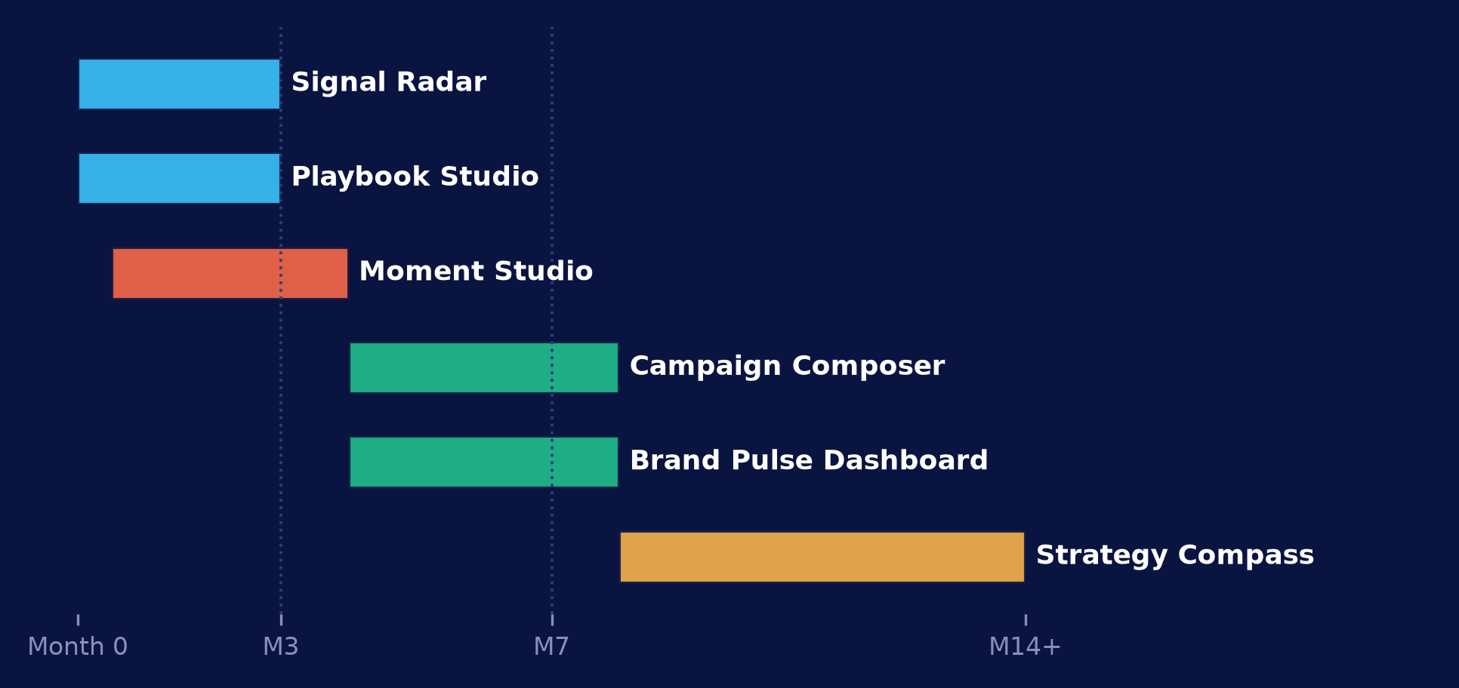
2 / 3 — THE PORTFOLIO
Six products, one backbone — prioritized by dependency and time-to-value
Every product below is built on PULSE: one Brand Signal Graph + Brand DNAi orchestration layer, not six separate AI builds.
Product | Lifecycle stage | Area of solution | Core tech | Phase
Signal Radar | Perceive | Unified real-time sensing | Multi-source ingestion, brand/logo recognition | 1
Playbook Studio | Understand | Governance & knowledge codification | Rules+ML brand-fit/risk scoring | 1
Moment Studio | Localize + Ship (reactive) | Real-time creative production & approval | Multi-agent generation + human console | 1
Campaign Composer | Localize + Ship (planned) | Planned content production | Same generation agents, brief-driven | 2
Brand Pulse Dashboard | Evaluate | Measurement & feedback | Real-time analytics, closed-loop scoring | 2
Strategy Compass | Strategy | Long-cycle positioning | Longitudinal signal analysis | 3
PRIORITIZATION RATIONALE
Phase 1 — foundation + first win: Signal Radar + Playbook Studio are prerequisites nothing else works without; Moment Studio ships alongside them as the fastest, highest-visibility proof of value.
Phase 2 — scale production: Campaign Composer reuses Moment Studio's generation agents at near-zero incremental cost; Brand Pulse Dashboard closes the loop to justify further investment.
Phase 3 — compounding advantage: Strategy Compass ships last, deliberately — it needs the longest accumulated signal history to be trustworthy.
Project NEXT | PULSE — Unilever's Always-On Brand Nervous System
Page 3

Slide 4
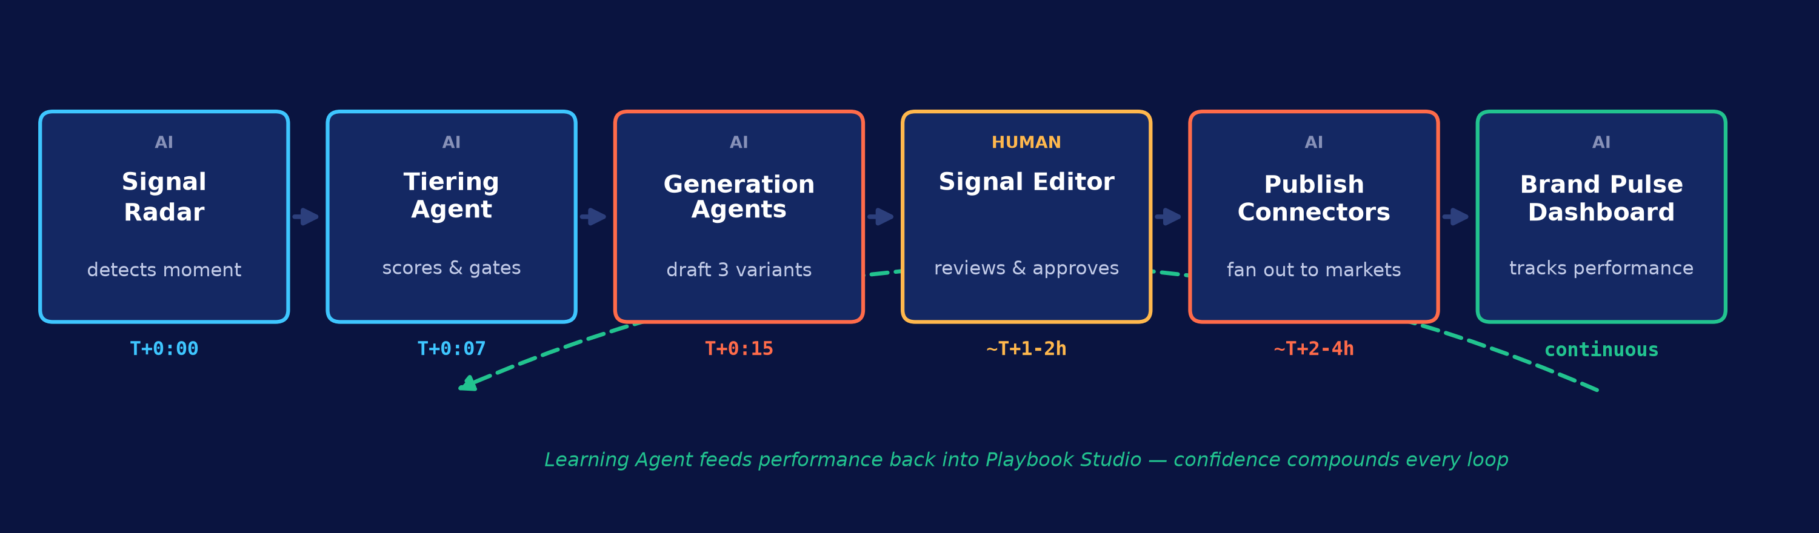
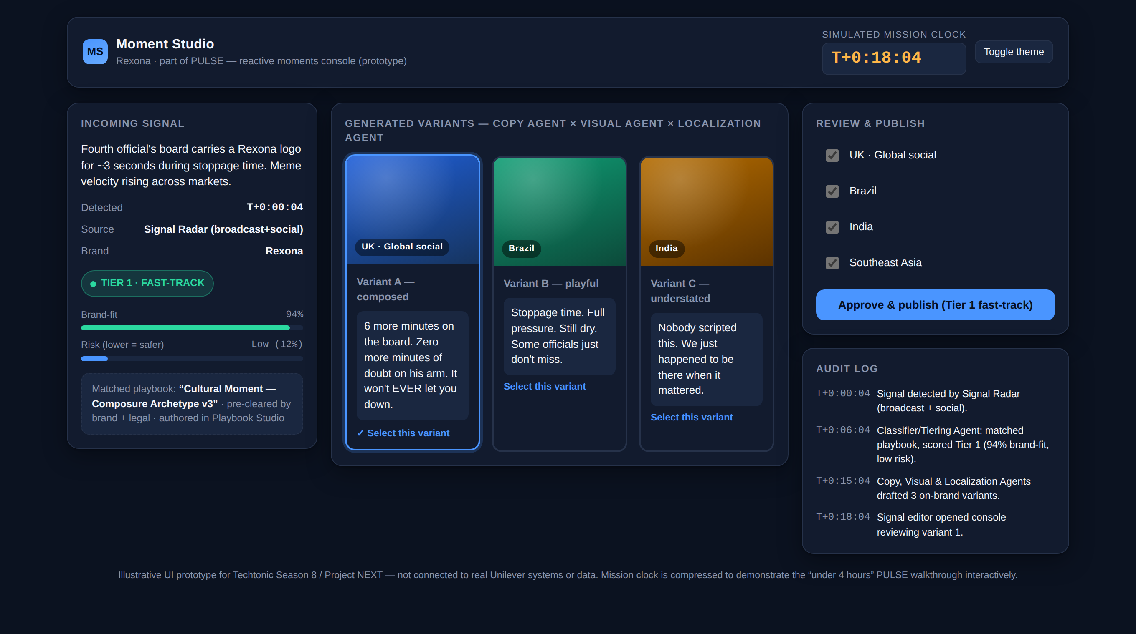
3 / 3 — PRODUCT IN DEPTH
Moment Studio: user journey, agents, governance, cost & roadmap
CAPABILITIES
COST & IMPLEMENTATION ROADMAP
PROTOTYPE — TRY IT LIVE
• Real-time signal-to-playbook matching
Phase | Duration | Squad | Illustrative cost
MVP | Mo. 0-3 | ~6 (PM, 2-3 AI/ML eng, 1-2 full-stack, design) | $250-400K
Pilot expand | Mo. 4-6 | Same squad + brand/legal governance lead | $150-250K
Phase 2 rollout | Mo. 7-12 | +2 eng for Campaign Composer, Dashboard | $400-600K
• Multi-variant generative drafting (copy + visual)
• Side-by-side human review, inline editing
• One-click multi-market publish
• Full audit trail + kill-switch recall
HUMAN OVERSIGHT BY TIER
Tier 1
Pre-cleared archetype — Single-tap approve, ≤15 min SLA
Tier 2
Novel but on-strategy — Full review + edit required
Tier 3
Off-playbook / sensitive — Escalate to brand & legal, no AI draft
Illustrative planning estimates only — not sourced Unilever cost data. Assumes reuse of existing Brand DNAi / digital-twin infrastructure.
Functional console: signal detected → AI-tiered → variants drafted → human approve → publish → performance feedback loop.
claude.ai/code/artifact/07a83b55…
Full architecture, agent detail and cost assumptions in the appendix and analysis.md.
Project NEXT | PULSE — Unilever's Always-On Brand Nervous System
Page 4

Slide 5
APPENDIX
Sources, assumptions & governance notes
SOURCES
• How Unilever is building an AI-first enterprise at scale — Unilever (unilever.com/news/news-search/2026)
• How AI is helping drive Desire at Scale across Unilever — Unilever (unilever.com/news/news-search/2025)
• Unilever reinvents product shoots with digital twins and AI — Unilever press release (unilever.com/news/press-and-media/2025)
• How AI is transforming Unilever's Personal Care business (names “Brand DNAi”) — Unilever (unilever.com/news/news-search/2025)
• Behind The Scenes Of Oreo's Real-Time Super Bowl Slam Dunk — Forbes, 2013 (forbes.com/sites/jenniferrooney)
• From ideation to execution: generative AI in modern digital marketing — ScienceDirect systematic review, 2025
• AI Marketing Case Studies 2026 — Pragmatic Digital (pragmatic.digital/blog)
ASSUMPTIONS & GOVERNANCE NOTES
• Official brief (Techtonic Season 8, source PDF) requires 3 submission slides + a mandatory prototype; cover and this appendix sit outside that count.
• Timings in the Moment Studio walkthrough are illustrative targets for a system proposal, not measured data — the honest reference point is the cited literature's 30-50% production-time reduction from generative AI adoption.
• Cost estimates on slide 3 are illustrative planning placeholders, not sourced Unilever figures — flagged explicitly rather than presented as researched.
• Real-time computer-vision detection of an unscripted brand appearance (e.g. a logo on a match official's armband) is a genuinely hard sensing problem beyond text/social listening, flagged as build risk, not assumed solved.
• Human-tap approval, even fast-tracked (Tier 1, ≤15 min SLA), is a deliberate choice over fully autonomous publish — speed traded for governance rigor.
• The prototype (linked on cover and slide 3) is a UI/flow mock-up demonstrating the intended experience and decision logic — not wired to real Unilever data, Brand DNAi, or distribution systems.
Project NEXT | PULSE — Unilever's Always-On Brand Nervous System
Appendix

