Slide 1
L.I.M.E. SEASON 18 — STAGE 1
The Next Shelf:
Building the Future of Kissan
Two required submission slides — Consumer Job and Concept Card — for the
Kissan Chutney opportunity, built on a secondary-research hypothesis pending
the team's own Task 1 interviews.
cases/2026-08-hul-lime-s18-kissan
Not a real deliverable substitute: the case grades a real 20-person consumer immersion (Task 1) hardest. This deck is a strong starting hypothesis and a ready-to-run interview guide — swap in real quotes before this goes anywhere near a jury.

Slide 2
Slide 1: Consumer Job
DEFINE YOUR
CONSUMER PERSONA
IDENTIFY THE
OPPORTUNITY
THE JOB TO BE DONE
“The Chatora”
18–30, urban India (Tier 1 & 2 India). Grew up on Kissan ketchup. Discovers food on Instagram/YouTube reels before it shows up in a store.
Already eats without asking permission: ketchup on dosa, chutney on pizza, double-dips, triple-dips — the exact behaviour in the case's own moodboard.
Packaged chutney hasn't caught up to how this generation actually eats.
It's still homemade, or stuck in jars/pouches nobody fully trusts or reaches for on the go.
Ketchup already made the leap to “trust it, squeeze it, done.” Chutney hasn't — yet.
WHEN I...
am eating literally anything — pizza, noodles, dosa, momos, even Maggi
I WANT TO...
reach for a chutney that's as trusted and ready as ketchup already is
SO THAT...
I can dip and fuse whatever I want, without cooking it myself or gambling on a random jar
Hypothesis pending Task 1 interviews — see research/discovery-guide.md

Slide 3
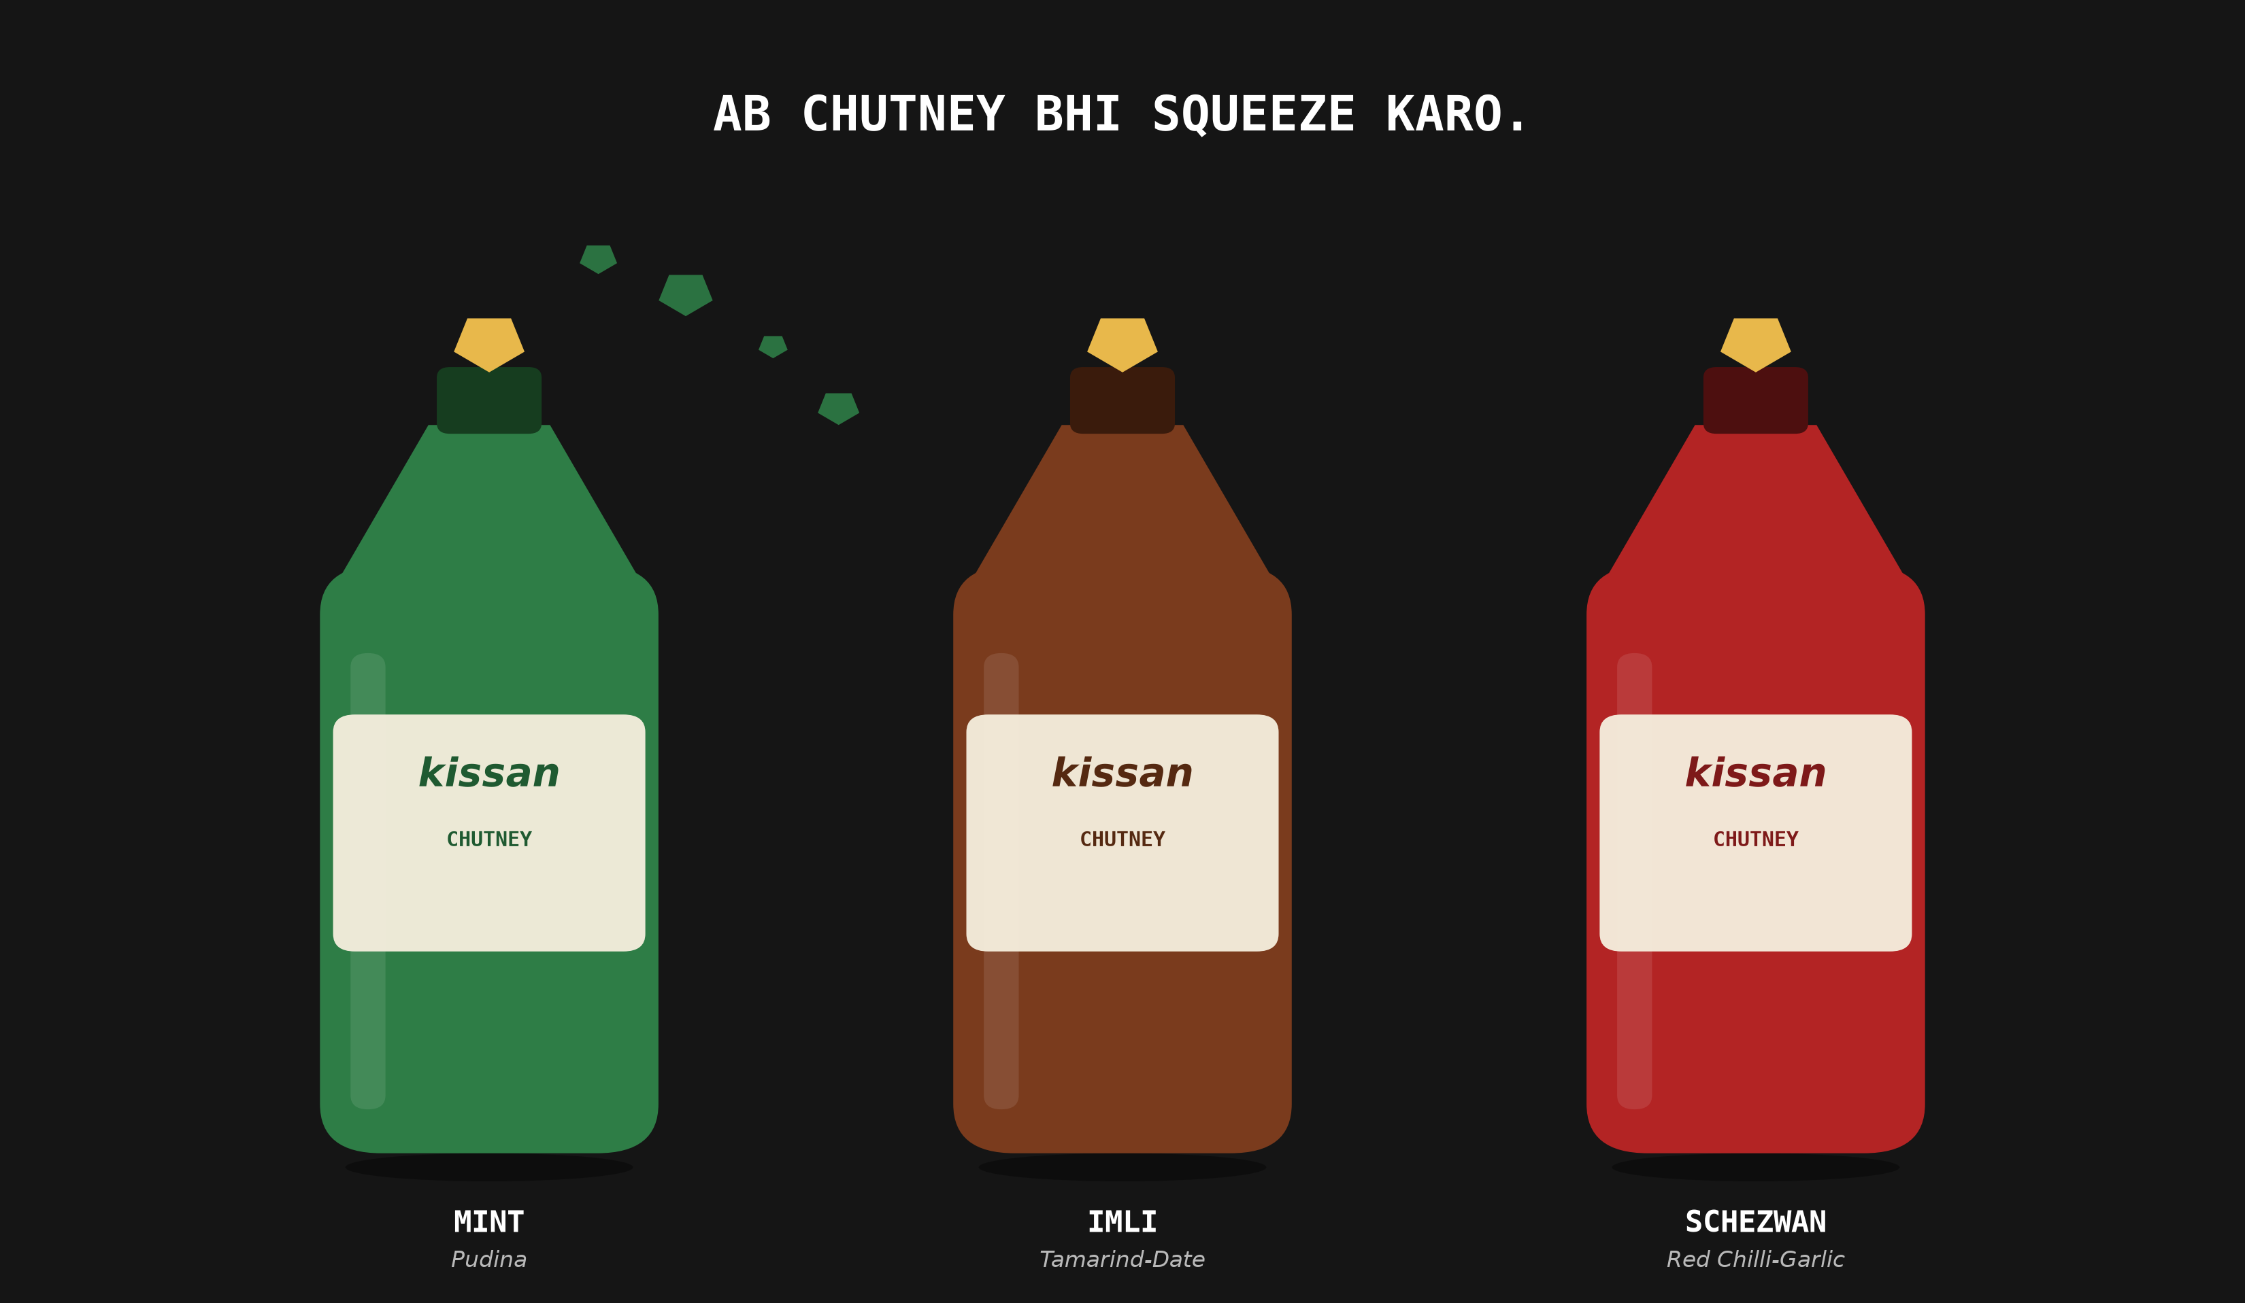
Slide 2: Concept Card
Kissan Chutney — Mint, Imli & Schezwan, in the same trusted squeeze as your ketchup. No chopping. No random jars. Just a clean burst of real flavour on literally anything — dosa, pizza, noodles, Maggi. Because when you already dip everything in everything, your chutney deserves to keep up.

