Slide 1
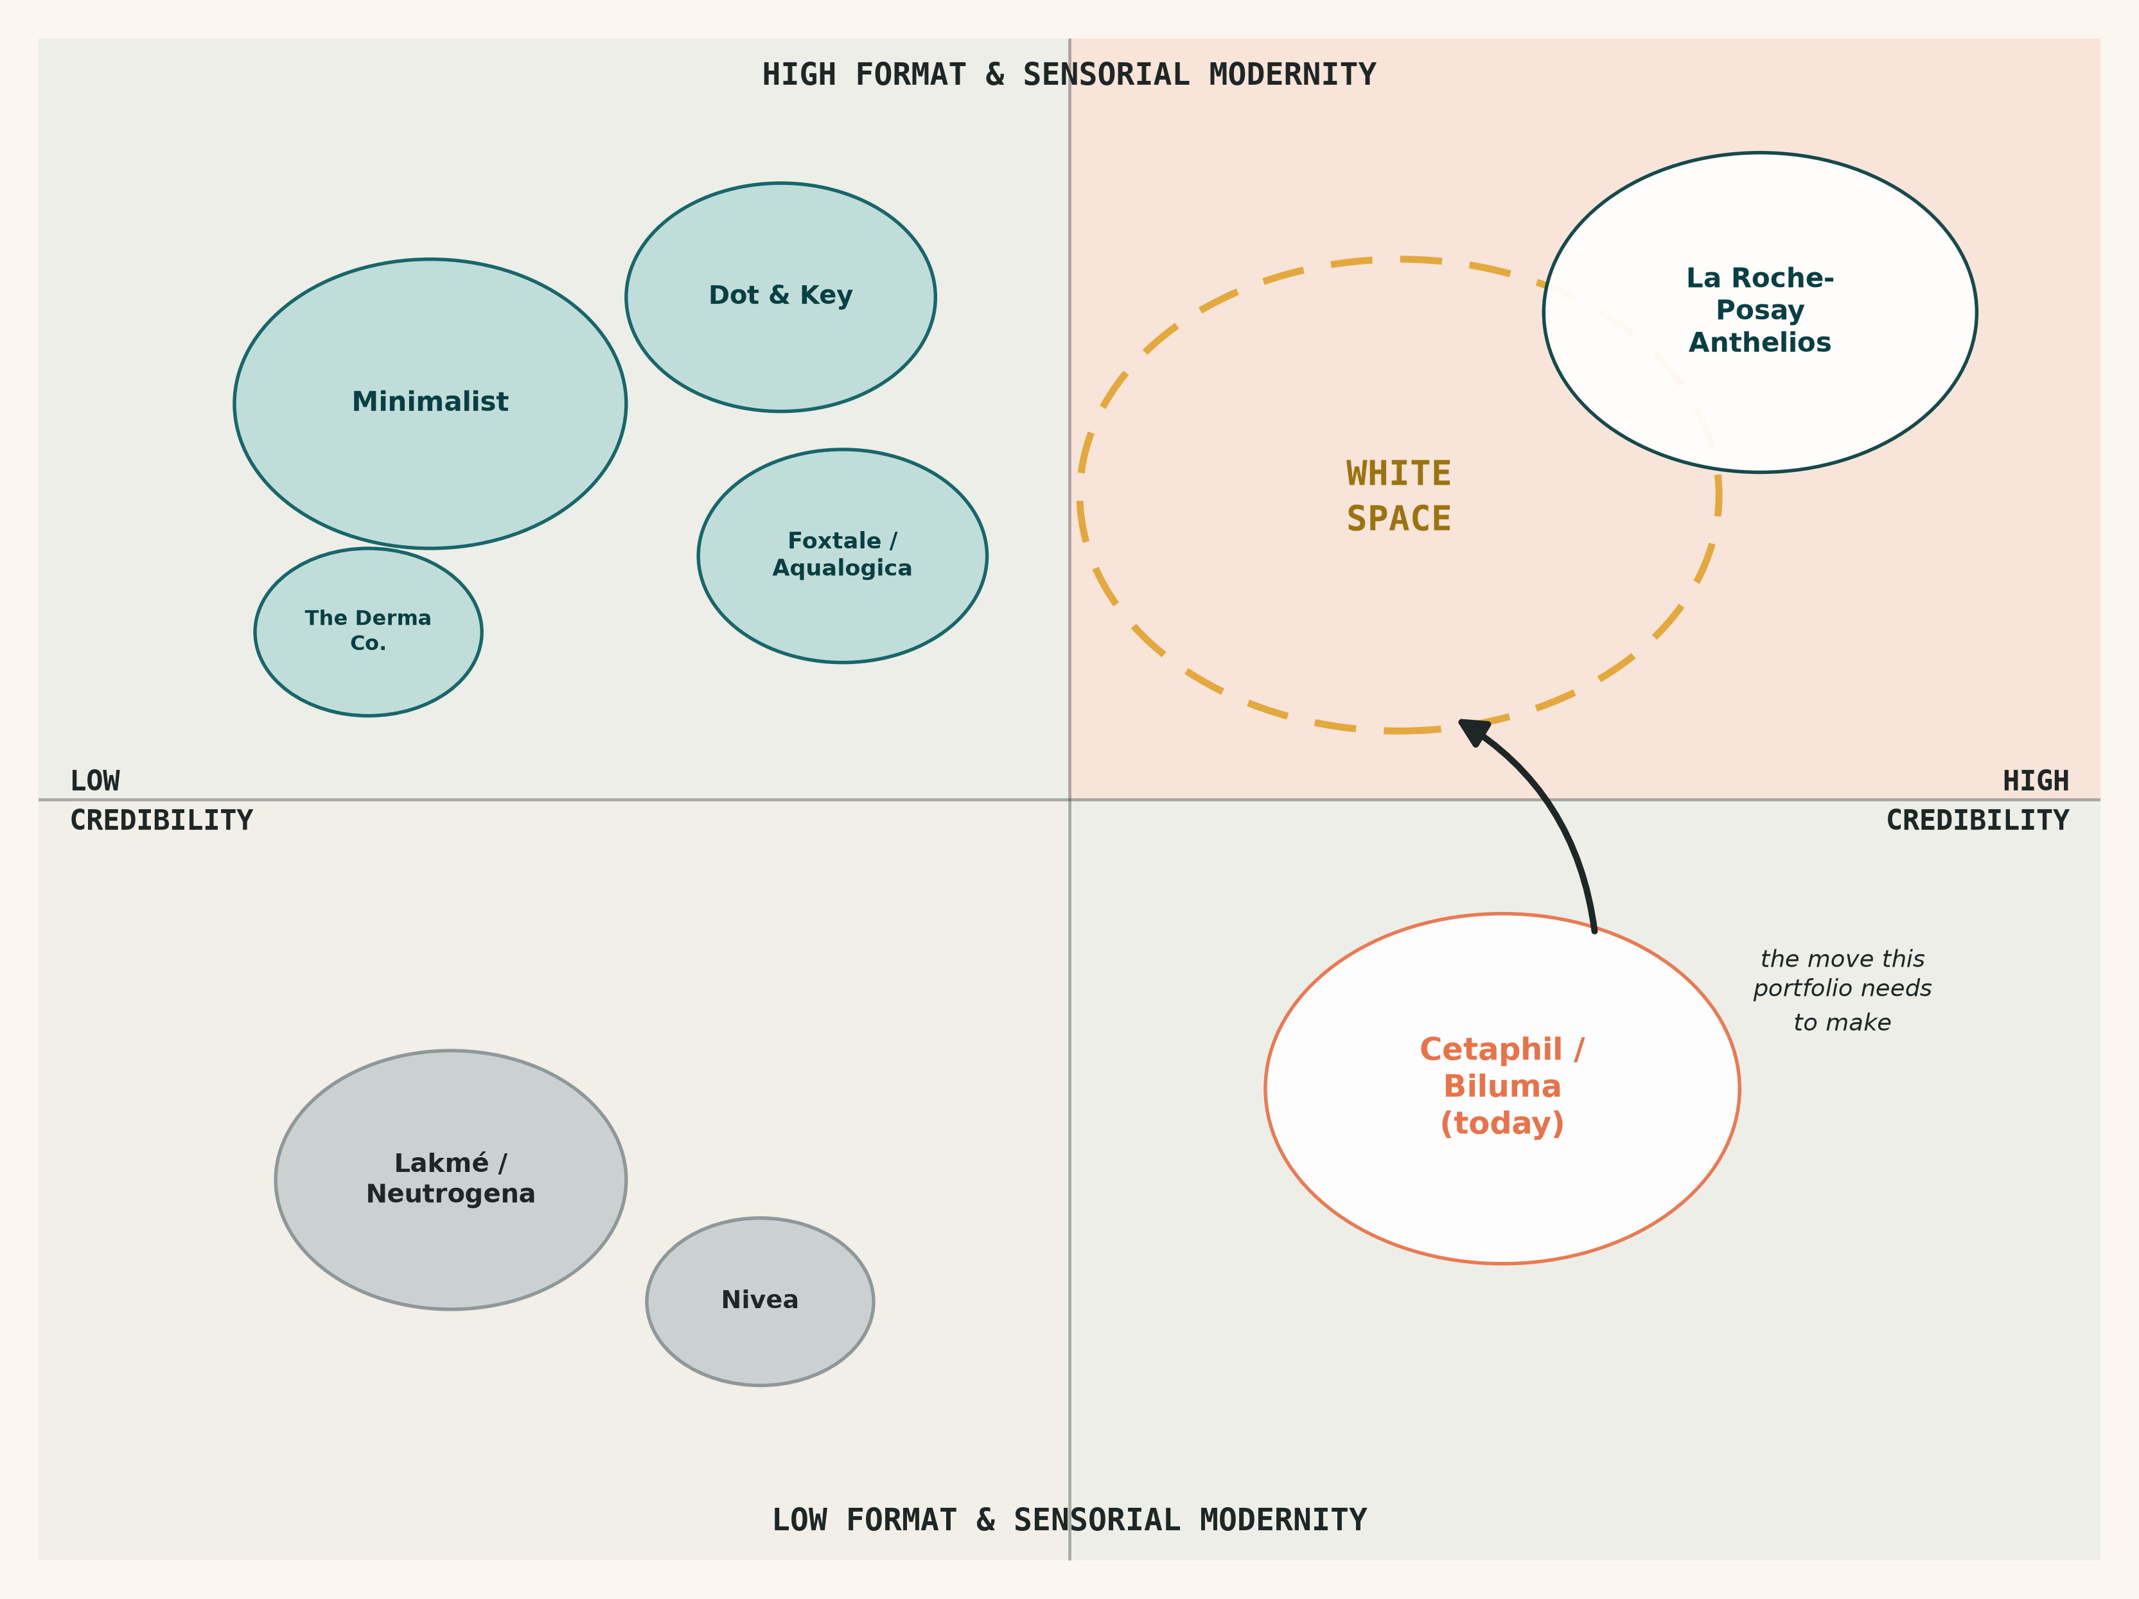
GRAD 3.0 -- GALDERMA SUNSCREEN CHALLENGE
Galderma has the derm credibility.
It doesn't have the format range -- yet.
The gap is translation, not science: Cetaphil and Biluma already carry the dermatological credibility indie D2C brands (Minimalist, Dot & Key, The Derma Co.) are still building. What they haven't built is the format range and content presence that makes that credibility legible to India's 25-35 sunscreen buyer.
Three consumer jobs -- Commuter, Skintok Regular, Occasional Buyer -- share one blocker: white cast, the single most cited reason Indian consumers skip reapplication.
6-9%
10.8%
White cast
India sun care
CAGR (2024-30)
sunscreen stick
CAGR (fastest)
#1 reapplication
barrier, India
The white space: high derm credibility + high format/sensorial modernity -- where La Roche-Posay Anthelios plays internationally but hasn't fully localized for Indian skin and climate. Nobody owns it here yet.
GRAD 3.0 -- Galderma Sunscreen Challenge -- Executive Summary
1

Slide 2
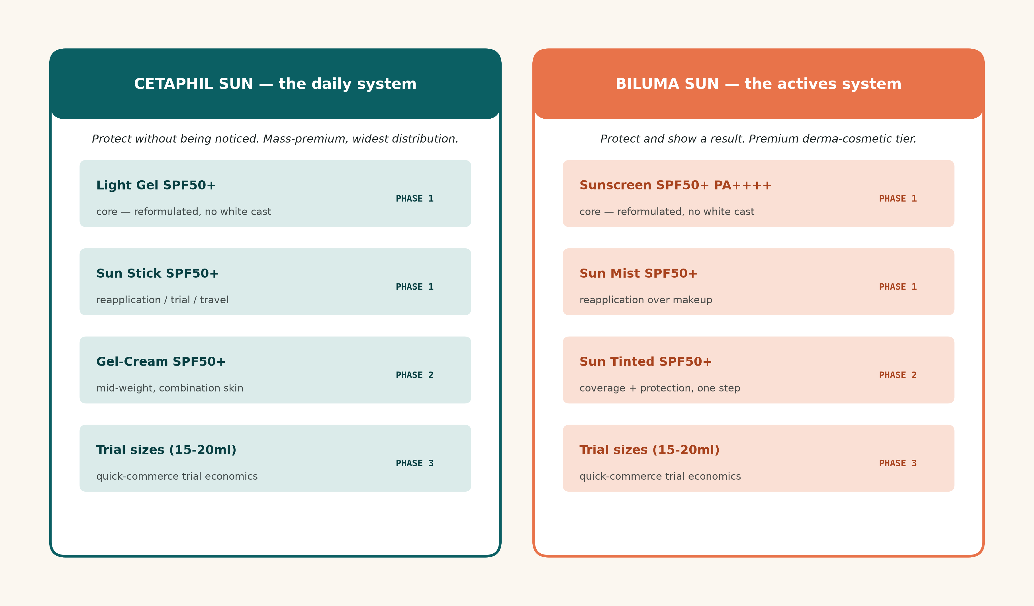
GRAD 3.0 -- GALDERMA SUNSCREEN CHALLENGE
Two brands, two systems, one standard
A 3-5 year portfolio, built to eliminate white cast portfolio-wide and win the trial-to-repeat path via quick commerce and dermatologist-creator partnerships.
PHASE 1 -- Year 1
PHASE 2 -- Yrs 2-3
PHASE 3 -- Yrs 3-5
Fix the core
Zero-white-cast reformulation portfolio-wide; launch Cetaphil Sun Stick + Biluma Sun Mist
Build the premium tier
Launch Biluma Sun Tinted + Cetaphil Gel-Cream; scale dermatologist-creator content
Defend and extend
Trial-size SKUs across the range; quick-commerce reorder mechanics; evaluate Kids/Family
Full detail -- SPF architecture, claims, pricing ladder, GTM by channel -- in GRAD3_Galderma_Sunscreen_Portfolio_Strategy.pptx (10-slide version).
GRAD 3.0 -- Galderma Sunscreen Challenge -- Executive Summary
2

