Slide 1
GRAD 3.0 -- GALDERMA SUNSCREEN CHALLENGE
Two Brands, One System:
A Sunscreen Portfolio for
India's Next Generation
A 3-5 year portfolio and go-to-market strategy for Cetaphil Sun and Biluma Sun, built to convert Galderma's dermatological credibility into the formats, claims and channels India's 25-35 sunscreen consumer already trusts.
Strategic consultants to Galderma India | GRAD 3.0 submission
Secondary-research-driven strategy case -- no dataset or exhibits were provided; all market figures cited in research/sources.md.

Slide 2
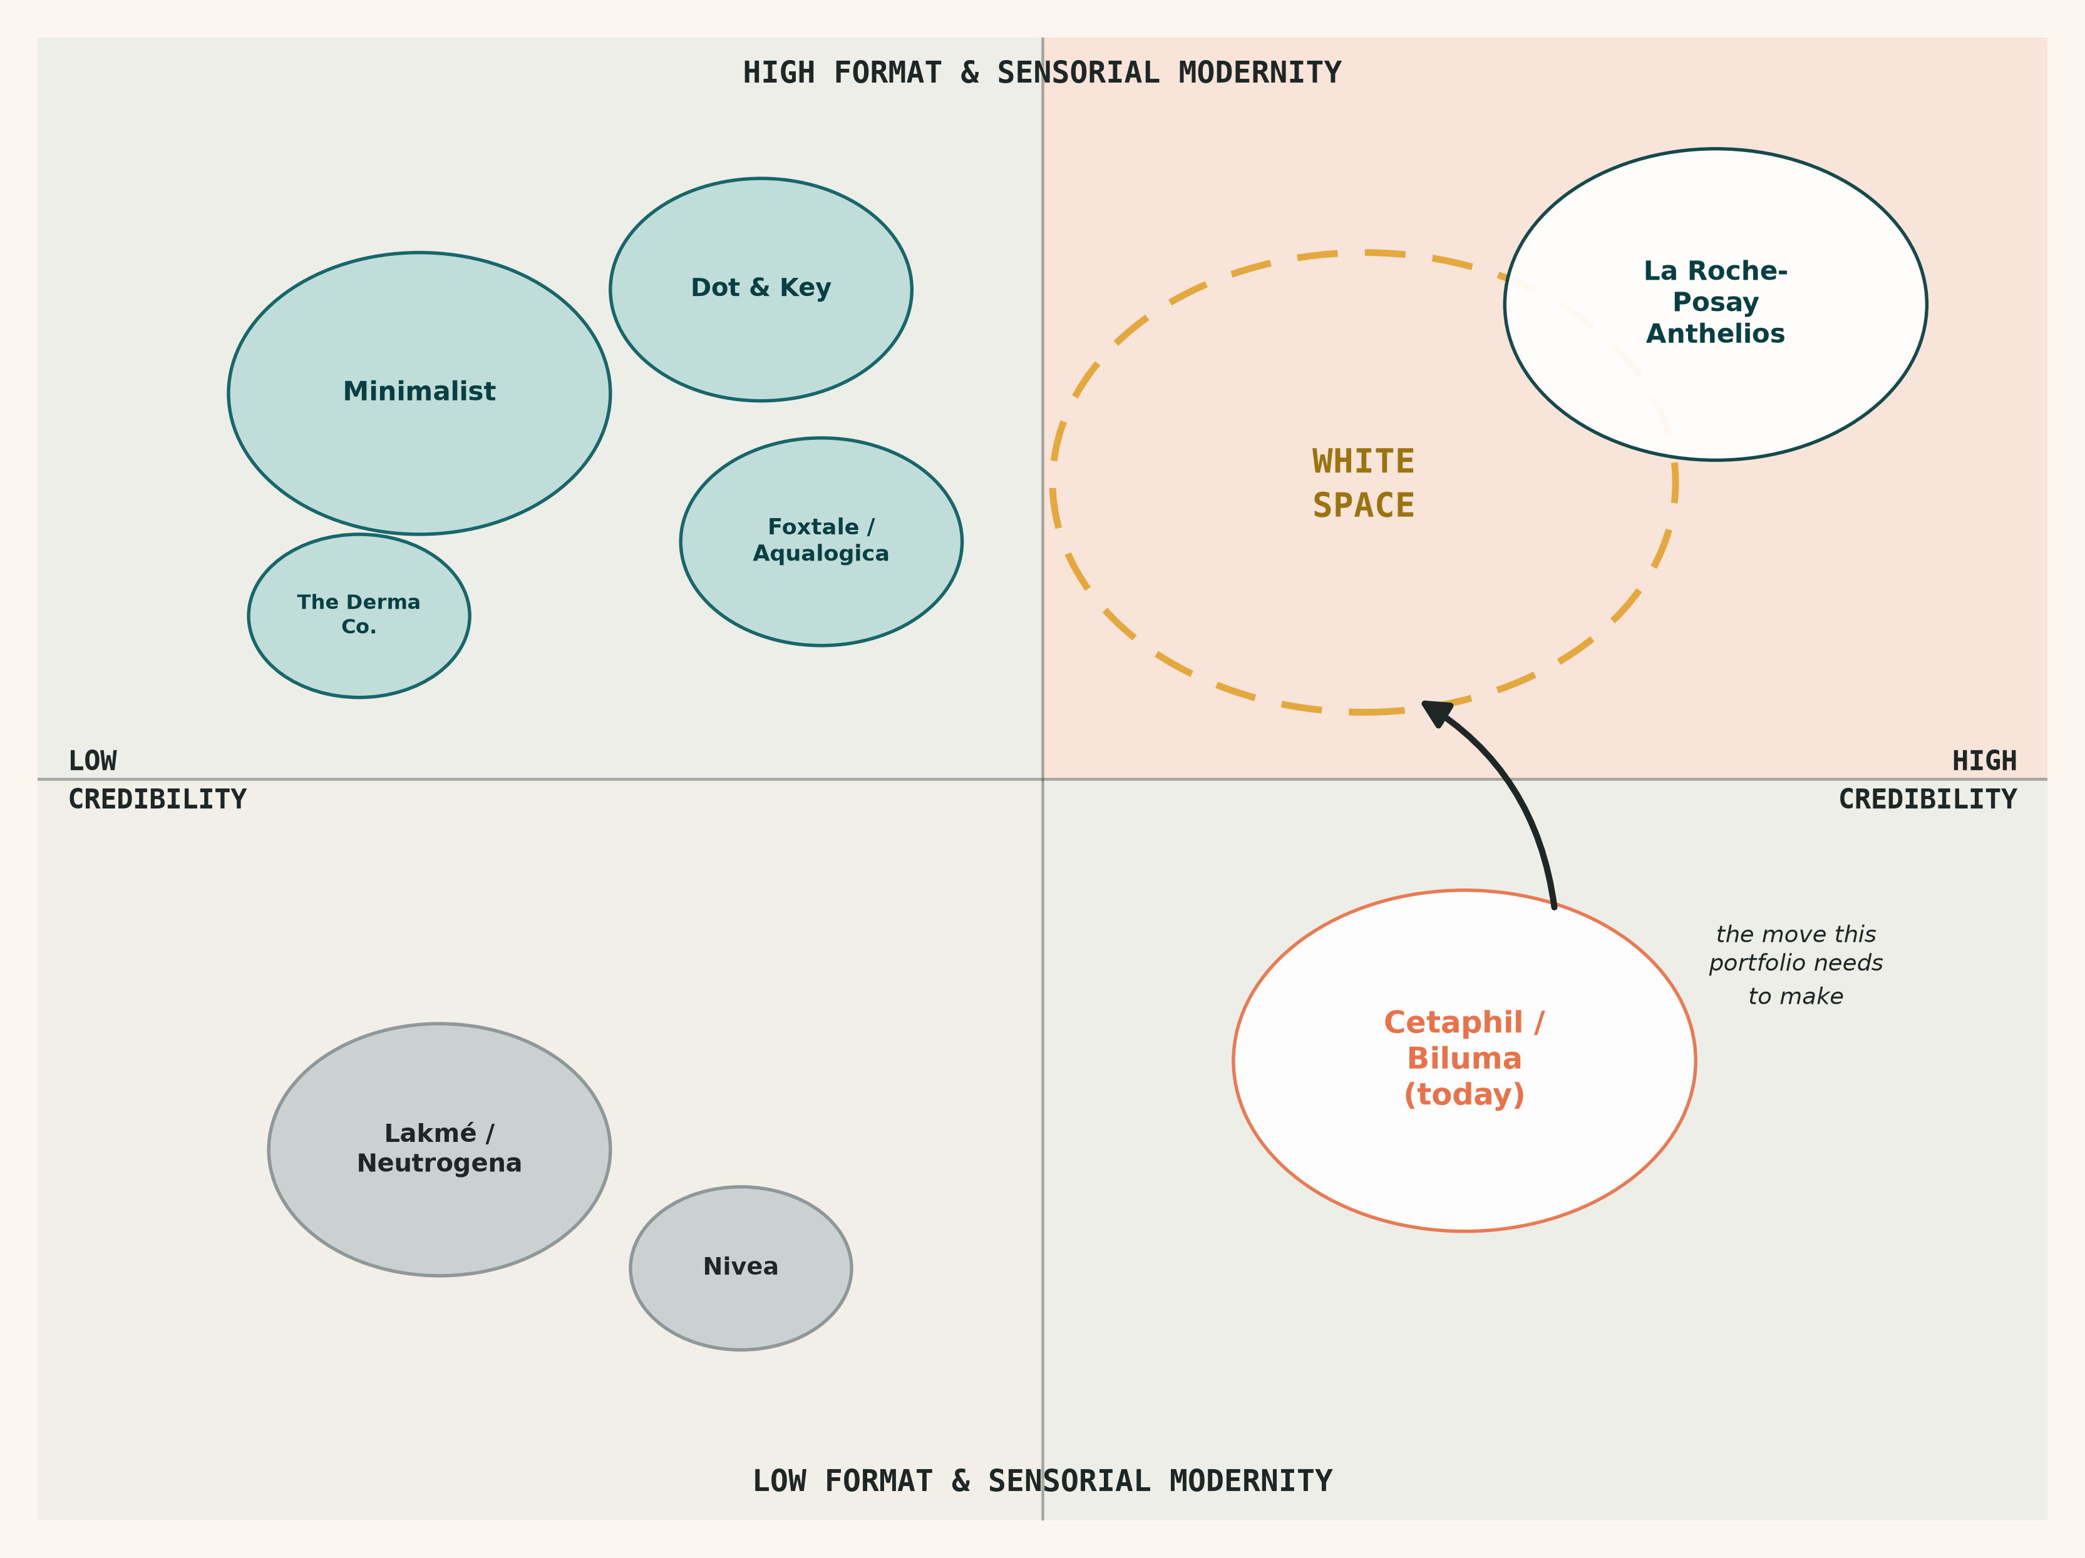
THE PROBLEM
Galderma has the derm credibility.
It doesn't yet have the format range.
Cetaphil Sun and Biluma Sun deliver trusted, dermatologically tested protection. But the 25-35 Indian consumer is choosing sunscreen on format, sensorial feel and content presence as much as on protection science.
That's a translation gap, not a science gap: Galderma already owns the credibility indie D2C brands are still building. What's missing is the format range and claims architecture to make that credibility legible to a skincare-literate buyer.
6-9%
10.8%
India sun care CAGR
(2024-2030, est.)
sunscreen stick format
CAGR -- fastest-growing
White cast
the #1 cited reason for skipped reapplication
among Indian consumers
GRAD 3.0 -- Galderma Sunscreen Challenge
2

Slide 3
CONSUMER DEEP DIVE
Three jobs, one shared blocker
THE COMMUTER
THE SKINTOK REGULAR
THE OCCASIONAL BUYER
JOB: Daily, defensive habit before stepping out. Wants fast absorption and zero mid-day retouching.
JOB: Sunscreen as step 5-7 of a routine, filmed or content-influenced. Wants ingredient literacy and a pack worth showing.
JOB: Reaches for sunscreen only for high-exposure occasions -- beach, wedding, a long outdoor day.
BARRIER: Reapplication friction -- white cast + greasy feel mean the 2pm top-up just doesn't happen.
BARRIER: Today's format reads "medicinal," not "routine-worthy" -- credibility isn't signaled visually.
BARRIER: Low category education -- buys on brand recall and pack size, not SPF/PA understanding.
The unifying insight: white cast is not a niche complaint -- it hits every persona differently, and fixing it across formats is the single highest-leverage move available to this portfolio.
GRAD 3.0 -- Galderma Sunscreen Challenge
3

Slide 4
COMPETITIVE LANDSCAPE
The white space: derm credibility, modern format
Indie-derma brands
have won the format and content narrative with far less R&D pedigree than Galderma actually has.
La Roche-Posay Anthelios
is the international benchmark for this exact move -- derm heritage, multi-format range -- not yet fully localized for India.
Cetaphil / Biluma today
sit bottom-right: real credibility, narrow format range. That gap is the strategy.
GRAD 3.0 -- Galderma Sunscreen Challenge
4

Slide 5
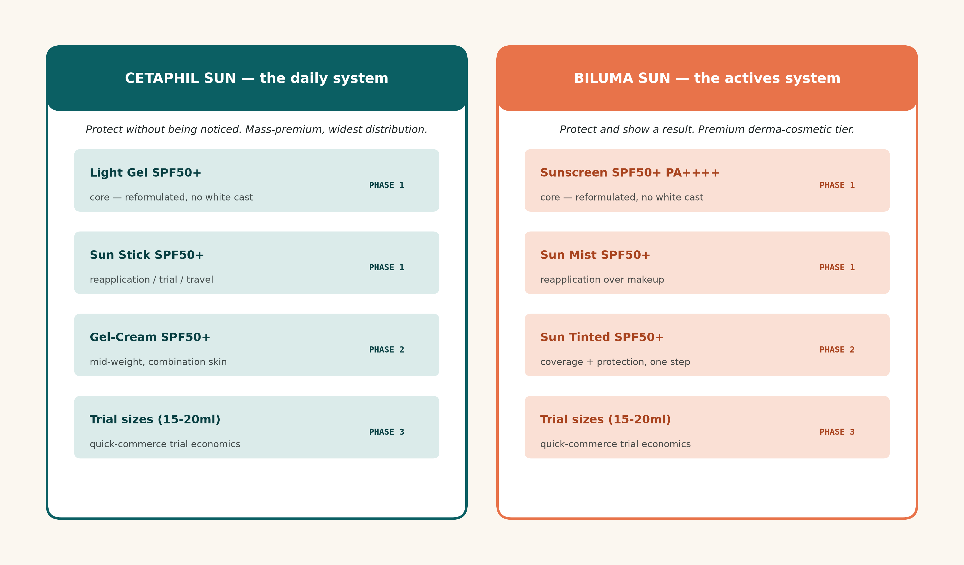
PORTFOLIO STRATEGY
Two brands, two systems, one standard
Cetaphil and Biluma stop being two sunscreens and become two systems -- each built around a distinct job, both engineered to eliminate white cast.
GRAD 3.0 -- Galderma Sunscreen Challenge
5

Slide 6
PORTFOLIO STRATEGY
SPF architecture, claims and ingredients
SPF50+ PA++++ across the entire portfolio. India's climate makes a lower-SPF "everyday" tier a false economy. Differentiate by format and finish, not protection level -- every Galderma sunscreen is "the good one," which also avoids fragmenting a still low-education category.
CETAPHIL SUN -- claims & ingredients
BILUMA SUN -- claims & ingredients
Portfolio-wide baseline: "No White Cast" -- extended from Biluma-only to every SKU.
Lead claim: "Dermatologist-recommended, all-day comfort."
Retained: Vitamin E -- Cetaphil's existing sensitive-skin anchor.
New: lightweight/non-greasy claim on the stick and gel-cream formats.
Portfolio-wide baseline: "No White Cast" -- Biluma's existing claim, now the standard.
Lead claim: "Protection + Visible Skin Goal."
Retained: Lactic Acid + Hyaluronic Acid -- Biluma's existing actives.
New: brightening / anti-pollution claim on the tinted variant, with real clinical substantiation indie brands can't match.
GRAD 3.0 -- Galderma Sunscreen Challenge
6

Slide 7
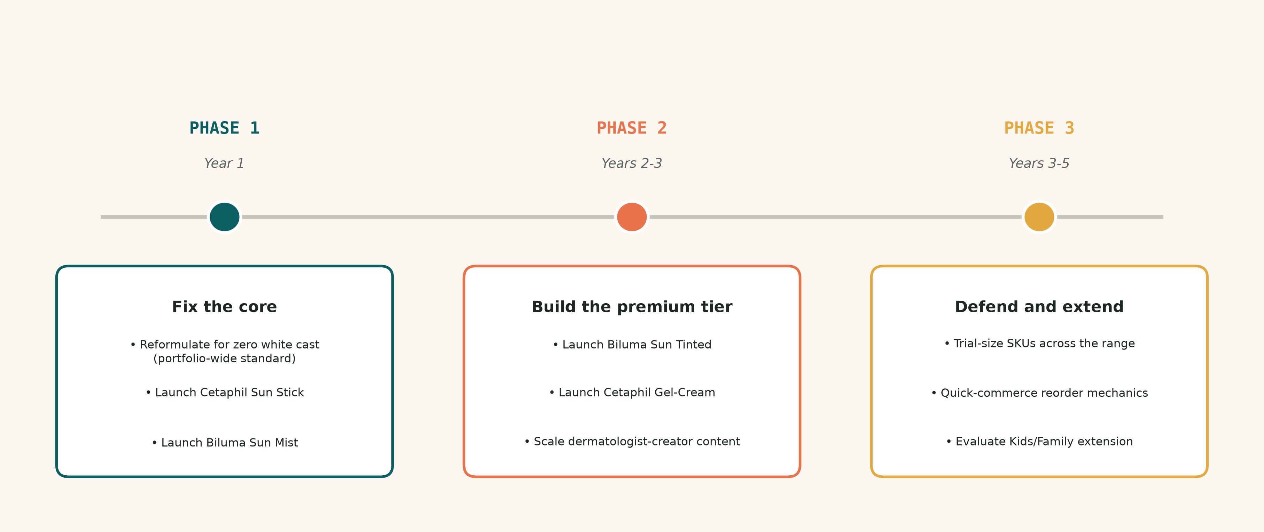
PORTFOLIO STRATEGY
Phased rollout, Year 1 to Year 5
GRAD 3.0 -- Galderma Sunscreen Challenge
7

Slide 8
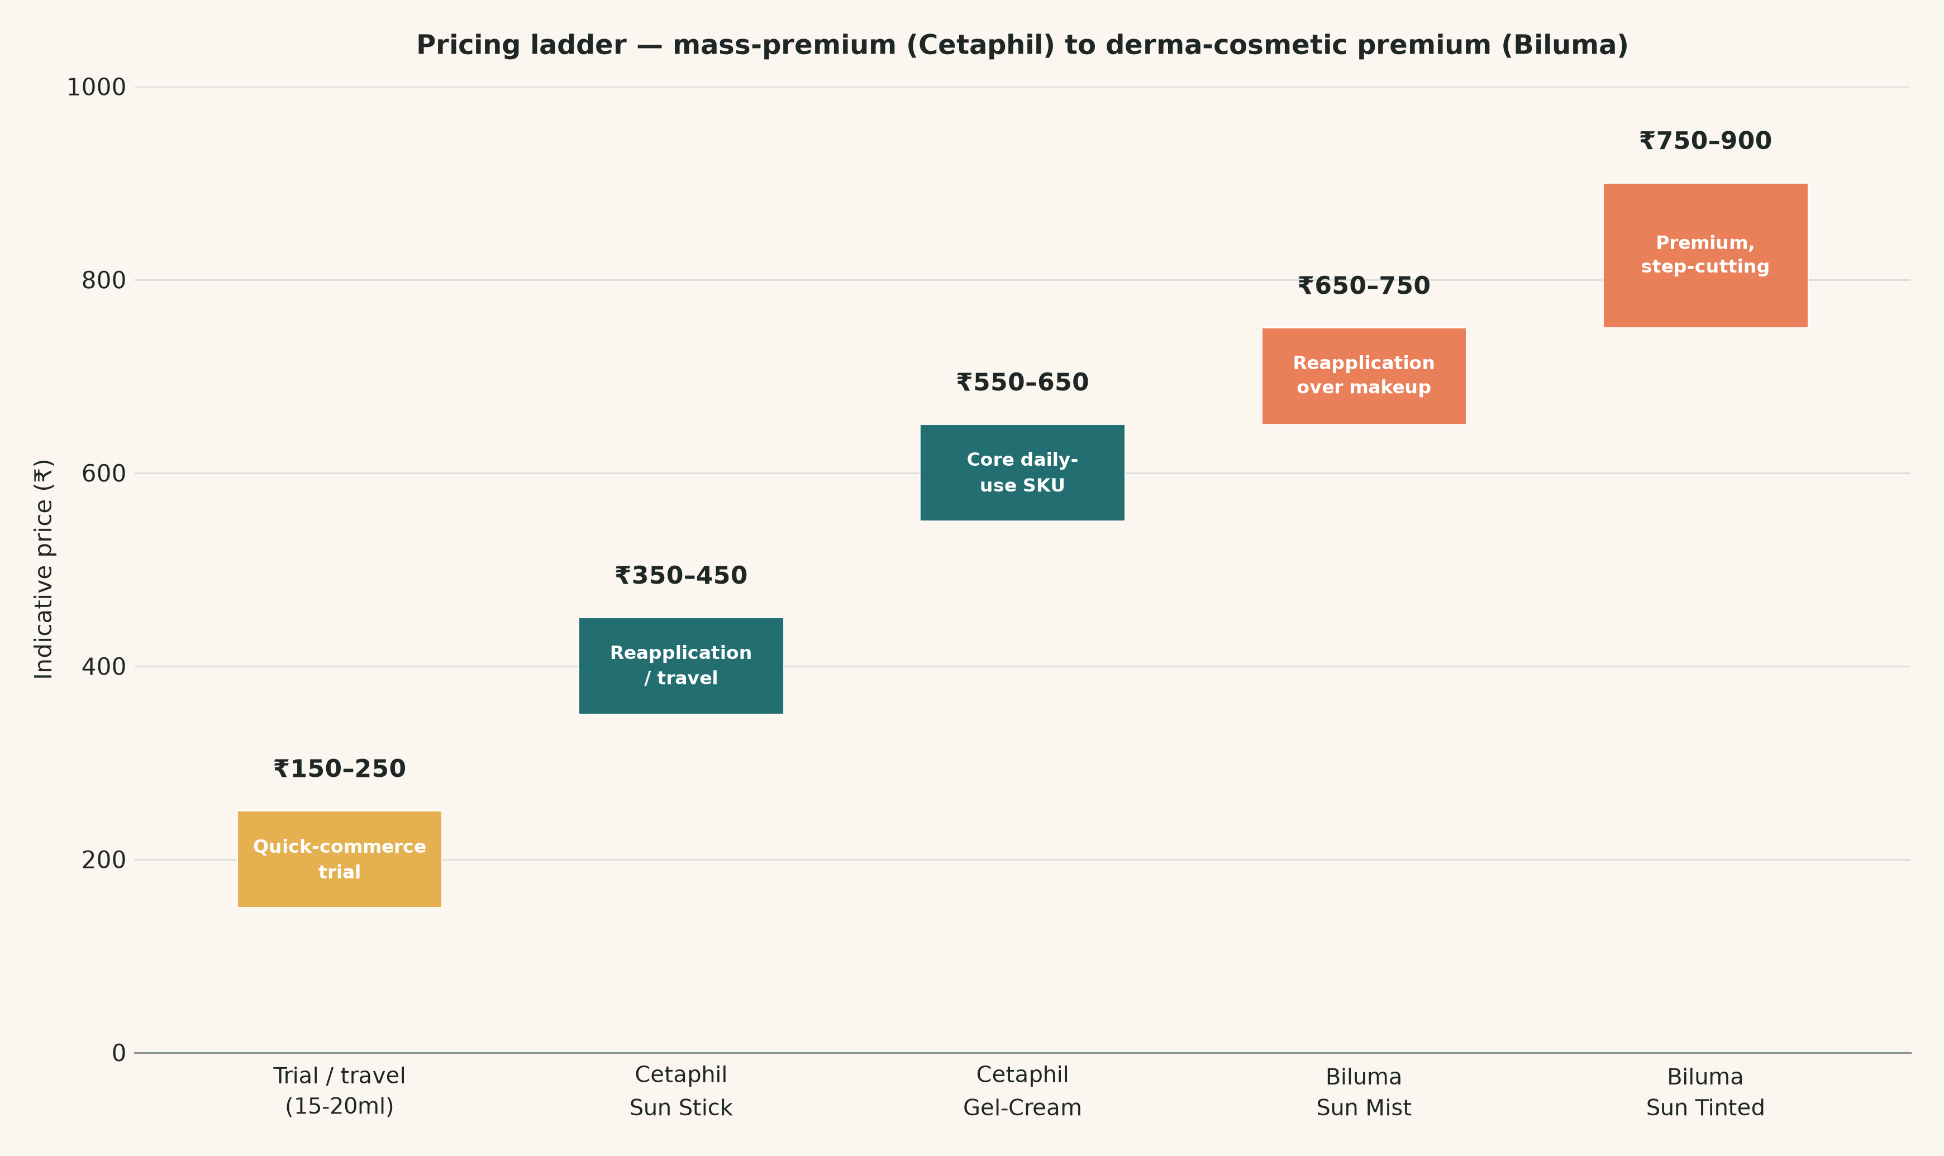
PORTFOLIO STRATEGY
Pack formats, sizes and pricing
Why this ladder
Cetaphil stays mass-premium, priced against The Derma Co. and Re'equil.
Biluma stays derma-cosmetic premium, approaching (not matching) La Roche-Posay import pricing.
Trial sizes exist purely for quick-commerce discovery economics -- not a margin play.
The two-tier hierarchy is preserved throughout: no SKU collapses both brands into one price band.
GRAD 3.0 -- Galderma Sunscreen Challenge
8

Slide 9
GO-TO-MARKET
Channels, partnerships, and the trial-to-repeat path
CHANNELS & TERRITORIES
PARTNERSHIPS
TRIAL -> ADOPTION -> REPEAT
• Lead with quick commerce + Nykaa/Amazon for trial-size and reapplication SKUs
• Pharmacy & dermatologist-clinic channels reinforce the credibility claim
• Metro / Tier-1 first; Tier-2 expansion in Years 2-3 with mass-tier Cetaphil formats
• Dermatologist-creator partnerships, not generic beauty influencers
• Carries credibility into the content-first discovery journey this cohort uses
• A structural advantage no indie D2C brand can fully replicate
• Trial: small-format SKUs on quick commerce, low-commitment pricing
• Adoption: stick + mist are the wedge -- fix reapplication, daily use follows
• Repeat: subscribe/reorder mechanics, plus a Cetaphil-to-Biluma "graduate" path
GRAD 3.0 -- Galderma Sunscreen Challenge
9

Slide 10
RISKS & CAVEATS
What this strategy assumes, and what to validate
Reformulation risk
"No white cast" is a real R&D commitment, not a marketing claim -- achievability within the phase timeline needs Galderma's own formulation science.
Cannibalization risk
Cetaphil's new gel-cream and Biluma's existing lotion could overlap -- pricing and claims must stay differentiated by finish and skin-goal.
Distribution execution risk
Winning quick commerce needs fulfillment and reorder readiness outside this analysis's scope -- validate with actual channel partners.
Data risk
Market sizing and channel growth are secondary research with real variance across sources -- see research/sources.md -- treat as directional, not internal-grade.
GRAD 3.0 -- Galderma Sunscreen Challenge
10

