Slide 1
CIPLA ASCEND — SEASON 4
CARDIO-COMPASS
A transparent, reproducible AI agent for prioritizing Cipla's Cardiac opportunity spaces
AI-Enabled Prioritization with Integrated Trend Analytics | Round 1 Submission
Ranjana Mainani
cases/2026-08-ascend-s4-cipla-cardiac

Slide 2
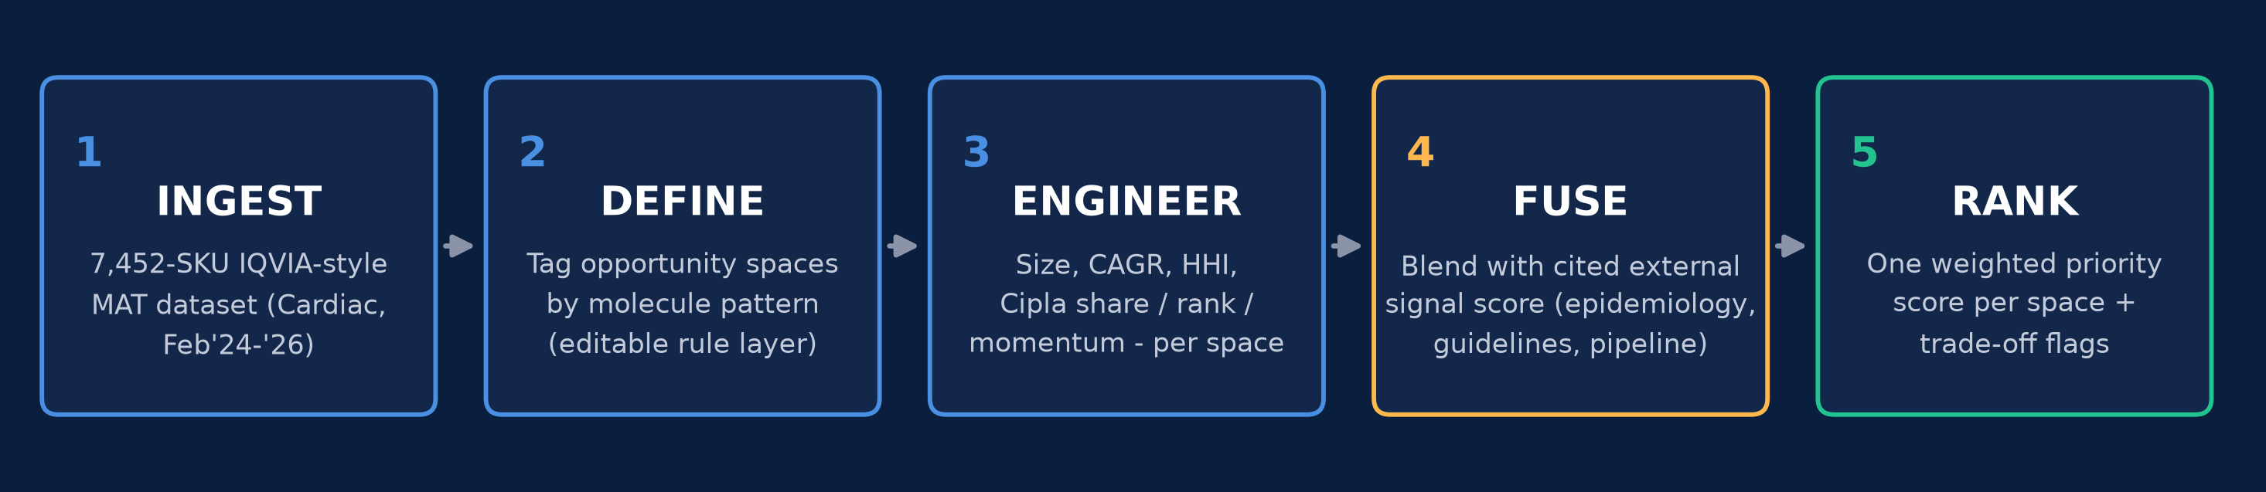
1 / 3 — THE AGENT
CARDIO-COMPASS is a transparent scoring pipeline, not a black box
Every input, weight, and formula below is visible and re-runnable — the finale can test it live.
OBJECTIVE & DATA INPUTS
PRIORITIZATION FORMULA (WEIGHTS ARE VISIBLE)
Rank Cardiac opportunity spaces by likelihood of outperforming the broader market over 3-5 years, and by Cipla's ability to actually capture that growth.
Inputs: 7,452-row IQVIA-style MAT dataset (brand/company/molecule level, Feb'24-'26) + a curated, source-cited external trend layer (epidemiology, dyslipidemia/hypertension guidelines, pipeline & launch signals).
Opportunity spaces are defined programmatically by molecule-pattern rules over MOLECULE_DESC — editable, auditable, not manual bucketing.
30%
Market attractiveness
0.5×norm(market size) + 0.5×norm(2yr value CAGR)
25%
Future potential
curated 0-100 signal score, cited to secondary research
20%
Competitive whitespace
100 − norm(HHI) — inverse of concentration
25%
Cipla right-to-win
0.4×share + 0.3×rank + 0.3×momentum (capped, low-base-safe)
Reproducible: `python analysis/agent_prioritization.py` regenerates this ranking straight from the raw dataset.
Cipla Ascend Season 4 | CARDIO-COMPASS
Page 2

Slide 3
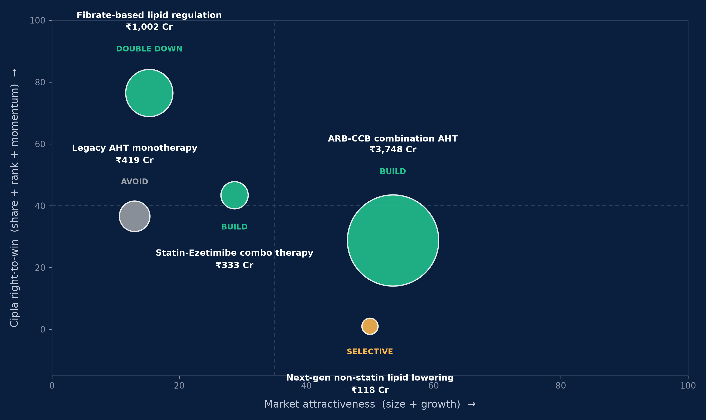
2 / 3 — THE RANKING
5 opportunity spaces ranked; 3 clear the bar to actively prioritize
Trade-offs the agent resolves: ARB-CCB wins size AND growth together; Statin-Ezetimibe wins growth despite low competition; Fibrates win on Cipla's existing right-to-win over a bigger, slower field.
Opportunity space | ₹Cr, MAT'26 | 2yr value CAGR | HHI | Cipla share / rank | Score | Action
ARB-CCB combination AHT | 3,748 | +15.8% | 683 | 1.6% / #18 | 62.8 | BUILD
Statin-Ezetimibe combo therapy | 333 | +60.8% | 1,380 | 0.3% / #21 | 57.9 | BUILD
Fibrate-based lipid regulation | 1,002 | +14.8% | 1,319 | 6.6% / #5 | 52.5 | DOUBLE DOWN
Next-gen non-statin lipid lowering | 118 | +110.1% | 1,948 | 0.0% / n/a | 46.6 | SELECTIVE
Legacy AHT monotherapy | 419 | +8.5% | 4,647 | 1.3% / #6 | 14.1 | AVOID
HHI = Herfindahl-Hirschman Index of company concentration within the space (lower = more fragmented / more whitespace).
Cipla Ascend Season 4 | CARDIO-COMPASS
Page 3

Slide 4
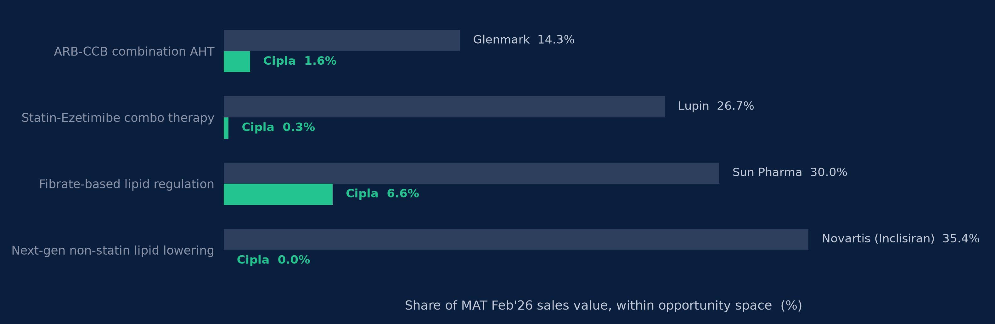
3 / 3 — RIGHT-TO-WIN & THE PLAYBOOK
Cipla trails the category leader everywhere except Fibrates — and the biggest
underpenetrated opportunity is patent-gated, not just uncontested.
UNDERPENETRATED, DESPITE STRONG POTENTIAL
Next-gen non-statin lipid lowering (+110% CAGR, highest in the dataset) splits in two:
• Inclisiran — ₹60 Cr, 100% Novartis, patent-locked. Not accessible near-term.
• Bempedoic acid combos — ₹57 Cr, already fragmenting across 7+ Indian generics majors post-Zydus's 2022 first-mover launch.
→ Selective fast-follower generic entry into bempedoic acid combinations; skip inclisiran.
DOUBLE DOWN
BUILD
SELECTIVE
AVOID
Fibrate-based lipid regulation
ARB-CCB combo + Statin-Ezetimibe combo
Next-gen non-statin lipid lowering
Legacy AHT monotherapy
Already rank #5, 6.6% share — defend and extend the FDC line.
Biggest prize + fastest grower; fragmented fields, real entry room.
Fast-follow bempedoic acid generics only; inclisiran is off the table.
Flat real volume (+0.07% CAGR), HHI 4,647 — fading, not investable.
Cipla Ascend Season 4 | CARDIO-COMPASS
Page 4

Slide 5
APPENDIX
Sources for external data & methodology notes
EXTERNAL SOURCES CITED (FUTURE-POTENTIAL SCORING)
• Bempedoic Acid for Lipid Management in the Indian Population: An Expert Opinion — PMC (pmc.ncbi.nlm.nih.gov/articles/PMC10040092)
• Zydus launches Bemdac to treat LDL-Cholesterol — Indian Pharma Post (indianpharmapost.com)
• Bempedoic acid market in India will become crowded soon with more generic launches — GlobalData (globaldata.com)
• Unmet Need for Further LDL-C Lowering in India despite Statin Therapy: LAI Recommendations — PubMed (pubmed.ncbi.nlm.nih.gov/36082889)
• Guidelines for dyslipidemia management in India: current scenario and gaps — PMC (pmc.ncbi.nlm.nih.gov/articles/PMC9647649)
• CSI Clinical Practice Guidelines for Dyslipidemia Management — ScienceDirect (sciencedirect.com/science/article/pii/S0019483223004698)
• Epidemiological trends and age-period-cohort effects on CVD burden attributable to ambient air pollution across BRICS — Nature Sci Reports (nature.com/articles/s41598-024-62295-6)
• Does Ambient/Indoor Air Pollution Drive Hypertension in Women in India? — Air Qual Atmos Health, Springer (link.springer.com/article/10.1007/s11869-025-01770-z)
• The India Hypertension Control Initiative — early outcomes, 2018-2020 — J Human Hypertension, Nature (nature.com/articles/s41371-022-00742-5)
• Treatment Optimisation for BP with Single-Pill Combinations in India (TOPSPIN protocol) — PMC (ncbi.nlm.nih.gov/pmc/articles/PMC11565424)
METHODOLOGY NOTES
• Primary dataset: Ascend Season 4 Cardiac market MAT dataset (IQVIA-style, 7,452 SKU-level rows, India, MAT Feb'24/'25/'26).
• "Future potential" pillar is analyst-curated from the sources above, not a live external feed — documented transparently given offline/sandboxed constraints.
• Cipla's own CAGR is capped at +100% before scoring to prevent low-base outliers (e.g. Statin-Ezetimibe, <₹1 Cr in FY24) from dominating the right-to-win pillar.
Cipla Ascend Season 4 | CARDIO-COMPASS
Appendix

