Slide 1
Document Summarization using
Submodular Functions
Team Members:​
Alok Panigrahi (200100019)​
Annie D'souza (20D070028)​
Course Instructor:​
Prof. Ganesh Ramakrishnan

Slide 2
GLISTER
Initial problem statement was to work on GLISTER, to modify and improve it
The literature review and initial code setup has been completed
We trained the model on CIFAR dataset and observed the results
However, whatever improvement (in terms of extensions or speed ups) we thought to implement had already been implemented in the current codebase
The improvements suggested were:
Since the bottleneck of the code is greedyDSS, we thought of the following:
Applying greedy algorithms to batches of subsets and taking an average of the weights encountered
Parallelizing the above
Since the current algorithms by itself gave promising results, minor improvements in the accuracy wouldn’t matter much
So we decided to shift to alternative topics

Slide 3
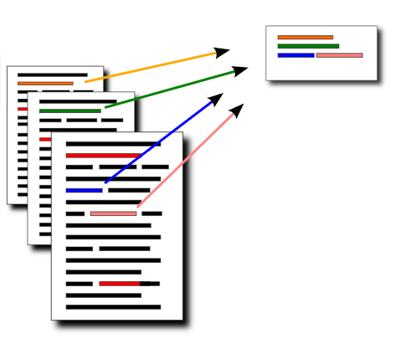
Multi-Document Summarization using Submodular Functions
1
Source: http://mogren.one/lic/

Slide 4
Introduction
Multi-document summarization​:
Representing a set of documents by a single short representation/ summary

Slide 5
Multi-document summarization
Extractive
Generate summaries using sentences and phrases only present in the text.
Abstractive
Summaries contain potentially new phrases and sentences not present in the source text
Methods used for summarization:
Pretrained encoders​
Unsupervised multi-task learners​
CNNs​
Fine-tuning LLMs​
Using submodularity

Slide 6
Problem statement
Perform Multi-document Summarization by modelling it as a monotone submodular function maximization task
- Find a low-cost subset of the document under the constraint that the summary covers all or sufficient amount of information across all documents

Slide 7

Methodology
Preprocessing of the documents
Defining the objective Function
L(S) - Coverage function
R(S) - Diversity reward function
λ - trade-off coefficient

Slide 8
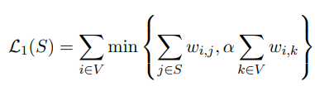
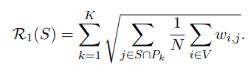
Coverage Function:
Diversity Reward Function:
P_k - Partition/ cluster
W_ij- Cosine Similarity between Sentences

Slide 9


- Number of times w appears in sentence i
Xxc - Inverse document frequency of term w (log of the number of documents appeared in over total number of documents)
Cosine Similarity Function (between two sentences)

Slide 10
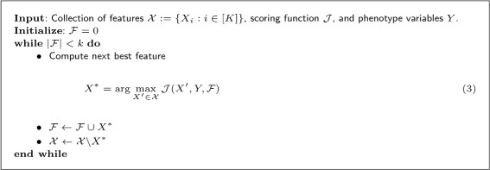
3) Greedy Algorithm for generating Summary

Slide 11
Dataset Used: DUC 2004
ROGUE scores used to check performance
Partition function - sklearn k-means clustering package

Slide 12
Results
Lambda | F score | Recall
0.5 | 38.42 | 37.9
0.7 | 33.73 | 34.05
0.8 | 49.04 | 47.06
Number of partitions - 0.2 X Number of sentences
Alpha = 0.8

Slide 13
Challenges Faced
To solve this submodular function we are using a greedy algorithm,
Time complexity of this algorithm is O(n^2). (n no. of sentences)
Thus, running it on all the 10 documents, was taking a lot of time and was giving runtime error.
The hyperlinks referring to the clustering algorithm mentioned in the CLUTO paper are no longer functioning.
Reference summary in DUC dataset was not available for all the task in required format
Solutions
Instead of summarizing all documents at once, we summarized documents in pair of two, got their individual ROGUE score and did this iteratively across all documents.
We used sklearn k-means clustering package for making the partition function.
We generated our own custom extractive summary using gensim packages.

Slide 14
Analysis and Future Works
Calculation of the cosine similarity between pairs of sentences is very slow .
Summaries of individual documents can be generated and multi-document summarization can be applied on these generated summaries to obtain a final summary.
- Pros: Speedup
-Cons:Frequency of a sentence across documents may not be captured ( which is being done using the idf term).
In case of a large number of documents, summaries can be generated in batches (randomly chosen) and combined (would capture the inverse document frequency to some extent).
Instead of using traditional greedy algorithm we can use lazy algorithm for generating the summary.
The quality of the summaries can be improved using ensemble learning.

Slide 15
References
1.'A Class of Submodular Functions for Document Summarization' paper by Hui Lin and Jeff Blimes

Slide 16
Thank You!

