Slide 1
Lighting Up Akari with
AI Search
0
1
2
Solving the LightUp puzzle with CSP backtracking,
hill climbing and simulated annealing
3
Anna Gasparyan · Ani Baghumyan · Izabella Atajanyan
2
CS 246 Artificial Intelligence — AUA, Summer 2026
Notes:
~30s. One presenter opens. Replace member placeholders with real names. The board on the right is the Pulles (2021) example puzzle with its unique solution, drawn by our own renderer's conventions.

Slide 2
The puzzle: three rules
R1 — Illumination
Every white cell must be lit. A bulb lights its whole row and column until a wall blocks it.
2
R2 — No mutual light
No bulb may shine on another bulb.
R3 — Clue exactness
A numbered wall must touch exactly that many bulbs. Plain walls constrain nothing.
A 3×3 instance, solved: the corner ‘2’ forces both its neighbors.
Uniqueness of the solution is a publishing convention — not a rule. The rules define a constraint-satisfaction problem.
2
Notes:
~1 min. State the rules quickly with the example. Do NOT dwell — the course requires only a brief problem statement. Mention the uniqueness note; it returns in the analysis.

Slide 3
Why LightUp is a good AI problem
NP-complete
Proven by reduction from Circuit-SAT (McPhail 2005). Worst-case exponential — cleverness must earn its keep.
Clean CSP
One binary variable per white cell; the three rules become sum constraints. Search space up to 2ⁿ.
Endlessly scalable
Our generator builds solvable instances from 3×3 to 25×25 with tunable wall and clue density.
Existing approaches (briefly): SAT encoding + backtracking (Pulles 2021) · hill climbing, simulated annealing, neural networks (Perera et al. 2021) · evolutionary algorithms (Salcedo-Sanz et al. 2009).
3
Notes:
~1 min. The three cards are the topic-choice justification. Keep the prior-work strip to two sentences — the course explicitly says existing approaches should be mentioned only very briefly.

Slide 4
Problem formulation (CSP)
Variables | one Xᵥ ∈ {bulb, no-bulb} per white cell
R1 all lit | Σ Xᵥ over {w} ∪ sight(w) ≥ 1 for every white cell w
R2 no clashes | Σ Xᵥ over a wall-free segment ≤ 1 (binary constraints)
R3 clues exact | Σ Xᵥ over a clue's neighbors = nₖ (global, exactly-k)
Goal test | all constraints satisfied — checked by one shared validator
“Lit” is a derived property, not a cell state — it inflates nothing: lit(w) ⟺ a bulb exists in {w} ∪ sight(w).
4
Notes:
~45s. One slide of formalism, no more. Do NOT explain what a CSP or backtracking is — covered in the course. The 'lit is derived' line preempts a common Q&A question about the domain.

Slide 5
One problem, five solvers
Backtracking — naive fixed order, full re-check per node (baseline to beat)
Hill climbing local search over complete assignments; objective = violation count
+ ordering heuristics MRV / degree variable order, value ordering
Simulated annealing same moves, temperature schedule escapes local optima
+ inference forward checking, clue propagation (0/4, saturated, exhausted)
Complete search (left) vs. local search (right) — same rules, same validator as referee, same statistics collected: nodes / moves, conflicts, backtracks, time.
5
Notes:
~1 min. The experiment design in one picture: each arrow on the left changes exactly one thing, so differences in the stats are attributable. Right column is the cross-paradigm comparison.

Slide 6
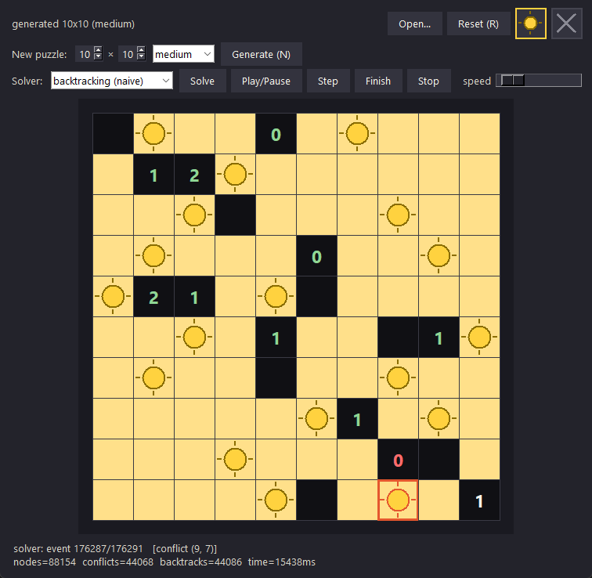
The system: game, generator, observable solvers
Playable game
Tkinter GUI: click to place bulbs, X marks, live rule feedback, any board 3×3–25×25, three difficulty presets.
Instance generator
Solution-first construction: build a valid lighting, derive clues from it, remove bulbs → solvable by construction.
Watchable search
Every solver streams place / conflict / backtrack events — animated replay with play, pause, step, finish.
6
Notes:
~45s. The screenshot is the naive solver mid-replay on a 10x10: red frame = conflict at (9,7), green digits = satisfied clues, status bar streams the event counter and search stats. Demo bait: if time allows in Q&A, a 20-second live solve in the GUI is worth more than this slide. Do not show code.

Slide 7
Experimental setup
Instances
Generated boards: sizes 7, 10, 14, 18, 25; easy / medium / hard density presets; 5 seeded instances per bucket
Every solver runs on IDENTICAL instances; 375 runs total (~11 min)
Reproducible: fixed seeds everywhere, 5 s budget per run
Metrics
Search effort: nodes / moves, conflicts, backtracks
Wall-clock time (median over seeds)
Solve rate within the timeout (local search: also solution quality)
Correctness is always judged by the rules validator — never by comparing to one known answer, because instances may have several legitimate solutions.
7
Notes:
~45s. Fill the two [CONFIRM] blanks once the experiment harness is final. The bottom principle matters in Q&A: multi-solution instances make answer-comparison invalid as a correctness test.

Slide 8
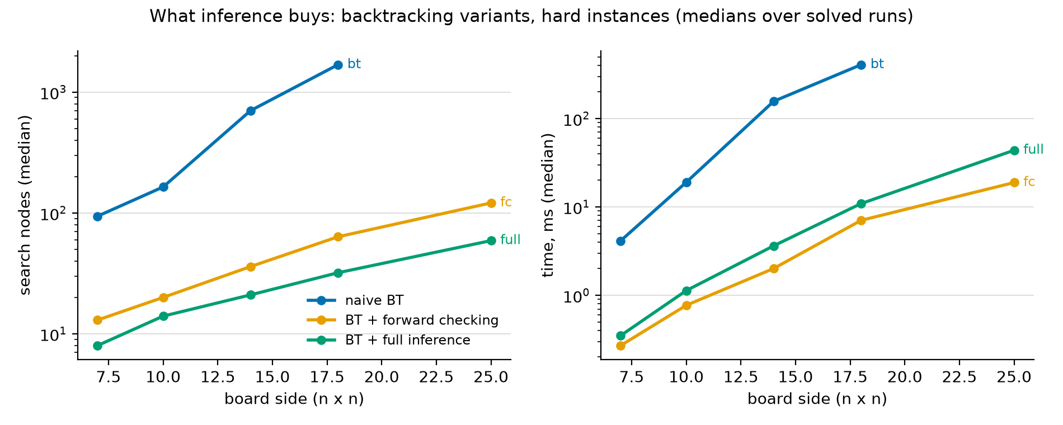
Results — what does inference buy?
0
search nodes to solve the published 7×7 —
full inference derives it by propagation alone
75/75
generated instances solved by full inference,
all sizes & difficulties — the only 100 % solver
Naive BT leaves the chart after 18×18 (0 % solved at 25×25). The honest nuance: full inference needs ~2× fewer nodes than forward checking, yet fc is slightly faster per board at large sizes — propagation costs time per node.
8
Notes:
~1.5 min. THE core slide. Say the numbers out loud: naive 308 nodes on the 7x7, forward checking 12, full inference ZERO - the published puzzle is solved by deduction alone, which is exactly what publishers curate for. Then the scaling panels: 1-2 orders of magnitude between naive and the smart variants. Close with the nodes-vs-time nuance - fewer nodes is not automatically less time.

Slide 9
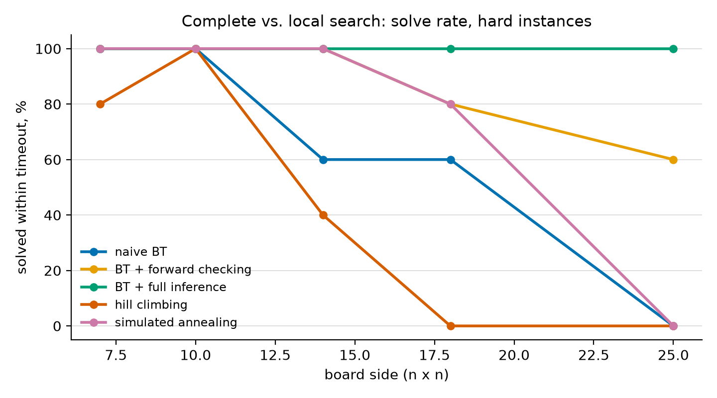
Results — complete vs. local search
What the sweep shows:
SA ≫ HC everywhere: 19/25 vs 11/25 hard instances solved (60 % vs 28 % over the whole sweep) — reproducing Perera et al. (2021) with our own implementation.
HC's signature failure: stuck ONE violation from the goal (one 20 s run: 12,496 restarts, never closed it).
Within a 5 s budget, complete search with inference dominates at every size we tested; local search's appeal here is simplicity, not speed.
Both local solvers are incomplete: they can never prove a board unsolvable.
9
Notes:
~1.5 min. Cross-paradigm comparison. Lead with SA vs HC (the Perera reproduction), then the one-violation-away story - it is the local-optimum concept made concrete. End on the honest framing: on these sizes complete search wins; incompleteness is the structural caveat.

Slide 10
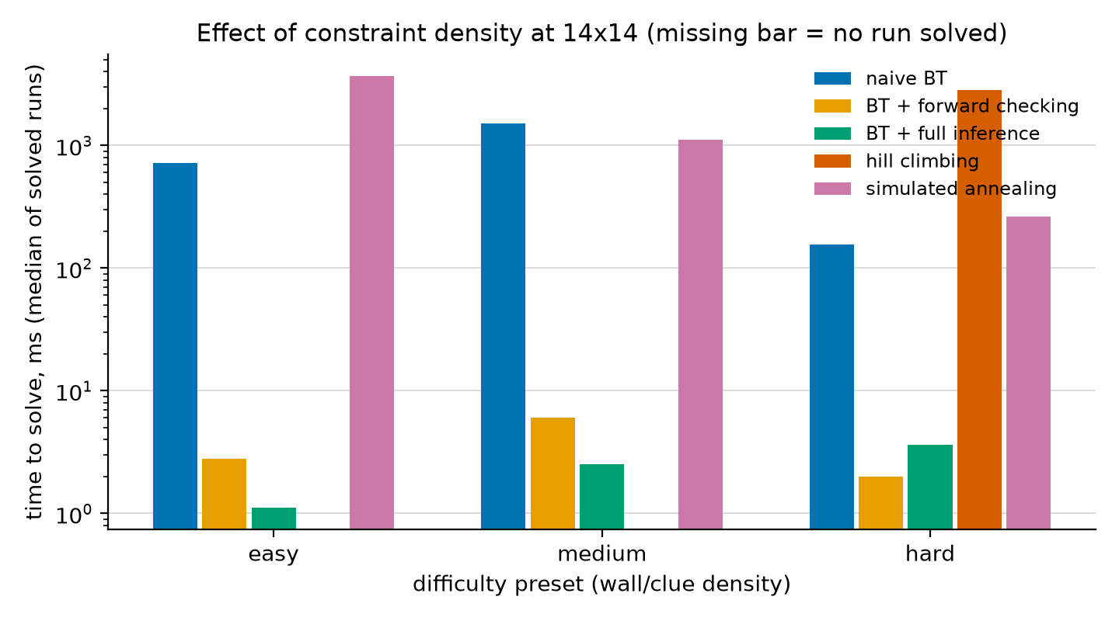
Results — what makes an instance hard?
Two surprises at 14×14:
Our sparse “hard” preset is often FASTER for solvers: fewer clues → more valid solutions → any one is easier to find. Human difficulty ≠ search difficulty.
Hill climbing inverts the pattern: it solved NOTHING at easy/medium density but sometimes cracked hard boards — dense clue terms roughen the landscape with local optima (missing bars = zero solved).
Full inference is the most stable across densities: 1–4 ms medians everywhere.
10
Notes:
~1 min. The beyond-the-obvious slide. The headline: our density presets predict difficulty for HUMANS (deduction chains), not for solvers - sparse boards have many solutions and finding any one is easy. Tie back to the uniqueness discussion. Calibrating difficulty by measured effort is named future work.

Slide 11
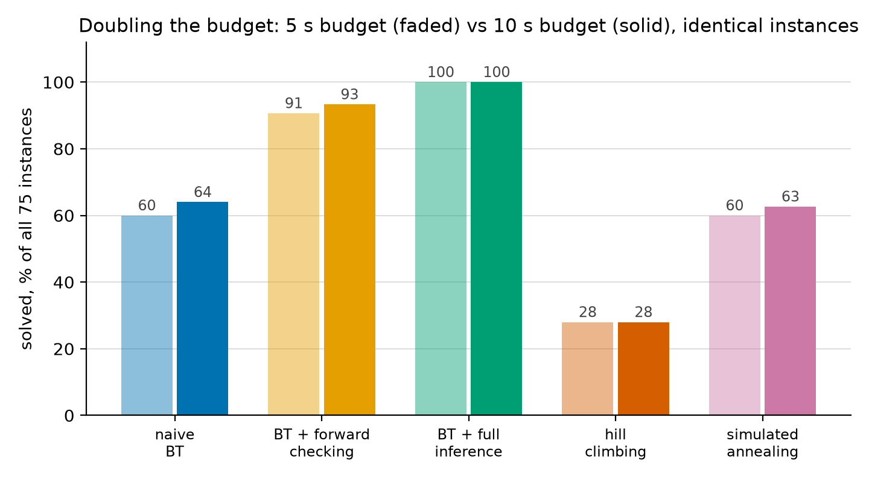
Robustness — is the 5 s budget arbitrary?
Doubling the budget on identical instances changed at most 3 results out of 75 per solver — and hill climbing gained exactly zero. More time helps solvers that are slow, not solvers that are stuck: the ranking is structural, not a timeout artifact.
11
Notes:
ONE sentence, ~20s: 'We re-ran the entire sweep with double the budget - almost nothing changed, and hill climbing gained exactly zero - so the solver ranking is structural, not an artifact of the timeout.' If asked in Q&A: we predicted the outcomes before running (full unchanged, hc zero); the one miss was SA, which we expected to gain more - exponential problems shrug at factors of two.

Slide 12
Conclusions
Inference is the story: full propagation solved all 75 generated instances — the only 100 % solver — and cracked the published 7×7 with zero search nodes.
Fewer nodes ≠ less time: full inference needs ~2× fewer nodes than forward checking, but propagation overhead makes fc slightly faster per board at 25×25.
Simulated annealing solved 60 % of all instances vs. 28 % for hill climbing (76 % vs 44 % on hard) — reproducing Perera et al.; HC's signature failure is stalling one violation from the goal.
Sparser boards were often EASIER for solvers (more solutions to find) — density presets model human difficulty, not search difficulty.
Future work: uniqueness-filtered generation, AC-3 / MAC on the binary constraints, difficulty calibration from measured search effort.
Thank you — questions welcome.
12
Notes:
~45s. Every claim here is a measured number from experiments/results/results.csv (overall: SA 45/75 = 60%, HC 21/75 = 28%; hard-only: 19/25 vs 11/25). All four members should have spoken by now (equal input is graded).

Slide 13
References
B. McPhail (2005). Light Up is NP-complete.
B. Pulles (2021). Analysis of Akari. Bachelor thesis, Radboud University.
L. Sun, J. Browning, R. Perera (2021). Shedding Some Light on Light Up with Artificial Intelligence. arXiv:2107.10429.
S. Salcedo-Sanz et al. (2009). A nested two-steps evolutionary algorithm for the light-up puzzle. ICGA Journal 32.
S. Russell, P. Norvig (2021). Artificial Intelligence: A Modern Approach, 4th ed. — Chapters 3, 4, 6.
puzzle-light-up.com — rules and reference instances.
13
Notes:
Not spoken — present for completeness and Q&A.

