Slide 1
Behavior of git checkout

Slide 2
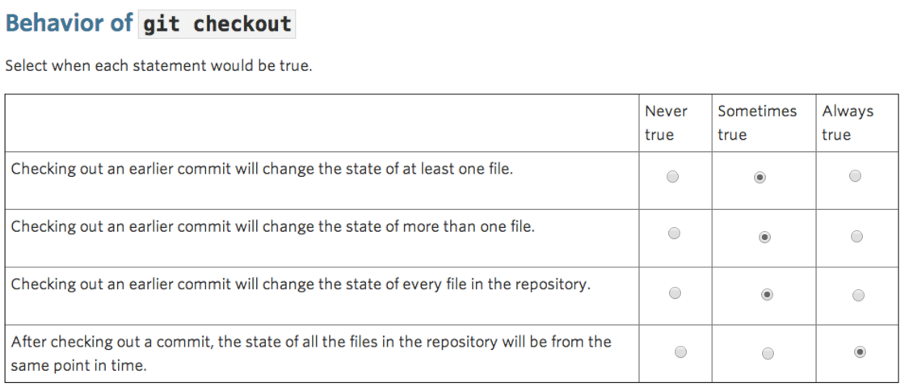
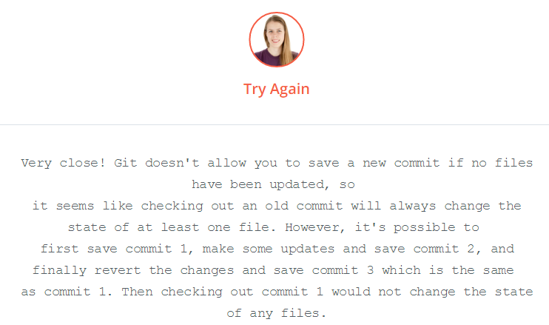

Slide 3
Behavior of git checkout

