Slide 1
Imagine You're Searching for Your Next Home…
You hop onto Zoopla looking for a 2-bedroom flat in Edinburgh.
Hundreds of listings show up — each with varied formats, agents, and pricing styles.
You want to compare prices, spot good deals, and filter by real agent performance.
But there's no central database — just scattered web results and inconsistent info.
How can data be structured to support meaningful insights?
This project (Zoopla ETL Pipeline Project) solves that — by extracting, structuring, and storing property listings for analysis and decision-making.

Slide 2
Zoopla ETL Pipeline Project: Business Challenge
No central, structured database for real-time Zoopla listings
Need to extract detailed property data (price, location, agent info, features)
Data must support querying, analysis, and integration with business platforms

Slide 3
Project Objectives
1. Extract residential property listings via Zoopla API
2. Normalize and transform to a clean tabular structure
3. Enforce schema constraints with foreign key references
4. Load into PostgreSQL with schema-enforced tables and referential integrity
5. Enable consistent querying for residential property analytics

Slide 4

Tools & Technologies
dotenv, requests — API security & request handling
RapidAPI (Zoopla) — Source API
Python, Pandas — Data processing
SQLAlchemy, PostgreSQL — Relational storage and ORM

Slide 5
ETL Process: Extract
Pulled JSON data via HTTP requests using filters (e.g., location, beds)
Parsed paginated results and flattened nested structures (json_normalise)
Stored raw listings in DataFrame for further transformation

Slide 6
ETL Process: Transform
Column cleanup:
Field fixes:
shortpricetitle: removed currency symbols, casted to float
tags & highlights: extracted "label" values from list of dicts
address: parsed into address_line, city, postcode from the back
Handled nested fields:
Converted nested lists (tags, highlights) to flat strings
Renamed columns to snake_case for consistency

Slide 7
ETL Process: Normalize (3NF): Split core table into dimensions and fact tables
Created dimension tables:
dim_agent — branch ID, phone, developer flag
dim_location — lat/lon, city, postcode
dim_attribute — listing features + tags and highlights
dim_pricing — short price, full price, qualifier
Created fact table:
fact_sales: holds metrics, foreign keys + listingid
Each table uniquely indexed and de-duplicated

Slide 8
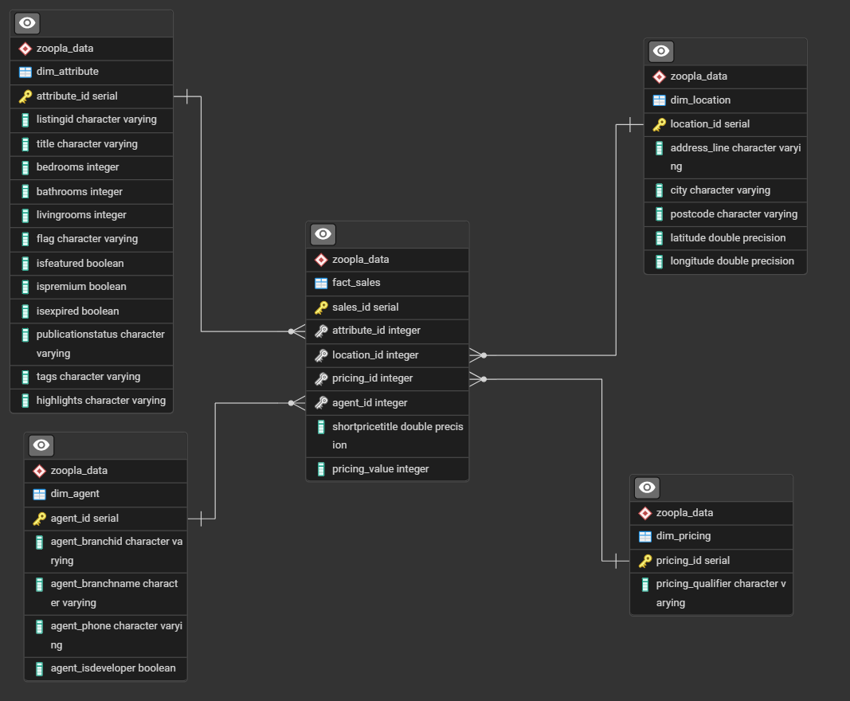
DB Star Schema, Load & Constraints
Used SQLAlchemy ORM (Object-Relational Mapping) to define models
Established primary and foreign keys for referential integrity
Defined & Created schema: zoopla_data
Used Base.metadata.create_all() to create tables with FK constraints
Inserted records using to_sql(append=True) to preserve constraints

Slide 9
Best Practices
Handled duplicates with .drop_duplicates()
Handled missing/null values with safe defaults
Avoided hardcoding credentials via .env file
Included schema validation and FK enforcement
Ensured referential integrity with primary/foreign keys
Disposed SQLAlchemy engine/session after use

Slide 10
Future Enhancements
Incorporate additional cities and filters
Add property image URLs and agent logos
Integrate Power BI or Streamlit for real-time dashboards
Automate periodic refresh with Airflow jobs
Enable Zoopla data-driven decision-making for agents, buyers, investors

Slide 11
Thank You
Any Questions?
Feel free to ask about the ETL pipeline, implementation, or business outcomes.

