Slide 1
Data Engineering for Real-Time Stock Market Analysis
Automated Data Engineering for Real-Time Stock Market Insights using Dockerized Pipelines, PostgreSQL, Kafka, and PySpark
A comprehensive solution designed to revolutionize how investment firms analyze financial markets by centralizing real-time stock data, automating ingestion workflows, and providing instant analytical insights for faster decision-making and optimized trading performance.
Presenter: Fisuyi Busayo A
MarketPulse Analytics – Powered by AMDARI

Slide 2
Company Overview: MarketPulse Analytics
Company Profile
MarketPulse Analytics, based in New York City, specializes in real-time stock market analytics, financial forecasting, and trading strategy optimization.
Founded in 2016, the firm delivers analytics solutions for hedge funds, investment managers, and private equity firms.
Core Services & Products
Real-Time Data Streaming
Live market feeds for stock prices, volumes, and indices.
Custom Reporting Solutions
Tailored analytics dashboards and KPIs.
Predictive Market Insights
Machine learning-based forecasts and alerts.

Slide 3
Current Business Challenges
MarketPulse Analytics faces rising demands for deeper, faster insights but struggles with latency, scalability, and reliability gaps. Strengthening its data engineering pipeline is essential to sustain real-time performance and meet client expectations in a fast-moving financial environment.
Customer Demand for More Insights
Clients increasingly expect predictive analytics, sentiment tracking, and portfolio optimization capabilities, pushing current systems beyond their processing limits.
System Reliability
As data pipelines expand, failure risks rise. Insufficient monitoring makes anomaly detection and issue resolution difficult..
Scalability
Growing data volumes strain infrastructure, leading to delays in real-time reporting—especially during peak market periods.
Data Latency
Integrating multiple data sources introduces lag, impacting the accuracy and timeliness of insights

Slide 4
Rationale for the Project
This project establishes a scalable, real-time analytics framework that enhances decision-making, minimizes risk, and delivers actionable insights. By combining automation, streaming, and visualization, MarketPulse Analytics drives efficiency and long-term business growth.
Trade Execution:
Traders require instant access to accurate market data to perform high-frequency trades effectively.
Risk Management:
Financial institutions need real-time monitoring and rapid position adjustments to minimize exposure and protect assets.
Market Sentiment Analysis:
Continuous tracking of news and social media sentiment provides early indicators of stock price movements.
Business Value:
Operational Agility: Real-time data pipelines enable faster reaction to market changes and volatility.
Competitive Advantage: Advanced analytics capabilities strengthen MarketPulse’s market position and client trust.

Slide 5
Project Objectives
Enhance Data Accuracy and Timeliness:
Reduce latency and improve the accuracy of real-time reports by optimizing and automating the data processing workflow.
Develop a Scalable Real-Time Data Pipeline
Implement a robust, fault-tolerant, and scalable pipeline using Kafka to stream stock market data from multiple exchanges, ensuring low latency and high availability.
Build Real-Time Reporting Tools
Create interactive reporting dashboards using Power BI to visualize market trends, stock performance, and other financial metrics in real time.
Improve System Monitoring
Integrate monitoring and alerting tools to maintain smooth pipeline operations with real-time issue detection and diagnostics.
Expected Outcome:
Faster, more accurate real-time reporting that enhances decision-making for traders and analysts.
Improved operational reliability with proactive anomaly detection.
A unified, automated analytics framework supporting high-frequency market operations.
Together, these objectives enable MarketPulse Analytics to deliver continuous, reliable, and actionable financial insights — empowering data-driven trading strategies and reinforcing competitive advantage in dynamic markets.

Slide 6
Project Scope
Data Extraction:
We will develop Python-based extractors integrated with the Alpha Vantage API to retrieve live-stock market data from multiple exchanges.
This automated ingestion process will be orchestrated using Kafka producers, ensuring continuous data streaming with minimal delay. Scheduled data pulls will maintain consistency and reliability across trading sessions.
Data Loading:
Processed and validated data will be stored in a centralized PostgreSQL database that acts as the single source of truth for market analytics and reporting.
The schema will be optimized for analytical queries, supporting both daily and historical performance tracking.
Automation:
The entire data pipeline will be orchestrated by Apache Spark and Kafka Streams, managing event flows and transformations in real time.
Docker will containerize all components for consistent deployments, while GitHub Actions will automate testing and versioned builds.
“Expected Outcome: Continuous, fault-tolerant data flow supporting real-time stock market analytics and decision-making”.
This comprehensive scope ensures that all aspects of the data lifecycle are covered—from ingestion to transformation and visualization—with automation embedded at every stage to guarantee low latency, scalability, and data integrity.

Slide 7
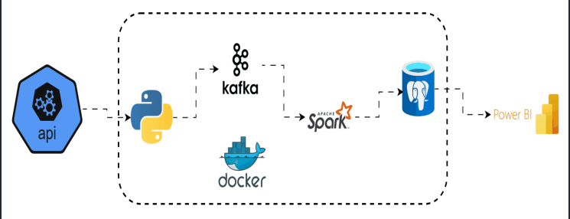
Data Pipeline Architecture
Flow: Alpha Vantage API → Kafka Streams → Spark Processing → PostgreSQL Storage → Power BI Dashboards.
This Ensures minimal latency, fault tolerance, and scalable data handling.

Slide 8

Orchestration & Automation
Apache Kafka
Serves as the backbone of the real-time streaming architecture, managing continuous data ingestion from multiple stock exchanges with high throughput and low latency.
Apache Spark
Executes large-scale, in-memory processing for real-time analytics, transformations, and aggregations on streamed market data.
Docker & Docker Compose
Containerizes all components for reproducible builds and automated CI/CD pipelines, ensuring reliability across development and production environments.
GitHub
For version control
Data Processing & Storage
Python & PySpark
Handles API integrations, data parsing, and transformation logic using libraries such as requests, spark, and psycopg2.
PostgreSQL
Acts as the central analytical repository for structured stock and historical data, enabling complex queries and time-series analysis for trading insights.
Visualization
Power BI
Provides dynamic dashboards and KPI visualizations that deliver real-time market insights into market trends, stock performance, and portfolio metrics., and decision support for traders and analysts.
Technology Stack

Slide 9
Project Deliverables
Dockerized Containers (Pipeline Components - Docker compose.yml, .env)
Automated testing, container builds, and deployment pipelines that maintain consistency across development and production environments.
Kafka Producers & Topic Contracts (producer.py)
Python-based producers and Kafka topic configurations (partitions, retention policies, schema contracts) ensuring consistent, high-throughput real-time data ingestion.
Spark Structured Streaming Jobs (consumer.py)
PySpark job monitoring (UI) workflows for real-time data transformation and aggregation, loading, featuring checkpointing, fault recovery, and anomaly detection.
PostgreSQL Schema & ETL Loaders (dbinit.sql, servers.json, Schema Diagram)
Optimized database schema definitions and server scripts for structured data storage, time-series indexing, and efficient query performance.
GitHub Repository and Architecture Diagram & Runbooks
Comprehensive visual documentation of the entire data pipeline architecture, with operational playbooks
Real-Time Dashboards (stockmarket Dashboard.pbix)
Interactive, live dashboards delivering insights into stock performance, trading volume, volatility, and predictive indicators.

Slide 10
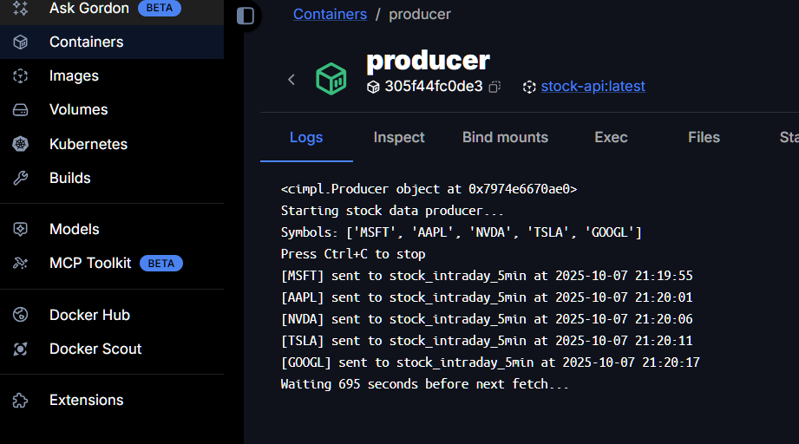
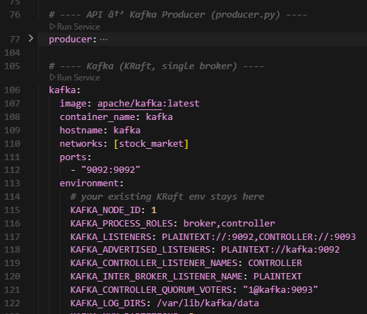
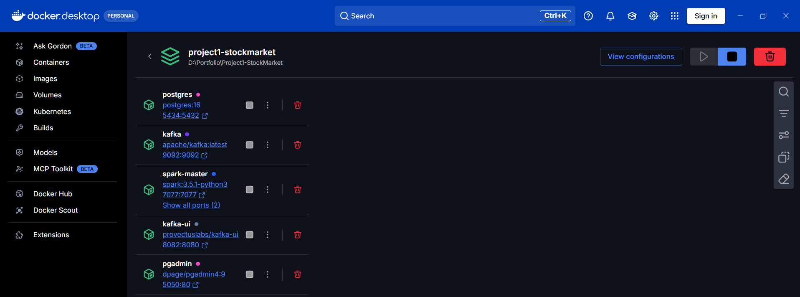
Artifacts – Docker desktop (Containers) (compose.yml)

Slide 11
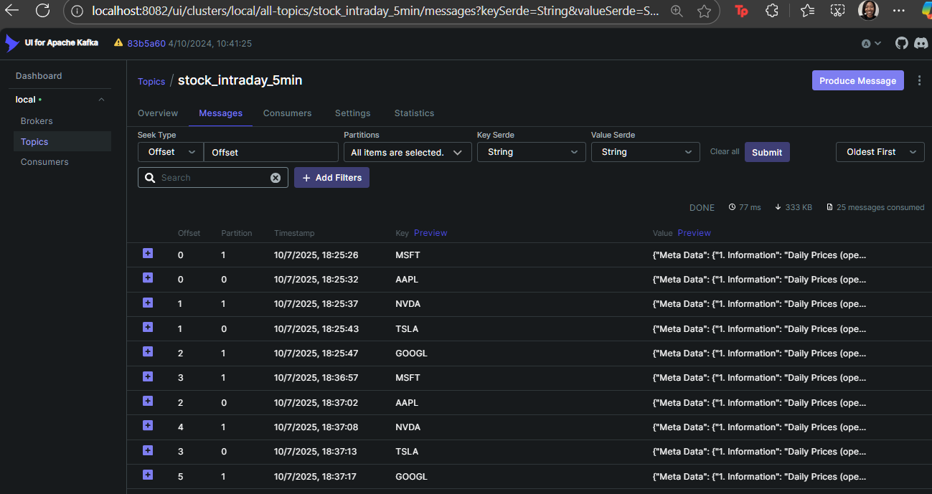
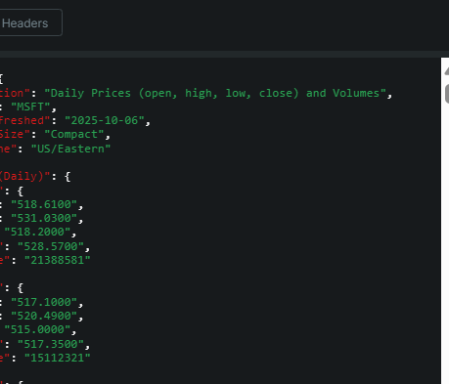
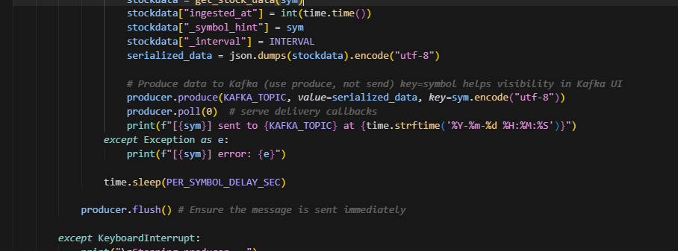
Artifacts – Web-based (Localhost) Kafka (producer.py)

Slide 12
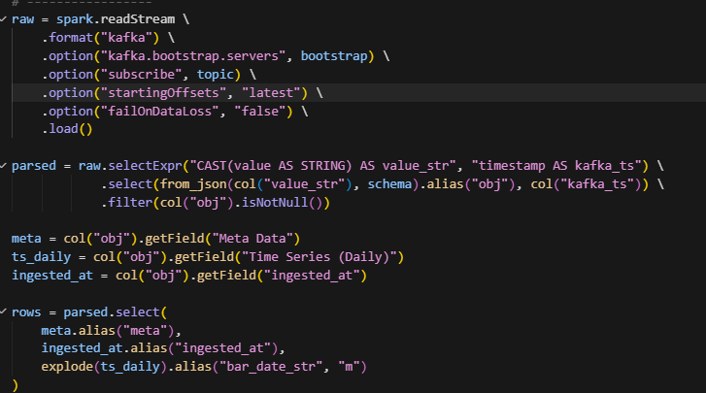
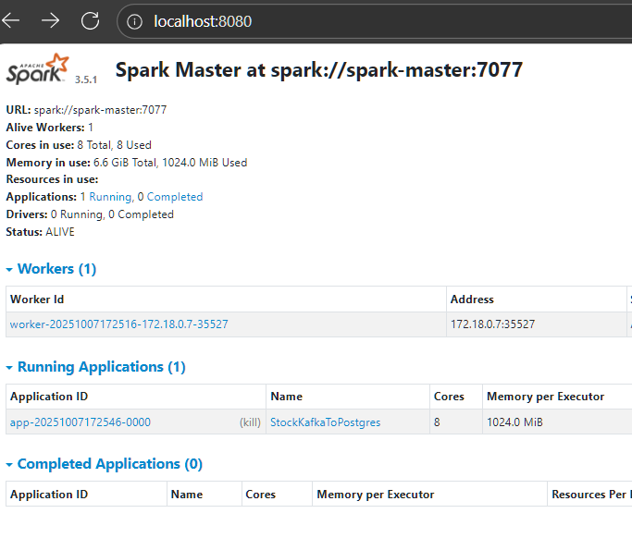
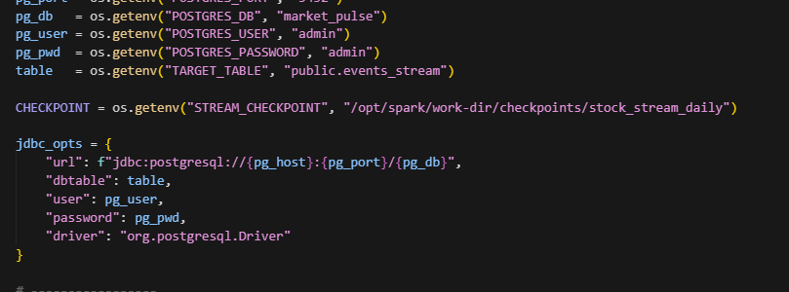
Artifacts – Web-based (Localhost) Spark (consumer.py)

Slide 13
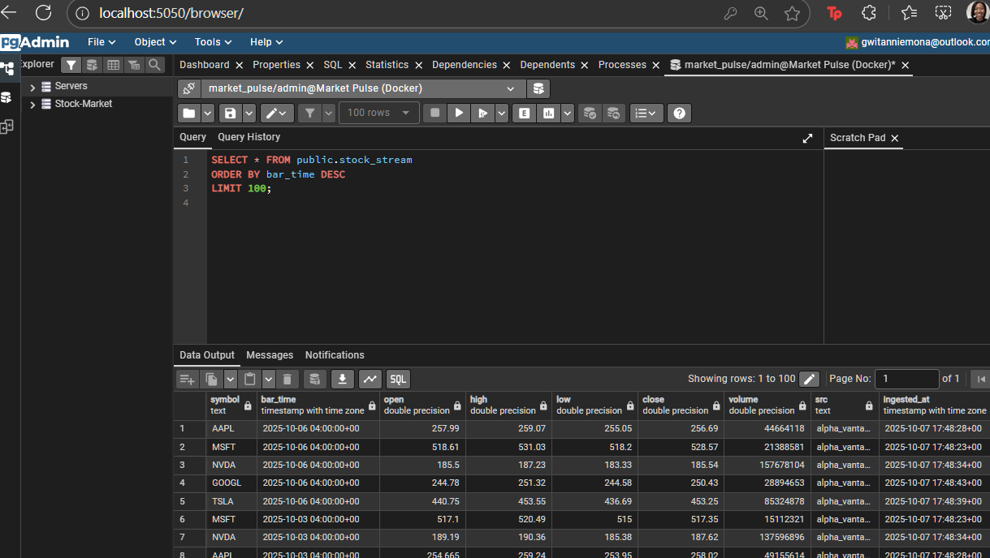
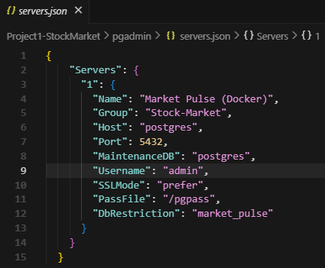
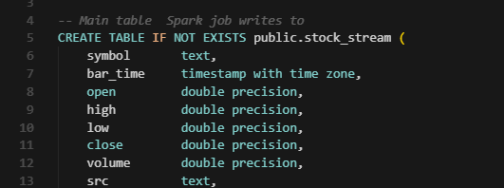
Artifacts – Web-based (Localhost) PostgreSQL (pgAdmin)

Slide 14
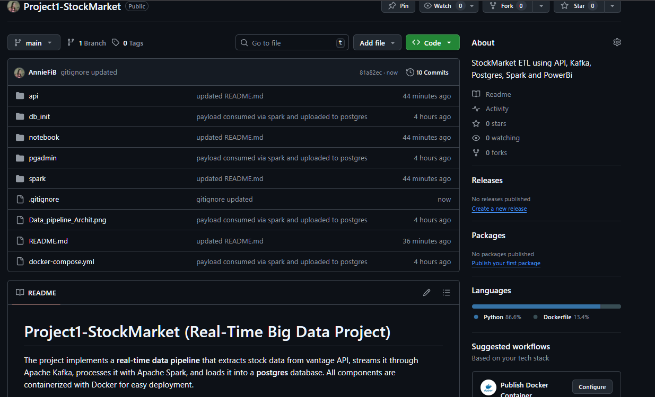
Artifacts – GitHub

Slide 15
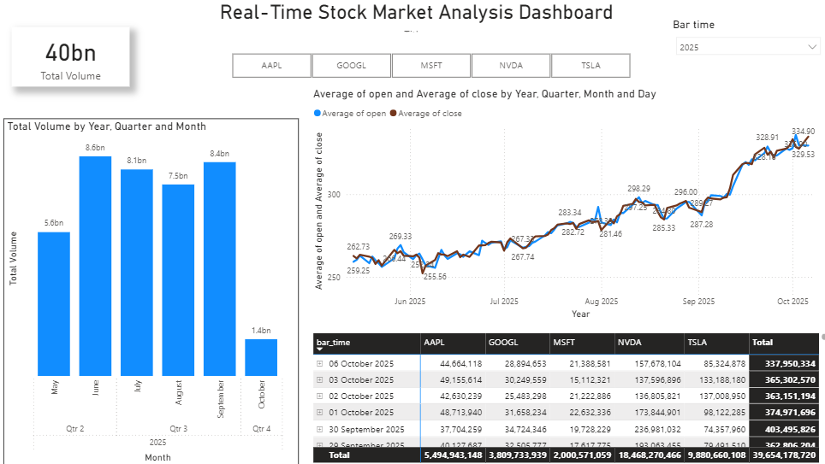
Artifacts – Power Bi Dashboard (stockmarket dashboard.pbix)

Slide 16


