Slide 1



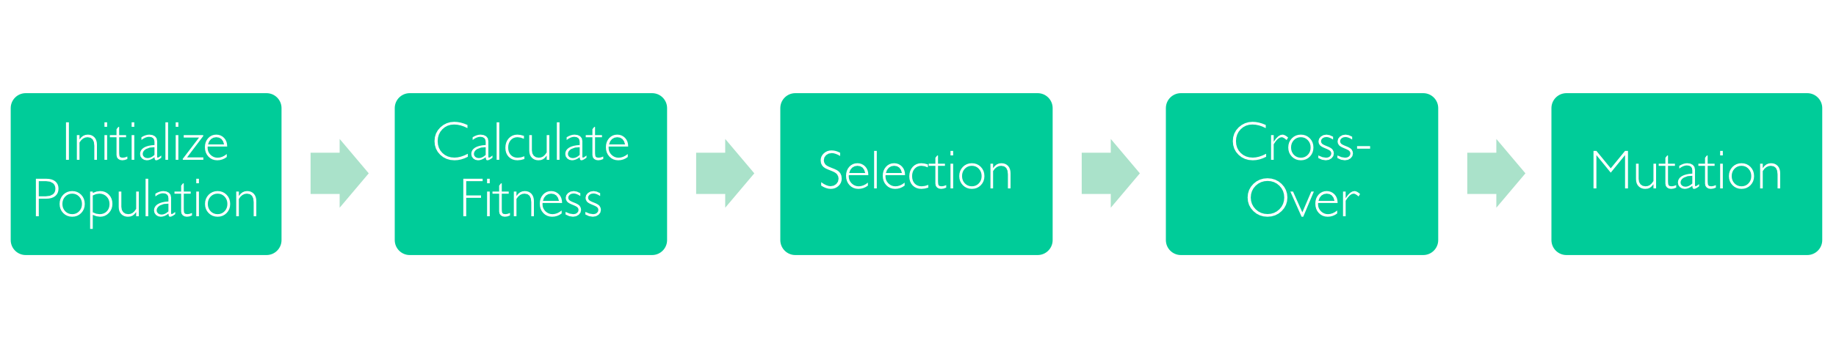

Programming Java for Longer Battery Life
Anna Frances Rasburn
Genetic Improvement(GI)
GI is the use of optimization and machine learning, based on Search Based Software Engineering techniques to improve existing software.

Slide 2

Your poster title goes here
Your name goes here

