Slide 1

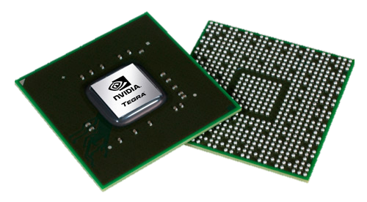


Programming Java for Longer Battery Life
Anna Frances Rasburn BSc in Computing Science
As the dependence on mobile phones and technology increases, we need to consider the environmental impact of this new reliance. Users now have a computer in their pocket and wish for their mobile phones to last longer, making them more convenient. A significant drain on the battery are applications that have a higher demand on the device’s CPU. Therefore this project’s aim is to research and investigate the different ways we can program Java applications (particularly regarding Android mobile applications) to reduce CPU power and therefore use less battery life.
Initialize Population
Calculate Fitness
Selection
Cross-Over
Mutation
Genetic Algorithms (GA)
GAs are algorithms based on the biological notion of evolution. Genetic algorithms act based on the idea of natural selection (survival of the fittest) and inheritance, where the fittest traits of the parent is passed on to the children. Fitness here is what traits of the application’s source code uses less energy consumption. The Steps for GA are shown above.
Genetic Improvement (GI)
GI is the use of optimisation and machine learning, using techniques such as Genetic Algorithms to improve existing software. It makes edits (small changes) to the programs source code for optimization purposes.
Optimisation
‘The action of making the best or more effective use of a situation or resource’
Optimisation includes changing the design of the code to obtain different results. These changes can create an infinite number of different solutions to explore. It modifies a system to work more efficiently such as a reduced energy consumption and faster execution time.
Measuring Energy
The Opacitor tool measures the energy used by applications according to the bytecode, this is measured in Joules. It can detect small changes in execution down to the opcode level.
In this project, the use of the Opacitor tool will allow for approximations of energy consumption of running java code.
stir.ac.uk
For further information contact: Anna Frances Rasburn
afr@cs.stir.ac.uk

