Slide 1


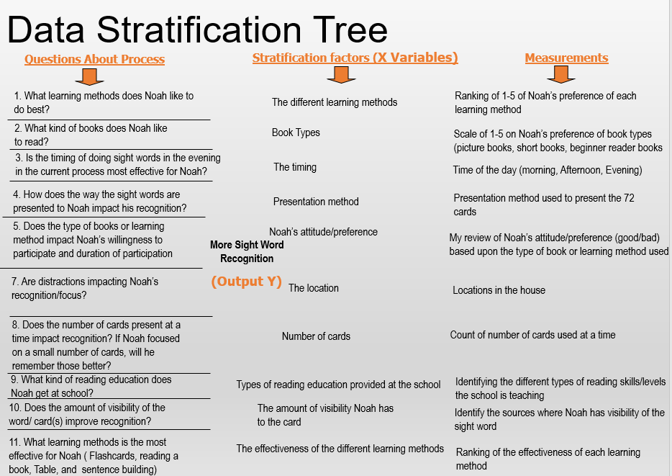
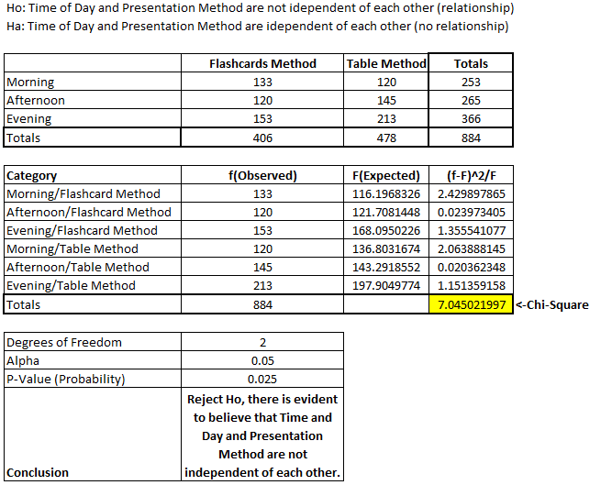
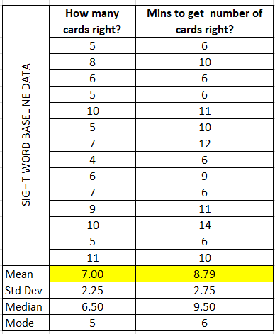
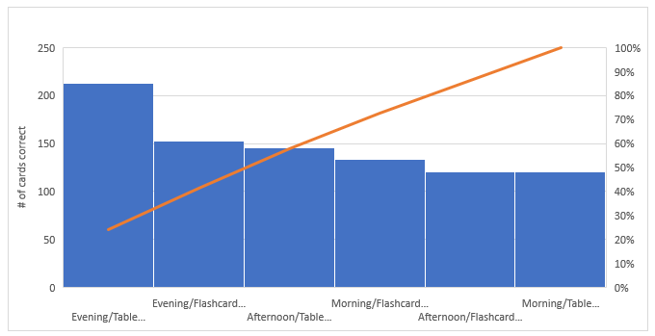
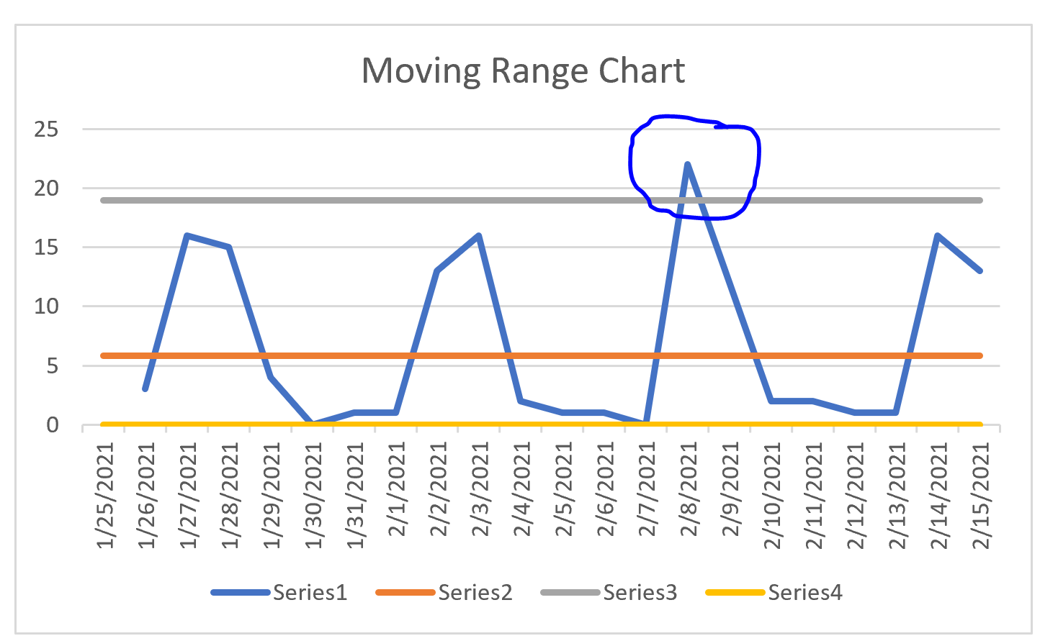
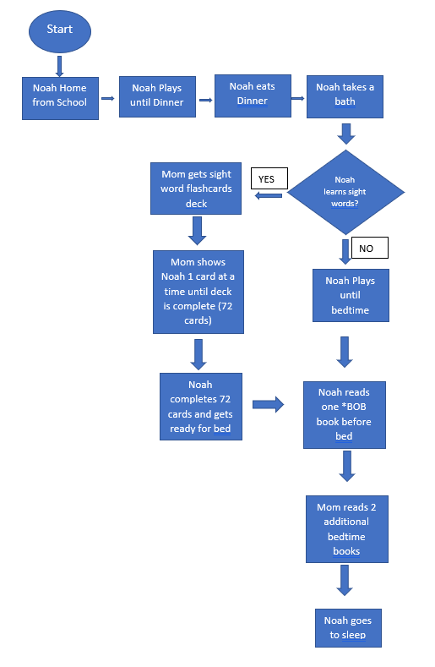
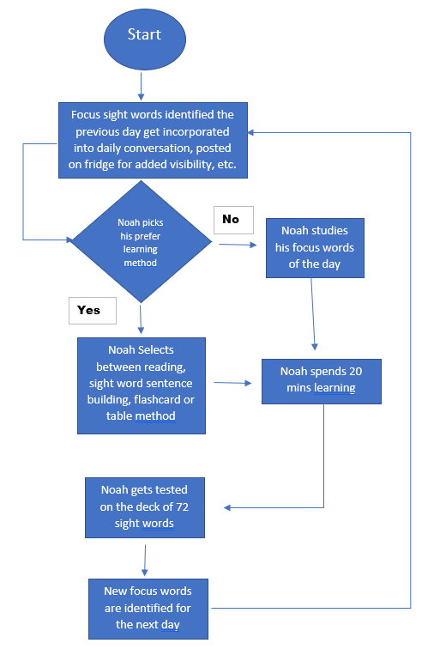
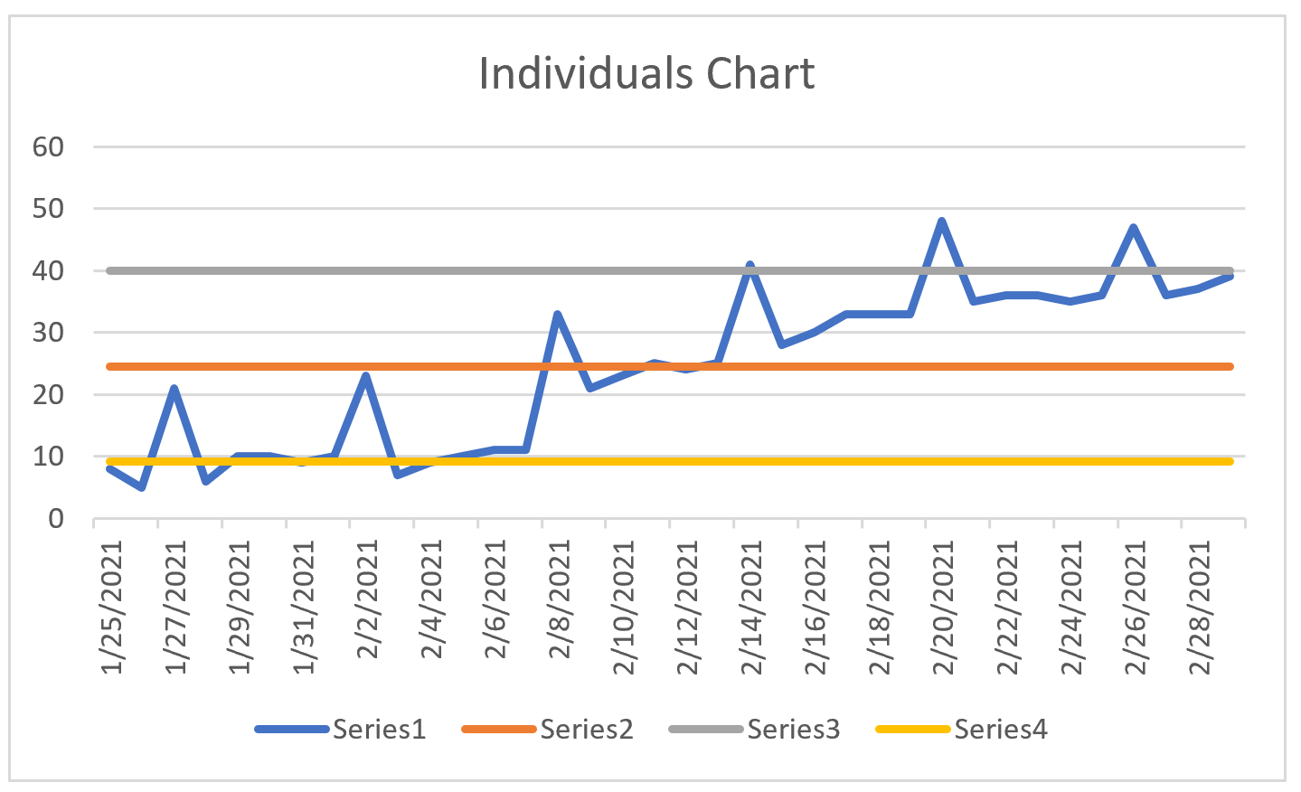

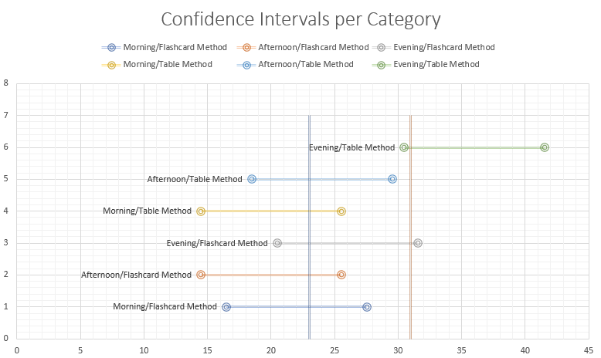
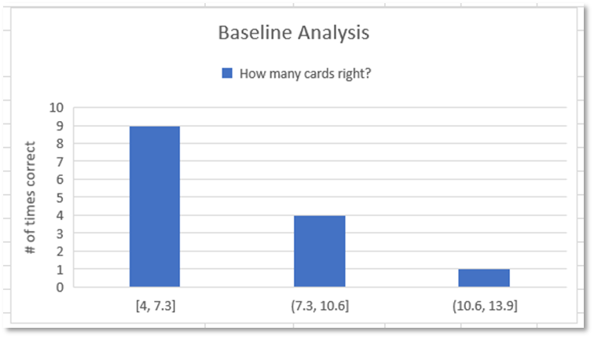
Process Improvement Project – Increase Sight Word Recognition
Process Owner: Annie Titus
Key Dates --->
Project Launch
1/21/2021
Define
1/25/2021
Measure
2/1/2021
Analyze
2/15/2021
Improve
3/15/2021
Control
On-Going
DEFINE
MEASURE
ANALYZE
IMPROVE
CONTROL
Identified Critical inputs and Outputs to Measure
Original Process Flow was altered to incorporate the following changes:
Additional Learning methods added
More freedom of choice for Noah to enhance his willingness to learn
Continuous visibility of sight words vs. a specific time of the day
Updated SQL is 2.3
Chi-Square test indicates relationship between Time of Day and Presentation Method.
Reject Ho
Most children began learning sight word recognition at the age of 4, and on average should know as least 10-12 words by age 5. My son, Noah will be 5 in Feb 2021, and know 8 sights words from a deck of 72-word flashcards. Due to lack of sight word recognition, Noah has been identified on his kindergarten readiness test as “needing to know more sight words”
Defect/Defects/ delays are inherent in the current process. Current SQL is 0
New Process IMR Chart
The Moving Range Chart: Spike in the out of control reflects the first day implementing the process improvements
The Individual Chart:
Initial Pareto showed progress fell within the first three methods: Evening/Table Method, Evening/Flashcard Method, and Afternoon/Table Method about ~59% of the time however, Confidence Interval shows Evening/Table is greater than everything else, except not able to prove that for Evening/Flashcard.
Measures of Center (descriptive statistics)
Original Process Map
Pareto Chart (above) and Confidence Intervals (below)
Low word count, high occurrence!
High word count, low occurrence!
New
Process Map
BUSINESS CASE: $27,612 increase in annual income due to having an adequate reading comprehension

Slide 2
Problem Statement and Goal
Problem Statement
  My son is starting Kindergarten in August 2021 and needs to learn more sight words. He will be 5 in Feb 2021, and we have started teaching sight words a few months ago. He currently knows about 8 sight words in a deck of 72-word flashcards. Most children began learning sight words at the age of 4. Due to the delay start of learning sight words, Noah has been identified on his Kindergarten readiness test as “needing to know more sight words” to prepare him for future reading capabilities
Goal
  Increase the number of sight word count Noah recognizes. Noah has a flashcard deck of 72 sight words. The goal is for him to recognize at least ½ of the cards, 36 sight words which will be a 39% improvement from his existing 11% sight word recognition
  To identifies ways of learning sight words that Noah enjoys, and will help continue to increase his word count

Slide 3
Original Process Flow
*BOB books are a series of children’s books designed to teach reading skills acquisitions.
Possible Root Causes:
Timing in the evening
Incentive
Learning method

Slide 4
Operational Definitions
Sight words
  Commonly used words that young children are encouraged to memorize by sight, so they can automatically recognize these words in print without having to use any strategies to decode. These words appear most frequently in our reading and writing, words such as “And, If, Of, There, This, etc.” source: weareteachers.com.
Time of Day
  Time of day will be referred to as Morning, Afternoon, or Evening indicating when I produce a full unit of cards to Noah
Presentation Method “testing” method
  I will be comparing two methods of presenting the sight words to Noah when assessing him. One is the flashcard method where I will present one card at a time to Noah and the second method is the table method, where I will lay out a unit of cards (72 cards) and allow Noah to see all cards and chose the ones he recognizes
Locations in the House
  There will be two locations I will be comparing. One is the Dining room, more central to the house and distractions are more easily seen or the second option is my study, where it is quieter with a close door
Noah’s Attitude
  This will be based from my observations of Noah and will be discrete data of Good or Bad. Observations include his body language (positive or negative), his verbal ( complaining or not complaining), and his facial expressions (sad, crying, happy, excited, etc.)
# of Cards presented at a time
  In addition to the learning methods, where I will present either 1 card at a time or 72 cards at a time, I will also test for my improved phase, Noah focuses on a small number of cards throughout the day, if that will improve recognition
Sources that increases sight word visibility
  Sources where I can increase Noah’s sight word visibility includes posting it on the fridge, taping it to his bathroom mirror, reading books and pointing out the sight words, etc.
Learning Method
  To teach Noah the sight words, I will be utilizing several methods, which includes reading books, using sight words to build sentences. I can also teach Noah using the flashcard and table method.

Slide 5
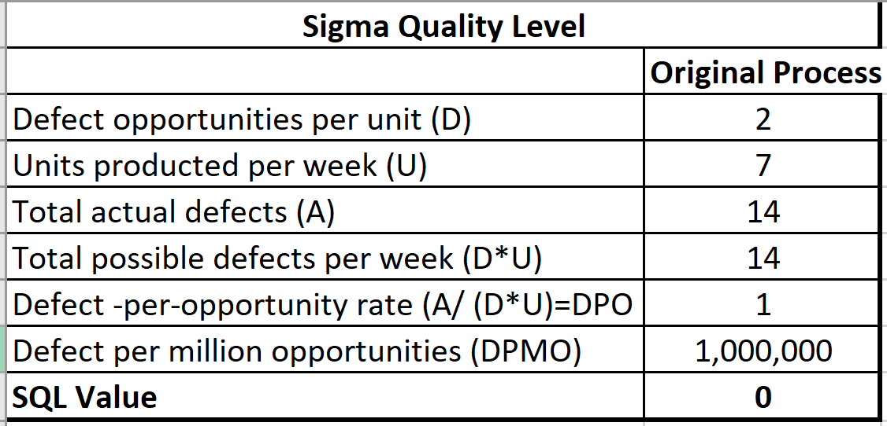
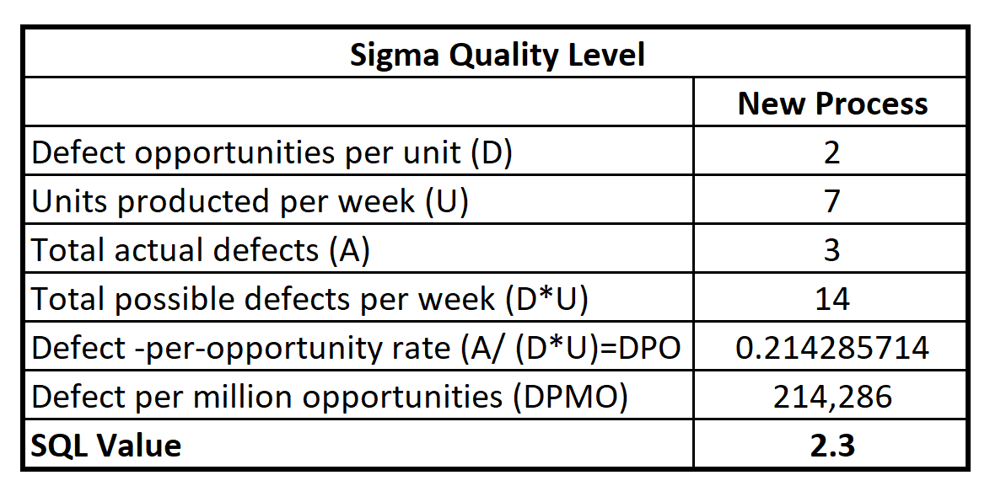
Original Process (Continuous Data):
Sigma Quality Level (SQL)
Possible Defects
  Taking greater than five minutes to recognize 36 sight word flashcards
  Not recognizing 36 sight words out of 1 unit of flashcards (72 words)
Data Needed: Time (Continuous) and Number of cards correct ( Discrete)
Sights words are meant to be recognized automatically. To be proficient, Noah should be taking about 8 second/per card to recognize 36 words and improving that time as he recognizes more words. If he takes longer than 8 second per words, he will not be able to recognize 36 words within five minutes
Noah needs to recognize ½ of the unit of cards, to achieve recognizing 36 sight words. Avoiding the two defects would be a measure of success.
The Original Process, with an SQL =0 The New Process, updated SQL = 2.3

Slide 6
Data Stratification Tree
Questions About Process
Stratification factors (X Variables)
Measurements
1. What learning methods does Noah like to do best?
The different learning methods
Ranking of 1-5 of Noah’s preference of each learning method
2. What kind of books does Noah like to read?
Book Types
Scale of 1-5 on Noah’s preference of book types (picture books, short books, beginner reader books
3. Is the timing of doing sight words in the evening in the current process most effective for Noah?
The timing
Time of the day (morning, Afternoon, Evening)
4. How does the way the sight words are presented to Noah impact his recognition?
Presentation “testing” method
What presentation “testing” method used to assess Noah
5. Does the type of books or learning method impact Noah’s willingness to participate and duration of participation
Noah’s attitude/preference
More Sight Word Recognition
My review of Noah’s attitude/preference (good/bad) based upon the type of book or learning method used
7. Are distractions impacting Noah’s recognition/focus?
(Output Y)
The location
Locations in the house
8. Does the number of cards present at a time impact recognition? If Noah focused on a small number of cards, will he remember those better?
Count of number of cards used at a time
Number of cards
9. What kind of reading education does Noah get at school?
Types of reading education provided at the school
Identifying the different types of reading skills/levels the school is teaching
10. Does the amount of visibility of the word/ card(s) improve recognition?
The amount of visibility Noah has to the card
Identify the sources where Noah has visibility of the sight word
11. What learning methods is the most effective for Noah ( Flashcards, reading a book, Table, and sentence building)
The effectiveness of the different learning methods
Ranking of the effectiveness of each learning method

Slide 7
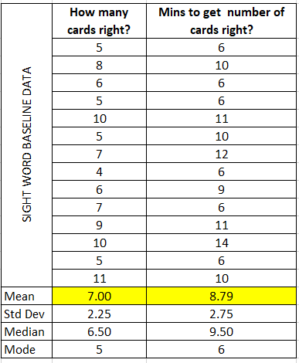
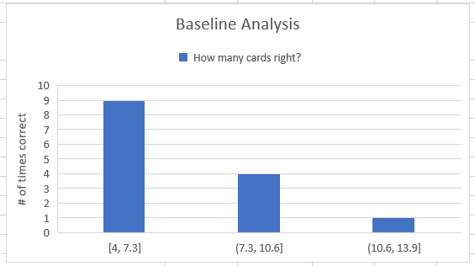
Descriptive Statistics
Left chart shows on average(mean), Noah gets 7 words correct, at about ~9 minutes. His mode is 5 cards, and the standard deviation is about 2 card difference each time.
Histogram reflects Noah gets between 4 to 7 words the most, 9 times. Noah has only gotten between 10 to 13 words correct once.
Conclusion: This is way below the target goal of 36 cards within 5 minutes and supports the original SQL.
The initial data reflects the original flow chart

Slide 8
Data Collection Method
Data Collection Method:
I will widen Noah’s learning methods by tracking and ranking Noah’s preference of which learning method he prefers and the effectiveness of the learning method
  To reduce measurement error, I will keep the learning methods consistent throughout the project: reading, sentence building, flashcard method, and table method. To prevent complete subjectivity of Noah’s preference, I will also use number of cards correct as a measure of success for the learning methods
I want to track Noah’s book preference when he does that learning method, to do so I will categorize his books into a few genres and rank his preference from 1-5
  To reduce measurement error, and complete subjectivity of Noah’s preference, I will gauge how many words Noah got from the books as part of the book preference
I want to identify If I increase the visibility of the sight word, will it improve recognition? I will need to know the sources where I’m increasing visibility at
  To reduce measurement error, I will track the sources and how many (if more then 1) each day where I’m increasing the visibility of the sight word
I want to identify if I focus on a small number of cards with Noah during the day, if he will recognize them better when he does his assessment, so I will want to track how many cards he’s focusing on per day
  To reduce measurement error, I will track the number cards I focus on with Noah during the day via spreadsheet and I will keep them the same words in that small group
Since I will be measuring the time of day, and measuring how much time it takes Noah to recognize 36 words within 5 minutes, I will need to be able to track the time of day, count the words he gotten right to keep track and record the time
  To reduce measurement error, I will recruit a helper (my husband) as a second set of eyes on keeping track of the count of sight words and the time on the timer
I will track the two type of presentation method to Noah, and time of day to see if there’s higher level of success with each category
I will identify two testing locations: one that has distraction and one that does not to see how success he is with testing in different environments

Slide 9
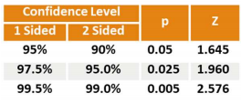

Sample Size
Data calculated for Number of Cards Recognized Correctly
Based on a baseline data of 14 days, I calculated the mean to be 7 with a standard deviation of 2.25
Margin of error of +/- 1 card
Measurement error identified within the Data Collection Method
Summary:
  By taking a sample of 34 days of data, I can be 99% sure that my average number of cards is within +/- 1 card
  To achieve 34 days, I will need to collect one sample(produce one unit of cards) once per day over the next 34 days
N=(2.576*2.25/1)^2= 33.59
Round up to n = 34 Samples

Slide 10
Chi-Square Test

Slide 11
Chi-Square Test Analysis..
Chi-Square Test indicated that there is a relationship between Time of Day and Presentation Method
Pareto chart shows the f(observed) of the Chi-Squared Test which indicates that the biggest progress falls in the first three categories of Evening/Table Method, Evening/Flashcard, and Afternoon/Table Method about ~59% of the time.

Slide 12
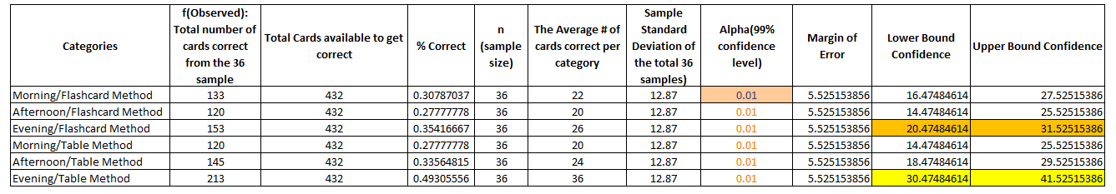
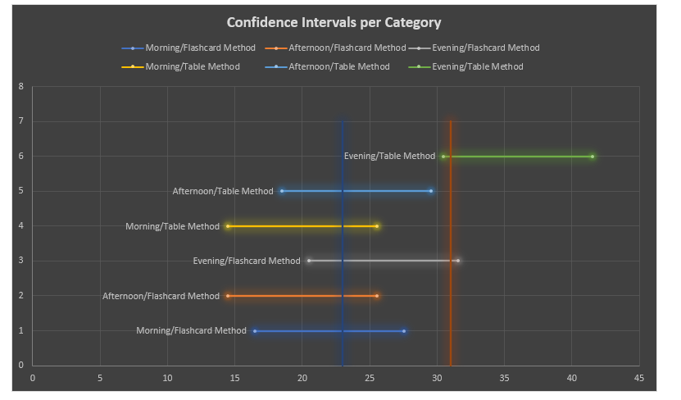
Confidence Intervals Per Category
At alpha =.01, Confidence intervals showed that the Evening/Table category is greater (have the highest confidence of success) than everything else, apart from the Evening/Flashcard which shows overlap in the confidence levels.
I understand .01 alpha was very aggressive and if I used a .05 alpha, I could have proven that the Evening/Table category was above all else, however, I felt that since I was building the foundation for my son’s reading comprehension, I wanted a higher alpha for a higher level of success.

Slide 13
Chi Square test and Confidence Interna cont..
Performing the Chi Square test and the confidence interval confirmed that evening/table method was the most effective method.
From here, I’m going to continue to use that as the presentation/testing method but will now explore other areas of root cause: ie. Sight word visibility, lack of different materials, etc..

Slide 14
New Process Flow Chart
The following items were change in the new process to improve the SQL
  Additional learning methods added
  More freedom of choice for Noah to enhance willingness to learn
  Continuous learning throughout(focus words) the day vs. just a specific time of the day
New SQL improved to 2.3!

Slide 15
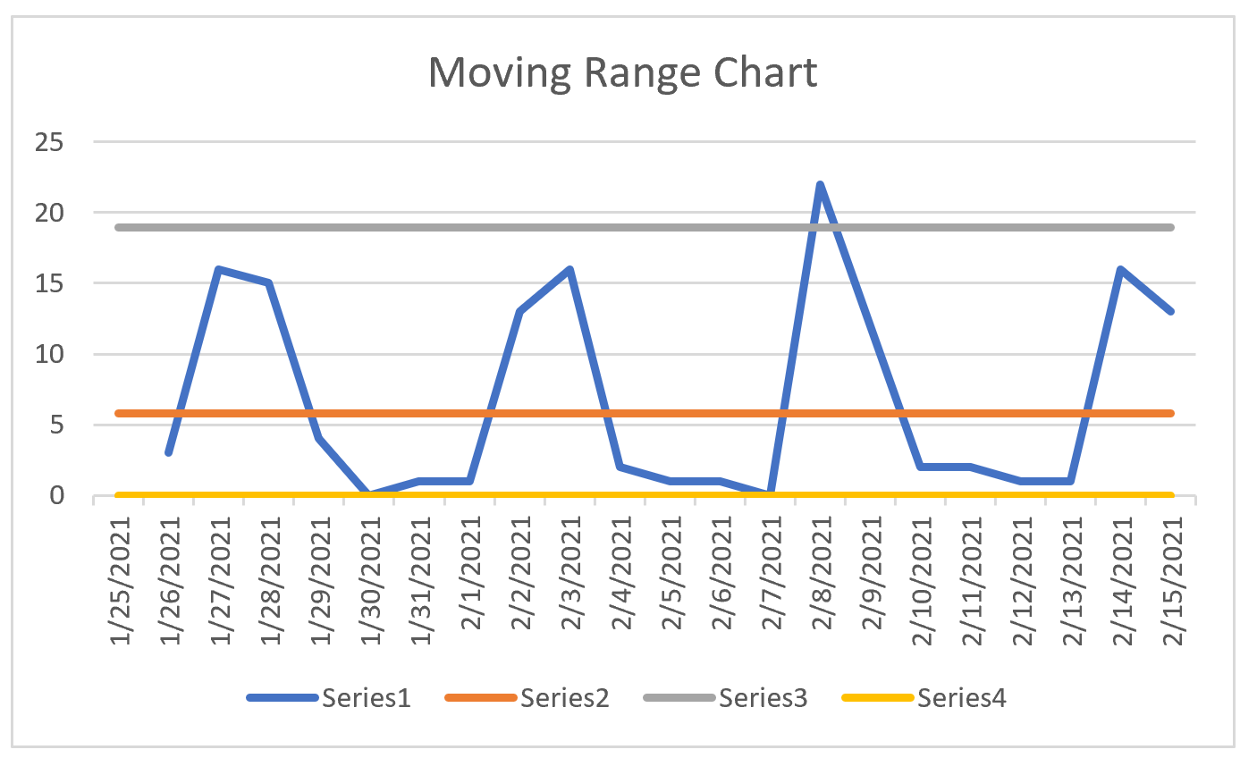
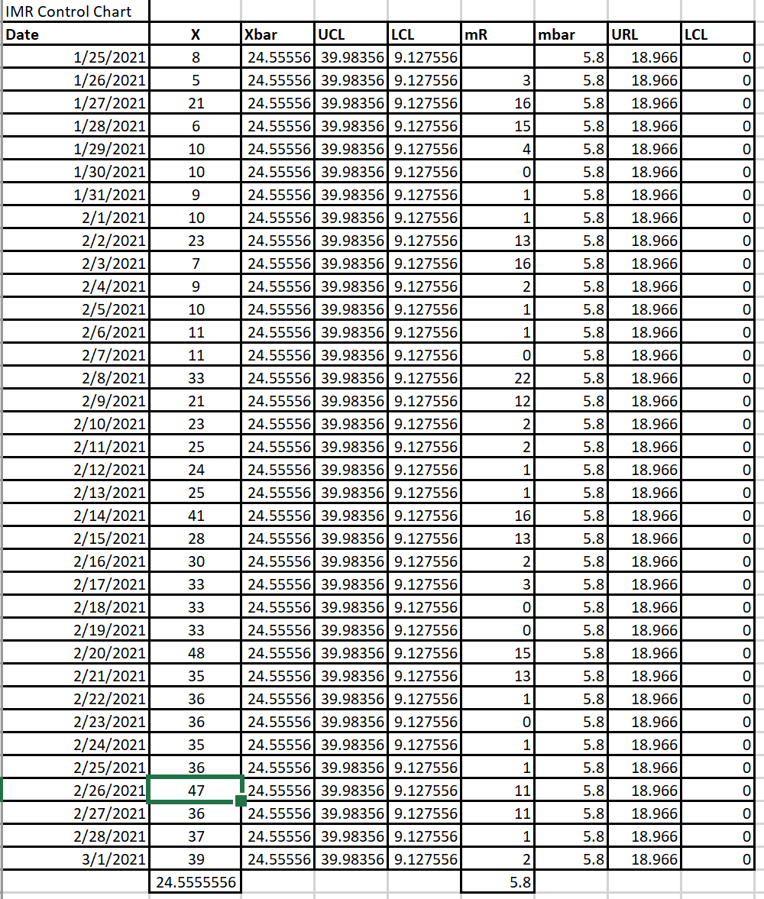

ImR Control Chart
Individual Moving Range chart reflects one data point out of control. After further analysis, 2/8 was the first day of the new process flow, incorporating the new improvements
I believe the up and down of the Moving Range reflects the changing in learning methods, Noah favored sentence building and reading, and on the days with the spikes were the days typically associated with sentence building, and/or reading prior to testing

Slide 16
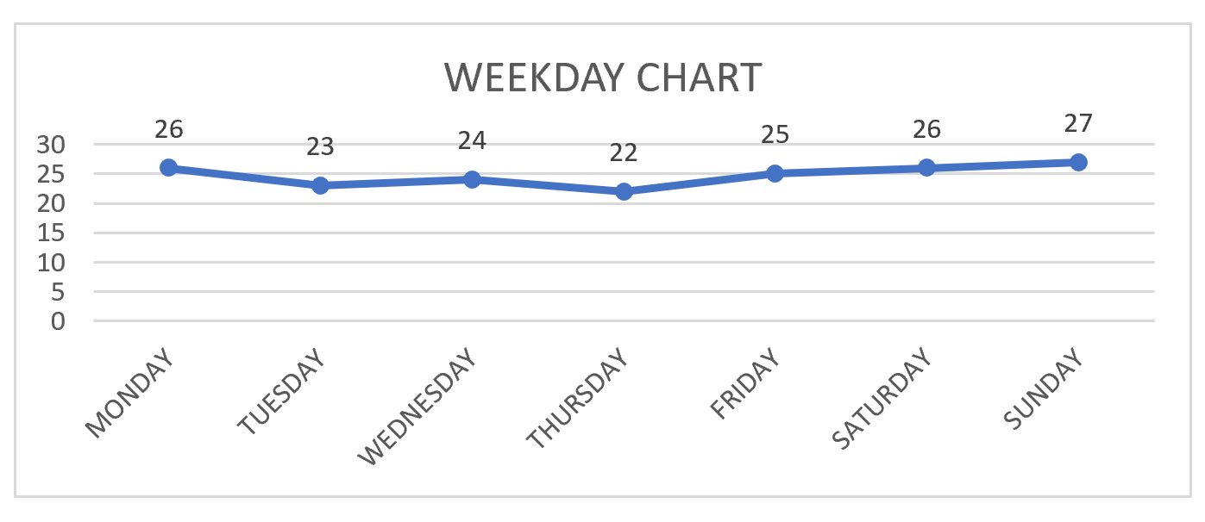
Control Chart Explained Cont..
Using the Weekday function in Excel, it was also cleared to see that some of the up and down reflected in the control charts reflects the days of the week.
Noah seems to do better during the weekend, then the weekdays with his highest average number of sight word cards correct on Sunday. One insight on this is that he has less learning, less activities to do over the weekend so he’s more relax when he’s doing the sight words.
More investigation will need to done on this.

Slide 17
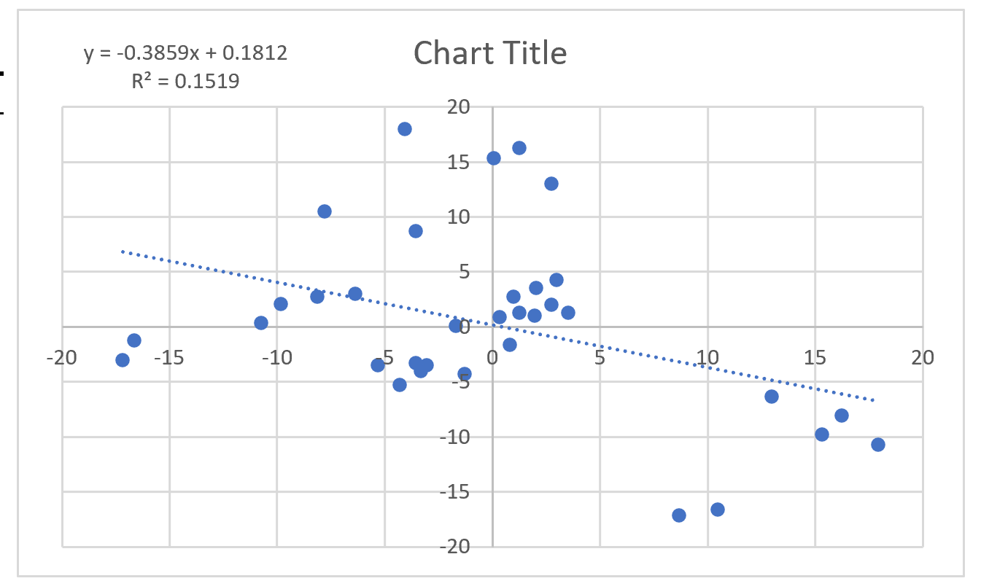
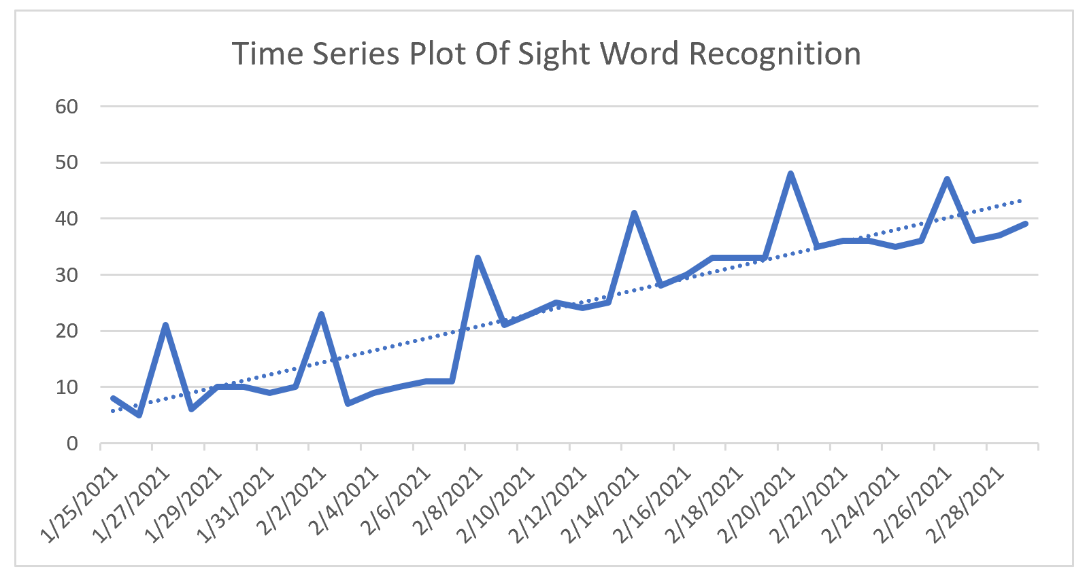
Autocorrelation
I Performed Autocorrelation and the graph indicates that there is no autocorrelation, R2 =.1519 is small, which reflects that the points are random and no strong indicator of a trend.
Due to no indicator of autocorrelation for now, a regression formula can be used predict how well Noah will do in the future.

Slide 18
Conclusion
The new process has a Sigma Quality Level of 2.3
  The original process had a Sigma Quality Level of 0
Root causes found in the original process:
  Not enough freedom of choice and choices for Noah to select – in the original process it was just using the flashcards as a way of learning
    New process included: reading, sentence building, table, and flashcard method
  Original Process only tested sight words in the evening
    New process was throughout the day, and test at Noah’s readiness
Since I only have a 72 card deck, Noah will eventually plateau in his progress of sight words, the key takeaway is to add visibility and other different but interesting methods of learning, so Noah wants to learn and increase his reading abilities

