Slide 2
Cognitive Services Labs in Action: Project Conversation Learner
Jason Williams Microsoft Research AI
THR3109

Slide 3
Project Conversation Learner
AI-first way of building a task-oriented bot
End-to-end recurrent neural network
Learns directly from multi-turn examples of conversations
Enables designers, business owners, domain experts to contribute/maintain bot
Express business rules and common sense in code
Bot output is structured as templates (text, cards)
Easy to add constraints to limit which actions are available
Call domain-specific APIs
Add code to resolve and manipulate entities
“Code what’s easy to code; learn what’s easy to learn”

Slide 4


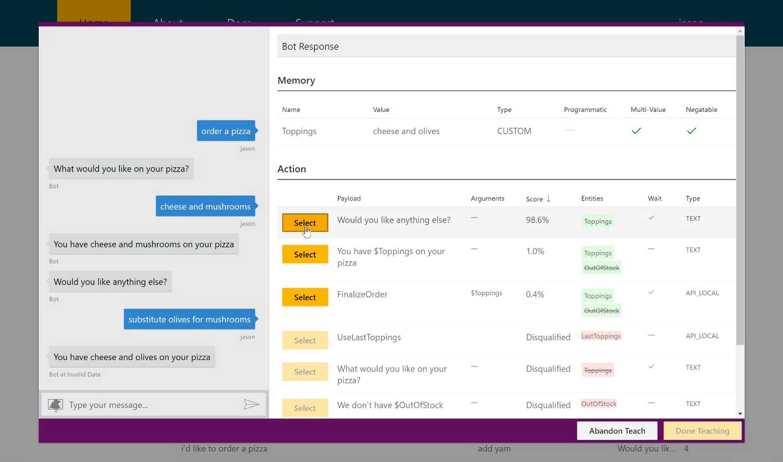




Project Conversation learner workflow
Nothing
Interactive teaching
Developer plays role of user
Bot
Conversation Learner UI
Developer makes corrections
Something
Make corrections to logged dialogs
Bot
Conversation Learner UI
Developer makes corrections
End users
Good

Slide 5
Project Conversation Learner Demo 1: getting started

Slide 6
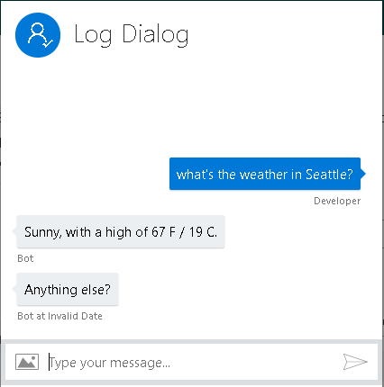
Project Conversation Learner control loop
WeatherBot
Entity extraction
Entity Detection Callback
Neural network
API call
API
Forecast() 0.93
Action type?
Anything else? 0.95
text
Fully-formed action
$city, correct? 0.07
$city, correct? 0.05
Anything else? 0.00
Forecast() 0.00
survey-card 0.00
survey-card 0.00
Learned model
Domain-specific code

Slide 7
Project Conversation Learner Demo 2: deep dive

Slide 8
Summary – Project Conversation Learner
AI-first way of building a task-oriented bot
Express business rules and common sense in code
Built on the Bot Framework
Releasing as a by-invitation Labs Cognitive Service
Request an invitation at the link below
We welcome your feedback
https://labs.cognitive.microsoft.com/en-us/project-conversation-learner

Slide 9
Conversational AI Sessions
Breakout
Schedule | Title | Speaker
Tue May 8 3:00-4:15pm | Bot intelligence, Speech Capabilities, and NLU best practices | Riham Mansour; Ahmed Ashour
Wed May 9 8:30-9:45am | Conversational AI: What's New? | Chris Mullins, Darren Jefford
Wed May 9 2:45-4:00pm | Conversational AI: Best Practices for Building Bots | Elaine Chang, Vishwac Sena Kannan
Theater
Schedule | Title | Speaker
Mon May 7 1:00-1:20pm | Cognitive Services Labs in action – Project Personality Chat | Tulasi Menon
Mon May 7 3:00-3:20pm | Cognitive Services Labs in action – Project Conversation Learner | Jason Williams
Mon May 7 4:00-4:20pm | Conversational AI: Bot Building Tools | Carlos Castro, Justin Wilaby
Mon May 7 5:30-5:50pm | Bot Authentication in Conversational AI | Jeff Derstadt
Mon May 7 8:00-8:20pm | Language Understanding Updates | Youssef Shahin
Tue May 8 11-11:20am | QnA Maker: FAQ to Bot in minutes | Prashant Choudhari

Slide 10
Cognitive Services Labs in Action: Project Conversation Learner
Jason Williams Microsoft Research AI

Slide 11
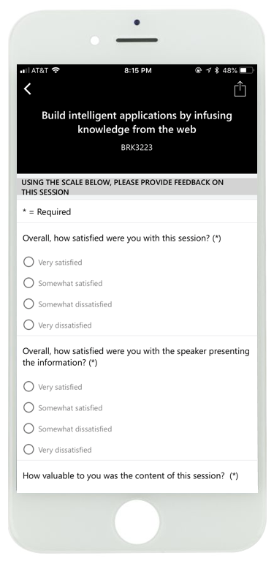
Please evaluate this session
Your feedback is important to us

Slide 13
Challenges for building a task-oriented bot
User experience separated from implementation
Learning from interaction is difficult
Machine learning expertise is expensive

Slide 14
Conversation Learner : AI-first task-oriented bots
Traditional approaches
Project Conversation Learner
<rule>
<if>
city == null
</if>
<then>
Which city?
</then>
…
Which city?
Seattle
Which day?
Today
Neural network
Flowcharts and rules
Doesn’t improve from data
Specialized knowledge required
Can be hard to fix bugs
Recurrent neural network
Learns directly from conversations
Accessible to non-experts
Fix bugs by making corrections

Slide 15
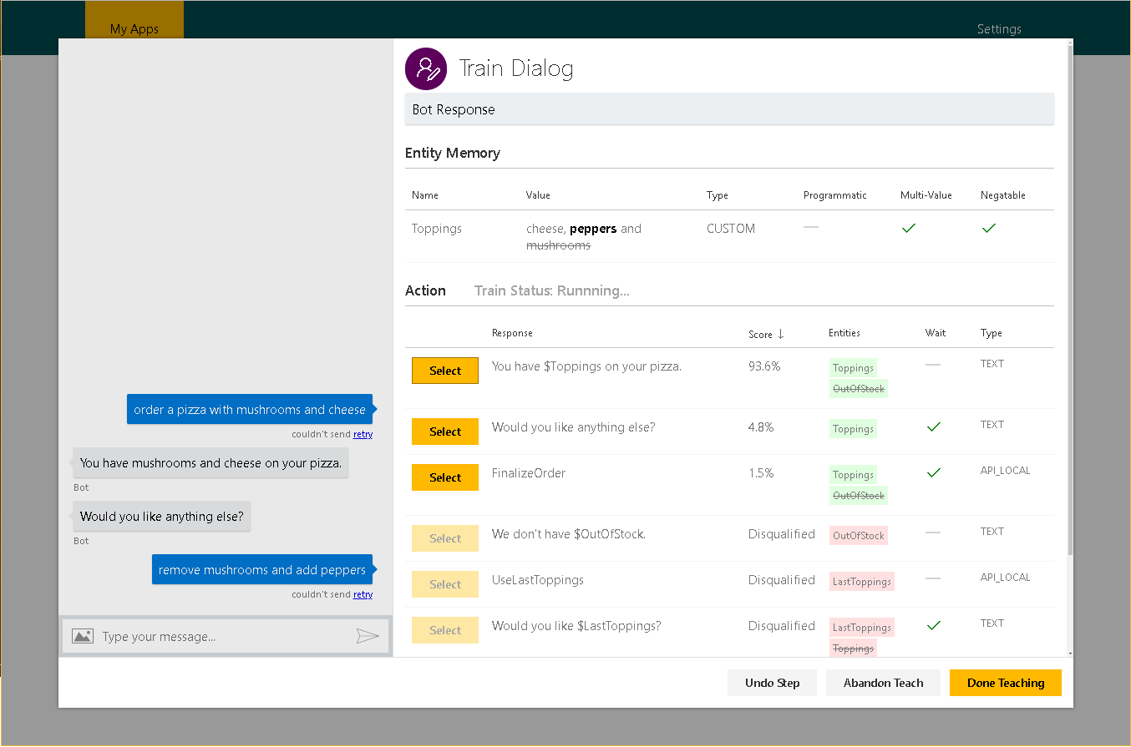
Conversation Learner
Inspect your bot’s internal state
See predicted action and confidence, and make a correction if needed
Learn a stateful model that chooses actions in context of dialog history
Add business rules that filter which actions are available
Create new training examples on-the-fly, or correct a logged dialog.

Slide 16
Text layout (without bullet points)
Main topic: Segoe UI Semilight, size 28pt
Segoe UI, size 20pt for second level
Segoe UI, size 16pt for third level

Slide 17
Text layout with bulleted text
Main topic: Segoe UI Semilight, size 28pt
Segoe UI, size 20pt for second level
Segoe UI, size 16pt for third level

Slide 18
Example with longer headline text wrapping to a second line
When the headline text is 2 lines, move this text block down to align to the lower blue guide
If you don’t see guidelines, click on the View menu, and then check the box in front of “Guides”
Use a “soft return” Shift + Enter to wrap text without adding extra line spacing

Slide 19
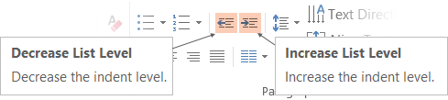
Adjusting list levels
Main topic: Segoe UI Semilight, size 28pt
Segoe UI, size 20pt for second level
Segoe UI, size 16pt for third level
Use the “Decrease List Level” and “Increase List Level” tools on the Home menu to change text levels.
Try this:
Place your cursor in the line of text that says “Segoe UI, size 20pt for second level”
Next click the Home tab, and then on the “Decrease List level” tool. Notice how the line moves up one level.
Now try placing your cursor in one of the top “Main topic…” line of text. Click the “Increase List Level” tool and see how the text is pushed in one level.
Use these 2 tools to adjust your text levels as you work

Slide 20
Bullet points layout with subtitle Set the subtitle to 20pt in the same text block, with character spacing Normal
Move the text block down vertically to align to lower guide
If you don’t see guidelines, click on the View menu, and then check the box in front of “Guides”
Hyperlink style: www.microsoft.com

Slide 21
Square photo with title
Smaller text

Slide 22
Square photo layout with smaller text

Slide 23
Slide palette info
The PowerPoint palette for this template has been built for you and is shown below.
Avoid using too many colors in your presentation.
PowerPoint Theme Accent colors
Accent 1
Accent 2
Accent 3
Accent 4
Accent 5
Accent 6
Use Accent 1 as the main accent color.
Use Accent 2 and Accent 3 only when additional colors are needed.
Use Accents 4-6 sparingly

Slide 24
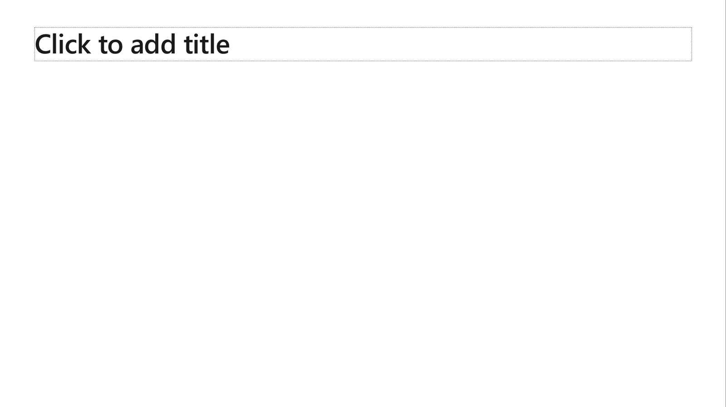
Creating accessible content
Take the following steps to create accessible content that everyone can consume effectively.
Contrast
Use high contrast colors for maximum readability
The recommended contrast ratio is at least 4.5:1
Shape and color
Use different shapes with a legend to indicate statuses to accommodate for color blindness
Example:
Alt text
Alt text helps people with screen readers understand the content of slides
You can create alternative text for shapes, pictures, charts, tables, SmartArt graphics, or other objects
Here’s how:
Right click the image or shape
Select Edit Alt Text
Enter a Title and Description of your image or object
Slide layouts
Using a built-in slide layout that matches your content ensures a hierarchical reading order of text blocks
Example:
If a new slide will have a title, rather than starting with a blank layout and adding a text block for the title, choose one of the built-in layouts with a title placeholder
Reading order
Screen readers describe content on the screen in the order it was created
To ensure your content is read back in the order you prefer, arrange your objects in the Selection Pane appropriately. Objects on the bottom of the selection pane are read first
Here’s how:
Click the Home tab
In the Drawing group, select the Arrange drop-down menu
Click Selection Pane…
Text
Text
Text
Subject 1
Subject 2
Subject 3
Color Contrast Analyzer
Download this tool to determine the legibility of text and the contrast of visual elements
Download
C1
C2
C3
Additional tips
Be sure to run the Accessibility Checker! Go to File click the Check for Issues drop down menu click Check Accessibility
Videos need to be accessible: If your presentation includes a video, ensure it is captioned and audio described (if appropriate)
Visit the Office Accessibility Center to learn more about accessibility in PowerPoint

Slide 25

Brand photography library
Looking for photography resources?
Explore the library on Brand Central.

Slide 26
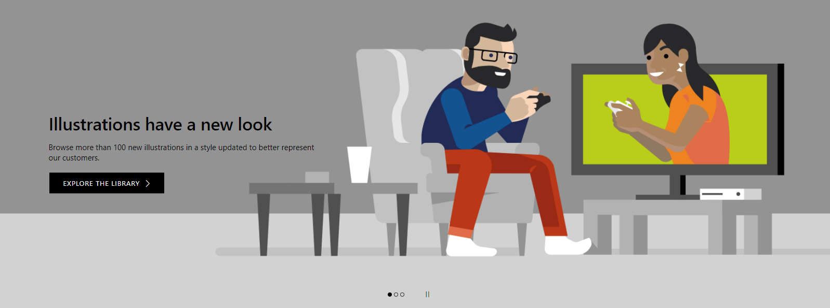
Illustration library
Looking for illustration resources?
Explore the library on Brand Central.

Slide 27
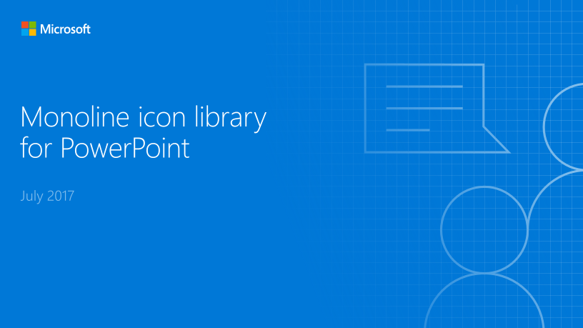
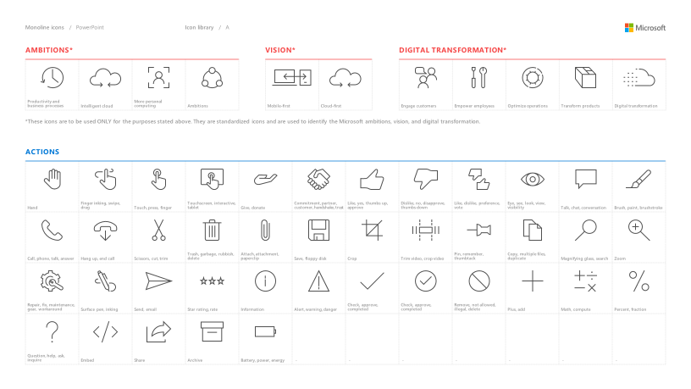
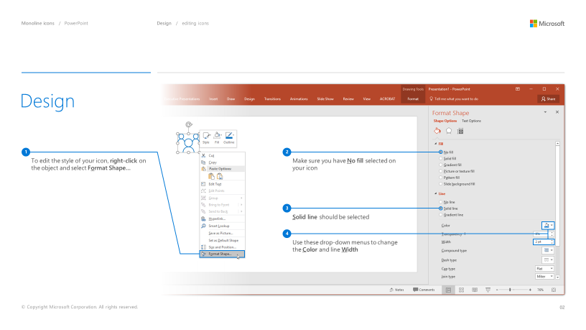
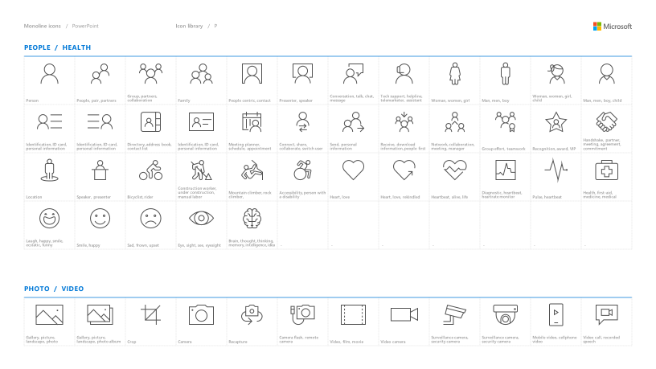
Microsoft monoline icons
Looking for icon resources?
The Monoline icon library for PowerPoint is a slide deck that provides a library of icons for use in PowerPoint presentations.
The Monoline icon style guide for PowerPoint is a pdf with additional guidelines.
Download both from Brand Central.

Slide 28
Demo
Speaker name

Slide 29
Video

Slide 30
Section title

Slide 31
Software code slide
This slide layout uses Consolas, a monotype font which is ideal for showing software code.

