Slide 2
Cognitive Labs in Action Project Personality Chat
Tulasi Menon
Senior Program Manager
THR3105

Slide 3
Conversational AI Sessions
Breakout
Schedule | Title | Speaker
Tue May 8 3:00-4:15pm | Bot intelligence, Speech Capabilities, and NLU best practices | Riham Mansour; Ahmed Ashour
Wed May 9 8:30-9:45am | Conversational AI: What's New? | Chris Mullins, Darren Jefford
Wed May 9 2:45-4:00pm | Conversational AI: Best Practices for Building Bots | Elaine Chang, Vishwac Sena Kannan
Theater
Schedule | Title | Speaker
Mon May 7 1:00-1:20pm | Cognitive Services Labs in action – Project Personality Chat | Tulasi Menon
Mon May 7 3:00-3:20pm | Cognitive Services Labs in action – Project Conversation Learner | Jason Williams
Mon May 7 4:00-4:20pm | Conversational AI: Bot Building Tools | Carlos Castro, Justin Wilaby
Mon May 7 5:30-5:50pm | Bot Authentication in Conversational AI | Jeff Derstadt
Mon May 7 8:00-8:20pm | Language Understanding Updates | Youssef Shahin
Tue May 8 11-11:20am | QnA Maker: FAQ to Bot in minutes | Prashant Choudhari

Slide 4


Enhancing Conversational Capabilities for Bots
Hey! How are you?
I’m good. How are you doing?
Small Talk Matters
Personality Matters

Slide 5

What does Personality Chat do?
Enhances your bot’s conversational capabilities by handling small talk,
in line with a distinct personality.

Slide 6
Personality chat endpoints
Bot Builder SDK
Cognitive Service Labs
Editorial responses
Available to integrate in your bot
Editorial + Auto-generated responses
Available as a demo

Slide 7
Editorial Personality Chat Library
100 + small talk scenarios covered
Choose between editorial responses in three personalities -
Professional | Friendly | Humorous
Small Talk Query | Professional | Friendly | Humorous
“Thank you” | You’re quite welcome. | You bet. | No prob.
“Will you marry me?” | I think it's best if we stick to a professional relationship. | You're three-dimensional. I'm non-dimensional. Our love can never be. | Sure. Take me to City Hall. See what happens.
“Who made you?” | There wouldn't be time to list everyone. | So many people! | Nerds.

Slide 8
How to integrate Personality Chat in your bot
1
Personality Chat in Microsoft Bot Builder SDK v4
Add the Personality Chat Middleware (that calls the Personality Chat API)
Personality Chat dataset
As a set of Question-Answers that can be imported into QnAMaker
Personality Chat in Microsoft Bot Builder SDK v3
Inherit the Personality Chat Dialog (that calls the Personality Chat API)
2
3

Slide 9
Integrating Personality Chat- Bot Builder SDK v4
using Microsoft.Bot.Builder.PersonalityChat;
…
…
public void ConfigureServices(IServiceCollection services) { services.AddBot<BasicPersonalityChatBot>(options => { options.CredentialProvider = new ConfigurationCredentialProvider(Configuration) var middleware = options.Middleware;
var PersonalityChatOptions = new PersonalityChatMiddlewareOptions(
respondOnlyIfChat: true, botPersona: PersonalityChatPersona.Humorous,
scoreThreshold = 0.5F
);
middleware.Add(new PersonalityChatMiddleware(PersonalityChatOptions)); });
}

Slide 10
Demo
Tulasi
WeatherBot-Professional
WeatherBot-Humorous

Slide 11
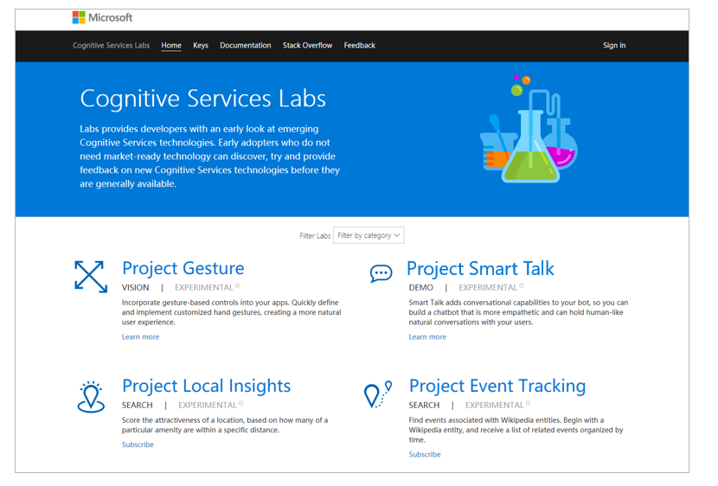

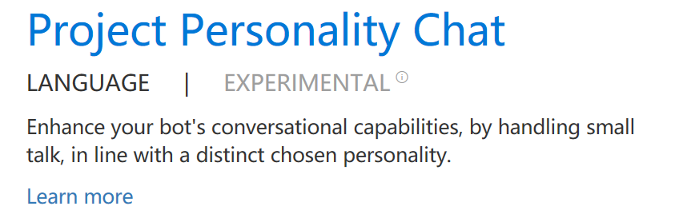
Project Personality Chat

Slide 12
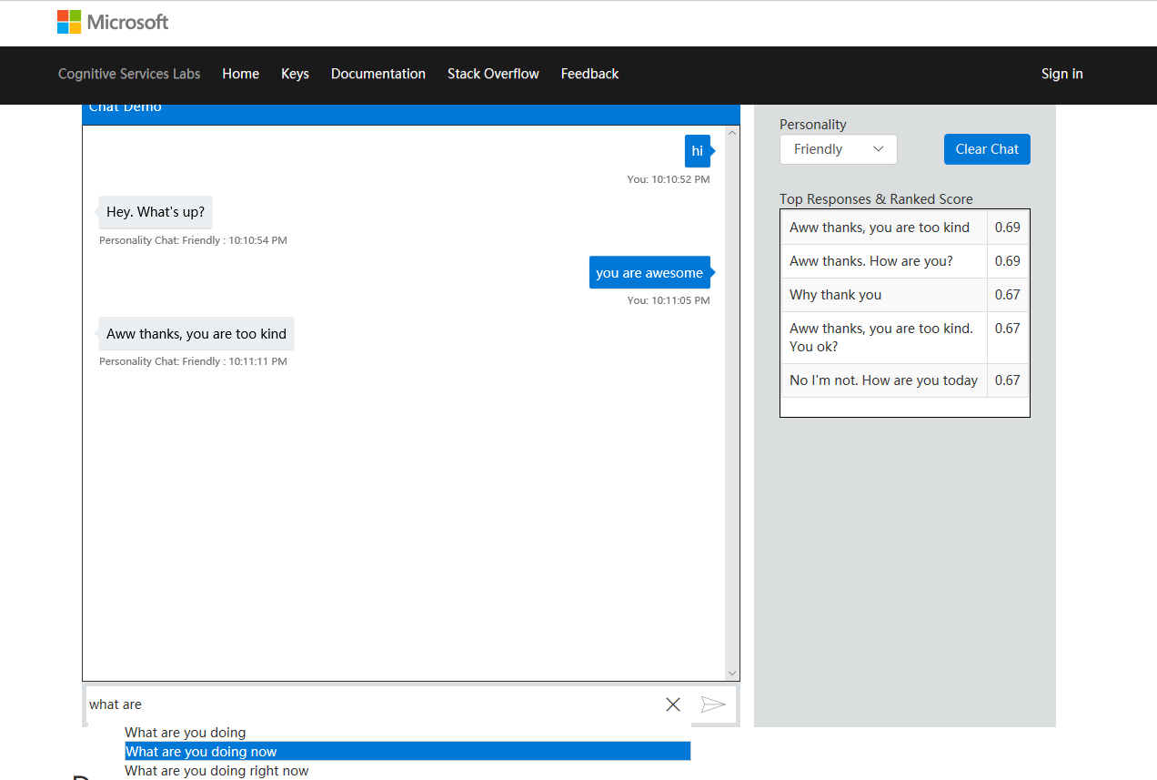

Slide 13
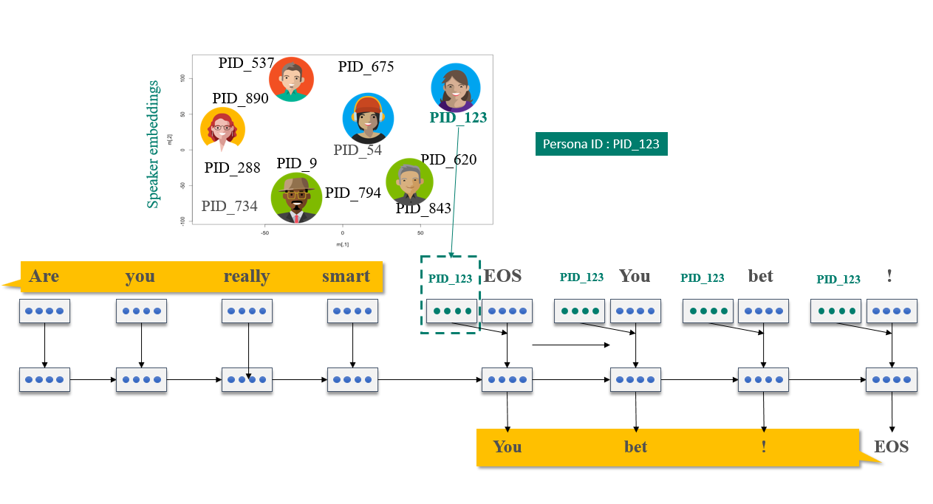
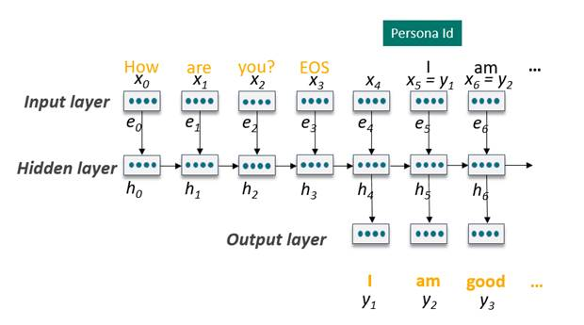
Response generation
PID_76

Slide 14
Demo
Tulasi
aka.ms/personalitychat

Slide 15
What Next?
Bot Framework V4 (preview)
Get started today – aka.ms/BotBuilderOverview
Try the awesome tools
Local – aka.ms/BotBuilderLocalDev
AZ CLI – aka.ms/BotBuilderAZCLI
Give us feedback, report issues – aka.ms/BotBuilderissues
Azure Bot Service
Get started today – aka.ms/botservice
Ask anything on Stack Overflow – aka.ms/botframeworkSOF
Report issues and feature asks – aka.ms/ABSUSerVoice
Follow us on – https://twitter.com/msbotframework
Language Understanding
Get started today – aka.ms/LUIS
Cognitive Services
Get started today – aka.ms/ cognitiveservices
AI Labs
Conversation Learner – aka.ms/conversationlearner
Personality Chat – aka.ms/personalitychat

Slide 16
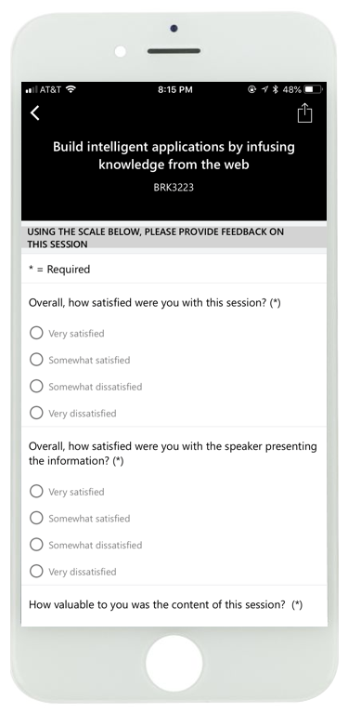
Please evaluate this session
Your feedback is important to us

