Slide 1
START SWISH!!!!
Night before:
Set presso and swish to autostart
disable skype, workrave, etc.

Slide 2
Distributed SWI-Prolog Development
Anne Ogborn
Notes:
Welcome to Distributed SWI-Prolog Development. I'm Anne Ogborn. Feel free to ask questions at any time.

Slide 3


Pengines
TorbjörnLager
University of Gothenborg
Jan Wielemaker
Free Univ. of the Netherlands
Notes:
Over the last 9 months an interesting ecosystem has built up in the SWI-Prolog environment, based around
a library called pengines, written by Torbjorn lager of the univ of Gothenborg and Jan Wielemaker at the Free University of the Netherlands.
I'm going to show you that library, starting with some of what motivated it, and then showing you the API.
After that we'll take a brief look at the rest of the ecosystem.
This is an early look at a very new system. While the core is pretty solid, many of the peripheral pieces are just
now being made, so it's an interesting time for us.

Slide 4
Pengine Roles
Notes:
I'll start by motivating pengines and explaining the larger pieces and their roles

Slide 5
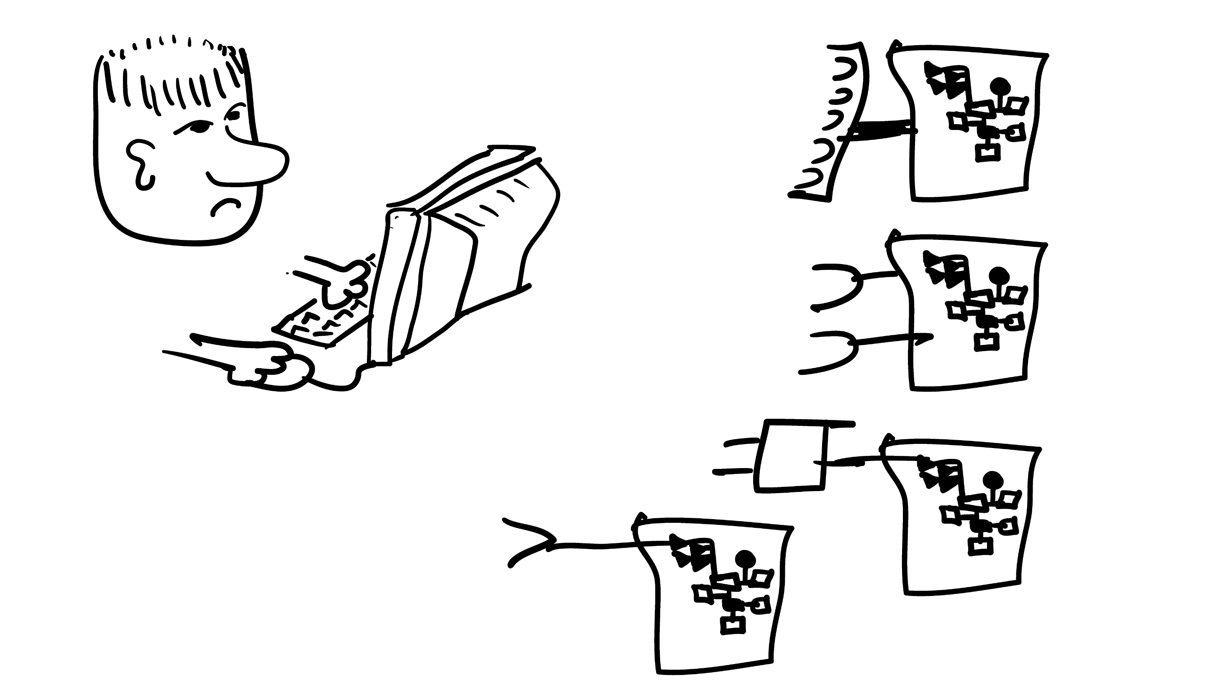
Notes:
This is how people interact with servers today. Every data feed has its own API. We need to manually write an interface to each one.
This even applies to our own server- we have to write code for ajax on each end of the pipe.
One cause of this is the lack of combinatorial power in HTTP. HTTP is hand me a query with some parameters,
I hand you back some information. It's not combinatorial.
So instead we have a combinatorial explosion of URI endpoints.
Is there a better way?

Slide 6
Notes:
We could give our friend shell access.
That would vastly simplify his problems, but it wouldn't do much for our security.
And it's a completely infeasible solution if we have millions of users.

Slide 7
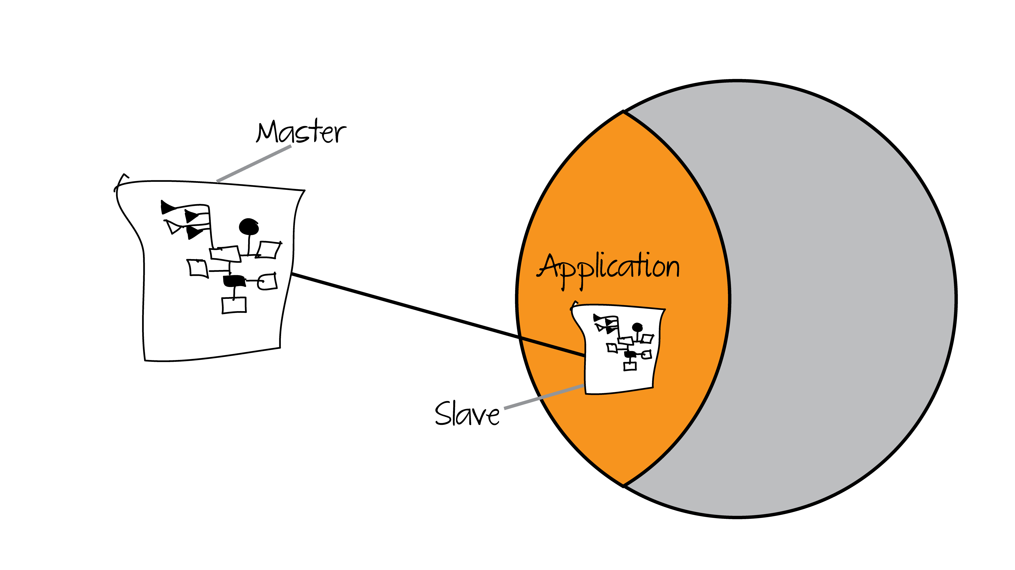
Notes:
A pengine is similar to an SSH shell in some ways.
An application is an URI endpoint that will create a certain type of pengine
A "master" sends a request to the application, and the application creates the slave pengine and returns the ID.
Since the master alone knows the ID, only it can control the pengine.
Now the master can send nondeterministic queries to the pengine slave.
Effectively, the master has a sandboxed shell on the host server.

Slide 8
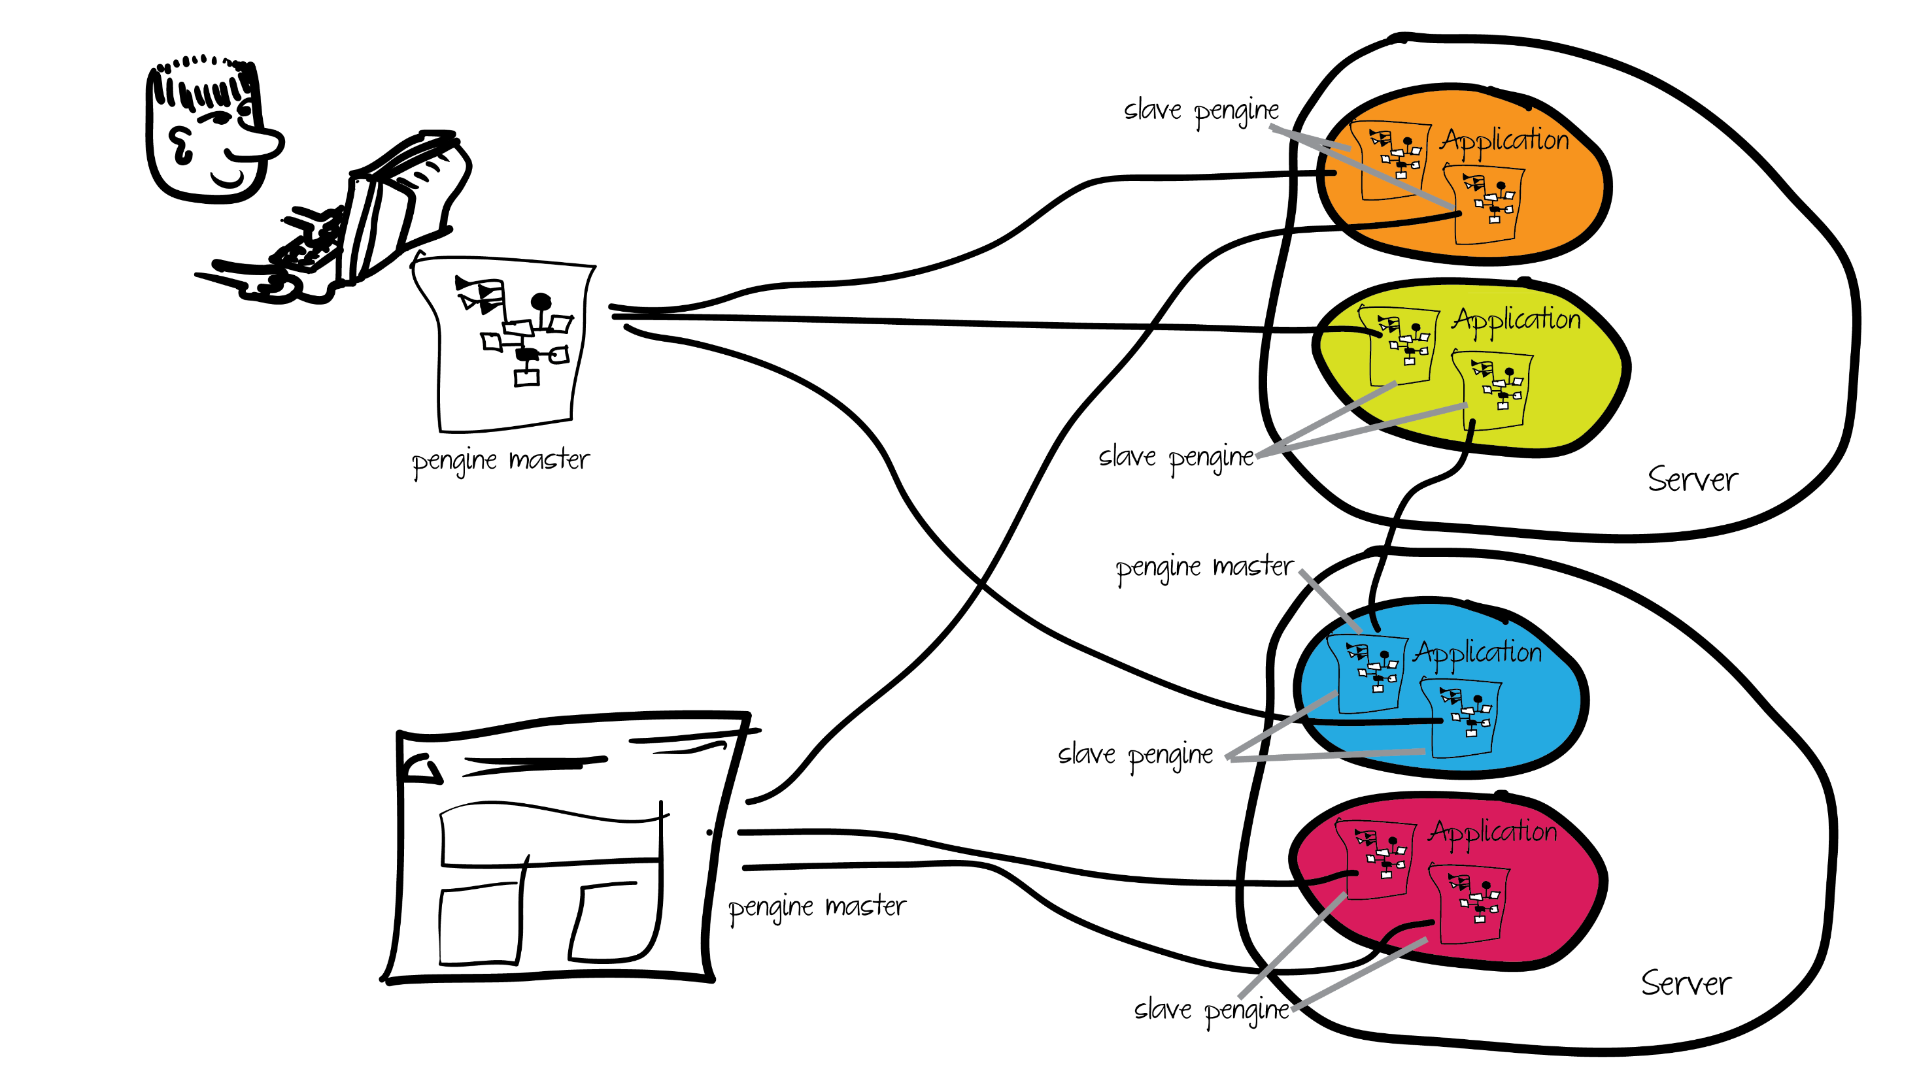
Notes:
So, here's a sample universe with some pengines.
The master could be random code in the same VM, or a foreign server, or a web page.
A master can have more than one slave, but each slave has one master.
The master can be a remote server, another process on the same server, the same VM that is running the application, or a web page.
People clear about the architecture?

Slide 9
The Pengine Knowledgebase
Notes:
Lets look in more detail at the knowledge that's exposed to the pengine,
that is, the complete set of facts and rules the pengine can see.

Slide 10
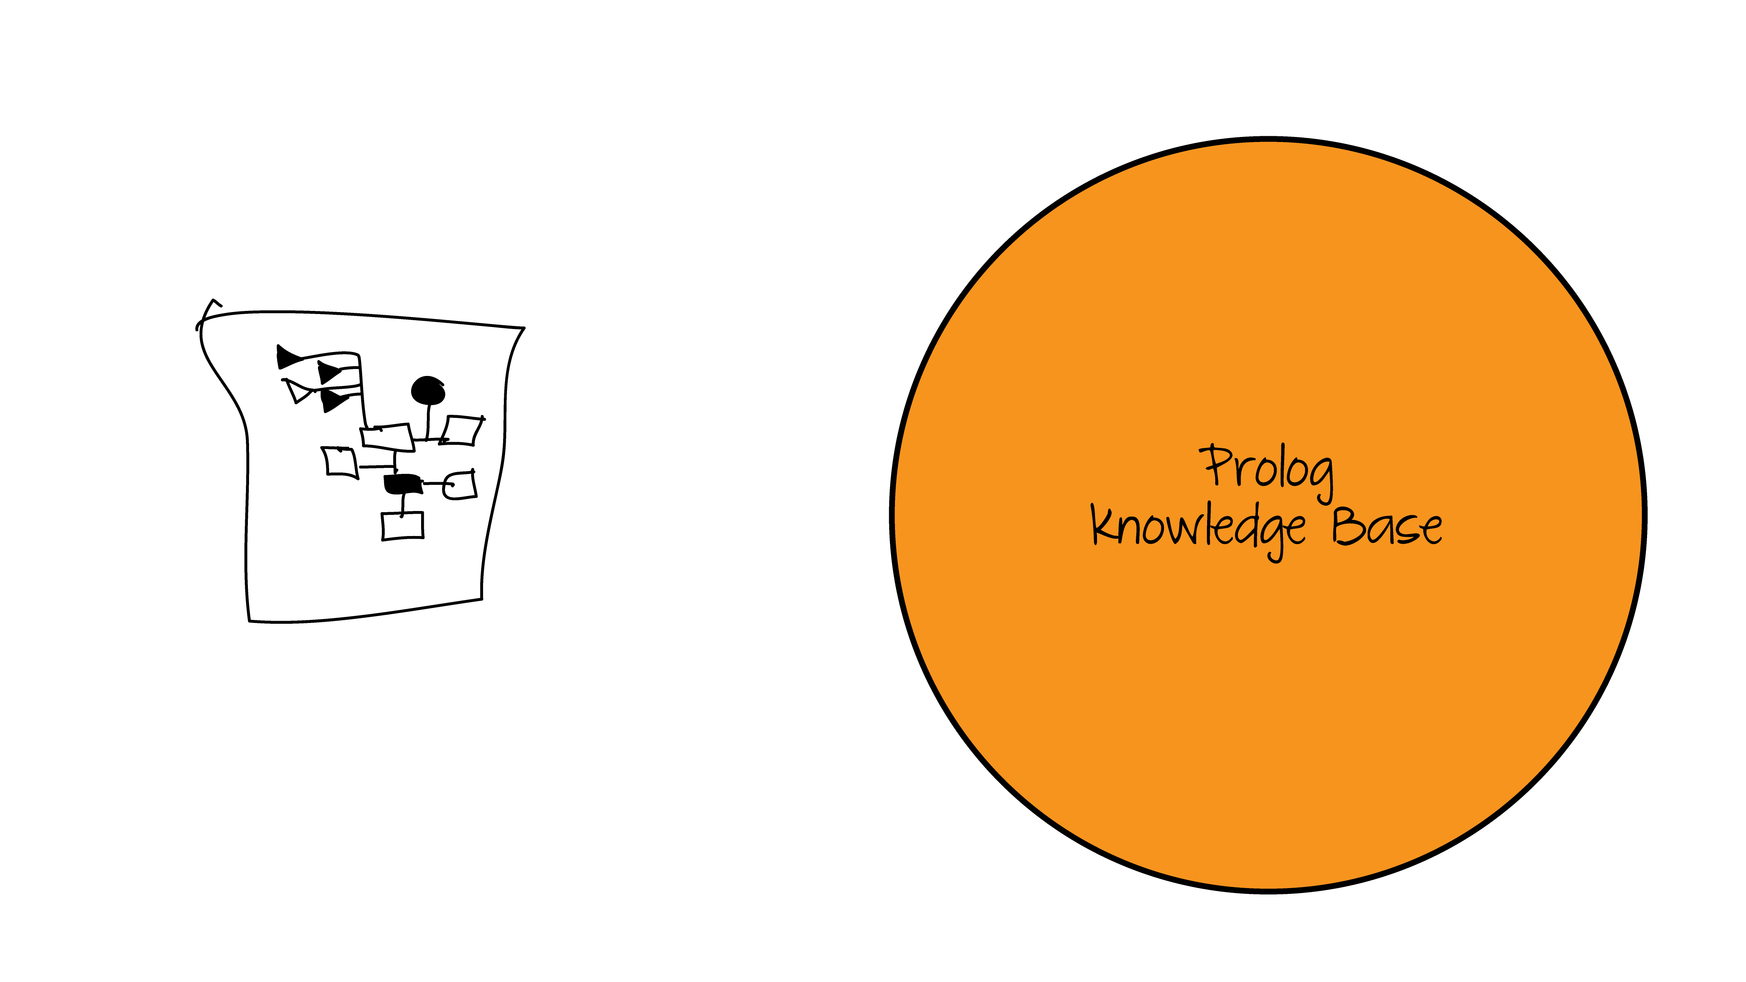
Notes:
Here's the server's total knowledgebase

Slide 11
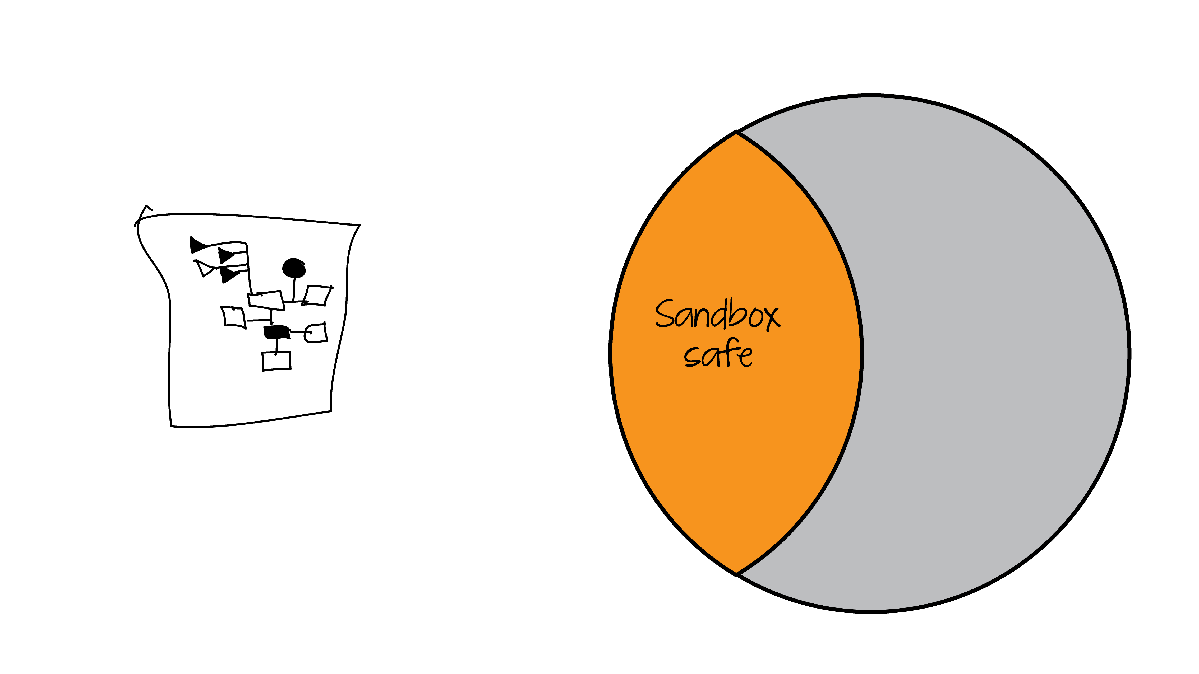
Notes:
Of course we shouldn't expose all of it. We don't want the pengine to be able to call shell, for example.
The default application is sandbox. Sandbox only exposes those items that it considers safe, and analyzes code before running it to make sure it too is safe.

Slide 12

Notes:
Typically one creates an application by importing a module into the sandbox. So we have the union of the sandbox and the application space

Slide 13

Notes:
The application, however, also needs to be safe code, so unsafe code is removed.

Slide 14

Notes:
However the container can explicitly mark individual predicates as safe. Obviously if you are going to allow users to alter a database, somewhere there has to be a hole to get to it.

Slide 15
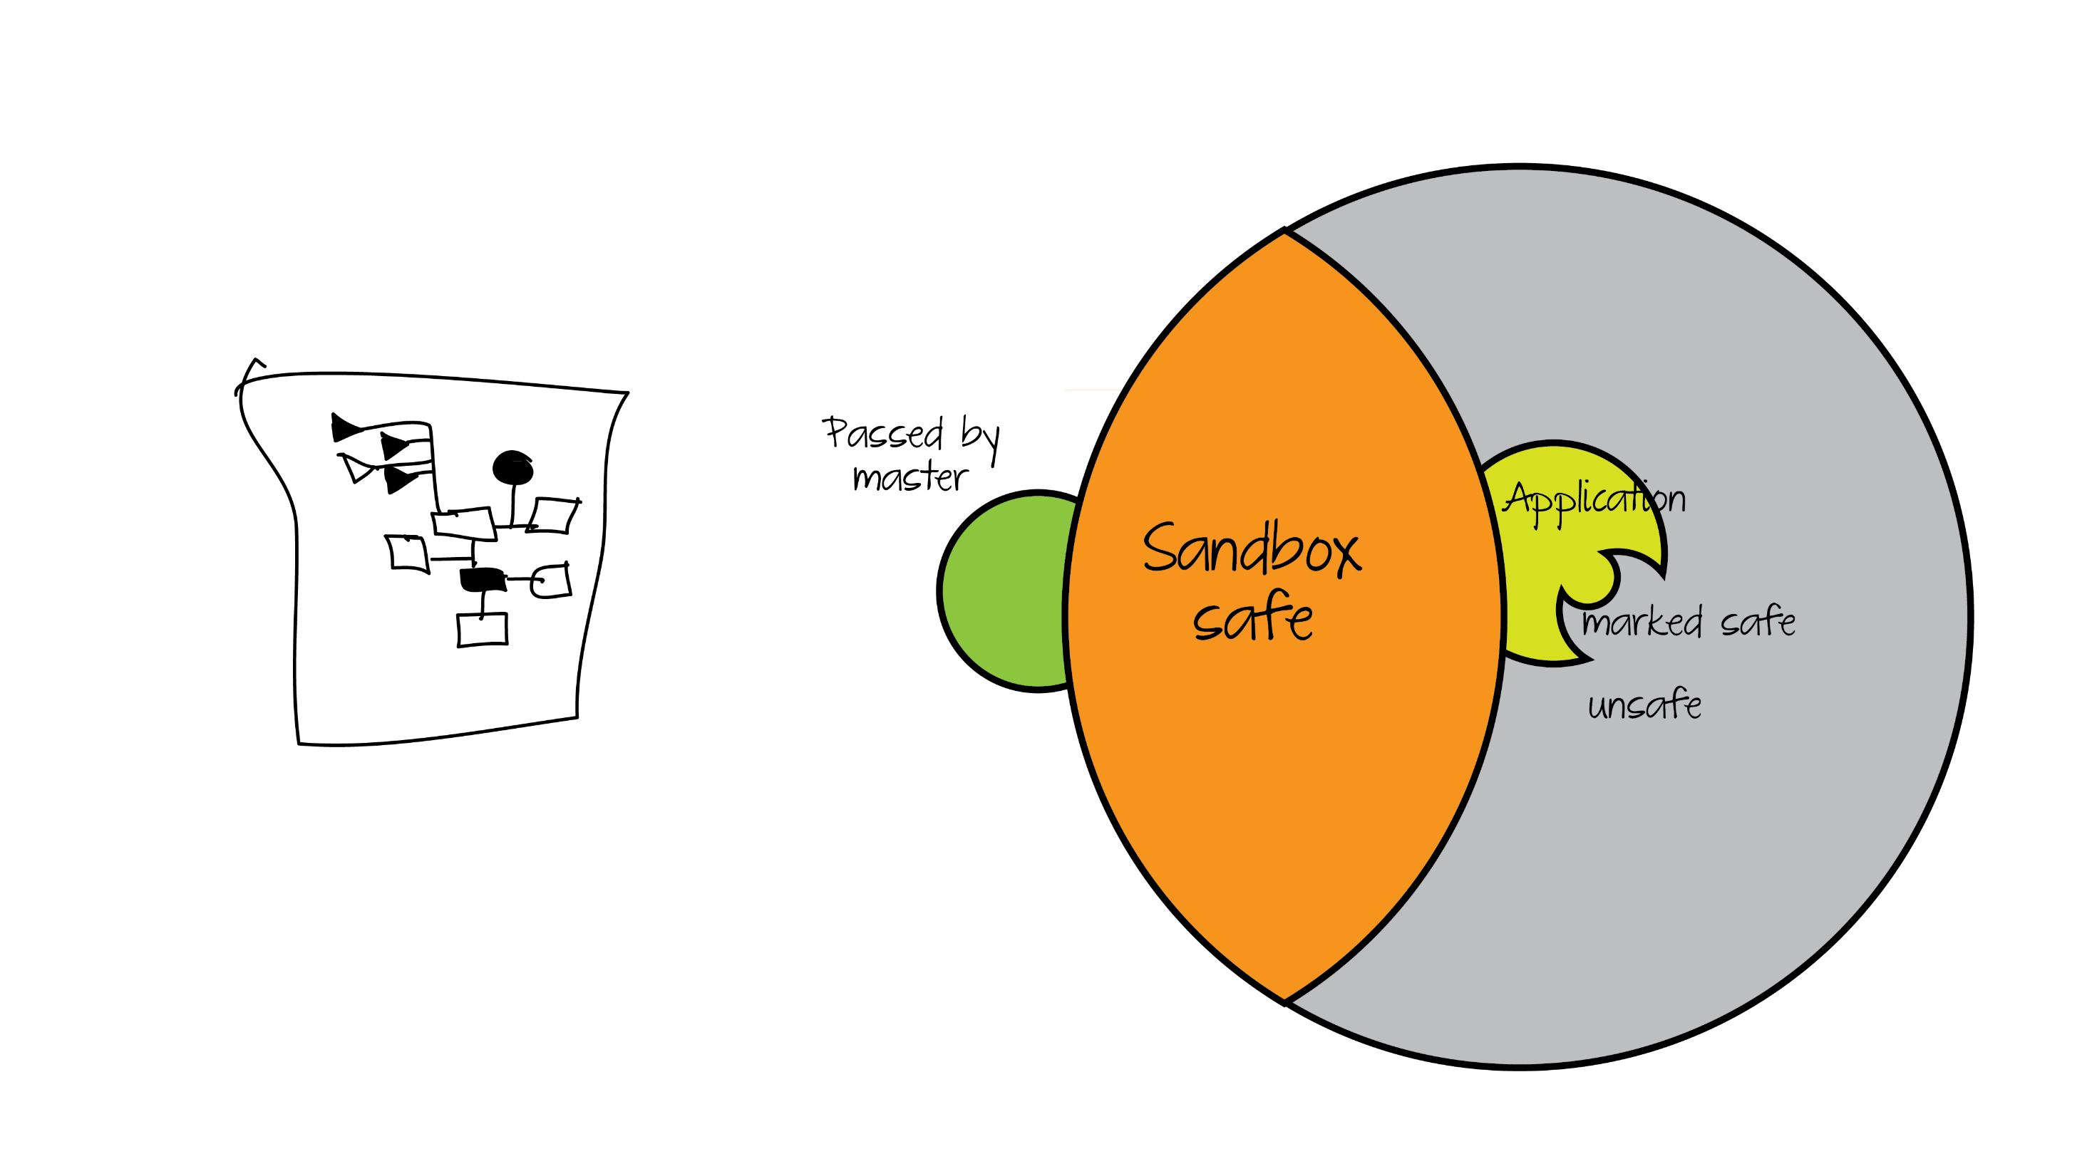
Notes:
When you make a pengine you can supply code to be added. This is great for holding state on the server, customizing queries by ID's and such, and making precompiled subqueries. This code is unique to this slave.

Slide 16
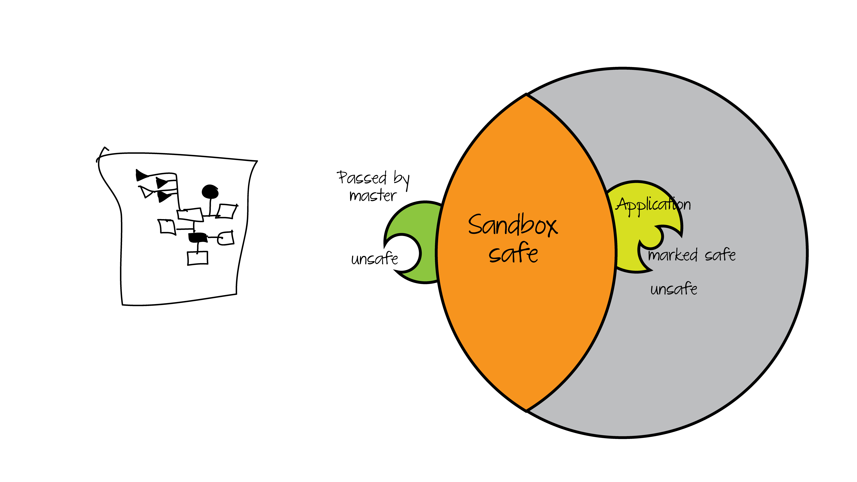
Notes:
Of course letting someone hand us a shell call would be unsafe, so we do the same code analysis on the code passed by the master.

Slide 17
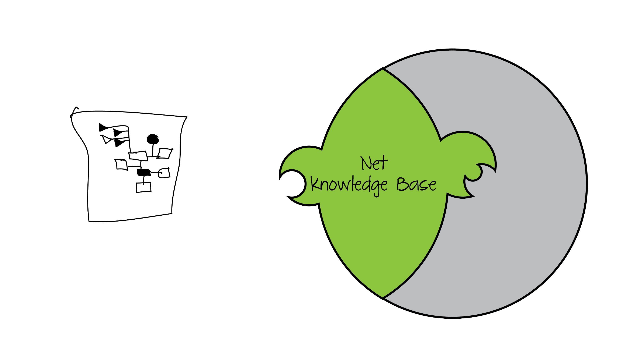
Notes:
So this is the net knowledge base we query against.

Slide 18
Querying The Pengine
Notes:
Now lets look at actually making some queries against the pengine

Slide 19
client.pl
pengine_demo(Port) :-
format(atom(URL), 'http://localhost:~d', [Port]),
pengine_create(
[ server(URL),
src_text("
q(X) :- p(X).
p(a). p(b). p(c).
")
]),
pengine_event_loop(handle, []).
handle(create(ID, _)) :-
pengine_ask(ID, q(_X), []).
handle(success(ID, X, false)) :- !,
writeln(X),
pengine_destroy(ID).
handle(success(ID, X, true)) :-
writeln(X),
pengine_next(ID, []).
Notes:
Once the pengine is created, the master can then make normal, nondeterministic Prolog queries.
Here we have some client code. Notice the pengine_event_loop and closure.

Slide 20
javascript example
<script>
var pengine = new Pengine({
oncreate: handleCreate,
onsuccess: handleSuccess,
onerror: handleSuccess
});
function handleCreate () {
pengine.ask("q(X)", {
template:'X'
});
}
function handleSuccess() {
$('#out').html(this.data);
pengine.next();
}
</script>
<script type="text/x-prolog"> q(X) :- p(X).
p(a).
p(b).
p(c).
</script>
Notes:
This is what the javascript looks like. It's substantially like the Prolog version. Note that code to be injected goes in a script tag with type text/x-prolog

Slide 21
Notes:
Lets try this.
Here we have a shell that lets us enter arbitrary code on the left, make a query here, and execute the query on the server.
This application is called SWISH, it's one of the central pieces of the pengines toolkit.
DEMO SIMPLE PENGINE QUERY IN SWISH.
Notice that we're submitting Prolog from Javascript here. We've learned that using pengines can make doing ajax type web development a lot simpler.
Questions?

Slide 22
Client using pengine_rpc
rpc_demo(Port, X) :-
pengine_rpc(
'http://someserver.nl/',
member(X,
[aap, noot, mies])).
Notes:
If you want to retain the same nondeterministic behavior as the local call, you can use pengine_rpc

Slide 23
IO
pengine_input(-Prompt, -Term)
pengine_output(+Term)
Notes:
pengine_input prompts the master and waits for input.
Prompt is a term, it need not be atomic
Because HTTP requires that the client initiate the transaction, you may need to call pengine_pull_response to get subsequent output or success events after output.

Slide 24
Notes:
You'll remember that we imported our application code into the sandbox.
Lets see how to do that.

Slide 25
main.pl
my_apis.pl
:- use_module(library(pengines)).
:- use_module(library(sandbox)).
:- use_module(pengine_sandbox:my_apis).
:- module(my_apis, [my_public/1]).
:- use_module(library(dcg/basics)).
my_public(X) :-
dont_say_walrus(X),
debug(pengine_example, 'my_public says ~w', [X]).
dont_say_walrus(X) :-
atom_codes(X, XC),
phrase(walrus, XC),
!,fail.
dont_say_walrus(_).
walrus --> string(_) , "walrus", string(_).
Notes:
To add material to sandbox, just import your module into pengine sandbox, and make your API predicates public.

Slide 26
main.pl
my_apis.pl
:- use_module(library(pengines)).
:- use_module(library(sandbox)).
:- use_module(pengine_sandbox:my_apis).
:- module(my_apis, [my_public/1, my_unsafe/1]).
:- use_module(library(dcg/basics)).
my_public(X) :-
dont_say_walrus(X),
debug(pengine_example, 'my_public says ~w', [X]).
my_unsafe(X) :-
atom_length(X, Len),
Len < 25,
open('foo.txt', write, Stream),
format(Stream, 'Hello Out There ~w~n', [X]),
close(Stream).
:- multifile sandbox:safe_primitive/1.
sandbox:safe_primitive(my_apis:my_unsafe(_)).
Notes:
Now, if we want to use unsafe predicates, adding them is fairly straightforward.
We just export the unsafe predicate, and then define a new clause for sandbox:safe_primitive that unifies with our call.
Notice that this means we can make an arbitrary test for what's safe, we're not restricted to either allowing unrestricted access to a predicate or forbidding it.

Slide 27
Federating Queries
from_everywhere(Name, Address) :-
pengine_rpc('http://someserver.com/',
rdf(S, rdf:type, foaf:Agent)),
pengine_rpc('http://someserver.com/',
rdf(S, foaf:name, Name)),
pengine_rpc('http://whitepages.com/pengines/',
rdf(S2, foaf:name, Name)),
pengine_rpc('http://whitepages.com/pengines/',
rdf(S2, wp:address, Address)).
Notes:
One of the big reasons for doing this work is a larger scheme of heading towards a more prolog oriented semantic web. Here's a query federated across two ser vers. You can see that doing these sorts of federated queries is as easy as doing a local query. No more SPARQL to deal with.

Slide 28
Cliopatria Whitepaper
Useful paper for understanding the relationship between prolog and RDF
http://cliopatria.swi-prolog.org/help/whitepaper.html
Notes:
This paper's useful for the relationship between Prolog and RDF

Slide 29
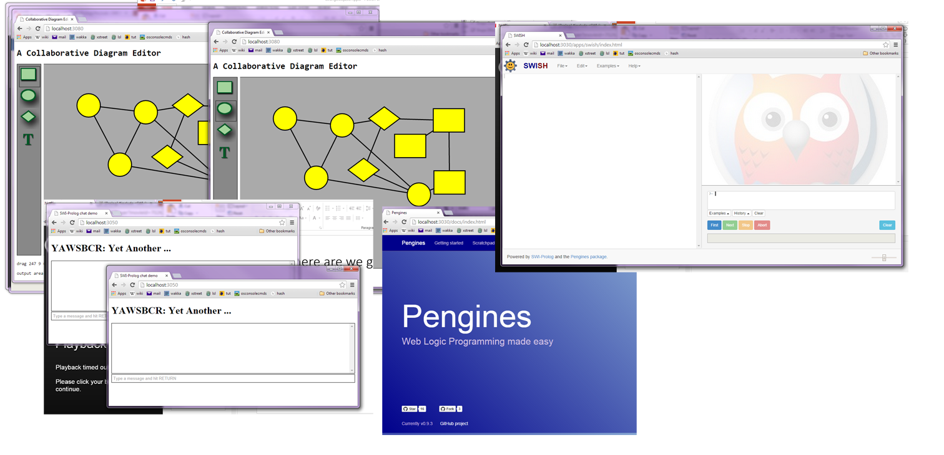
Where Are We Going?
Notes:
Building an ecosystem around pengines
websocket
hub.pl tool for collaborative applications
Projects
Chat Room
White Board
Hospital scheduling
SWISH
Online LearningTool
Data Browser
Eventually replace XPCE
Try the collaborative system, It makes building a shared environment fun and easy.

Slide 30
Resources
slides https://github.com/Anniepoo/strangeloop2014
Sources/Nightlies
SWISH 2.0 http://swish.swi-prolog.org
SWISH 1.0 http://pengines.swi-prolog.org
whiteboard https://github.com/Anniepoo/whiteboard.git
chat https://github.com/JanWielemaker/swi-chat
Docs http://pengines.swi-prolog.org/docs/documentation.html
Notes:
Here's some resources. I don't expect anybody to read this mess, get Slides
Enjoyed hearing, enjoyed telling
Thanks to Torbjörn Lager and Jan Wielemaker, who tolerated many naive questions while I was working on this.
Any questions?

