Slide 1
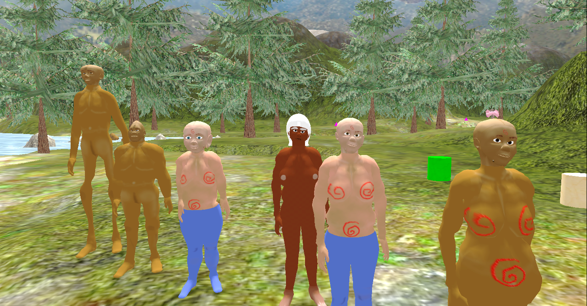
6 people
I'm overworked
I'm hungry
I'm bored

Slide 2
Constraints
Each person has a caloric and a protein level, with max(10.0 atm) and 0. If it falls to 0 they die. If they're at max they don't eat.
Same with work, boredom

Slide 3
6 people
I can't cook
I can't hunt in the snow

Slide 4
Set of possible tasks
rest, play, cook, hunt, fish, pick_berries, tend_corn
Each person does 1 task each day of a 336 day year
During the year it is statistically possible/not possible to do various things depending on climate/ecology.

