Slide 1

SWI-Prolog
For The Real World
Anne Ogborn

Slide 3
www.swi-prolog.org
16 ?- append([a,b], [c,d], X).
X = [a, b, c, d].
17 ?- append(X, [c,d], [a,b,c,d]).
X = [a, b] ;
false.
18 ?- append(X, Y, [a,b,c,d]).
X = [],
Y = [a, b, c, d] ;
X = [a],
Y = [b, c, d] ;
X = [a, b],
Y = [c, d] ;
X = [a, b, c],
Y = [d] ;
X = [a, b, c, d],
Y = [] ;
false.

Slide 4
constrain_demo(X) :-
X in 1..5,
foo(X),
label([X]).
foo(X) :- X in 3..7 .
2 ?- constrain_demo(X).
X = 3 ;
X = 4 ;
X = 5.

Slide 5
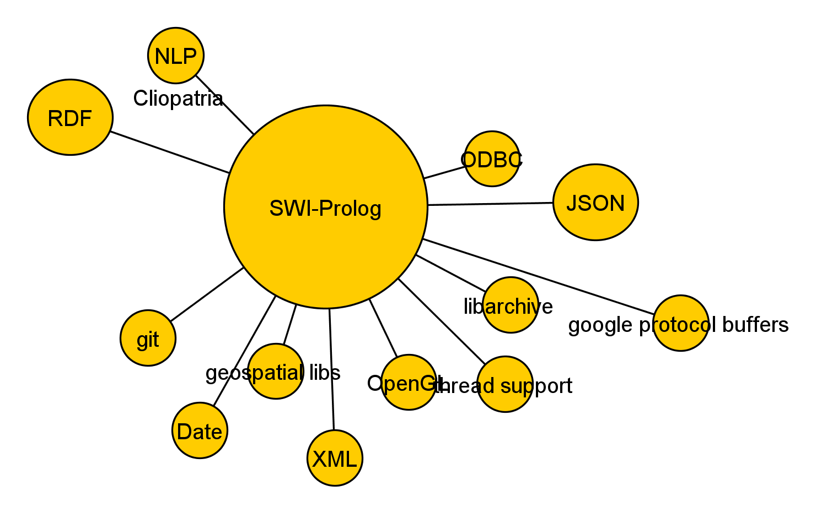

Slide 6
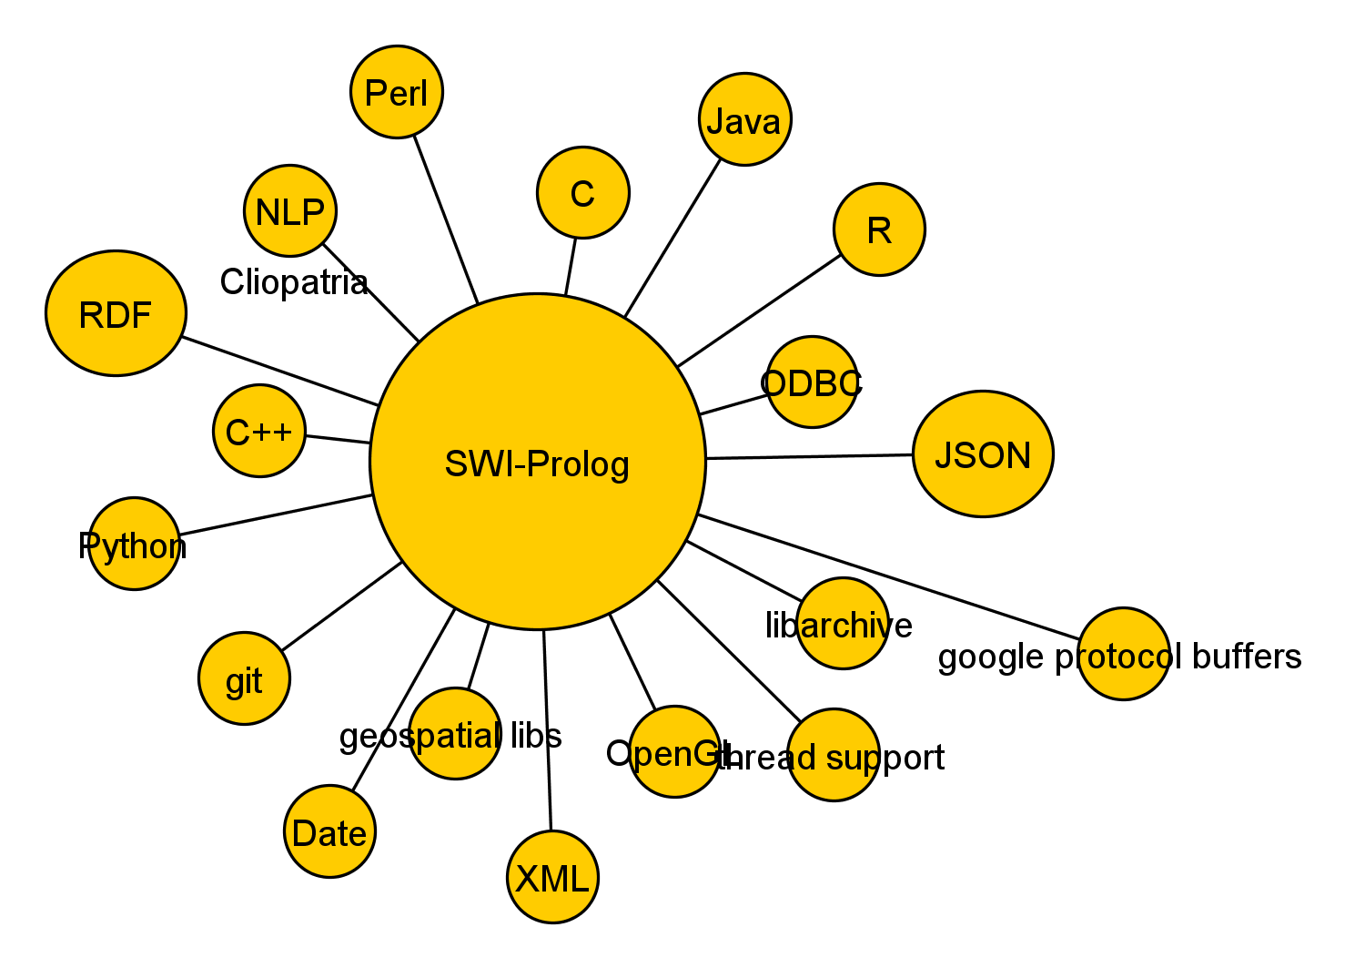

Slide 7
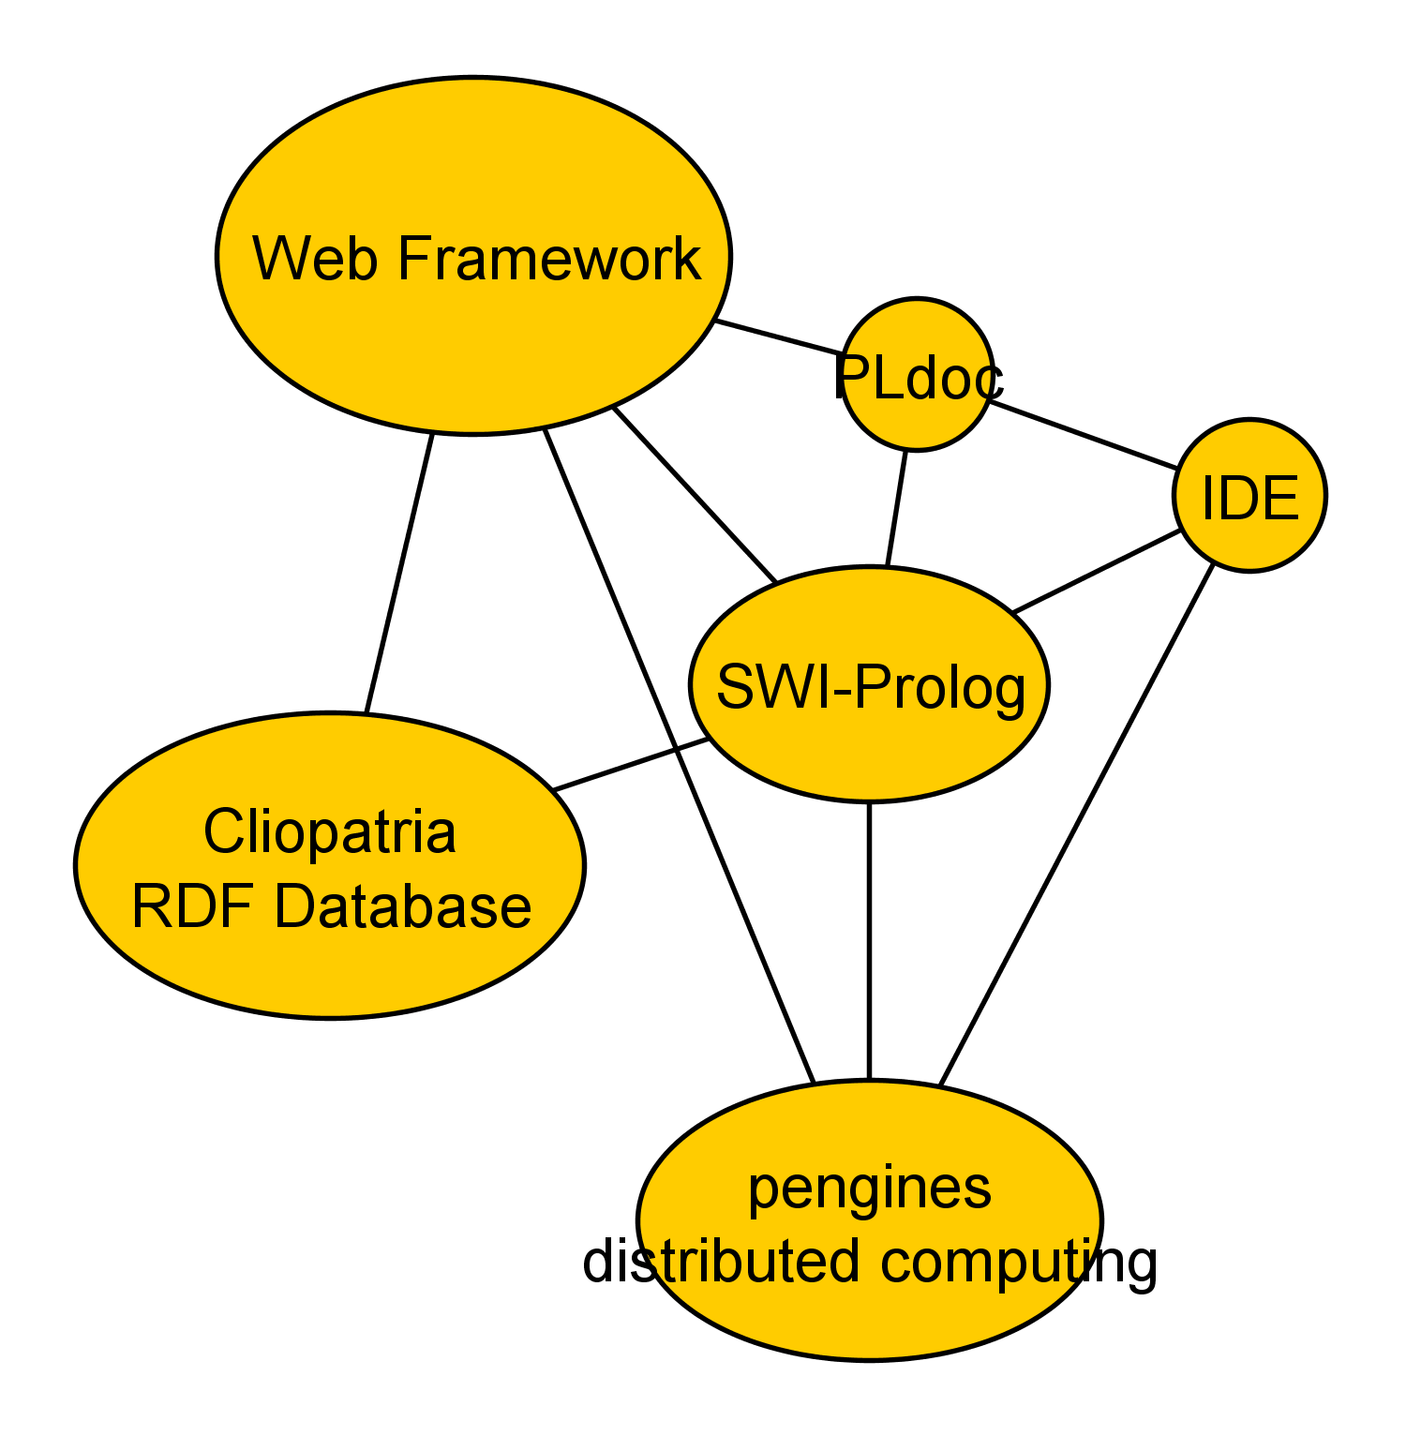

Slide 8
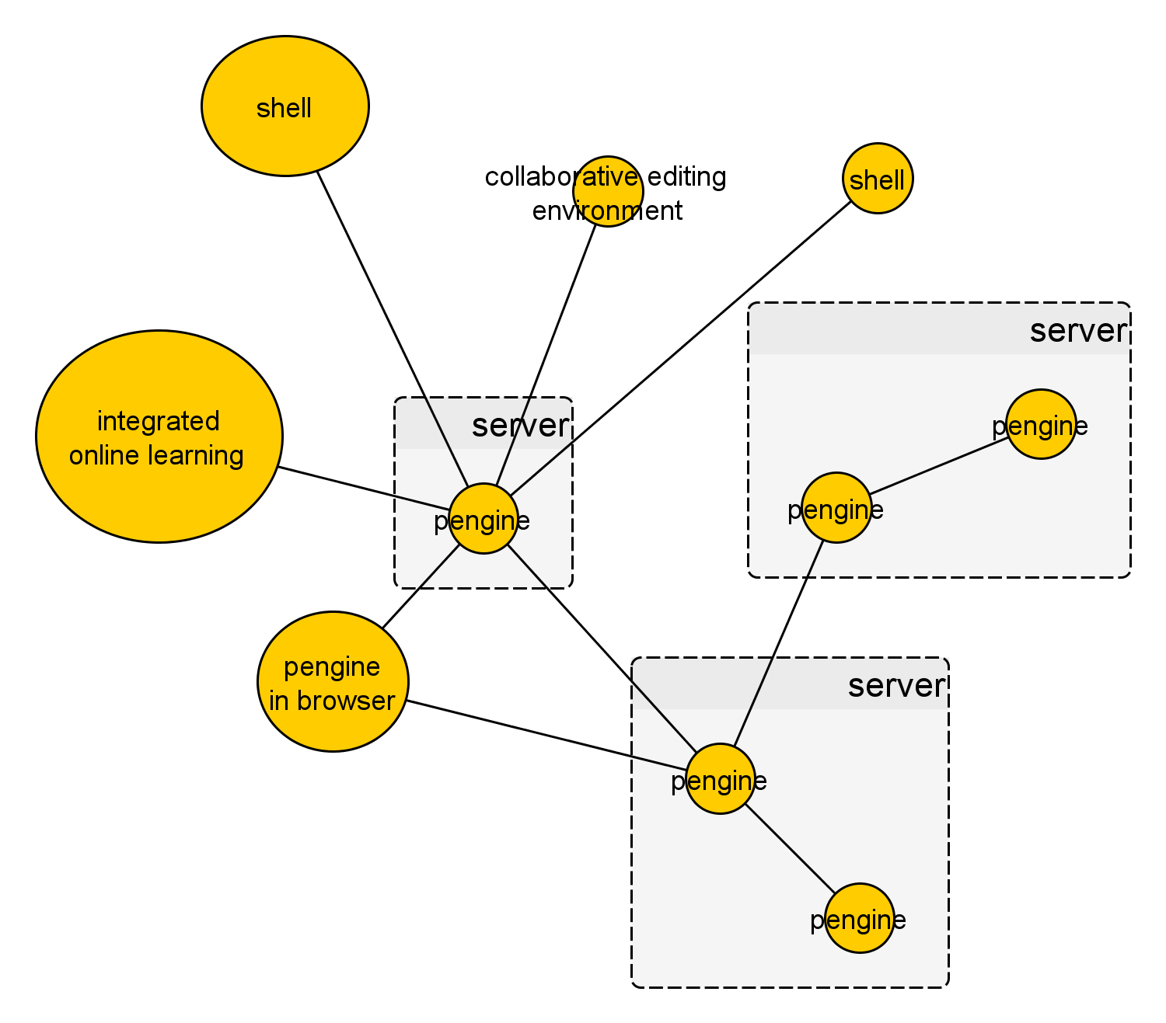

Slide 9
Where To Go From Here?
swi-prolog.org
Programming in Prolog, by W.F. Clocksin and C.S. Mellish
learnprolognow.org - online book
Leon Sterling & Ehud Shapiro - The Art of Prolog
http://www.pathwayslms.com/swipltuts/ - notably the web framework
Richard O'Keefe - the Craft of Prolog
Leon Sterling - The Practice of Prolog
##prolog channel on freenode.net IRC
Code/slides for this talk available at https://github.com/Anniepoo/oscon2014
Office hours 10:40am tomorrow, Expo hall, table B

