Slide 1

SWI-Prolog
For The Real World
Anne Ogborn

Slide 2
www.swi-prolog.org
Notes:
Family Tree

Slide 3
www.swi-prolog.org
16 ?- append([a,b], [c,d], X).
X = [a, b, c, d].
17 ?- append(X, [c,d], [a,b,c,d]).
X = [a, b] ;
false.
18 ?- append(X, Y, [a,b,c,d]).
X = [],
Y = [a, b, c, d] ;
X = [a],
Y = [b, c, d] ;
X = [a, b],
Y = [c, d] ;
X = [a, b, c],
Y = [d] ;
X = [a, b, c, d],
Y = [] ;
false.

Slide 4
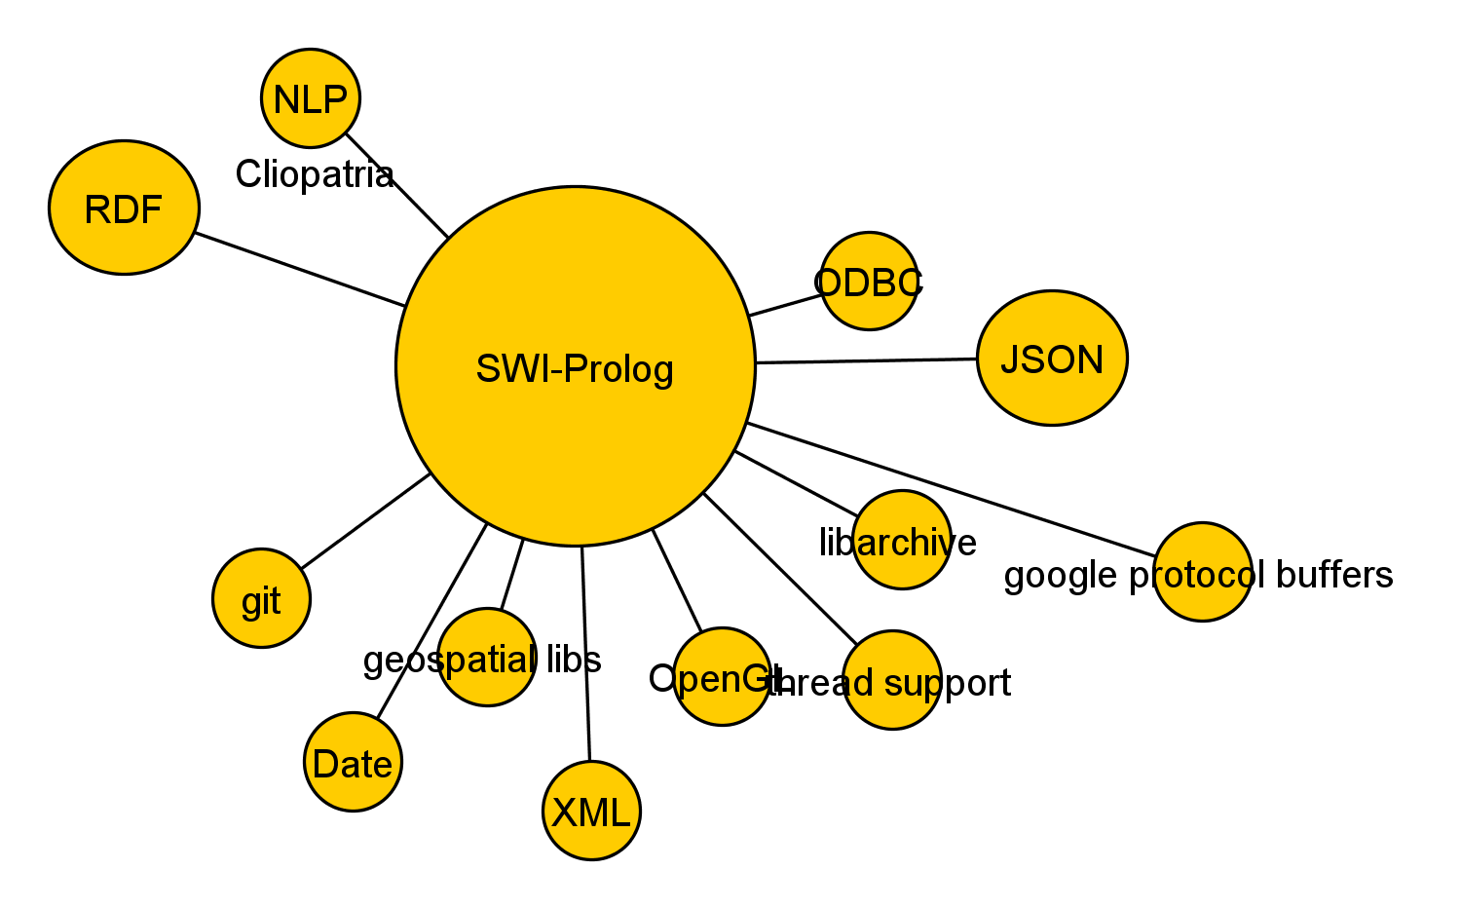

Slide 5
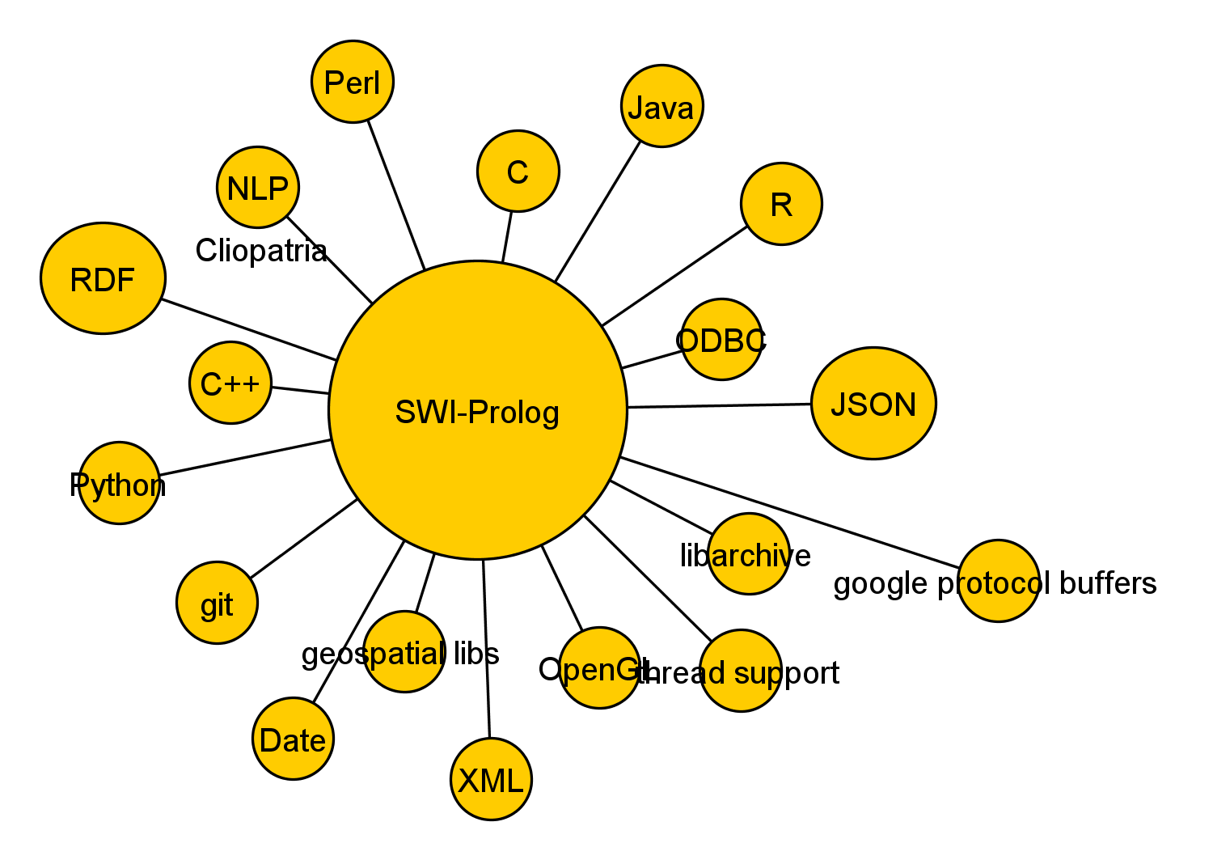

Slide 6
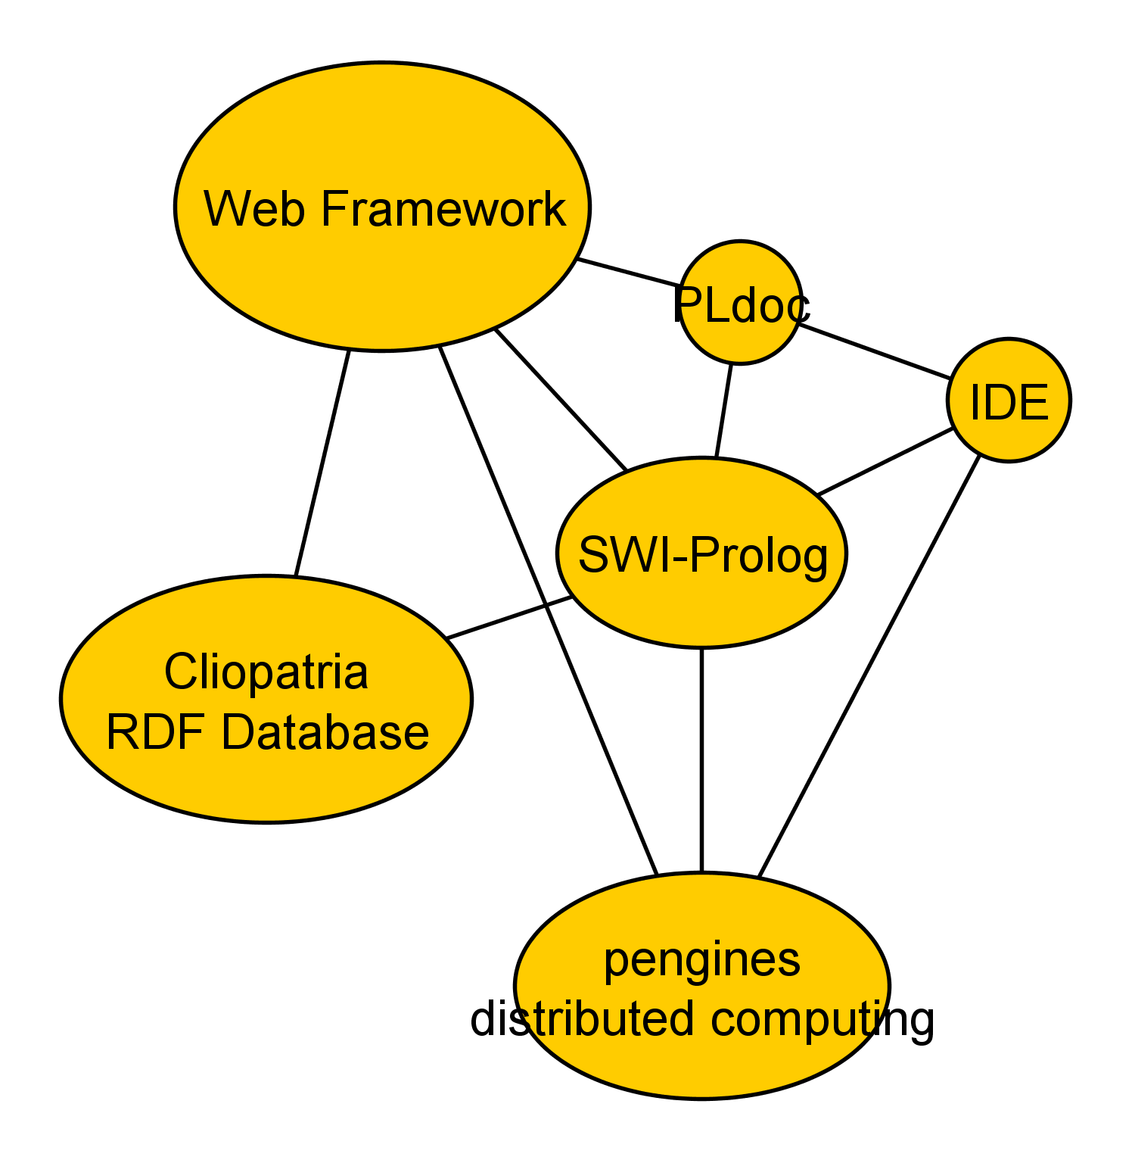

Slide 7
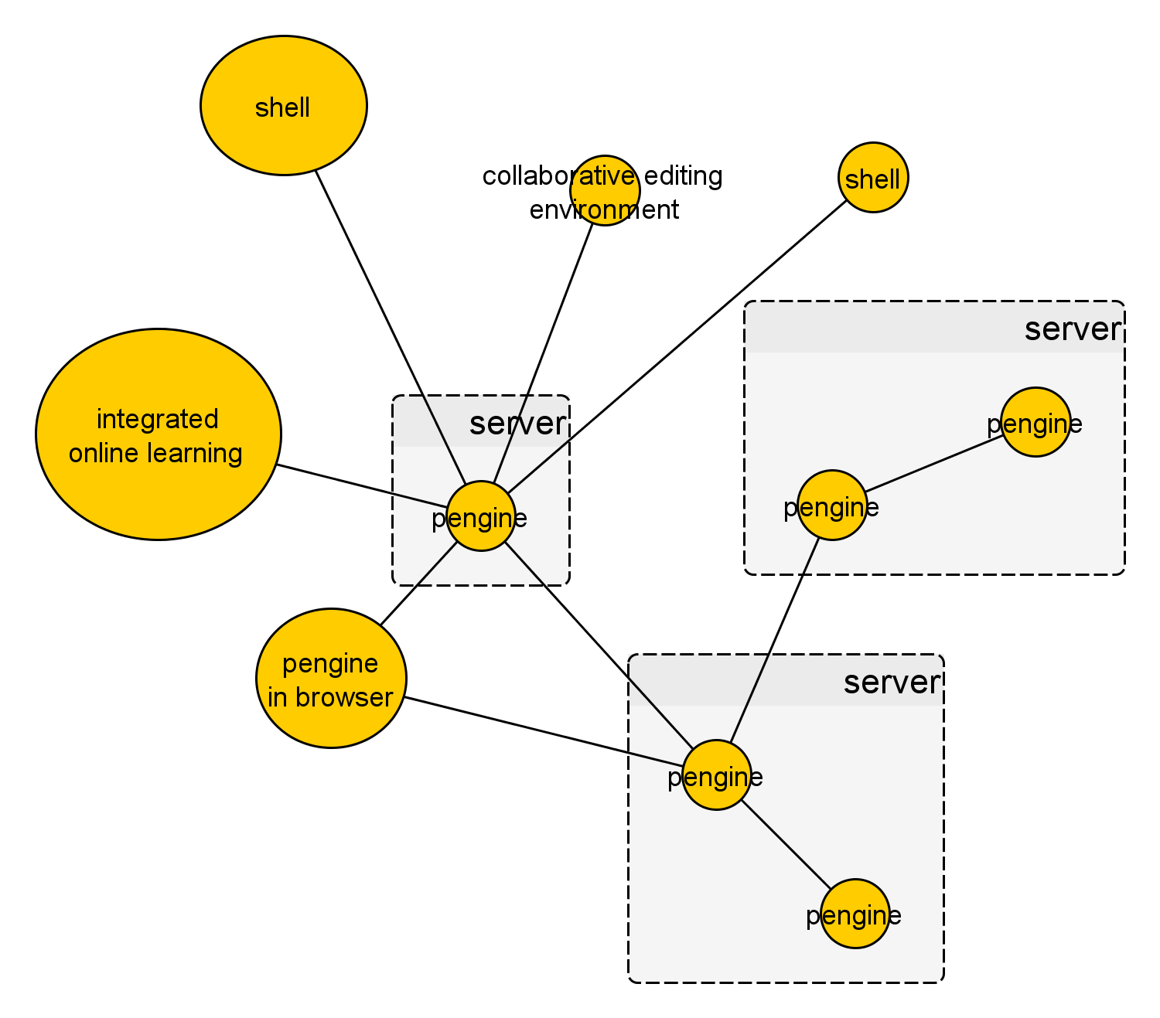

Slide 8
Where To Go From Here?
swi-prolog.org
Programming in Prolog, by W.F. Clocksin and C.S. Mellish
learnprolognow.org - online book
Leon Sterling & Ehud Shapiro - The Art of Prolog
http://www.pathwayslms.com/swipltuts/ - a set of tutorials by me, notably the 'usual way' to learn the web framework
Richard O'Keefe - the Craft of Prolog
Leon Sterling - The Practice of Prolog
##prolog channel on freenode.net IRC
Code for this talk available at

