Slide 1
Smart Warehouse Management System
Instructor:
Lilia SFAXI
Reporter
All team members of Project 5

Slide 2
CONTENTS
Project background and objectives
Data loading and
Program testing
Summary and future work
System design and implementation
Problems encountered and solutions
Notes:
b75d0af2-83ba-468a-bfb1-d7d2a8cc1799.source.default.zh-Hans

Slide 3
Project background and objectives
PART ONE

Slide 4
Project introduction and objectives
Project profile
This project aims to develop an intelligent warehouse management system to help efficiently manage and optimize the storage, retrieval and distribution of items in large warehouses.
Project objective
1. Create a Python class for warehouse items and implement a linked list to track inventory.
2. Develop tools that support adding, deleting and updating inventory items.
3. Implement the data loading function, read from the data set and initialize the system.
4. Organize items by category through tree structure to improve retrieval efficiency.

Slide 5
System design and implementation
PART TWO

Slide 6
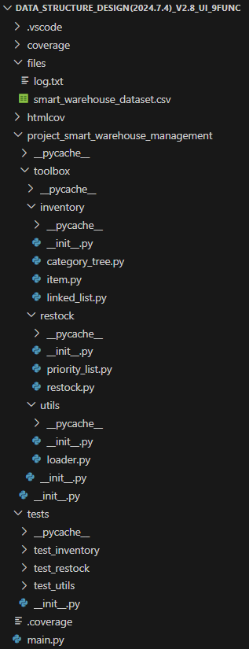
Project structure
Clear Structure:
The project framework has a well-defined structure with clear module responsibilities, making the code easy to understand and manage.
High Maintainability:
Clear module separation and thorough documentation improve the readability and maintainability of the code, facilitating future maintenance and optimization.
Strong Extensibility:
The project design considers future expansion needs, allowing new features or modules to be added easily without affecting existing functionality.

Slide 7
Data structure design
Linked_list
A inventory management system based on single linked list is implemented, which supports adding, deleting and updating commodity information, and can sort by commodity number.
Category_tree
A classification tree based on binary search tree is implemented, which is used to store and manage commodity information according to commodity classification, and supports insert, find, update and delete operations.
Priority_list
A minimum heap data structure is implemented to store elements and support the operation of inserting, extracting minimum elements and maintaining the properties of heap.

Slide 8
Algorithm implementation
There are 7 different algorithms shown below.
1
2
3
4
Insert Algorithm
Update Quantity Algorithm
Remove Algorithm
Finding Flgorithm
7
6
5
Generated Log Algorithm
Generate Restock Queue Algorithm
Show by Category Algorithm
Notes:
5d2d6480-6b0e-4747-beae-361439731ad7.source.7.zh-Hans

Slide 9
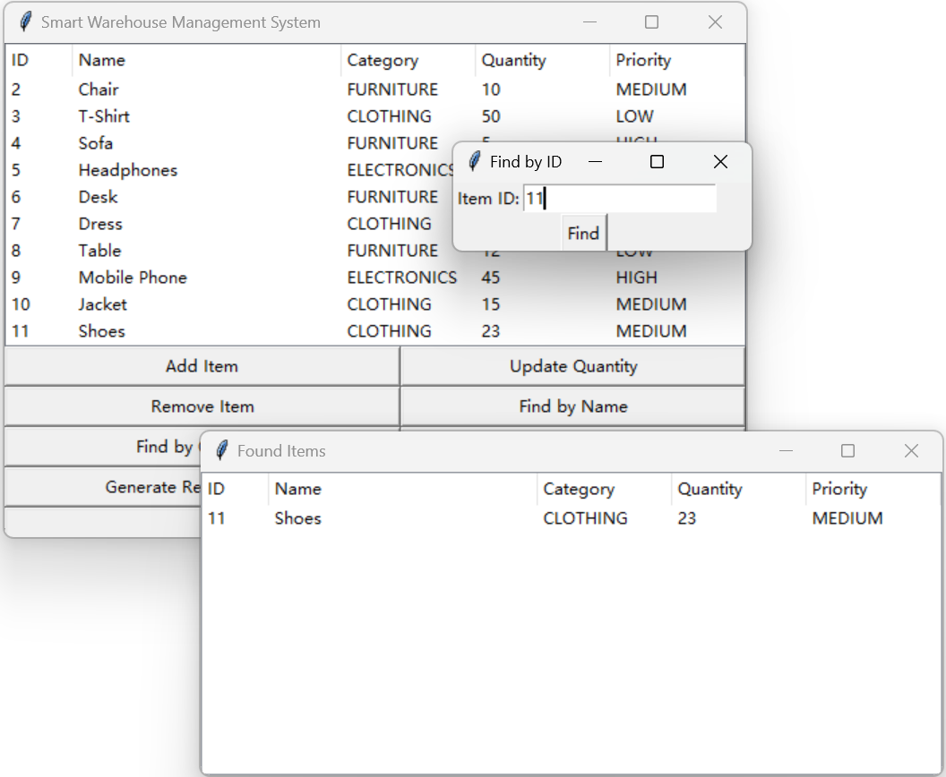
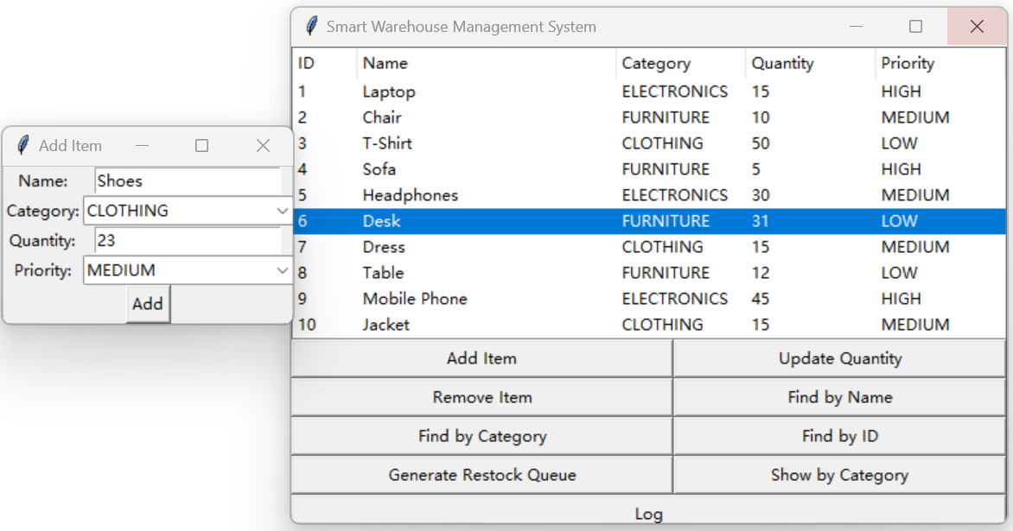
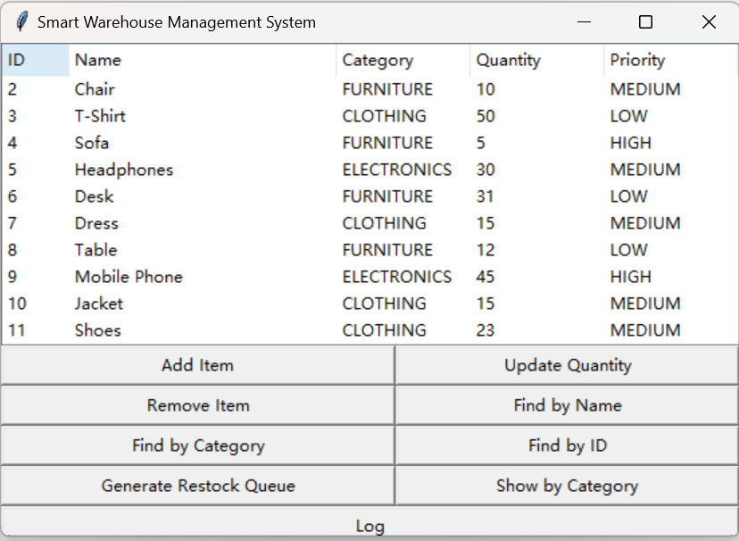
Algorithm implementation
Insert Algorithm
Add an item
Found in inventory
And the search was successful

Slide 10
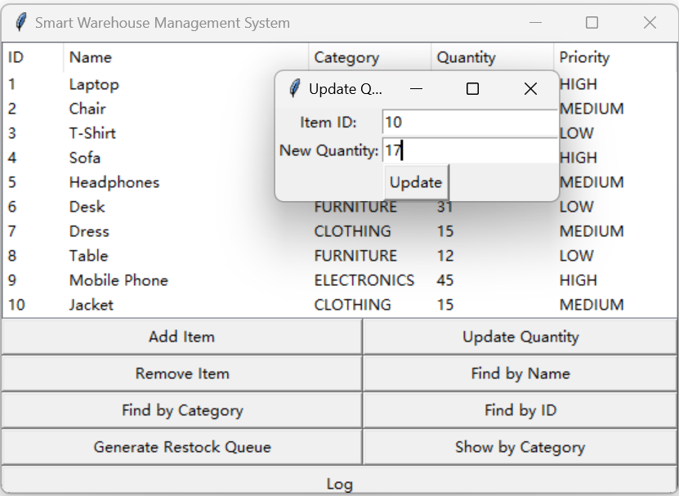
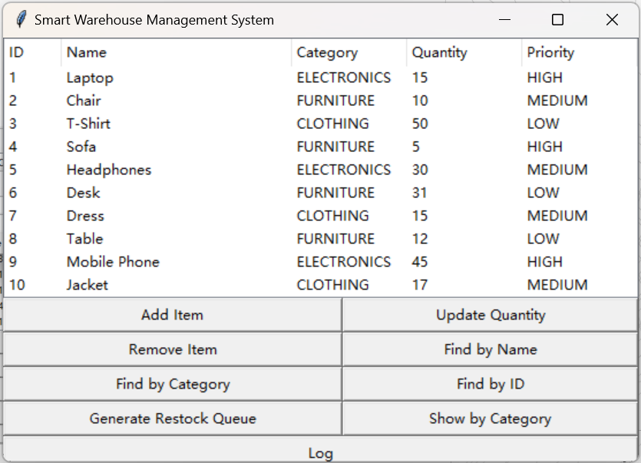
Algorithm implementation
Update Quantity Algorithm
(by button)
Update item quantity
Update quantity successful

Slide 11
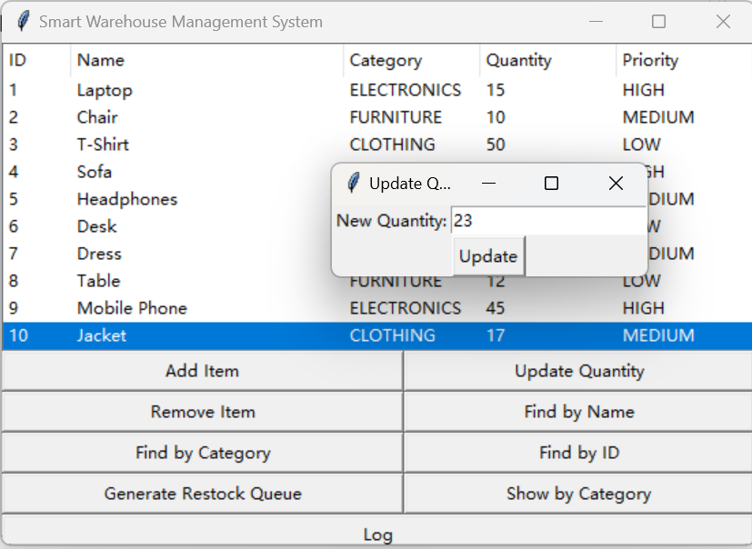
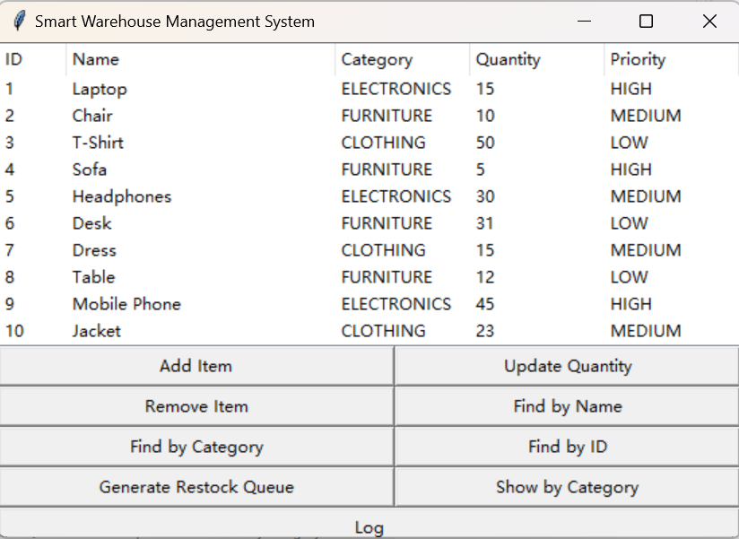
Algorithm implementation
Update Quantity Algorithm
(by right click)
Update item quantity
Update quantity successful

Slide 12
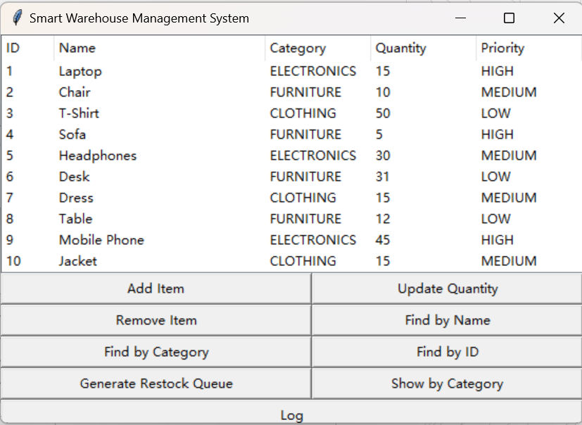
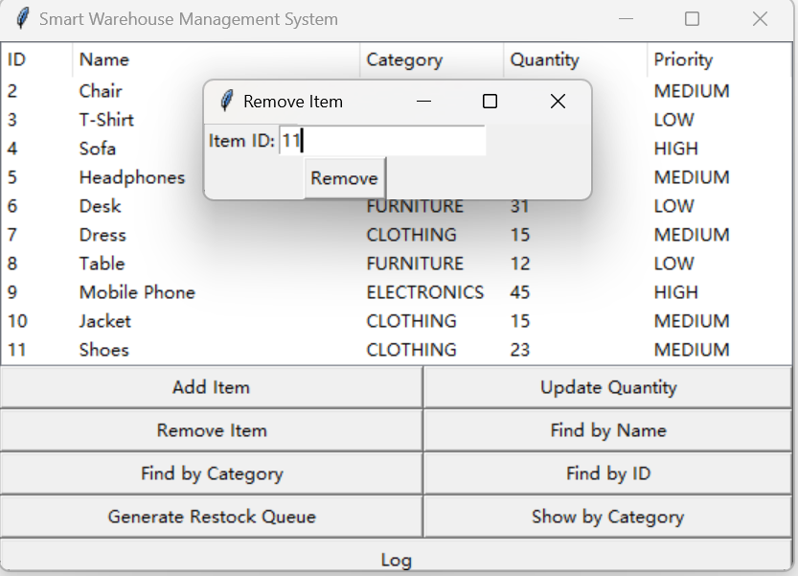
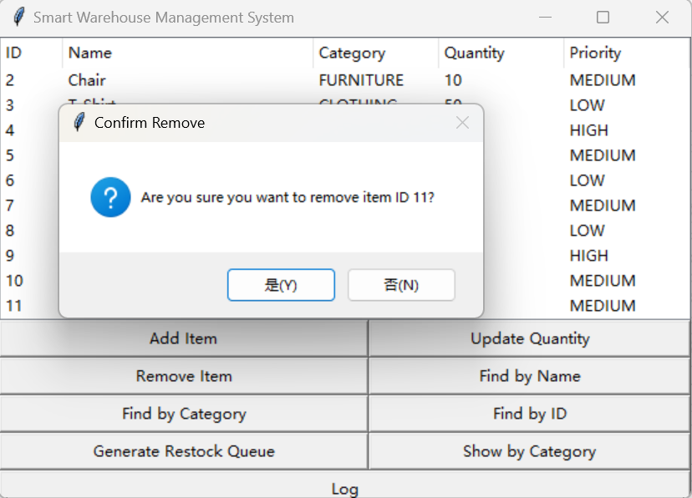
Algorithm implementation
Remove Algorithm
(by button)
Remove item
Perform secondary confirmation
Removal successful

Slide 13
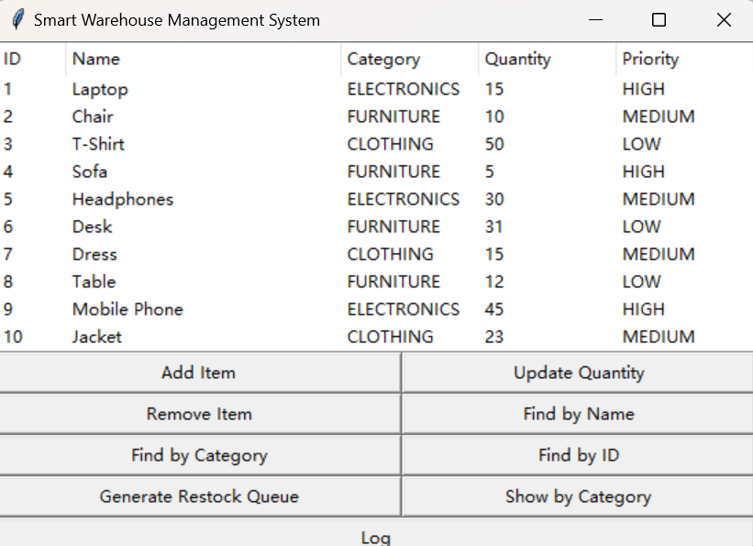
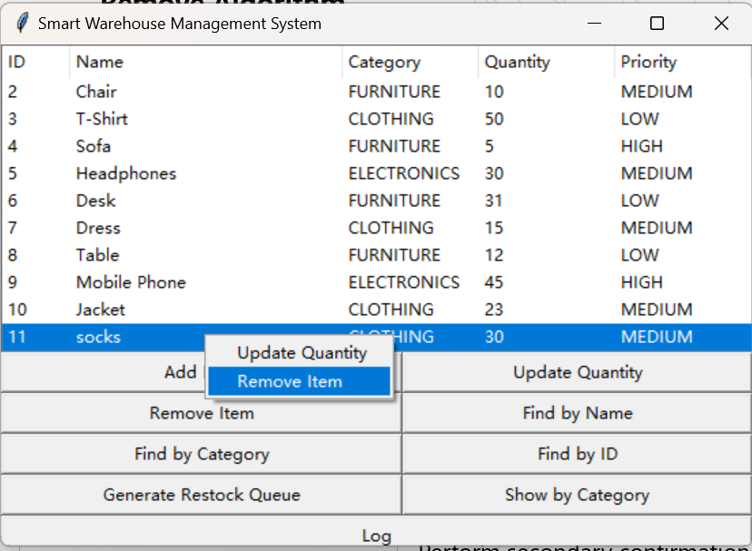
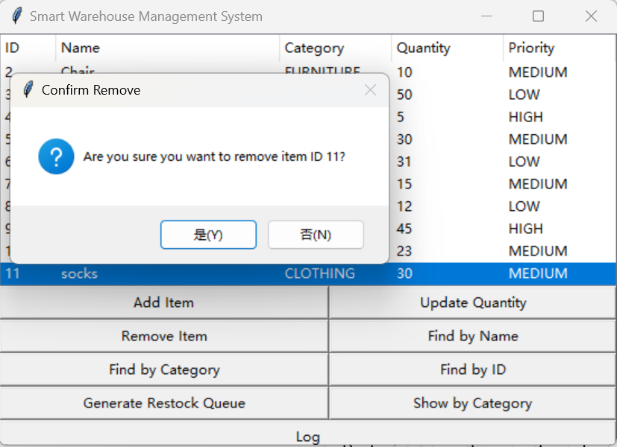
Algorithm implementation
Remove Algorithm
(by right click)
Remove item
Removal successful
Perform secondary confirmation

Slide 14
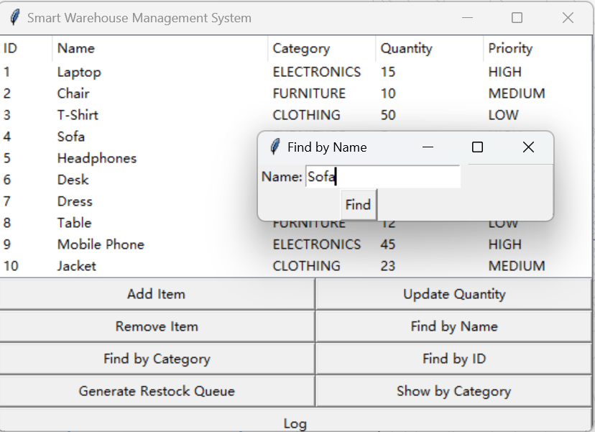
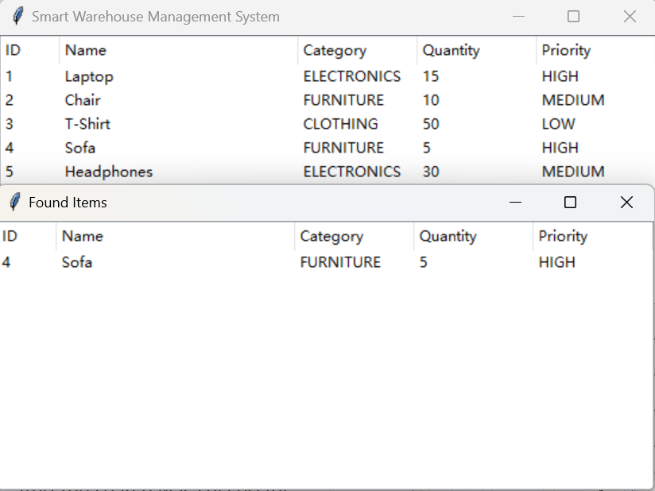
Algorithm implementation
Finding Flgorithm
(by name)
Find an item
Search successful

Slide 15
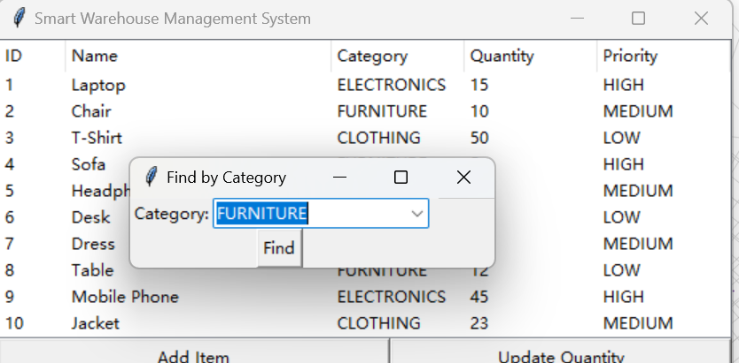
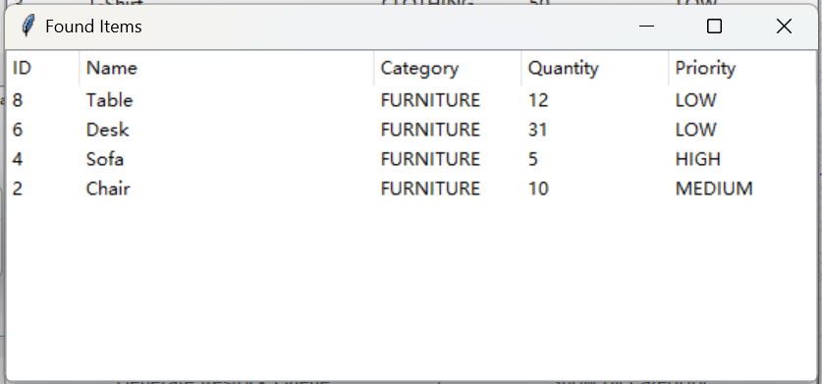
Algorithm implementation
Finding Flgorithm
(by Category)
Search successful
Find an item

Slide 16
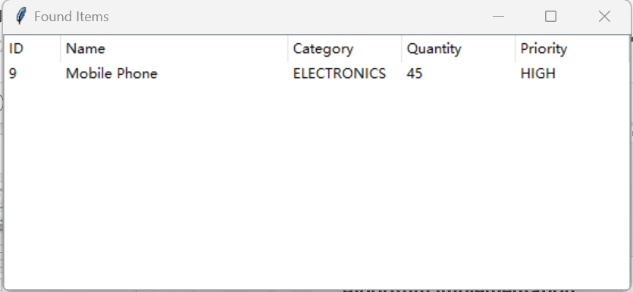
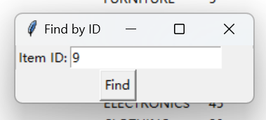
Algorithm implementation
Finding Flgorithm
(by ID)
Find an item
Search successful

Slide 17
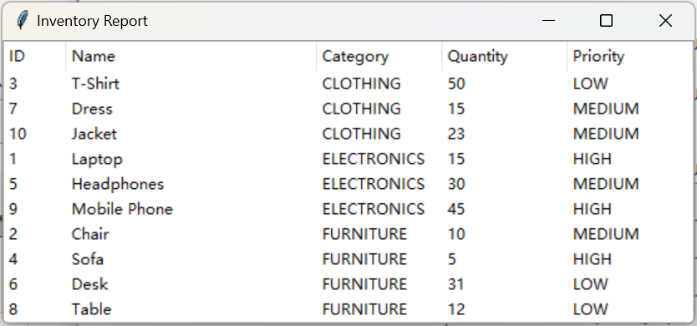
Algorithm implementation
Show by Category Algorithm

Slide 18
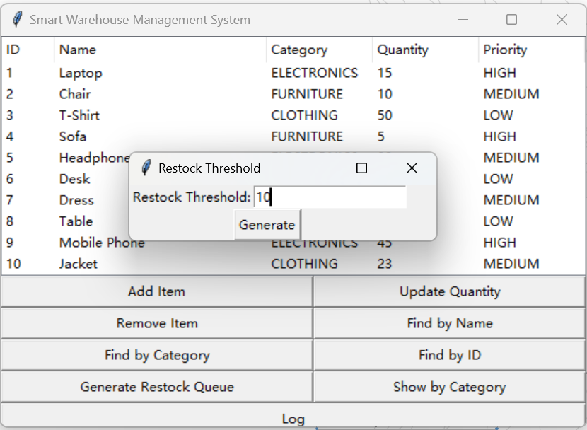
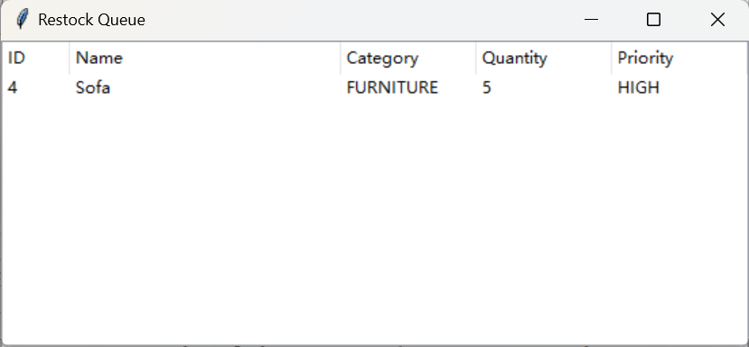
Algorithm implementation
Generate Restock Queue Algorithm
Output restock queue
Enter a threshold

Slide 19
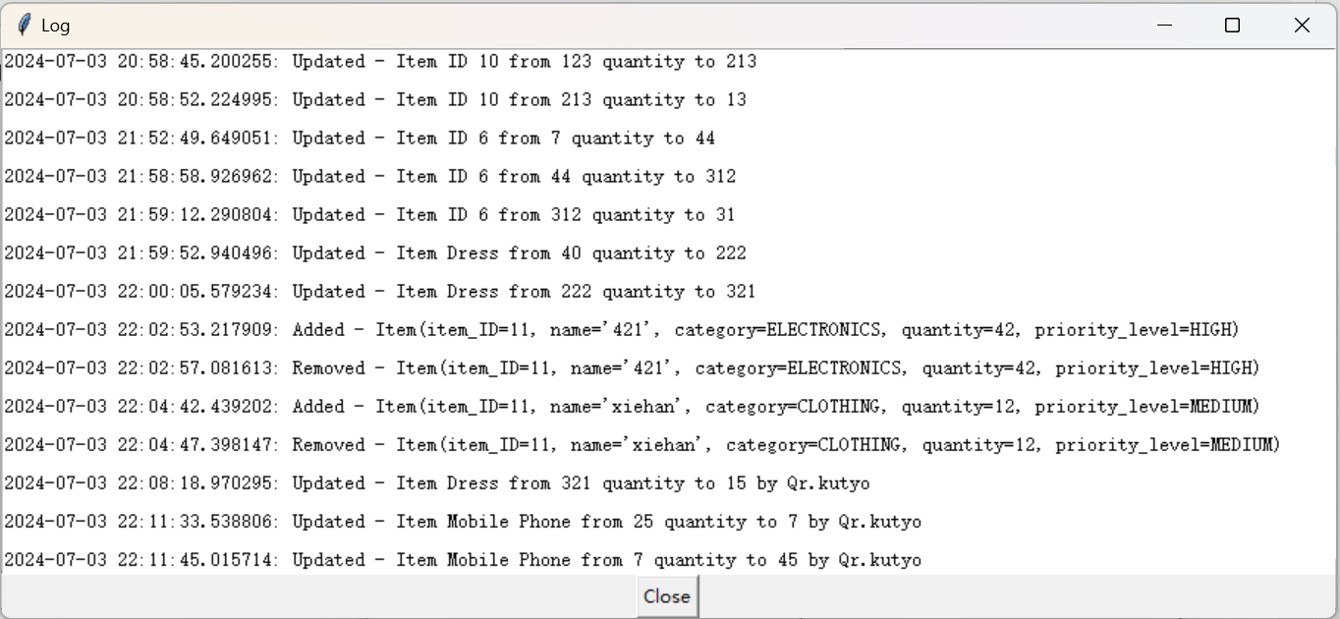
Algorithm implementation
Generated Log Algorithm

Slide 20
Data loading and
Program testing
PART THREE

Slide 21


Data loading and preprocessing
Data set introduction
The data set csv file, as shown in the figure, consists of multiple items with headers such as item_ID, name, category, quantity, and priority_level
Data processing
Read data from CSV files, create 'Item' objects and store them in linked lists and category trees, respectively, for on-demand access and management of item data.

Slide 22
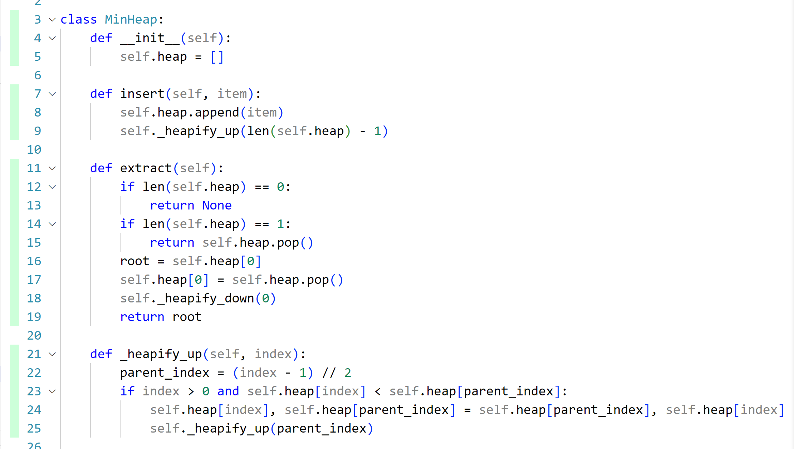
Test coverage in the code
By loading the extension you can clearly see which parts are covered and which are not

Slide 23
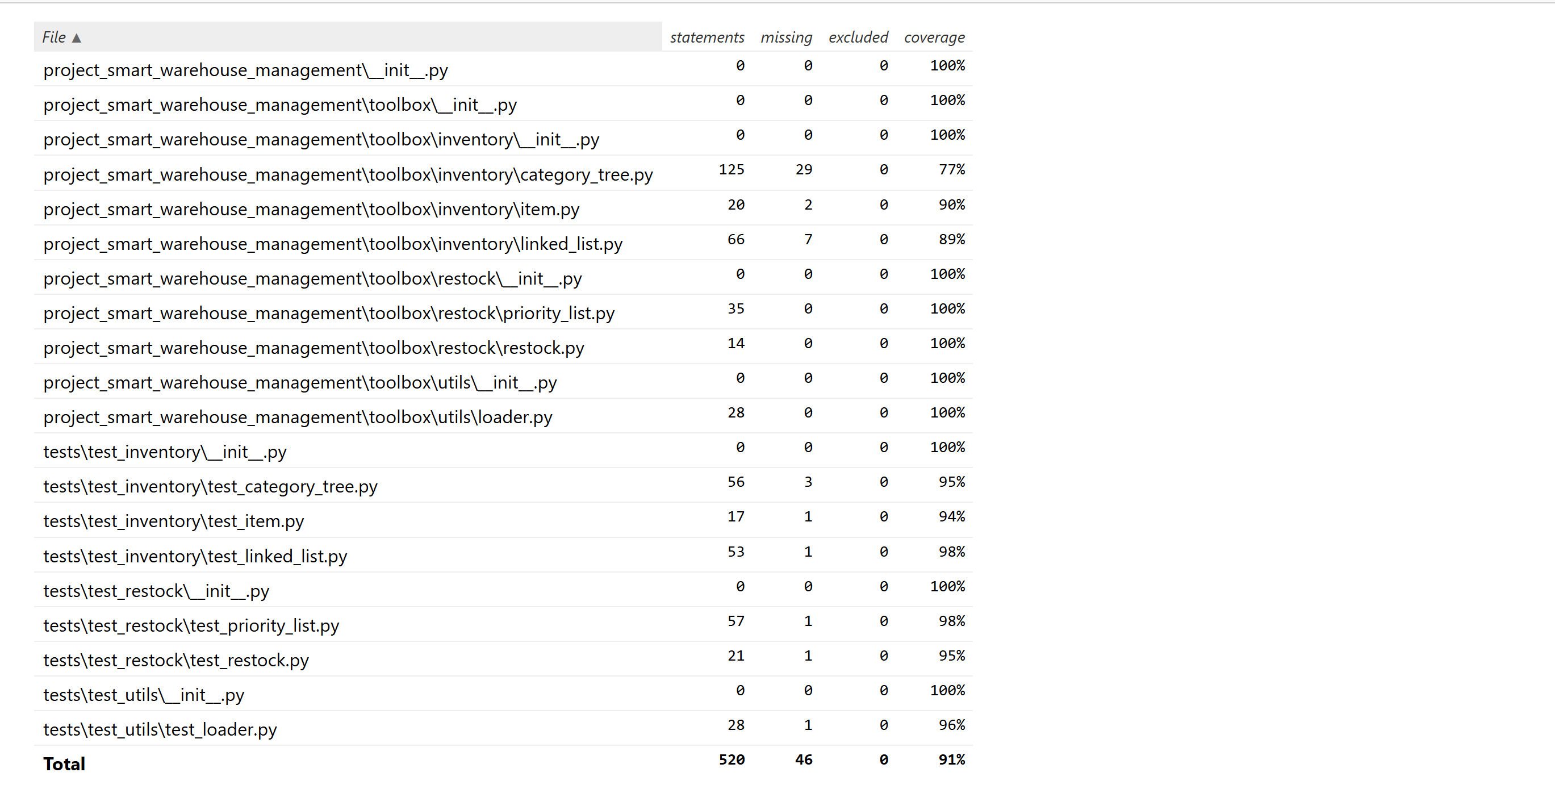
Test results and coverage reports
Reaction embodiment
The code coverage of up to 91% reflects that the test cases cover most of the code path widely, which can be seen that the code quality and stability are good.

Slide 24
Problems encountered and solutions
PART FOUR

Slide 25
Problems encountered and solutions
1. We encountered some errors during the module import process, such as attempting to import the module under the inventory package in the category_tree code.
So in each code, we added code similar to this, set the correct system path, and then import modules based on this：
current_dir = os.path.dirname(os.path.abspath(__file__))
project_root = os.path.dirname(current_dir)
sys.path.append(project_root)
2. When we were creating the GUI interface in the main function, we found that after adding a new item, we couldn't find it during the search.
So after checking, we found that we were looking for the tree we were using, but we only added the linked list to the linked list and did not update it to the tree, so it was not found. Therefore, we added the following line of code in the def add_item module:
self.inventorys.insert(category,item)
At the same time, we have also added the inter function in category_tree.py, used for inserting nodes.

Slide 26
Problems encountered and solutions
3. In the search function of GUI, we found that if we first modify the quantity of items and then search, the quantity of items does not change. But in reality, the changes have already been made in the CSV file.
After checking the main function code, we found that it was due to the lack of updating the number of items in the node of category_tree. Therefore, we added a function ‘update _quantity’ to update the number of items in the category tree code, which solved this problem.

Slide 27
Summary and future work
PART FIVE

Slide 28
Project summary
Currently successful
Future work
We have successfully developed an intelligent warehouse management system that integrates efficient inventory management, classified storage, intelligent replenishment functions, and provides a user-friendly graphical interface.
Further optimize the algorithm of intelligent warehouse management system, improve its performance and intelligence level, and enhance the user interface interaction and data visualization effect.
Notes:
d55f3c7b-7083-4b05-8c3f-c44aa8a8eda2.source.2.zh-Hans

Slide 29
Project 5
THANK YOU FOR WATCHING

