Slide 1

Top 10
For App Trader
February 2021
Prepared by Joker Consulting

Slide 2
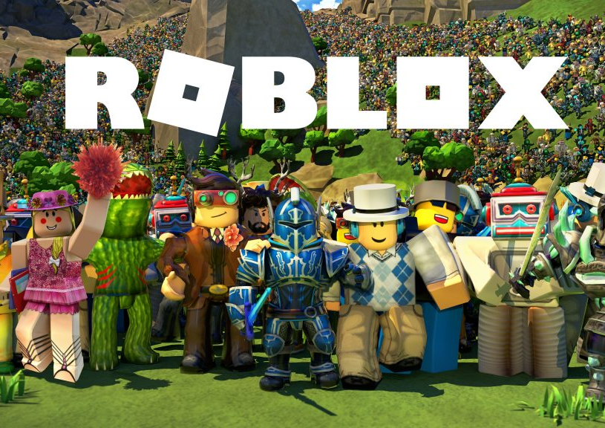
Rating = Longevity
The higher the rating, the longer the app is in use, meaning higher profits for App Trader.

Slide 3

What’ll it cost?
With our top 10 games, App trader will only spend the minimum amount of money required to acquire the rights of an app, while returning the maximum amount of return.
For this reason, all of our games are $0 for consumers, with many options for in-app purchases.

Slide 4
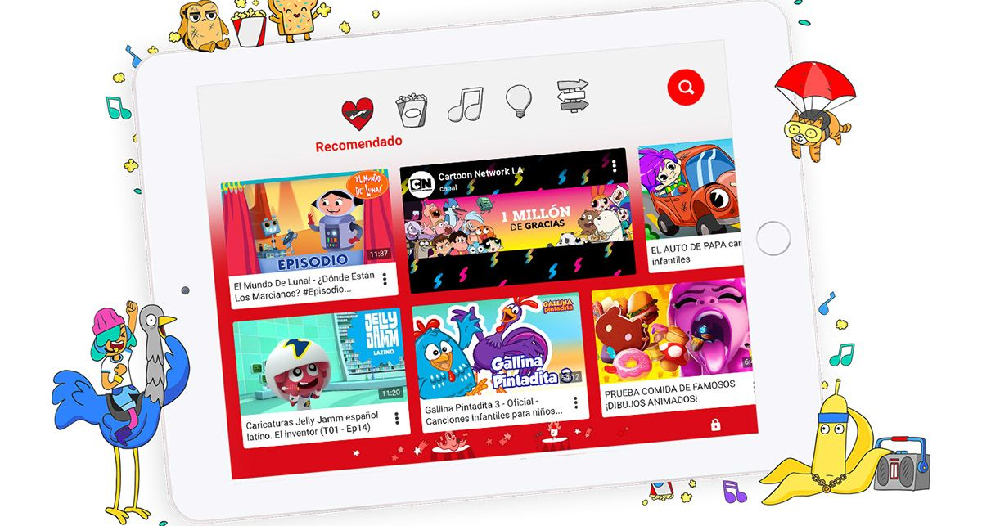
Profit for Years
Since our games have the highest ratings, they will be profitable for up to 11 years.

Slide 5

Content Rating
The age range for these games ranges from 4 to 12, meaning they are for EVERYONE!

Slide 6
Top 10
 | Star Rating | Total return over lifetime | Initial Cost
Dude Perfect 2 | 5 | $198,000 | $20,000
Shadow Fight 2 | 5 | $198,000 | $20,000
War Robots | 5 | $198,000 | $20,000
Solitaire | 5 | $198,000 | $20,000
Hungry Shark Evolution | 5 | $198,000 | $20,000
Hill Climb Racing 2 | 5 | $198,000 | $20,000
Score! Hero | 5 | $198,000 | $20,000
YouTube Kids | 5 | $198,000 | $20,000
ROBLOX | 5 | $198,000 | $20,000
Angry Birds Epic RPG | 5 | $198,000 | $20,000
We recommend these 10 apps that are available on the App Store and the Play Store.

