Slide 1
Changes in Unemployment Rates and GDP Trends over time worldwide
-What is their interplay?

Slide 2
Outline
Unemployment Rates over Time
GDP
Their interplay

Slide 3
Unemployment Rates over Time

Slide 4
Unemployment refers to the share of the labor force that is without work but available for and seeking employment

Slide 5
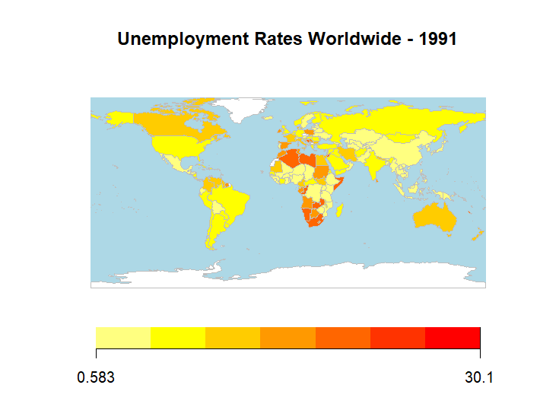
Unemployment Rates Worldwide

Slide 7
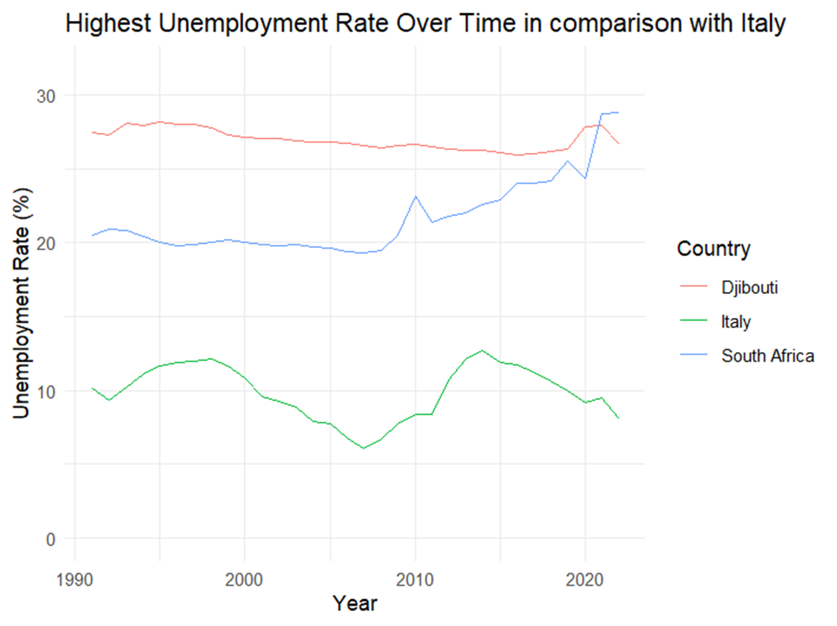
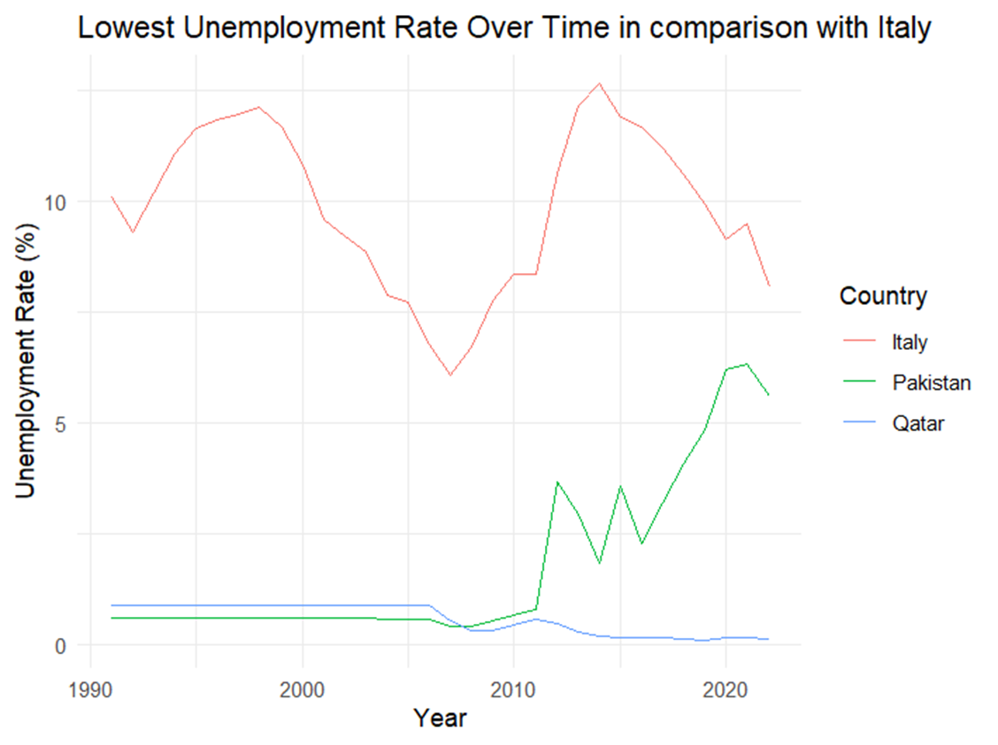
The Highs and Lows

Slide 8
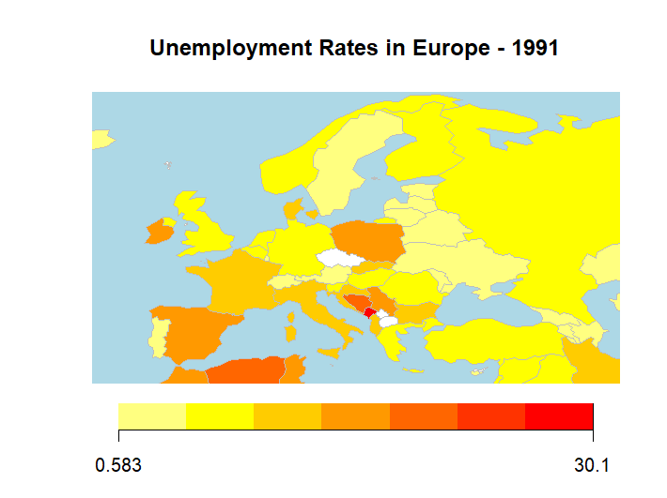
Unemployment Rates Europe

Slide 9
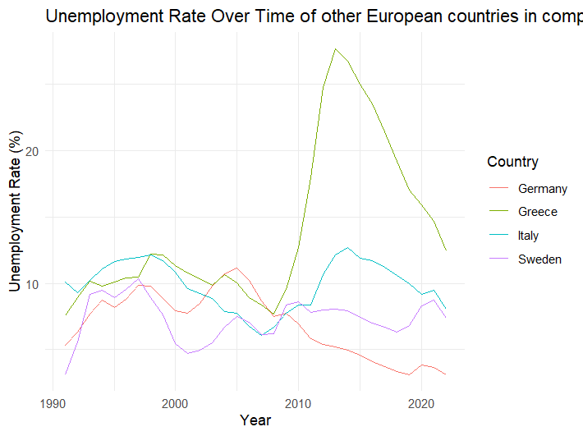

Slide 10
Hypothesis: What caused these Changes?
Economic Recessions and Depressions (Great Recession)
Technological Advancements (AI)
Natural Disasters and Pandemics (Covid Pandemic)
Trade and Globalization

Slide 11
Another possible indicator:
Gross Domestic Product
the monetary value of all finished goods and services made within a country during a specific period

Slide 12
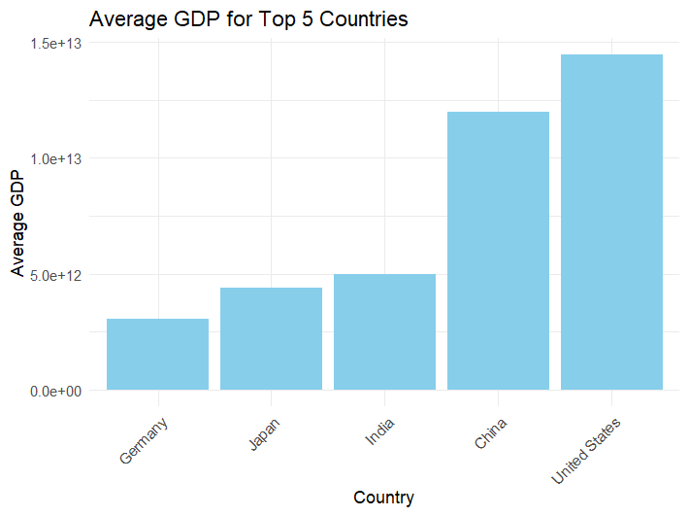
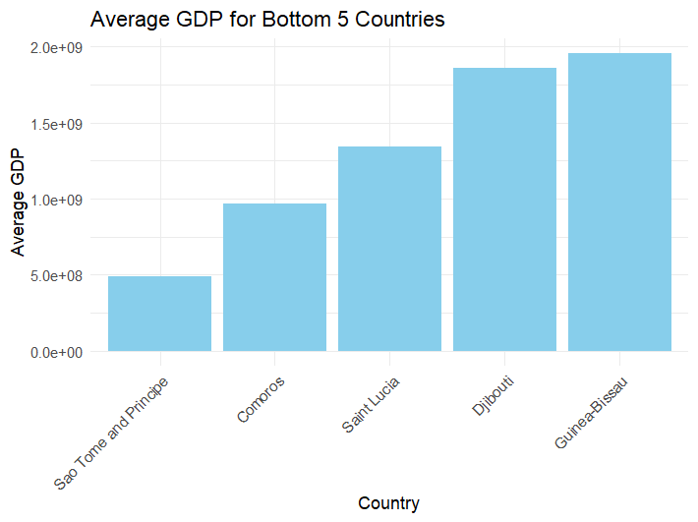
Tops and Lows

Slide 13
Okuns Law
An observation that a rise in employment is often associated with a rise in GDP (Gross Domestic Product)

Slide 14
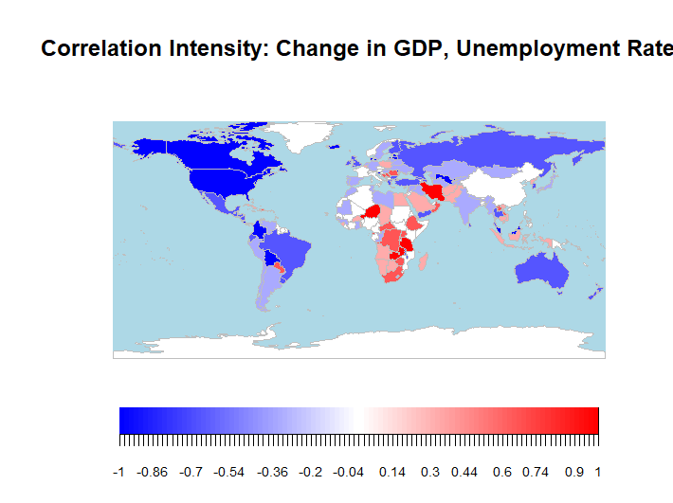

Slide 15
Countries for which Okuns Law can be proven as true

