Slide 2
Ensemble learning
Chapter 7 in Python Machine Learning TE

Slide 3

Ensemble learning
Simplicity of (statistical classifier) models
DL requires huge amount of data
https://cdn-0.scatteredquotes.com/wp-content/uploads/2019/04/Avengers-Endgame-Quotes-7.jpg

Slide 4
What we will cover
What is ensemble models → combining classifications
How to ensemble models
→ Majority voting
→ Bagging – bootstrapping samples, single classifier
→ Boosting – weak learners focusing on hard to classify samples
AdaBoost/XGBoost
Evaluation and tuning

Slide 5
Resources
Python Machine Learning TE, Chapter 7, pages 219-254.
Jupyter notebook: Chapter 7, part 1
Ensemble methods in scikit-learn: http://scikit-learn.org/stable/modules/ensemble.html

Slide 6
Ensemble Learning
Main idea: Many models in combination can perform better than one -> combine individual classifiers into a meta-classifier.
Bagging (Bootstrap aggregating):
Reduce overfit by combining different models built from different subsets of the available training data.
Boosting:
Hierarchy of weak learners with different tasks.
Combine weak learners into a common, flexible, high performance model.

Slide 7
Ensemble Learning
Main idea: Many models in combination can perform better than one -> combine individual classifiers into a meta-classifier.
Bagging (Bootstrap aggregating):
Reduce overfit by combining different models built from different subsets of the available training data.
Boosting:
Hierarchy of weak learners with different tasks.
Combine weak learners into a common, flexible, high performance model.

Slide 8


Analogy - dietary advice
Many experts & many opinions
Single learner analogy:
Listen to one expert
Large bet on single product?
May be disappointed
Ensemble learning:
Listen to many experts
Construct consensus
More robust advise
Reduce chance of disappointment

Slide 9
Majority Voting
→ Majority voting (binary) simply means that we select the class label that has been predicted by the majority of classifiers. (Generalized to multiclass settings, the principle is called plurality voting.)
[p. 233-236]

Slide 10
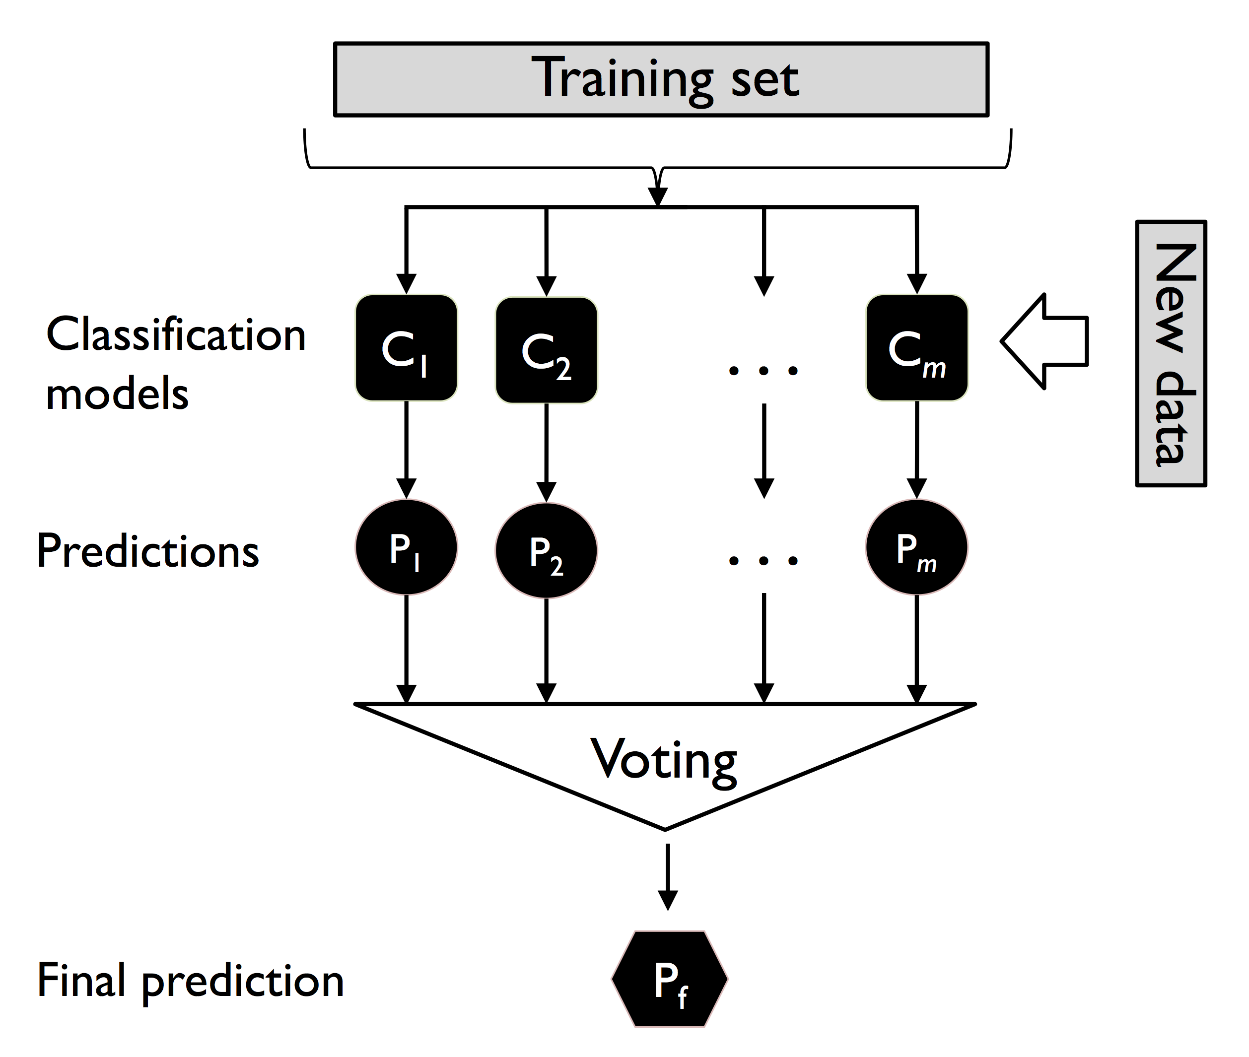
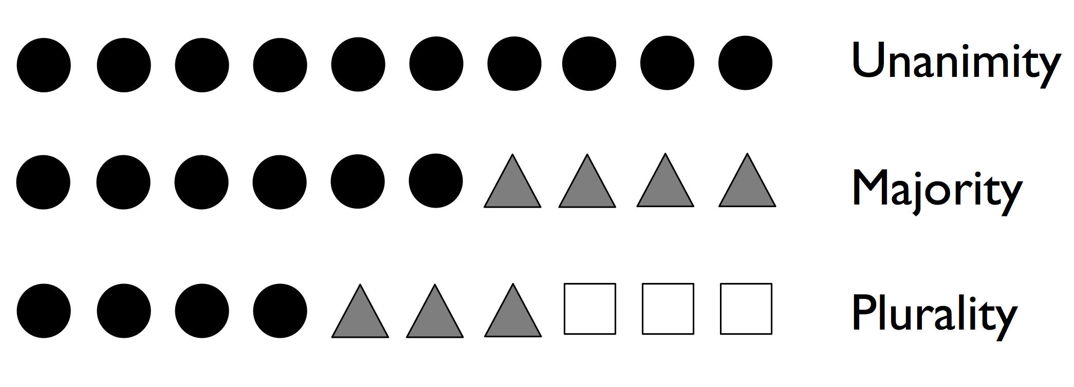

Majority voting
Train several classifiers and/or subsets and predict a sample
Choose the class that received the most votes among the classifiers. $\hat{y}=mode\left\{C_{1}\left(x\right),C_{2}\left(x\right),…,C_{m}(x)\right\}$

Slide 11
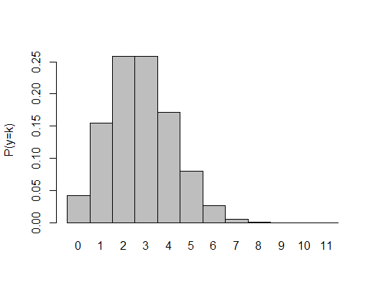
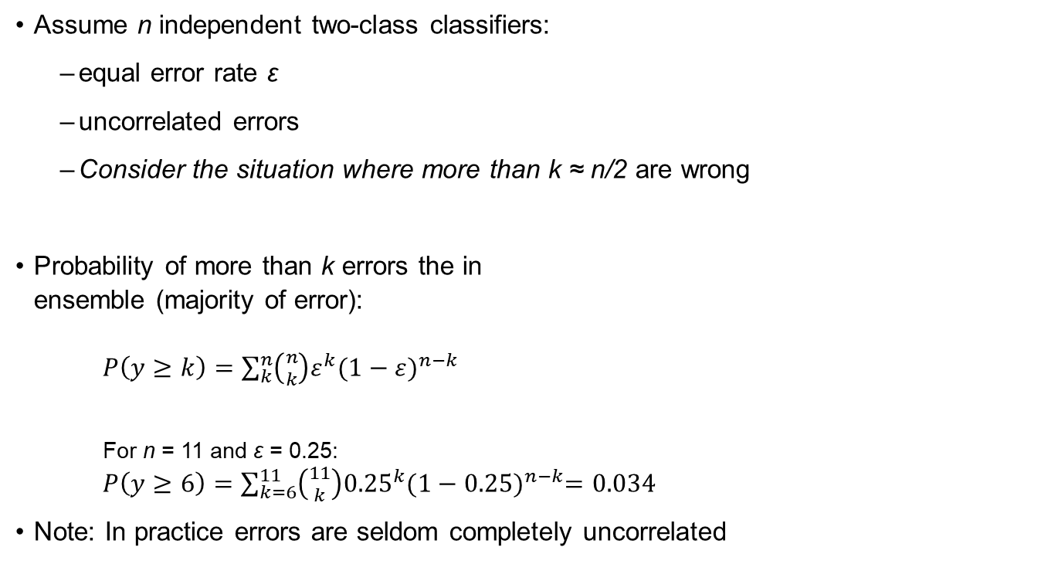
Combinatorial argument
Assume n independent two-class classifiers:
equal error rate ε
uncorrelated errors
Consider the situation where more than k ≈ n/2 are wrong
Probability of more than k errors the in ensemble (majority of error): $P\left(y≥k\right)=\sum_{k}^{n}{\left({n \atop k}\right)ε^{k}{(1−ε)}^{n−k}}$
For n = 11 and ε = 0.25: $P\left(y≥6\right)=\sum_{k=6}^{11}{\left({11 \atop k}\right){0.25}^{k}{(1−0.25)}^{n−k}=0.034}$
Note: In practice errors are seldom completely uncorrelated
Jupyter: Chapter 7, part 1

Slide 12
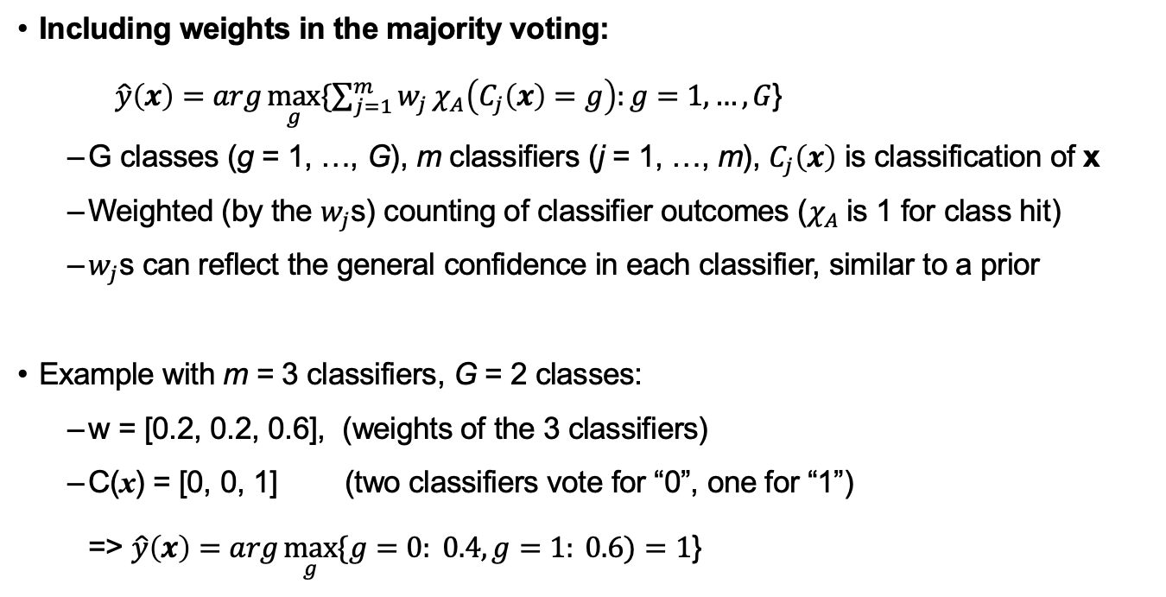
General majority vote
Including weights in the majority voting: $\hat{y}\left(x\right)=arg\max_{g}{\{\sum_{j=1}^{m}{w_{j}}χ_{A}\left(C_{j}\left(x\right)=g\right):g=1,…,G}$}
G classes (g = 1, …, G), m classifiers (j = 1, …, m), $C_{j}\left(x\right)$ is classification of x
Weighted (by the $w_{j}$s) counting of classifier outcomes ($χ_{A}$is 1 for class hit)
$w_{j}$s can reflect the general confidence in each classifier, similar to a prior
Example with m = 3 classifiers, G = 2 classes:
w = [0.2, 0.2, 0.6], (weights of the 3 classifiers)
C(x) = [0, 0, 1] (two classifiers vote for “0”, one for “1”) => $\hat{y}\left(x\right)=arg\max_{g}{\{g=0: 0.4, g=1: 0.6)}=1$}

Slide 13
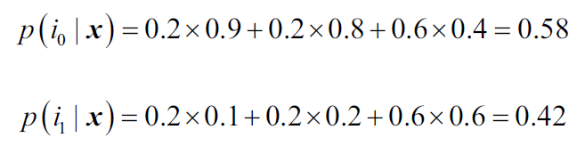
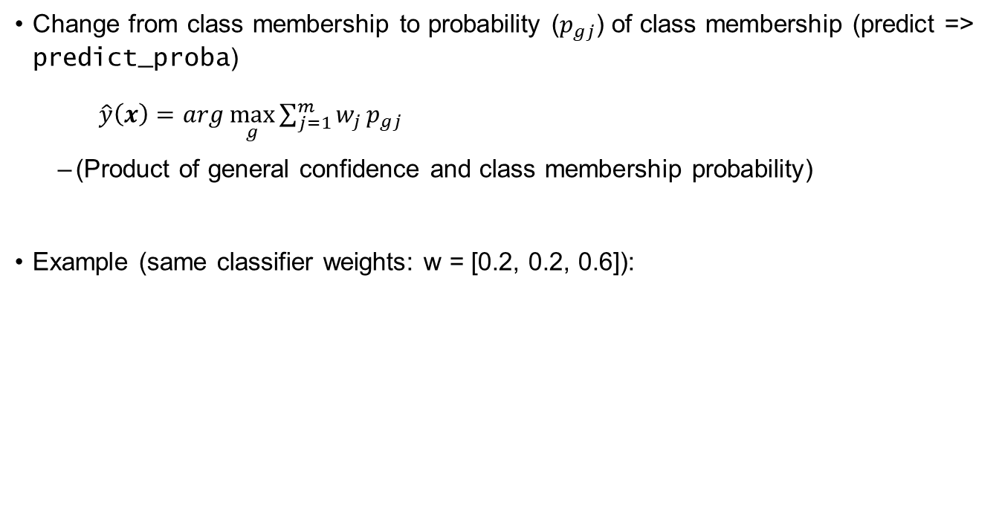

Posterior probabilities
Change from class membership to probability ($p_{gj}$) of class membership (predict => predict_proba) $\hat{y}\left(x\right)=arg\max_{g}{\sum_{j=1}^{m}{w_{j}}p_{gj}}$
(Product of general confidence and class membership probability)
Example (same classifier weights: w = [0.2, 0.2, 0.6]):
p(g = 0| x )
p(g = 1| x )
$$\hat{y}\left(x\right)=arg\max_{g}\left[ p\left(g=0\right| x\right),p\left(g=1\right| x)]=0$$

Slide 14
Implementing a majority vote classifier
We will make an estimator in the scikit-learn style: http://scikit-learn.org/stable/developers/develop.html
To reduce the amount of code needed, we use inheritance from BaseEstimator and ClassifierMixin which include some mandatory functions:. get_params, set_params, score.
To make estimators compatible with pipelines we need fit/fit_transform and transform functions. As this is a classifier, the transform parts are not needed.
Including predict enables prediction, predict_proba enables ROC AUC and similar.
Jupyter: Chapter 7, part 1

Slide 15
Bagging
→ Draw bootstrap samples (random samples with replacement) from the initial training dataset to fit the individual classifiers in the ‘ensemble’.
[p. 243-248]

Slide 16
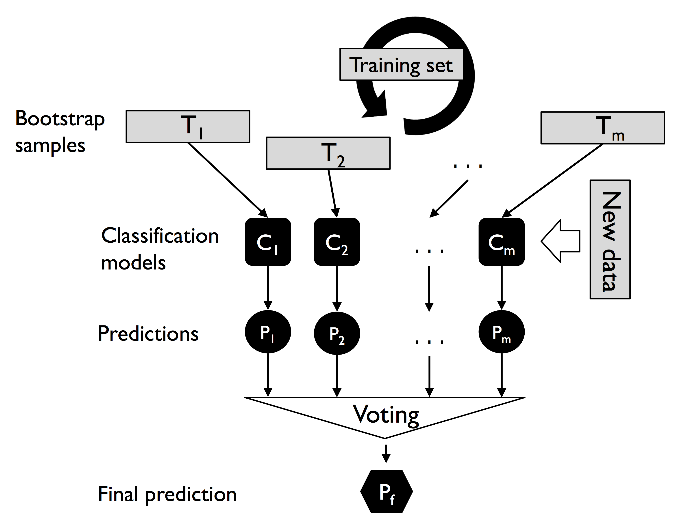
Bagging – bootstrap aggregation
Building an ensemble of classifiers from bootstrap samples.
Repeatedly sample with replacement from the training data.
(Replacement causes duplicate observations in the training data)
Train the classifier on each sample and predict new data.
Vote for final prediction.
Note: In the models of regression, the final prediction is made by averaging the predictions of the all-base model, and that is known as bagging regression.

Slide 17
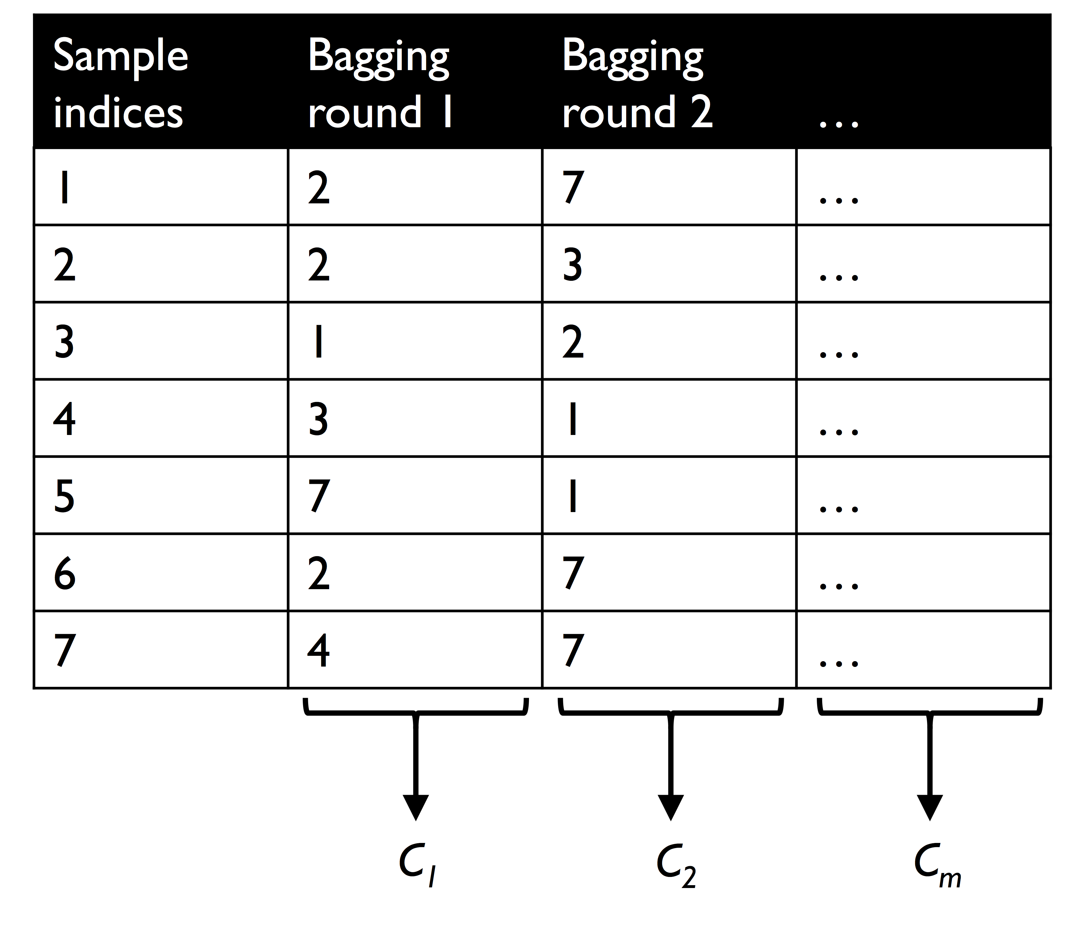
Bagging “in a nutshell”
Typically we use unpruned decision trees as our individual classifiers
Note: Training accuracy can be forced to 100% with single sample end-nodes.
Strategy:
Fit a classifier for each of the m bootstrap samples (bootstrap aggregation).
Apply all the m classifiers for prediction.
Make the final (ensemble) prediction by Majority voting based on the m individual classifiers.
Jupyter: Chapter 7, part 2

Slide 18
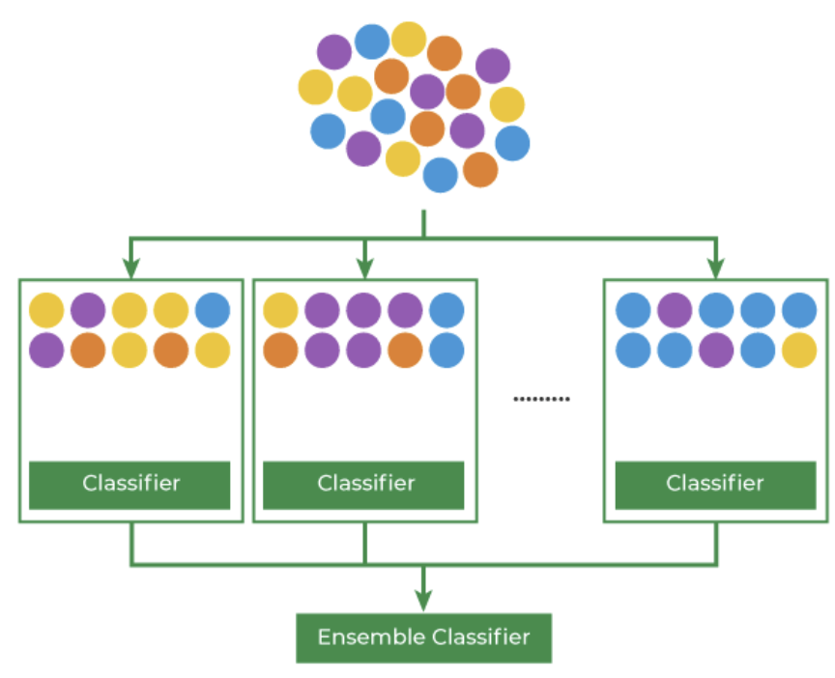
Bagging Classifier – code example*
Basic steps:
Bootstrap sampling
Base model training (individually)
Aggregation/Majority voting
Classifier instance from scratch
from sklearn.ensemble import BaggingClassifier
*https://www.geeksforgeeks.org/ml-bagging-classifier/

Slide 19
Boosting
→ Weak learners subsequently learn from misclassified training examples to improve the performance of the ‘ensemble’.
[p. 249-257]

Slide 20

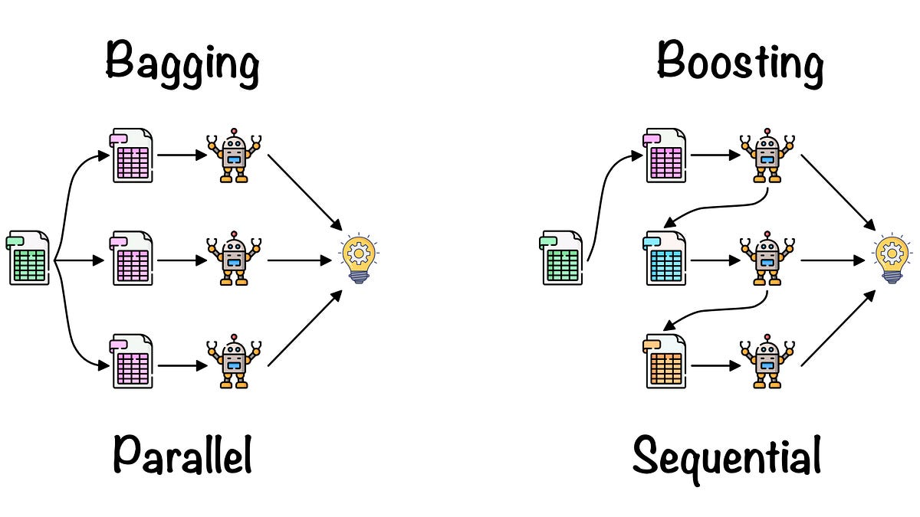
Boosting “in a nutshell”
Very simple individual classifiers (weak learners), usually a decision tree stump (a tree with only one split).
Focus on the samples that are hard to classify:
Re-learning based on up-weighting of previous misclassifications.
Many different boosting algorithms exist, e.g., AdaBoost, LogitBoost, BrownBoost, LPBoost, XGBoost, …
AdaBoost directly available in scikit-learn, together with (Histogram) Gradient Boosting (Histogram is experimental in sklearn 0.24.1)
xgboost available in scikit format (pip install XGBoost (Mac/Linux), compilation on Windows)
BrownBoost available through Intel daal libraries (pip install daal (different interface))

Slide 21
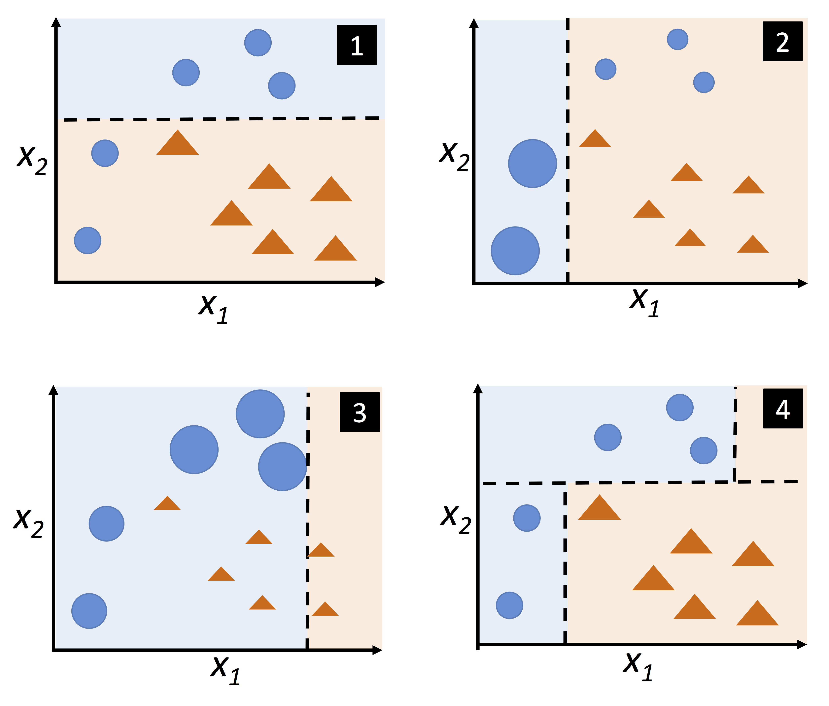
The AdaBoost
Complete training set every time
Repeated reweighting
Learn from previous mistakes
First classification
Increase weights on misclassified samples, decrease on the correct ones.
Repeat, usually several times
Combine the classifiers obtained in all the previous steps by weighted majority voting.

Slide 22
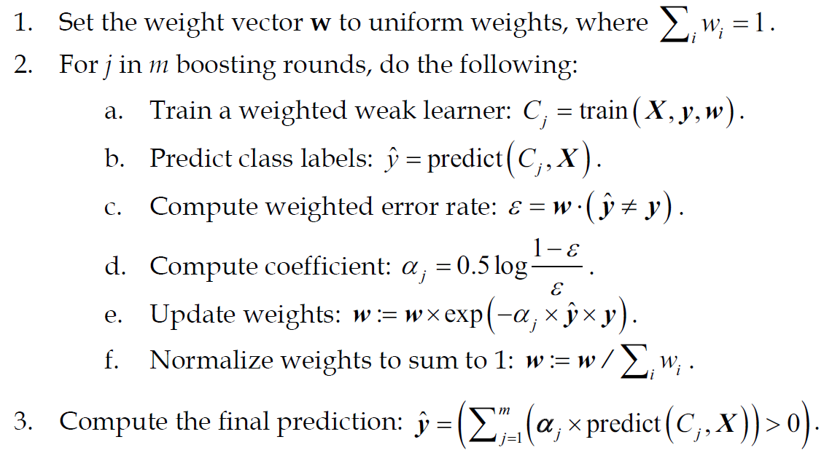
AdaBoost, detailed description
First time all the sample weights in w are equal.
In later iterations weights are adjusted to emphasize samples that seems hard to classify correctly.

Slide 23
AdaBoost, detailed description
Use the sample weights w to emphasize errors from hard to classify samples

Slide 24
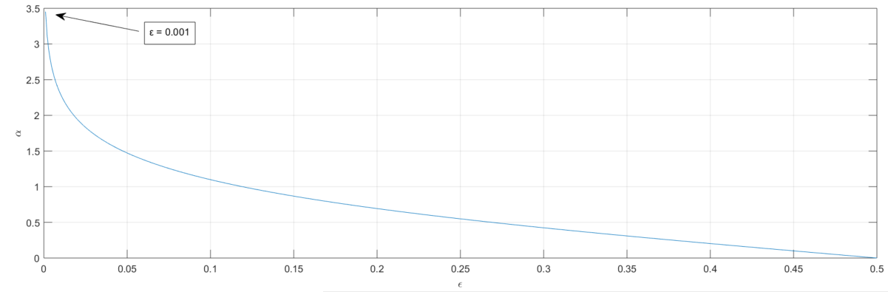
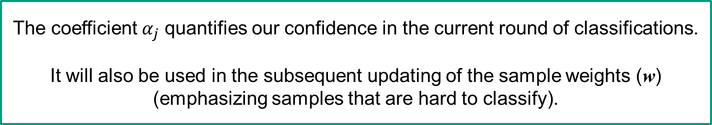
AdaBoost, detailed description
The coefficient $α_{j}$ quantifies our confidence in the current round of classifications.
It will also be used in the subsequent updating of the sample weights (w) (emphasizing samples that are hard to classify).

Slide 25
AdaBoost, detailed description
Next round’s weights are an adjustment of this round’s weights according to the confidence in this round and correct/incorrect classification (y_{i} = +/- 1), x = element-wise product resulting in a vector.

Slide 26
AdaBoost, detailed description
Note: In the notation below, element-wise multiplication is represented by the cross symbol (×) and the dot-product between two vectors by a dot symbol (⋅), see more details on pages 250-54:
Jupyter: Chapter 7, part 2

Slide 27
Gradient Boosting
AdaBoost: Adjusts the weights of training instances to focus on the ones that previous classifiers misclassified.
Gradient Boosting: Builds each tree on the residuals of the previous tree's predictions, effectively focusing on reducing the errors.
AdaBoost | Gradient Boosting
During each iteration in AdaBoost, the weights of incorrectly classified samples are increased, so that the next weak learner focuses more on these samples. | Gradient Boosting updates the weights by computing the negative gradient of the loss function with respect to the predicted output.
Calculates the weights for the weak classifiers in the final decision based on their accuracy. | Uses a learning rate to shrink the contribution of each tree to prevent overfitting and improve model robustness.
AdaBoost uses simple decision trees with one split known as the decision stumps of weak learners. | Gradient Boosting can use a wide range of base learners, such as decision trees, and linear models.
AdaBoost is more susceptible to noise and outliers in the data, as it assigns high weights to misclassified samples | Gradient Boosting is generally more robust, as it updates the weights based on the gradients, which are less sensitive to outliers.

Slide 28
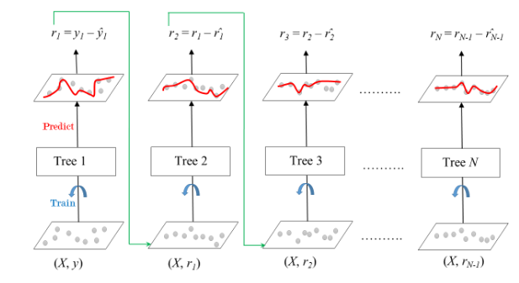
Gradient Boosting
Initialize a base model
Compute residual
Build a weak learner to the residuals
Compute the gradients of the loss
Update the model
Make the final prediction

Slide 29

Step-by-step walk through* _{(regression)}
Dataset
Loss function (MSE) $\frac{1}{2}{(Observed −Predicted)}^{2}$
Initial prediction
$\frac{123+56+345+98}{4}=156$
Pseudo residuals
-33
-100
189
-58
Age | Category | Weight (kg) | Price (USD)
25 | Electronics | 2.5 | 123
34 | Clothing | 1.3 | 56
42 | Electronics | 5.0 | 345
19 | Homeware | 3.2 | 98
Average
156
*https://www.datacamp.com/tutorial/guide-to-the-gradient-boosting-algorithm

Slide 30
Step-by-step walk through*
Dataset
Build a weak learner
Pseudo residuals
-33
-100
189
-58
Age | Category | Weight (kg) | Price (USD)
25 | Electronics | 2.5 | 123
34 | Clothing | 1.3 | 56
42 | Electronics | 5.0 | 345
19 | Homeware | 3.2 | 98
Category = E
Age < 30
Weight > 2
-33
189
-58
-100
*https://www.datacamp.com/tutorial/guide-to-the-gradient-boosting-algorithm

Slide 31
Step-by-step walk through*
Dataset
New prediction
Pseudo residuals
-33
-100
189
-58
Age | Category | Weight (kg) | Price (USD)
25 | Electronics | 2.5 | 123
34 | Clothing | 1.3 | 56
42 | Electronics | 5.0 | 345
19 | Homeware | 3.2 | 98
Category = E
Average
Age < 30
Weight > 2
123 (!)
156
-33
189
-58
-100
*https://www.datacamp.com/tutorial/guide-to-the-gradient-boosting-algorithm

Slide 32

Step-by-step walk through*
Dataset
Learning rate $η→0.1$ (lots of small steps in the right direction results in better prediction)
New predictions
Sample 1: $156+η∗\left(−33\right)=152.7$
Sample 4: $156+η∗\left(−58\right)=150.2$
(New) Pseudo residuals
-29.7
-90
170.1
-52.2
Age | Category | Weight (kg) | Price (USD)
25 | Electronics | 2.5 | 123
34 | Clothing | 1.3 | 56
42 | Electronics | 5.0 | 345
19 | Homeware | 3.2 | 98
Category = E
Age < 30
Weight > 2
-33
189
-58
-100
*https://www.datacamp.com/tutorial/guide-to-the-gradient-boosting-algorithm

Slide 33


Step-by-step walk through*
Dataset
New weak learner of residuals
New predictions
1.$156+\left(η∗−33\right)+\left(η∗70.2\right)=159.7$
4. $156+\left(η∗−58\right)+\left(η∗52.2\right)=144.9$
(New) Pseudo residuals
-36.7
-81
153.1
-46.9
Age | Category | Weight (kg) | Price (USD)
25 | Electronics | 2.5 | 123
34 | Clothing | 1.3 | 56
42 | Electronics | 5.0 | 345
19 | Homeware | 3.2 | 98
Category = C
90
Age < 20
-52.2
$$\frac{−29.7+170.1}{2}$$
*https://www.datacamp.com/tutorial/guide-to-the-gradient-boosting-algorithm

Slide 34




Step-by-step walk through*
Average
156
New prediction
$156+\left(0.1∗−189\right)$ $+\left(0.1∗70.2\right)=144.12$
Category = E
Age | Category | Weight (kg)
30 | Electronics | 2.9
Age < 30
Weight > 2
$$η∗$$
-33
189
-58
-100
Category = C
90
Age < 20
$$η∗$$
-52.2
$$\frac{−29.7+170.1}{2}$$
*https://www.datacamp.com/tutorial/guide-to-the-gradient-boosting-algorithm

Slide 35
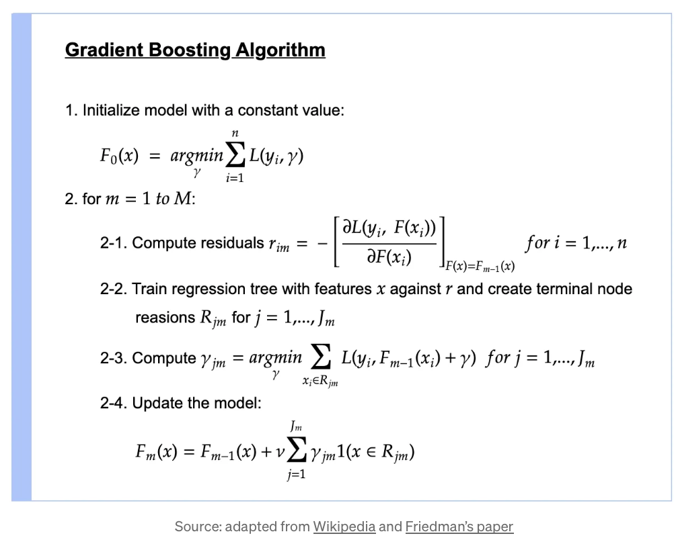
Gradient Boosting – algorithmic overview*
Initial prediction -> searching for a value that minimize the loss (mean)
Loop through M trees
Derivative of the loss function with respect to previous predictions
Build a tree
Minimising the average loss of the residuals on all the samples that belong in the terminal node R_{jm}
New prediction of the combined models
*https://towardsdatascience.com/all-you-need-to-know-about-gradient-boosting-algorithm-part-1-regression-2520a34a502

Slide 36
Gradient Boosting – code example
Notebook Gradient_Boosting.ipynb
Regression
Classification

Slide 37
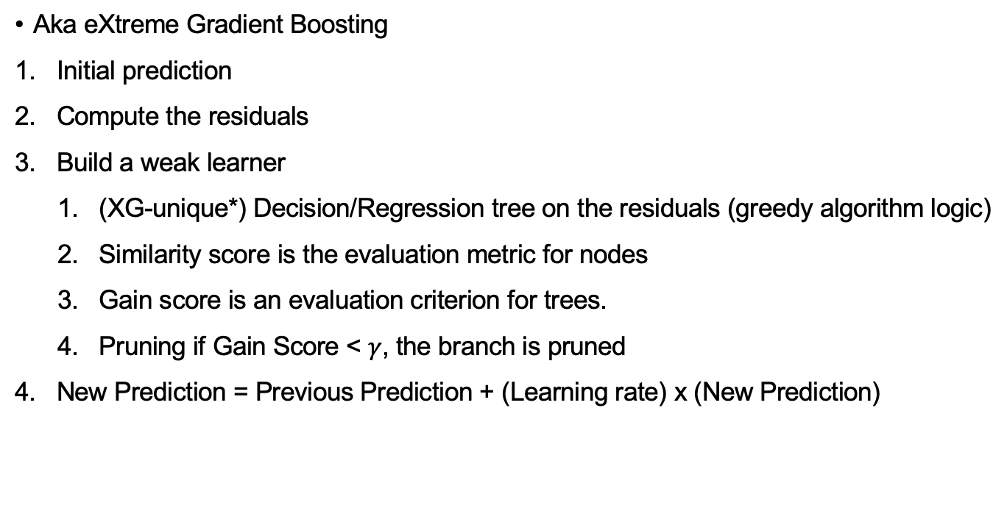
The XG-Boost
Aka eXtreme Gradient Boosting
Initial prediction
Compute the residuals
Build a weak learner
(XG-unique*) Decision/Regression tree on the residuals (greedy algorithm logic)
Similarity score is the evaluation metric for nodes
Gain score is an evaluation criterion for trees.
Pruning if Gain Score < $γ$, the branch is pruned
New Prediction = Previous Prediction + (Learning rate) x (New Prediction)
* Regularized decision tree
Lambda: regularization parameters which reduces the predictions sensitivity to individual observations.
Gamma: specifies the minimum loss reduction required
to make a further partition of the tree and controls the
actual structure of the trees.

Slide 38
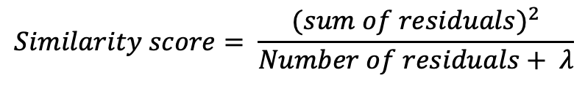
*XG-unique Trees
$$Gain={Similarity}_{left}+{Similariy}_{right}−{Simialarity}_{root}$$
$$Similarity score= \frac{{(sum of residuals)}^{2}}{Number of residuals+ λ}$$

Slide 39
The XG-Boost
Advantage | Disadvantage
Performance (track record on Kaggle competitions) | Computational Complexity (more computationally intensive steps)
Scalability (suitable for large datasets) | Overfitting (especially when trained on small datasets)
Customizability (range of hyperparameters that can be adjusted, making it highly customizable) | Hyperparameter tuning (importance of properly tune the parameters)
Interpretability (naturally provide feature importance through gain and similarity score/cover) | Memory requirements

Slide 40
XG Boost – code example
Notebook XGboost.ipynb
Classification

Slide 41
Summary

Slide 42
Bagging versus Boosting
Bagging
A parallel ensemble of classifiers, aiming to improve classification performance by decreasing model variance.
Especially useful for improving accuracy of unstable models and prevent against overfitting. Works as averaging across “overfitted” models.
Can degrade the performance of stable classifiers like k-NN.
Example: Random forests
Boosting
A sequential ensemble of classifiers (next classifier emphasizes errors made by the previous one), aiming at decreasing model bias.
Combines underfitted models.
The individual classifiers must be at least better than random guessing (but not necessarily “too good”).
Examples: Gradient boosting, AdaBoost

Slide 43
Summary
Majority voting:
(Weighted) consensus from many classifiers.
Also used “under the hood” in multiclass classification problems.
Ensemble learning is:
computationally more time consuming,
prone to overfitting,
but capable of improving on other classifiers (reduce bias and variance).

