Slide 1
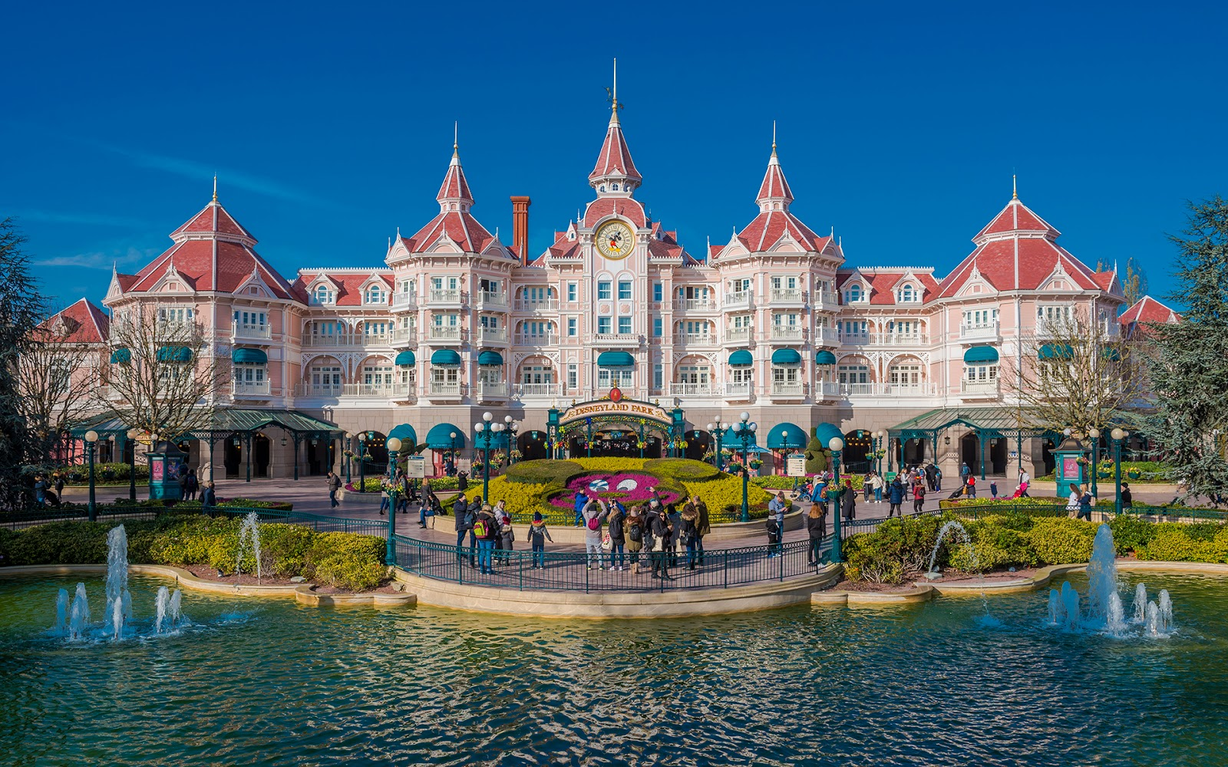
Disneyland Waiting Time Prediction
Sara Knapp
Annina Mack
Lukas Gaiser
"Dieses Foto" von Unbekannter Autor ist lizenziert gemäß CC BY-NC-ND

Slide 2
Structure
Starting Point
Methods
Learnings

Slide 3

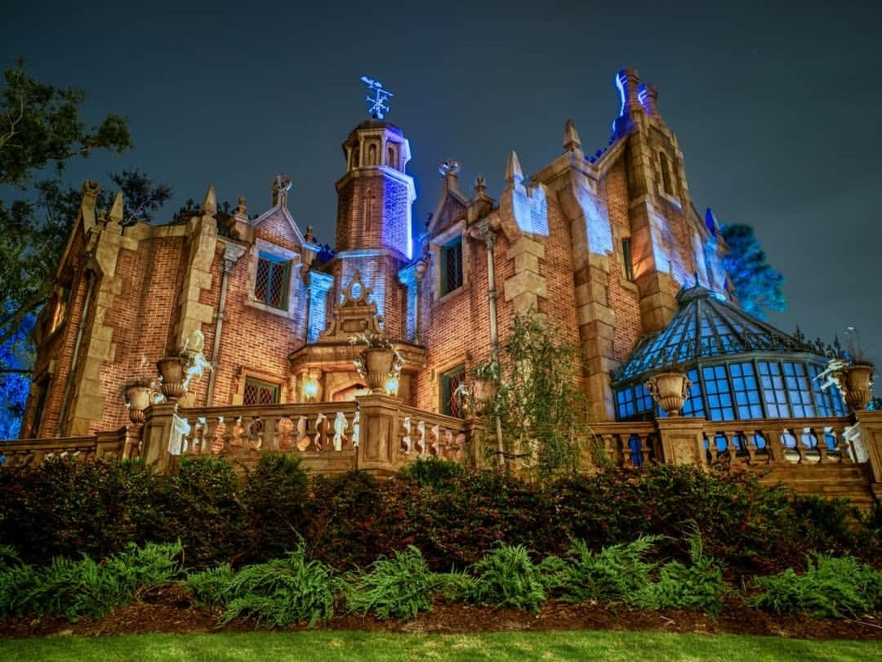

Research Question
Goal:
We want to predict the waiting times for the attraction „Haunted Mansion“ in Disney Land Florida
Use Case
Dynamic Pricing Options for Disney to respond to strong fluctuations in costumers

Slide 4

Data Source and Problem Type
Regression Problem
Target Variable
Features
Waiting times reported by visitors
Date and Time
Holidays
Weather
…

Slide 5
Methods

Slide 6
Challenges

Slide 7
Achievements

Slide 8
Conclusion

