Slide 1
Clustering in Machine Learning
By
Dr. S PADMANABHAN

Slide 2
What is Clustering ?
The task of grouping data points based on their similarity with each other is called Clustering or Cluster Analysis.
This method is defined under the branch of Unsupervised learning, which aims at gaining insights from unlabeled data points, that is, unlike supervised learning we don’t have a target variable.
Clustering aims at forming groups of homogeneous data points from a heterogeneous dataset. It evaluates the similarity based on a metric like Euclidean distance, Cosine similarity, Manhattan distance, etc. and then group the points with highest similarity score together.

Slide 3
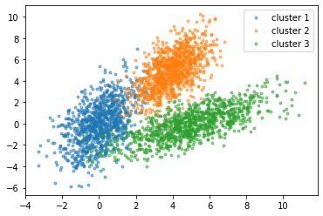

Slide 4
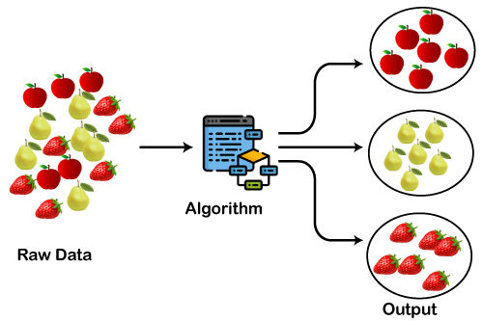

Slide 5
Types of Clustering
Broadly speaking, there are 2 types of clustering that can be performed to group similar data points:
1. Hard Clustering: In this type of clustering, each data point belongs to a cluster completely or not.
For example, Let’s say there are 4 data point and we have to cluster them into 2 clusters. So each data point will either belong to cluster 1 or cluster 2.

Slide 6
Types of Clustering
Data Points | Clusters
A | C1
B | C2
C | C2
D | C1

Slide 7
Types of Clustering
2. Soft Clustering: In this type of clustering, instead of assigning each data point into a separate cluster, a probability or likelihood of that point being that cluster is evaluated.
For example, Let’s say there are 4 data point and we have to cluster them into 2 clusters. So we will be evaluating a probability of a data point belonging to both clusters. This probability is calculated for all data points.

Slide 8
Data Points | Probability of C1 | Probability of C2
A | 0.91 | 0.09
B | 0.3 | 0.7
C | 0.17 | 0.83
D | 1 | 0

Slide 9
Types of Clustering Algorithms
Various types of clustering algorithms are:
Centroid-based Clustering (Partitioning methods)
Density-based Clustering (Model-based methods)
Connectivity-based Clustering (Hierarchical clustering)
Distribution-based Clustering

Slide 10
1. Centroid-based Clustering (Partitioning methods)
Partitioning methods are the most easiest clustering algorithms.
They group data points on the basis of their closeness.
Generally, the similarity measure chosen for these algorithms are Euclidian distance, Manhattan Distance or Minkowski Distance.
The datasets are separated into a predetermined number of clusters, and each cluster is referenced by a vector of values. When compared to the vector value, the input data variable shows no difference and joins the cluster.

Slide 11
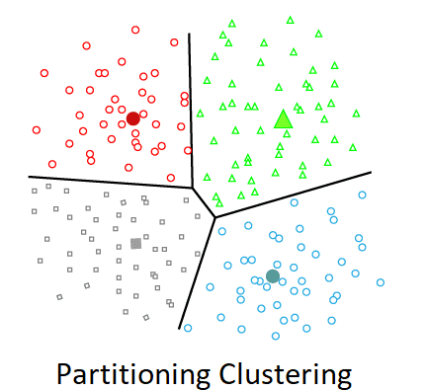

Slide 12
2. Density-based Clustering (Model-based methods)
Density-based clustering, a model-based method, finds groups based on the density of data points.
Contrary to centroid-based clustering, which requires that the number of clusters be predefined and is sensitive to initialization, density-based clustering determines the number of clusters automatically and is less susceptible to beginning positions.
They are great at handling clusters of different sizes and forms, making them ideally suited for datasets with irregularly shaped or overlapping clusters.
These methods manage both dense and sparse data regions by focusing on local density and can distinguish clusters with a variety of morphologies.

Slide 13
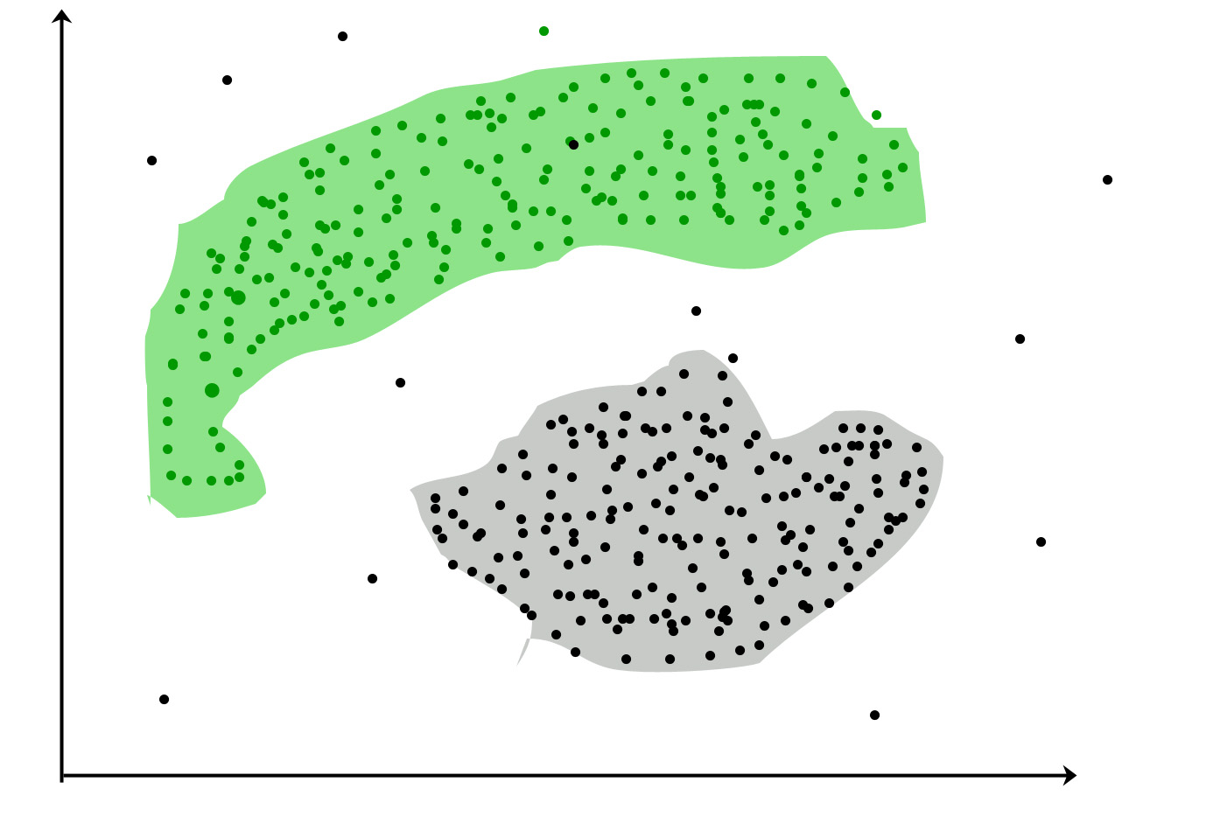

Slide 14
3. Connectivity-based Clustering (Hierarchical clustering)
A method for assembling related data points into hierarchical clusters is called hierarchical clustering.
Each data point is initially taken into account as a separate cluster, which is subsequently combined with the clusters that are the most similar to form one large cluster that contains all of the data points.

Slide 15
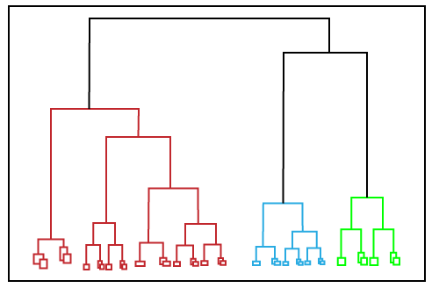

Slide 16
3. Connectivity-based Clustering (Hierarchical clustering)
There are 2 approaches for Hierarchical clustering:
Divisive Clustering: It follows a top-down approach, here we consider all data points to be part one big cluster and then this cluster is divide into smaller groups.
Agglomerative Clustering: It follows a bottom-up approach, here we consider all data points to be part of individual clusters and then these clusters are clubbed together to make one big cluster with all data points.

Slide 17
4. Distribution-based Clustering
Using distribution-based clustering, data points are generated and organized according to their propensity to fall into the same probability distribution (such as a Gaussian, binomial, or other) within the data.
The data elements are grouped using a probability-based distribution that is based on statistical distributions. Included are data objects that have a higher likelihood of being in the cluster.
A data point is less likely to be included in a cluster the further it is from the cluster’s central point, which exists in every cluster.

Slide 18
