Slide 1
oops
PRESENTED BY,
ANN MARIYA FRANCIS

Slide 2
Introduction
A class is a blueprint or a template for creating objects. It defines a set of attributes (data) and methods (functions) that the objects of the class will have.
Classes are a fundamental concept in object-oriented programming (OOP).
A class is defined using the class keyword followed by the class name.
A class docstring is a type of documentation string that provides a description and documentation for a Python class. It is typically placed as the first statement in a class and enclosed in triple quotes (either single or double).

Slide 3
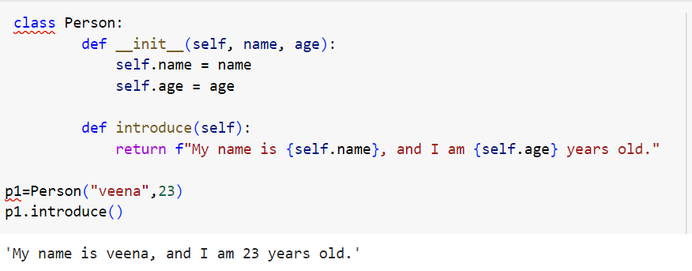
Object
An object is an instance of a class.A class is like a blueprint while an instance is a copy of the class with actual values.. Method invocation, also known as method calling invoke a method by using the dot (.) operator.

Slide 4
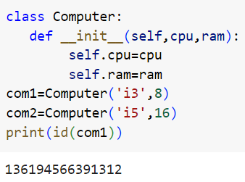
Creating a Python Object
A block of memory is allocated on the heap. The size of memory allocated is decided by the number and size of the variables and methods available in that class.
The location of the allocated memory address of the instance is returned to the object.
The memory location is passed to self.

Slide 5
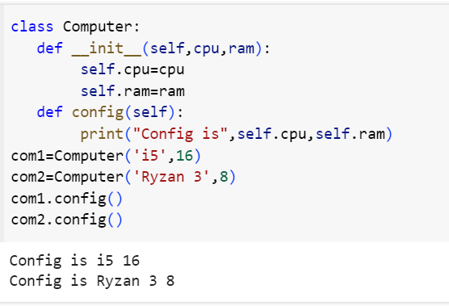
The Self Parameter
The self parameter is a reference to the current instance of the class, and is used to access variables that belongs to the class.
It does not have to be named self , you can call it whatever you like, but it has to be the first parameter of any function in the class.

Slide 6
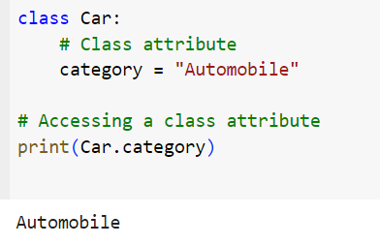
Attributes
Attributes are variables that store data associated with the class. Attributes define the characteristics or properties of the class and its objects.
1.Class attributes
Class attributes are shared by all instances of the class. They are defined at the class level but outside of any methods

Slide 7
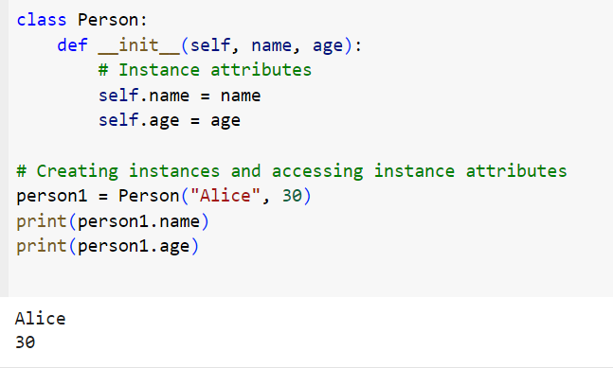
2.Instance Attributes
Instance attributes are specific to individual instances of the class.They are defined and assigned within the class's methods, often in the constructor method (_init_).

Slide 8
Namespace
Namespace represents the memory block where names are mapped/linked to objects
Types:
Class namespace
-The names are mapped to class variables
Instance namespace
-The names are mapped to instance variables

Slide 9
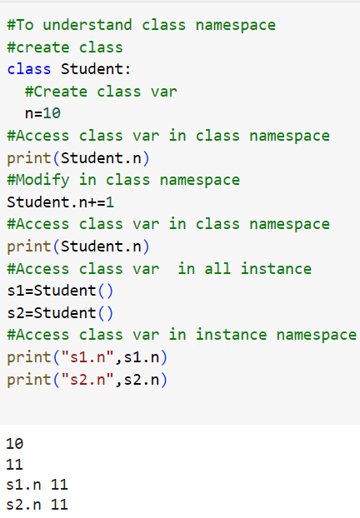
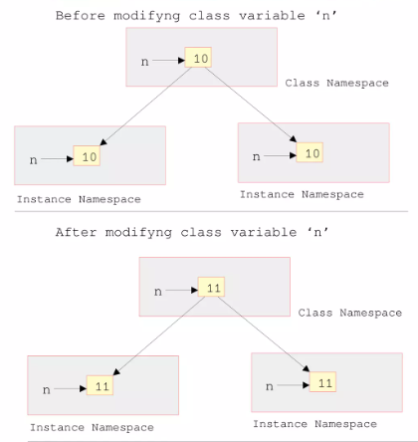

Slide 10
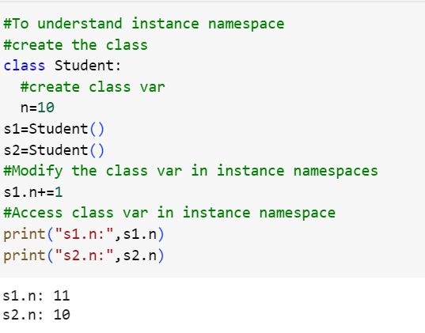
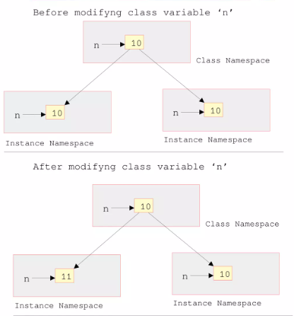

Slide 11
Instantiation
To create an object (instance) of a class, you call the class as if it were a function.
This process is known as instantiation, and it creates a unique object with its own set of attributes and methods.
For example:
Modern_car= Car()
# Creates an instance of the 'Car' class

Slide 12
Methods
Methods are functions defined inside the class that operate on the class's attributes.
Methods represent the behavior or actions that objects of the class can perform.
Methods encapsulate the functionality associated with the class and operate on the class's attributes and data.

Slide 13
Types
Instance Method
Accessor
Mutator
Class Methods
Static Methods

Slide 14
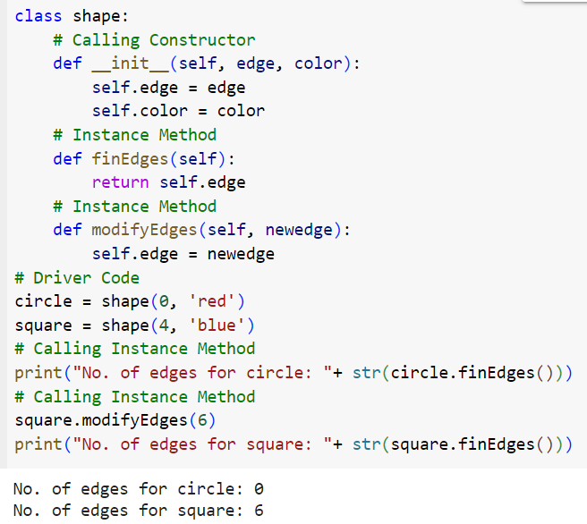
Instance Methods
Instance method is a function that is associated with an instance of a class

Slide 15
Accessor and Mutator
Accessor are the Methods just reads the instance variables, will not modify it.
Generally written in the form :getxxx()
Also called getter methods
Mutator not only reads the data but also modifies it
Generally written in the form:setxxx()
Also called setter methods

Slide 16
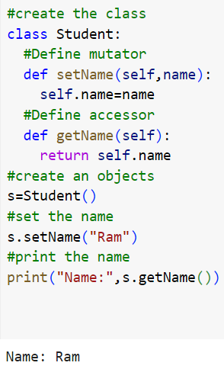

Slide 17
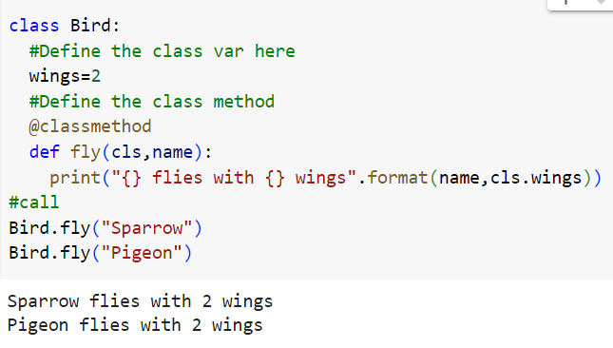
Class method
This method Acts on class variable only
First param is ‘cls’, followed by any params

Slide 18
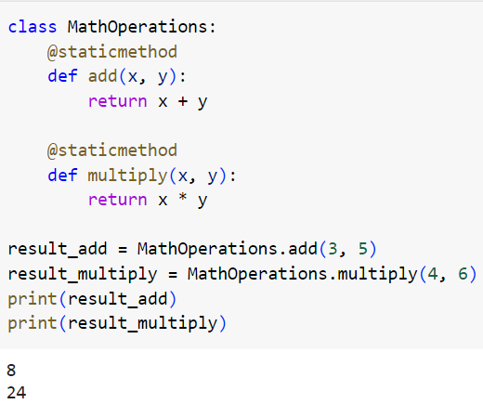
Static method
They are used when a method doesn't depend on the instance or class state and doesn't modify them.

Slide 19
Magic methods
.
.
Magic methods, also known as dunder methods, are special methods in Python that have double underscores ("dunder") at the beginning and end of their names. These methods have specific names and are automatically invoked
_init_ (Constructor Method):The _init_ method is called the constructor method.Constructors are used to create and initialize the ‘instance variables’.
def __init__(self):
self.name=“Ram”
self.marks=99
The constructor will be called only once i.e at the time of creating the objects

Slide 20
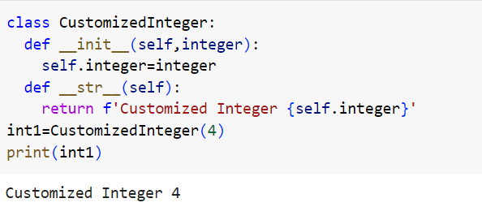
2. __str__: The __str__ method is used to define a human-readable string representation of an object.

Slide 21
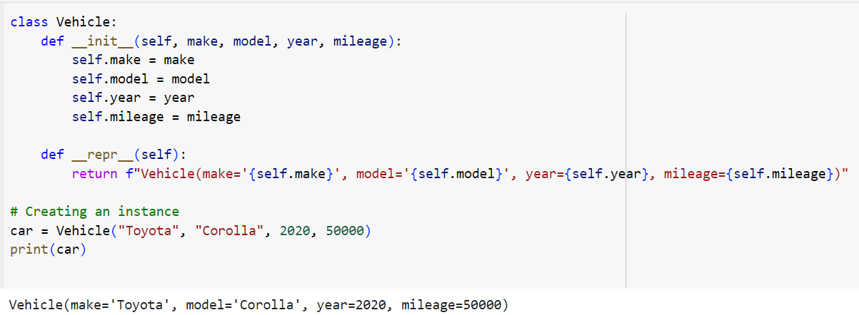
3.__repr__: Returns a string representation of an object. Used for debugging and representation; should ideally be unambiguous and readable.

Slide 22
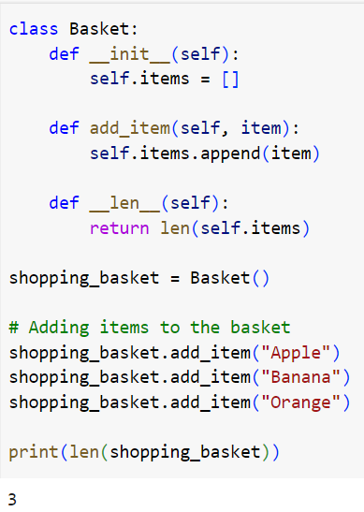
5. __len__(self): Returns the length of an object. Used for built-in len() function.

Slide 23
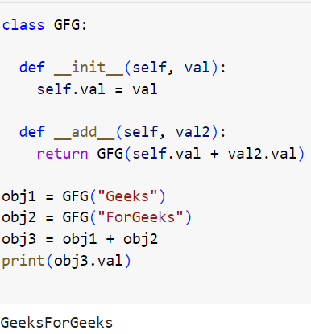
4. Python __add__() function is one of the magic methods in Python that returns a new object(third) i.e. the addition of the other two objects.

Slide 24
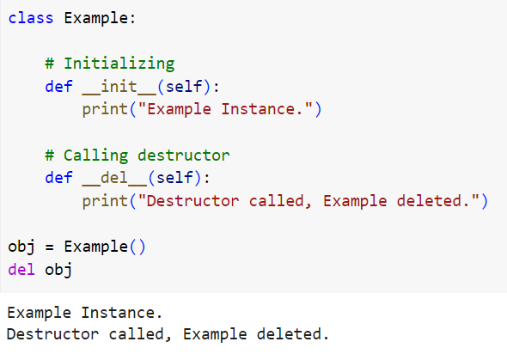
Destructor Method
It is also called the destructor method and it is called (invoked) when the instance (object) of the class is about to get destroyed.

Slide 25
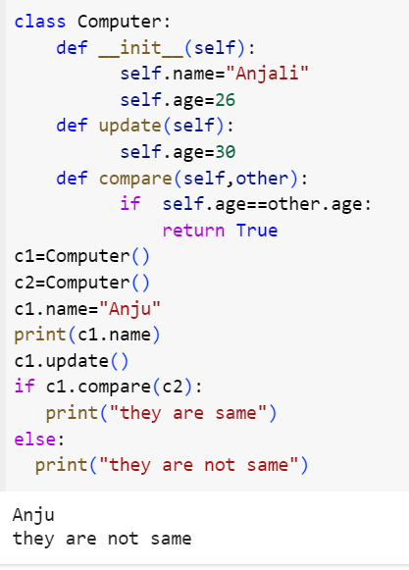
Attribute Access and Modification
We have got two objects c1 and c2 When we want to change the c1 value write c1.name=“Anju” c1 it is passed to the self and c1.name=“Anjali” gets updated to c1.name=“Anju”.When we call c1.update () self will be assigned to c1.To compare two objects’ ages. The compare method takes two parameters first one is who is calling (c1) and the second parameter is whom to compare.

Slide 26
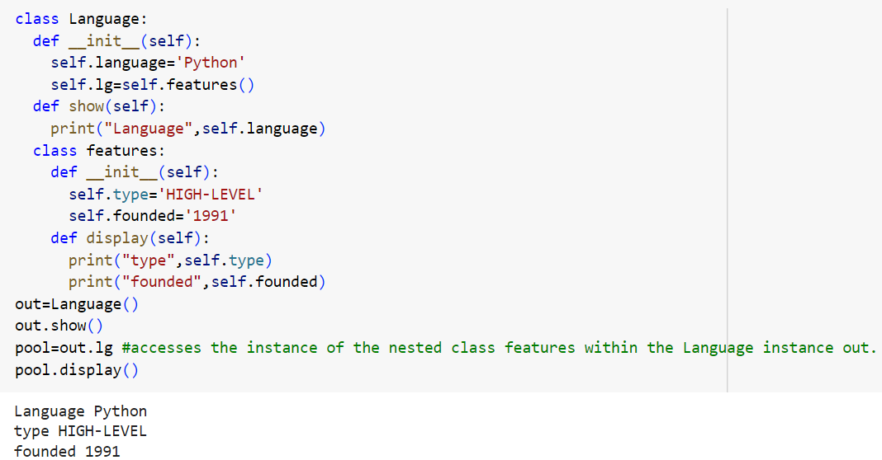
Inner class
Creating class B inside class A is called nested class or inner class

Slide 27
THANK YOU

