Slide 1
Spam ham SMS classification
PROJECT GUIDE:
SEETHAL PRINCE E
ASSISTANT PROFESSOR
CSE
ANN MARIYA CLARINE
S3 MCA
ROLL NO: 4
UNI REG NO: SCM21MCA-2004

Slide 2
INTRODUCTION
SMS spamming is an activity of sending ‘ unwanted messages’ through text messaging or other communication services, normally using mobile phones.
Machine learning classifiers are usually used to predict spam SMS.
The objective is to demonstrate a machine-learning model that is effective in classifying messages as spam or ham.
Spam – ‘ unwanted messages’
Ham – ‘ not spam’

Slide 3
Problem statement
To classify SMS into spam and ham based on the text content using machine learning.

Slide 4
Literature review
AUTHOR | TITLE | METHOD
Nilam Nur Amir Sjarif, Nurulhuda Firdaus Mohd Azmi, Suriayati Chuprat, Haslina Md Sarkan, Yazriwati Yahya & Suriani Mohd Sam | SMS spam message detection using term frequency-inverse document frequency and random forest algorithm[1]. | Used Multinomial Naïve Bayes, Knn, Svm, Decision Tree, Random Forest and obtained accuracy of 97.06, 91.19, 87.49, 96.57 and 97.50 respectively.
Mehul Gupta, Aditya Bakliwal, Shubhangi Agarwal & Pulkit Mehndiratta | A comparative study of spam SMS detection using machine learning classifiers[2]. | Used Svm, Naïve Bayes, Decision Tree, Logistic Regression, Random Forest, Adaboost, Ann, Cnn and obtained accuracy of 98.57, 98.48, 96.05, 98.30, 98.65, 97.85, 98.39, 99.10 respectively.
Xiaoxu Liu , Haoye Lu & Amiya Nayak | A spam transformer model for SMS spam detection.[3]. | Used Logistic Regression, Naïve Bayes, Random Forest, Svm, Lstm, Cnn-lstm, Spam Transformer and obtained accuracy of 98.56, 98.38, 97.90, 98.62, 98.56, 97.66, 98.92 respectively.

Slide 5
Proposed model and methodology
Data collection
Data preparation
Choosing algorithms
Training and testing
Model creation
Performance evaluation

Slide 6
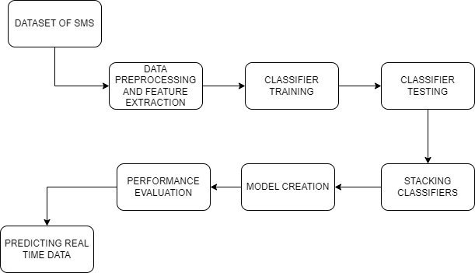
Proposed model and methodology

Slide 7
dataset
The dataset was collected from uci machine learning repository[4].
The file was converted into csv format from txt format.
Dataset contains 5572 datapoints.

Slide 8
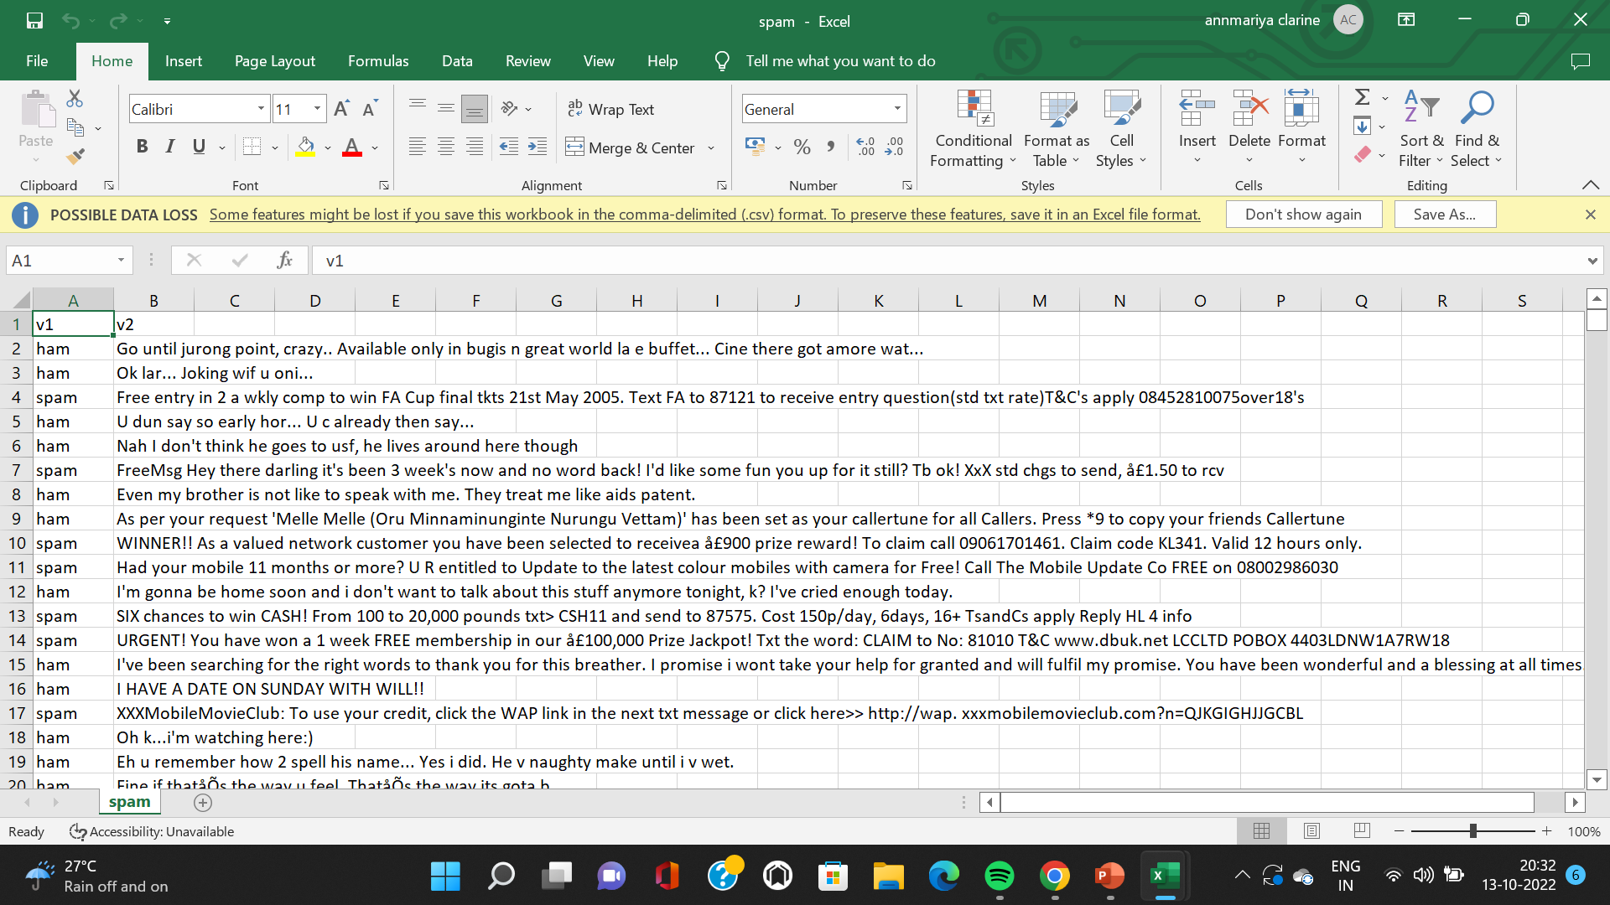
dataset

Slide 9
Pre-processing and feature extraction
Dataset is collected.
The text data is converted into lower case.
We have removed :
Digits
Special characters
Stopwords

Slide 10
Pre-processing and feature extraction
Tokenization and lemmatization is performed over the data.
Tokenization - breaks the raw text into small chunks[5].
Lemmatization - converts the word to its meaningful base form[6].

Slide 11
Pre-processing and feature extraction
Dataset is split into train and test with a ratio of 80:20.
Tf-idf vectorizer is used for feature extraction.
Tf-idf - Term Frequency Inverse Document Frequency
Term frequency - measure of frequency of a word in a document[7].
Inverse Document Frequency - measure of importance of a word[8].

Slide 12
ALGORITHMS USED
Multinominal naïve bayes:
An advanced version of naïve bayes.
It involves multinomial distribution which works well for countable type of data such as the words in a document or text [2].
Decision tree classifier
A decision tree is a special binary tree that helps in classification.

Slide 13
ALGORITHMS USED
Random forest classifier
Random forest-term used for an ensemble of decision trees[2].
Takes the vote of individual trees for classification.
Support vector machine classifier(svc)
Can draw the margins between different classes and the hyper plane line can separate with support vectors to that hyper plane line[9].

Slide 14
IMPLEMENTATION AND RESULTS
Each algorithm is trained and tested with dataset.
ALGORITHM | ACCURACY | PRECISION
MULTINOMINAL NAÏVE BAYES | 0.976682 | 0.941606
DECISION TREE | 0.958744 | 0.848276
RANDOM FOREST | 0.981166 | 0.943662
SVC | 0.984753 | 0.977941

Slide 15
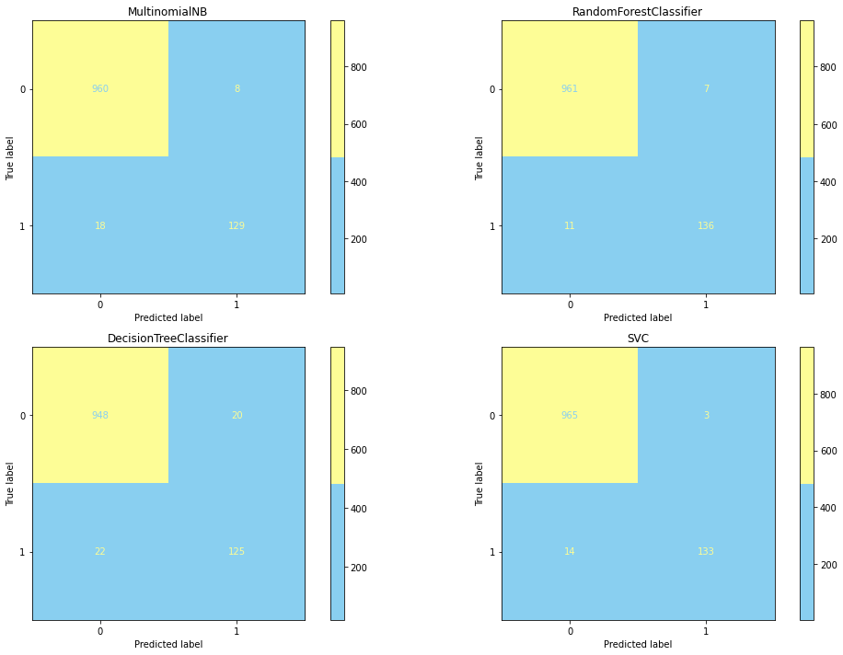
IMPLEMENTATION and results
The confusion matrix is plotted for each classifier for better visualization.

Slide 16
IMPLEMENTATION AND RESULTS
Stacking is used to combine all the four classifiers.
Stacking is an ensemble machine learning algorithm that learns how to best combine the predictions from multiple well-performing machine learning models[10].
ACCURACY | PRESICION
0.9865 | 0.9647

Slide 17
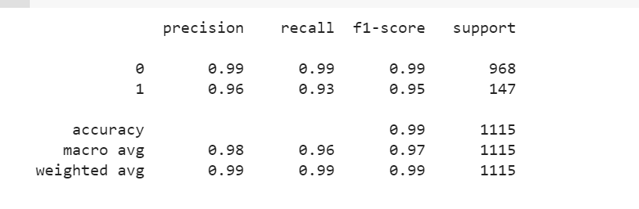
IMPLEMENTATION AND RESULTS
CLASSIFICATION REPORT OF THE MODEL

Slide 18
IMPLEMENTATION AND RESULTS
Pickle is used to save model.
Data read from user is cleaned, vectorized and predicted using model.
Streamlit is used to create the user interface.

Slide 19
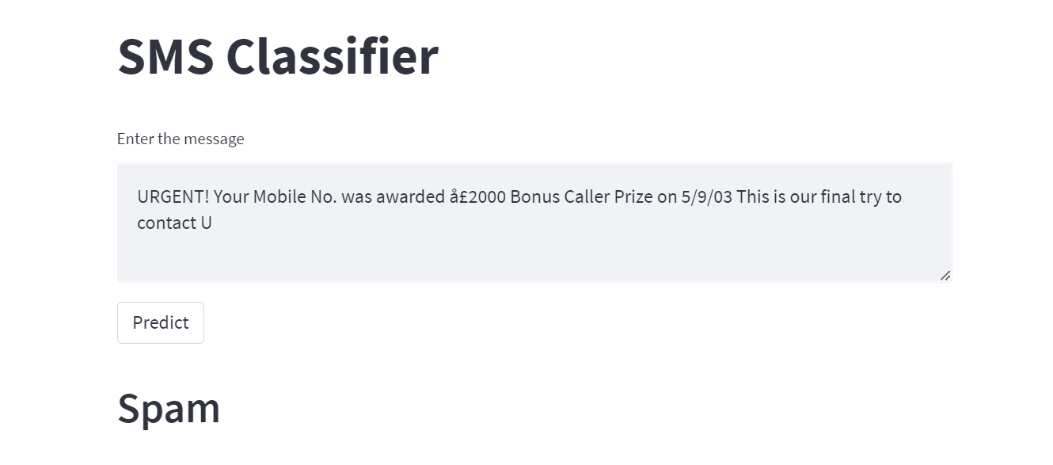
IMPLEMENTATION AND RESULTS

Slide 20
conclusion
An architecture has been designed to classify SMS into spam and ham.
A stacked model has been created using machine learning algorithms.
The model has been trained and tested to detect spam and ham SMS. The model has achieved accuracy of 98.65%.
A user interface has been designed to make predictions based on real-time data.

Slide 21
references
[1] Nilam Nur Amir Sjarif, Nurulhuda Firdaus Mohd Azmi, Suriayati Chuprat, Haslina Md Sarkan, Yazriwati Yahya & Suriani Mohd Sam – “SMS spam message detection using term frequency-inverse document frequency and random forest algorithm”
[2] Mehul Gupta, Aditya Bakliwal, Shubhangi Agarwal & Pulkit Mehndiratta – “a comparative study of spam sms detection using machine learning classifiers”
[3] Xiaoxu Liu , Haoye Lu & Amiya Nayak: “A spam transformer model for SMS spam detection.”

Slide 22
references
[4] Dataset -https://archive.ics.uci.edu/ml/datasets/SMS+Spam+Collection
[5]https://towardsdatascience.com/tokenization-for-natural-language-processing-a179a891bad4
[6]https://www.analyticsvidhya.com/blog/2021/08/text-preprocessing-in-python-getting-started-with-nlp/
[7]https://www.analyticsvidhya.com/blog/2021/07/bag-of-words-vs-tfidf-vectorization-a-hands-on-tutorial/
[8]https://towardsdatascience.com/text-vectorization-term-frequency-inverse-documentfrequency-tfidf-5a3f9604da6d

Slide 23
references
[9] T. Jhansi Rani, T. Jaya Vumesh, P. Saiteja, V. Ajay Kumar Reddy, M. Meghana:– “SMS spam detection framework using machine learning algorithms and neural networks”.
[10] https://machinelearningmastery.com/stacking-ensemble-machine-learning-with-python/

Slide 24
Thank you

