Slide 1

Structuring your web apps via
Training Session 1
Getting Started

Slide 2
Agenda
Introduction to Backbone.JS
Prerequisites.
Quick definition
Overview.
Why do we need it?
Where should I use it?
What is SPA?
Knowing Backbone's Backbone
Overview on general MVC
Difference between general MVC Vs. Backbone’s MVC
How to use Backbone.JS
How Backbone works?
Adding Backbone to your web apps
JavaScript console with reference to Backbone.JS
Root resources

Slide 3


Introduction to Backbone.JS
What are the Prerequisites ?
JavaScript & jQuery

Slide 4
Introduction to Backbone.JS Continue…
Quick definition:
Backbone.JS is a light weighted client side JS library (Not a framework) which provides structure to your JavaScript based web applications.
Overview:
Created by Jeremy Ashkenas.
Easily available on www.backbonejs.org
Written in JavaScript.
Cross-Platform.
Production 6.3KB, Development 56KB.

Slide 5
Introduction to Backbone.JS Continue…
Overview Continue:
For building web apps based on SPA.
Hard dependence on Underscore.JS & light dependence on jQuery & json2.JS
Key-value binding and custom events.
Rich API of enumerable functions.
Views with declarative event handling.
RESTful JSON interface.

Slide 6
Introduction to Backbone.JS Continue…
Why Backbone.JS?
What jQuery is missing?
Does it replace jQuery?
Where should I be using this?
Creating front end heavy Data driven applications.
E.g. Think the Gmail interface, new Twitter etc.

Slide 7
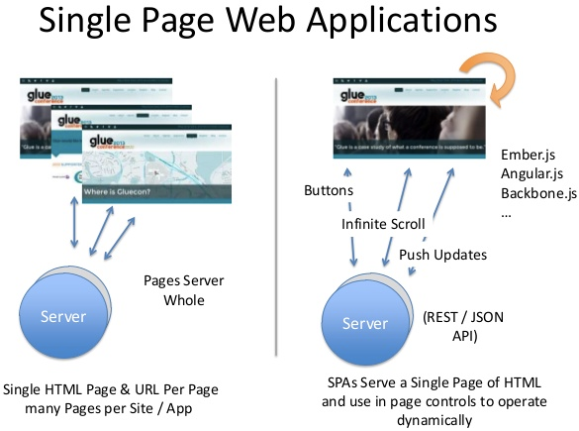
Introduction to Backbone.JS Continue…
Learn more

Slide 8
Knowing Backbone's Backbone
General MVC
M=Model, V=View, C=Controller
Backbone’s MV*
M=Model, V=View, C=Collection [+Router]
RoR MVC
M=Model, V=View, C=Controller, R=Router

Slide 9
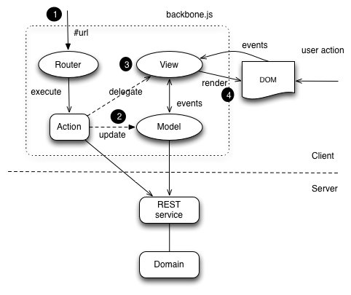
How to use Backbone.JS ?
How Backbone works ?

Slide 10
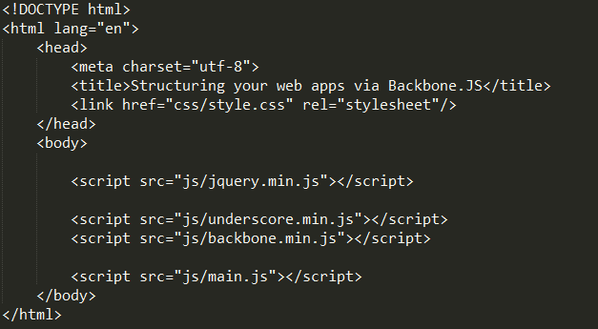
How to use Backbone.JS ? Continue…
Adding Backbone to your web apps

Slide 11
How to use Backbone.JS ? Continue…
JavaScript console with reference to Backbone.JS
Step 1: Navigate to github repostory.
Step 2: Download the repository & navigate to Examples directory in Google Chrome.
Step 3: Press F12, Click on Network and refresh the page.
Step 4: Now, go to console tab and type “Backbone” in JS console provided by Chrome.

Slide 12
Root resources
https://github.com/hegdeashwin/Training-Session-1
Presentation slide.
Example directory.
Thank you.

