Slide 1
Name: ANNU ANNA RENI
Enrolment Number:EN12025087763
Batch Code: DA50
Mentor: ASHISH RAJPUT
MOVIE DATA INSIGHTS AND PREDICTIONS

Slide 2
01
BUSINESS PROBLEM
To identify meaningful patterns and emerging trends within the movie industry
BUSINESS OBJECTIVES
To identify the key factors influencing movie success.
To understand audience preferences.
To analyze market trends and content evolution
To build ml models to predict movie ratings and revenue

Slide 3
02
DATA DESCRIPTION
Industry: Film Analytics
Dataset Source: The Movie Dataset (tmdb_5000_movies),Credit Dataset (tmdb_5000_credits)
tmdb_5000_movies has 18 column and tmdb_5000_credits has 4 columns
Size: ~4,800 cleaned movie records
Duration: 1916–2017
TOOLS USED
SQL
STATISTICS
MACHINE
LEARNING
EXCEL
PYTHON
TABLEAU

Slide 4


03
FLOW
Completed objective with respective tools using preprocessed dataset
Written interpretations.
Identified objectives and selected their respective tools
Preprocessed datasets in jupyter notebook and downloaded
Summarized findings and concluded

Slide 5
04
OBJECTIVE 1:
KEY FACTORS AFFECTING MOVIE SUCCESS

Slide 6
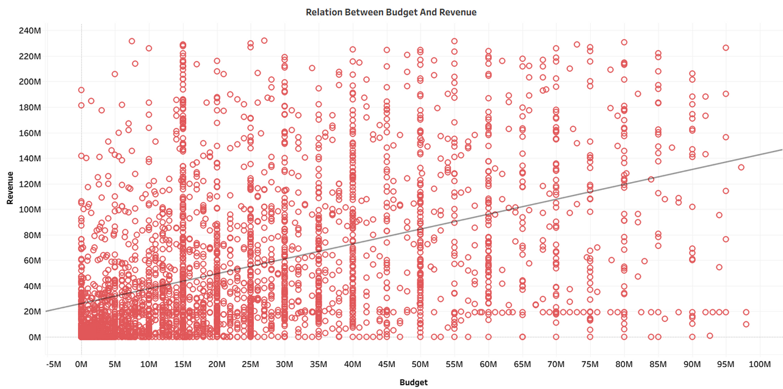
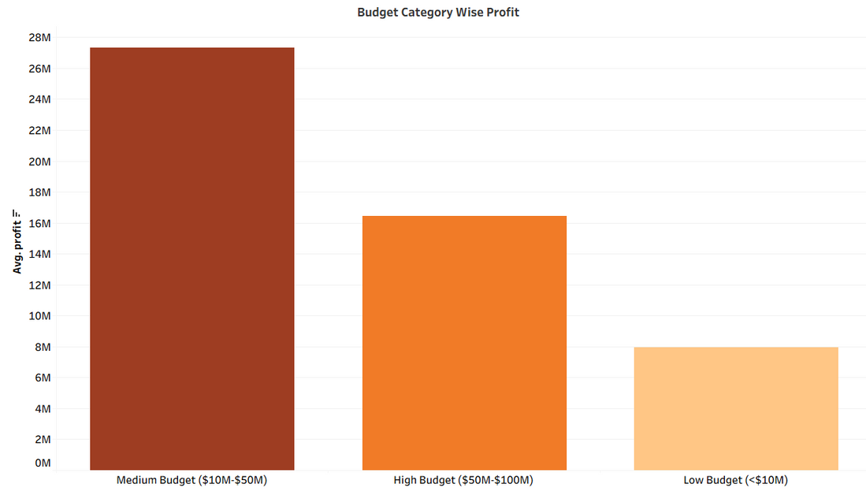
05
1a
FOCUS AREA: REVENUE AND BUDGET ANALYSIS
DOES A HIGHER PRODUCTION BUDGET LEAD TO HIGHER REVENUE
WHICH BUDGET RANGE (LOW, MEDIUM, HIGH) DELIVERS THE BEST PROFIT
Movies with higher budgets generally earn higher revenue, but the relationship is not perfectly linear
Medium budget movies have the most profit than low and high budget movies

Slide 7
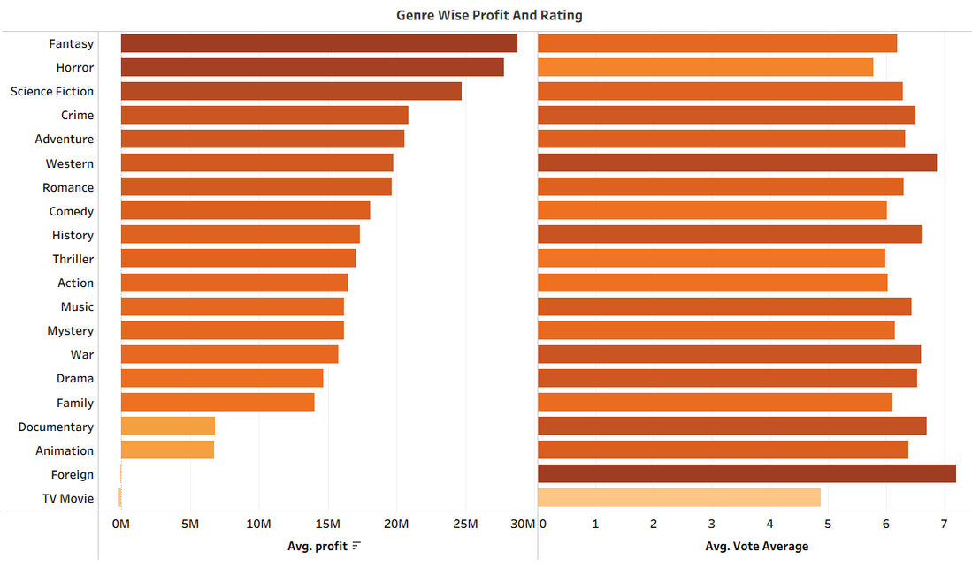
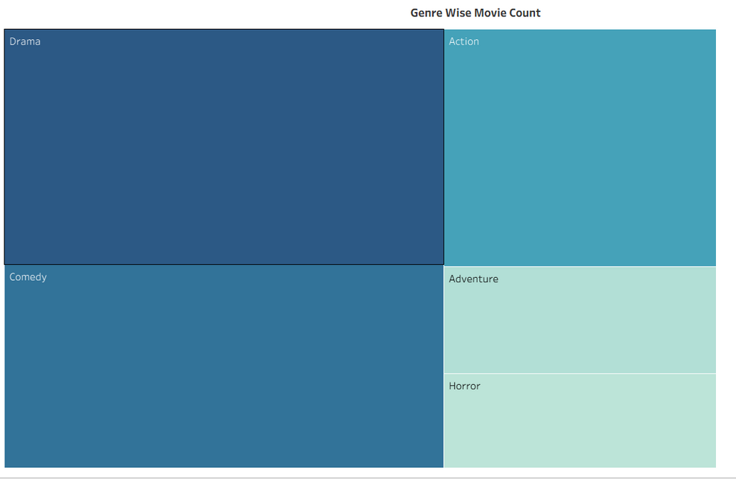
06
FOCUS AREA: GENRE PERFORMANCE
1b
DO HIGH PROFIT MOVIES ALWAYS GET HIGH RATING
WHICH ARE THE TOP PRODUCED GENRES
Most genres have rating between 6-7 but profit varies across genres
Drama is most frequently produced genre

Slide 8
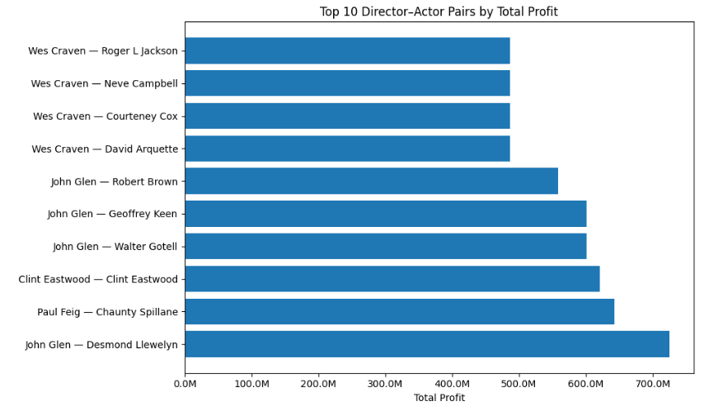
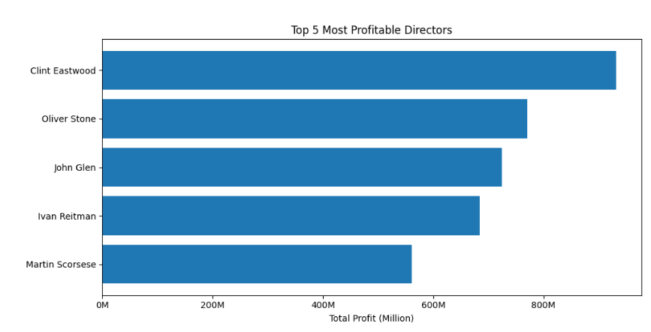
07
FOCUS AREA: CAST AND CREW INFLUENCE
1c
WHICH DIRECTOR–ACTOR PAIRINGS PRODUCE THE MOST PROFITABLE MOVIES
WHO IS THE MOST PROFITABLE DIRECTOR
Clint Eastwood is the most profitable director
John Glen and Desmond Llewelyn are the most profitable director- actor pairing but clint Eastwood , both as director and actor, also generates good profits

Slide 9
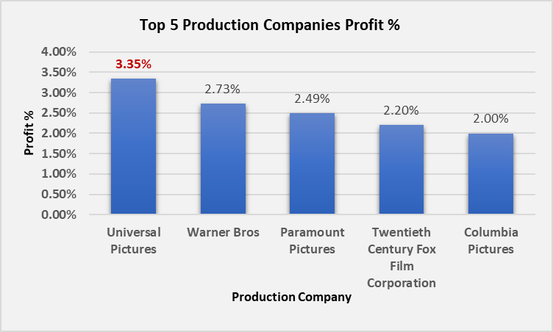
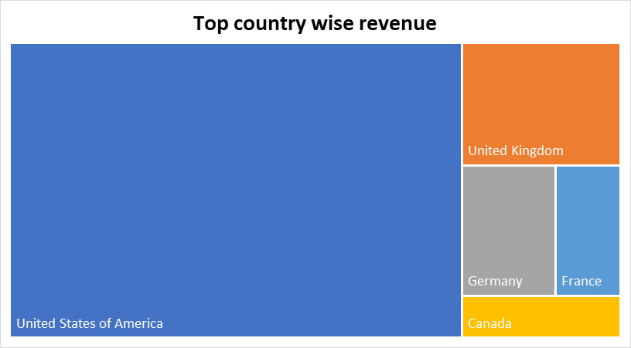
08
1d
FOCUS AREA: PRODUCTION EFFICIENCY
WHICH PRODUCTION COMPANY MAKE MORE PROFIT
WHICH COUNTRY MAKE MOST REVENUE
Universal pictures is the only production company with more than 3% contribution
USA produce the most revenue

Slide 10
09
OBJECTIVE 2: UNDERSTANDING AUDIENCE PREFERENCES

Slide 11
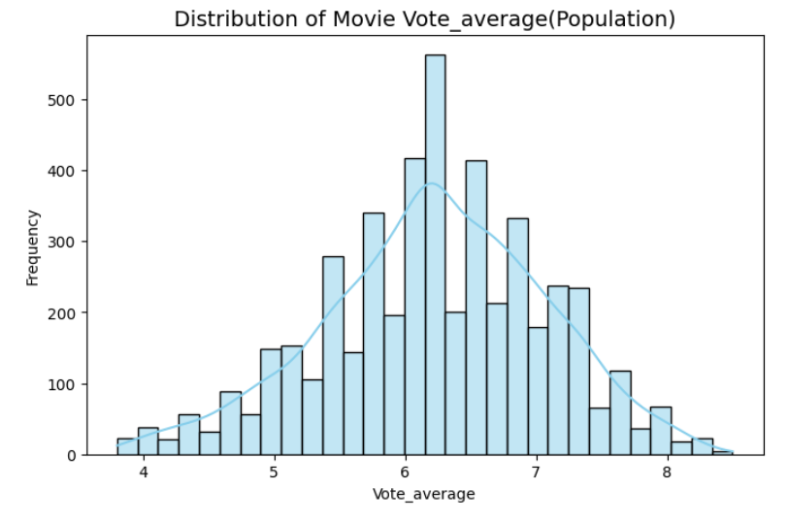
10
FOCUS AREA: AUDIENCE RATING ANALYSIS
2a
DO ACTION MOVIES RECEIVE HIGHER AVERAGE AUDIENCE RATINGS THAN THE OVERALL MOVIE AVERAGE
DO MOST MOVIES GET SIMILAR RATINGS FROM THE AUDIENCE, OR ARE THERE BIG DIFFERENCES
t _stats
t_critical
p_value
-5.9856
1.64
1
There is no evidence that action movies are rated higher than the overall movie average rating
Rating between 6 and 7 have most movies

Slide 12
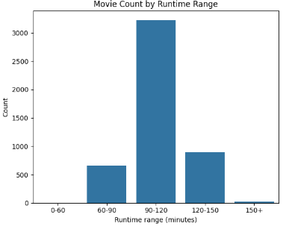
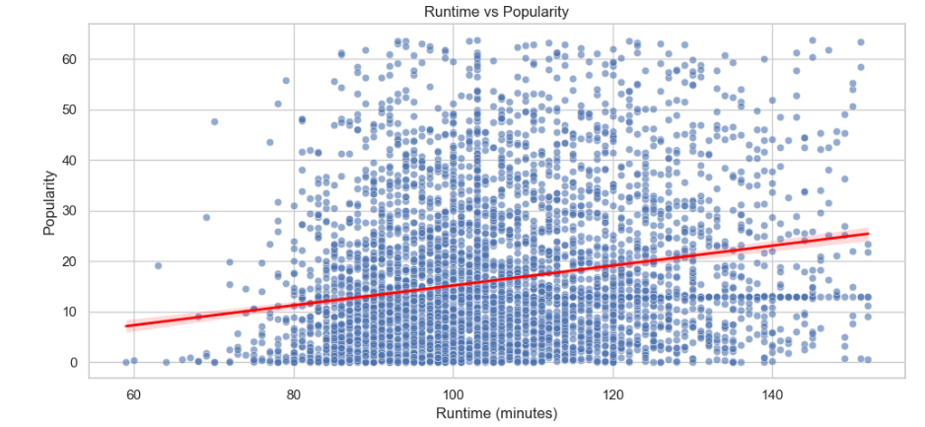
11
FOCUS AREA: RUNTIME AND VIEWER STATISFACTION
2b
DOES LONGER MOVIE LEAD TO HIGHER POPULARITY SCORE
WHAT IS THE TYPICAL RUNTIME OF MOST MOVIES
Longer movies do not always result in higher popularity, although some long movies do perform well.
Most movies has the runtime of 90-120 minutes

Slide 13
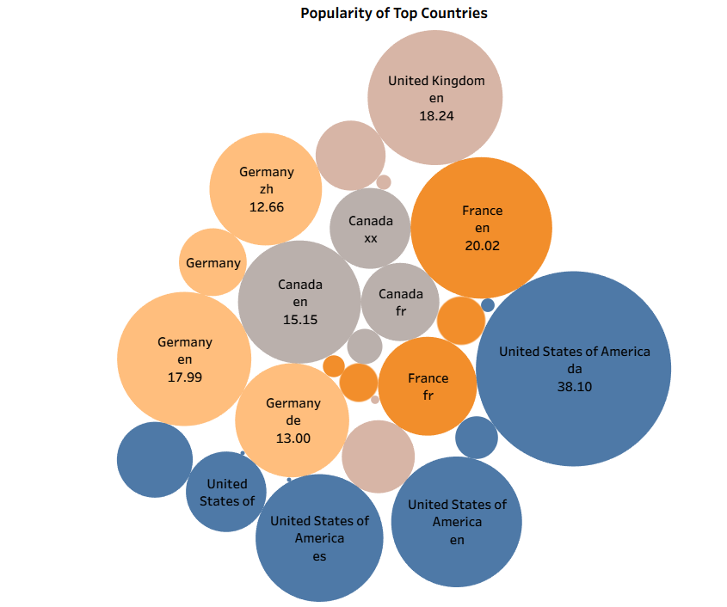
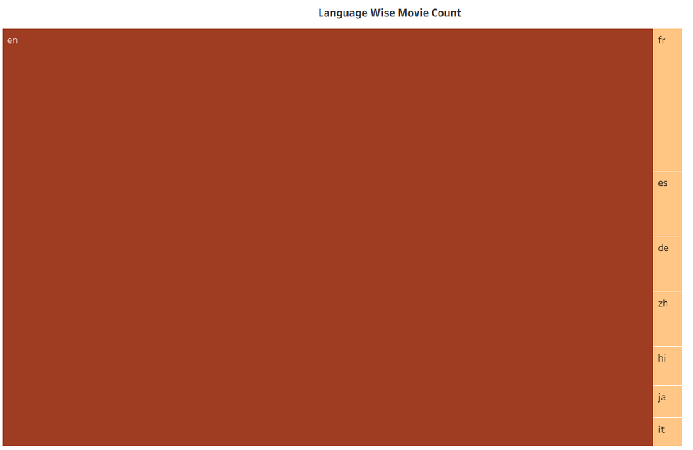
12
FOCUS AREA: LANGUAGE AND REGIONAL TREND
2c
WHICH LANGUAGE HAS THE HIGHEST NUMBER OF MOVIES PRODUCED
WHICH COUNTRY PRODUCE MORE POPULAR MOVIE
En language has the highest number of movies produced
The USA produces the most movies

Slide 14
13
OBJECTIVE 3:
ANALYZING MARKET TREND AND CONTENT EVOLUTION

Slide 15
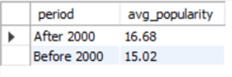
14
3a
FOCUS AREA:POPULARITY OVER TIME
Step 1:- Connected Jupyter notebook and MySQL workbench
Step 2:- Created cursor
Step 3:-Created table and inserted columns
Step 4:-Convert rows into tuples and inserted rows
Step 5:- Save all the changes in the database
HAS THE POPULARITY OF MOVIES SIGNIFICANTLY CHANGED BEFORE AND AFTER THE YEAR 2000
Movie popularity is significantly higher after the year 2000.

Slide 16
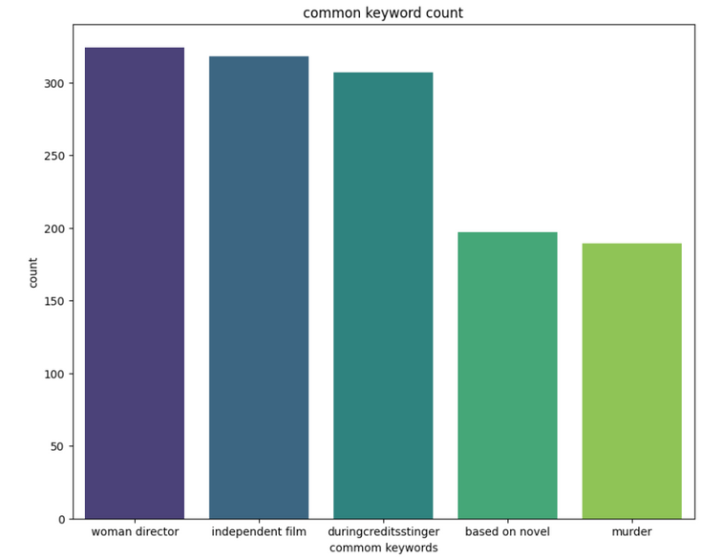
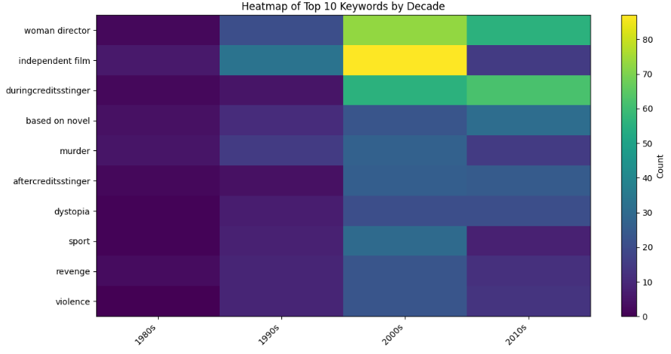
15
FOCUS AREA: CONTENT AND THEME EVOLUTION
3b
WHICH KEYWORD APPEARS MOST FREQUENTLY
HOW ARE THE MOST COMMON KEYWORDS DISTRIBUTED ACROSS DIFFERENT DECADES
Women director is most common theme
The 2000s have the highest number of movies associated with common keywords

Slide 17
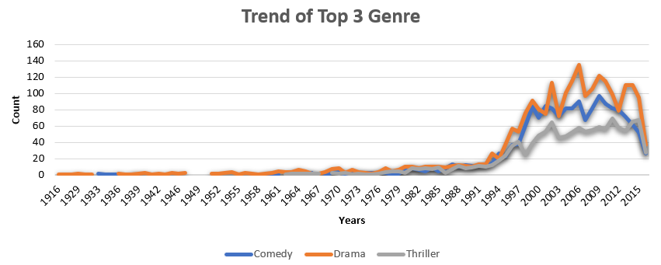
16
FOCUS AREA:GENRE TRENDS
3c
WHICH GENRE IS MOSTLY PRODUCED
Drama movies are most consistently produced genre over the years.

Slide 18
17
OBJECTIVE 4:
MOVIE RATING AND REVENUE PREDICTION

Slide 19
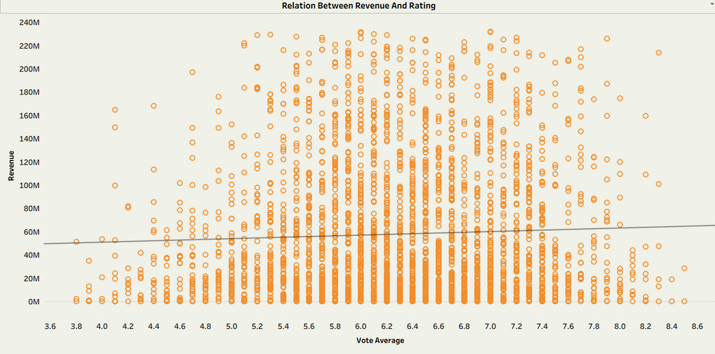
18
FOCUS AREA: REVENUE AND RATING ANALYSIS
4a
DOES A HIGHER RATING LEAD TO HIGHER REVENUE
A higher rating does not necessarily lead to higher revenue

Slide 20
19
4b
FOCUS AREA: MOVIE RATING PREDICTION
Predicting the movie rating category (good, average, poor) using budget, runtime ,genre count, production country ,language and production company. Since the output a class label, this is a classification problem
Apply Standard Scaling to normalize all numeric features
Train the Logistic Regression model using training data
Prepare the data and select feature and target
Split the dataset into training and testing sets
Logistic regression table
Accuracy Score
0.62
Predict the rating classes on the test data
Evaluate the model
Precision Score
0.62
Recall Score
0.62
F1 Score
0.62

Slide 21
20
4b
FOCUS AREA: MOVIE RATING PREDICTION
Cluster top-rated movies to identify distinct segments of high-performing films . Features used are budget, popularity, runtime, genre count
Apply Standard Scaling to normalize all numeric features
Identified the k value using elbow method and silhouette score
Apply kmeans model and plotted it using scatter plot
Prepare the data and select feature and target
Identified cluster features average
K
2

Slide 22
21
4c
FOCUS AREA: MOVIE REVENUE PREDICTION
Predicting whether a movie is high revenue generating using suitable features
Prepare the data and select feature and target
Split the dataset into training and testing sets
Applied Standard Scaling
Find the best value of k
KNN model table
Accuracy Score
0.78
Precision Score
0.78
Evaluate the model
Applied KNN model
Recall Score
0.78
F1 Score
0.78

Slide 23
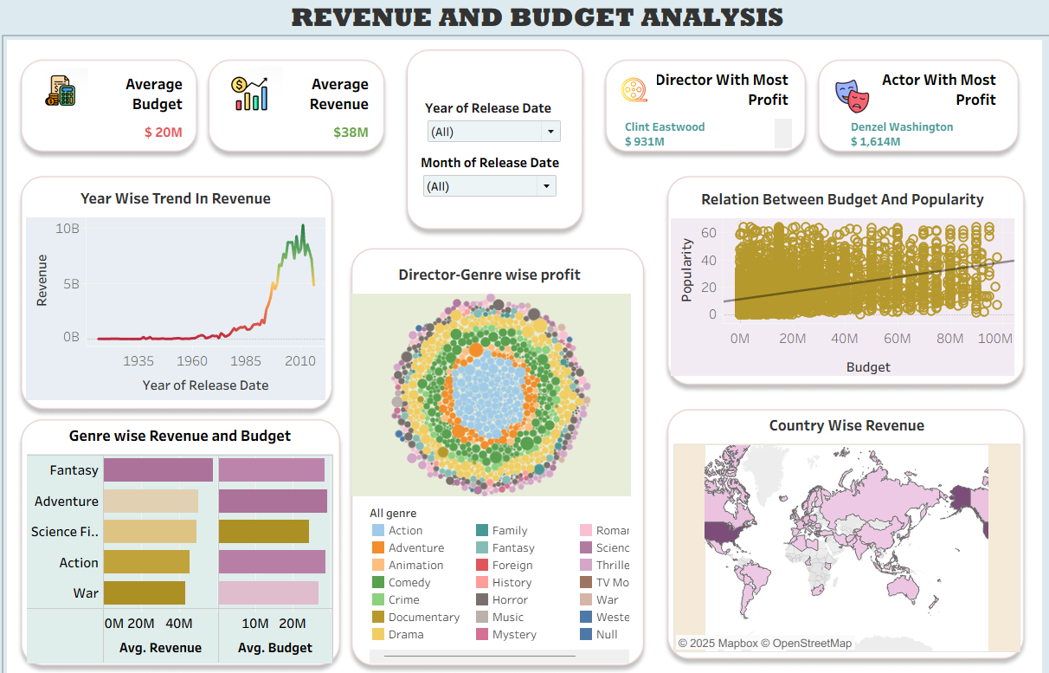
21
DASHBOARD

Slide 24
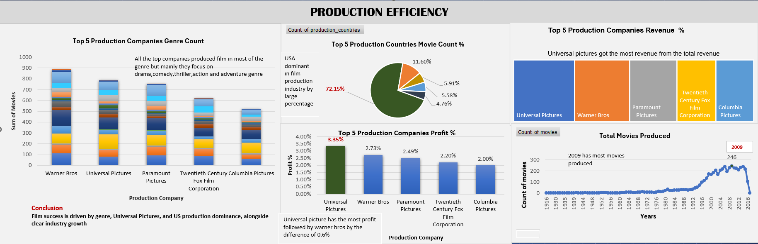
22
DASHBOARD

Slide 25
23
SUMMARY
Medium-budget movies deliver the highest profitability.
Drama is the most produced genre; Universal Pictures leads in profits.
Strong director–actor combinations significantly boost success.
Audiences prefer movies between 90–120 minutes; longer films are not more popular.
Content themes increased sharply after 2000.
Build ml model to predict rating class and high revenue movies
CONCLUSION
Concluded that budget range, genre profitability, strong director–actor collaborations, and efficient production studios are the most influential factors determining movie success.
Established that audience preferences depend on ideal movie runtimes, rating patterns, and popularity trends, which vary across languages and regions.
Identified long-term industry patterns showing that movie popularity, genre focus, and thematic content have evolved significantly, especially after 2000.
Demonstrated that machine-learning models to predict movie ratings and revenue, helping stakeholders estimate movie performance even before release.

Slide 26
24
BUSINESS SUGGESTIONS AND IMPLEMENTATIONS
Use predictive models to forecast revenue and audience ratings before release.
Develop genre-specific strategies — invest more in Adventure, Fantasy, and Animation, while maintaining strong Comedy and Drama portfolios.
Strengthen partnerships with proven directors and actors who have consistent profit records.
Incorporate data analytics teams into production planning and post-release analysis for continual improvement.
LIMITATIONS AND FUTURE SCOPE
Limitations:
Dataset lacks detailed information on marketing strategy, regional revenues etc.
Dataset contain information only till 2016.
Future Scope:
Integrate OTT data to understand post-release performance.
Explore global vs. regional preferences to tailor movie strategies for specific markets.

Slide 27
THANK YOU

