Slide 1
Happiest Health Summit 2026 | Phase 1: Prototype and Code
GlucoTwin AI
A predictive digital twin that fuses a patient's health record with wearable glucose data to warn of a dangerous low up to 2 hours ahead, and explains why.
Team Powerpuff Girls: Anushka Aggarwal, Anshu Yadav, Aarti
Indira Gandhi Delhi Technological University for Women (IGDTUW)
Notes:
TIMING 0:00-0:45. Greet the panel, introduce the team and one sentence: GlucoTwin AI forecasts a dangerous low-glucose event before it happens, from two fused data streams, and explains the reason. Say clearly that everything is built on synthetic, privacy-safe data and this is decision support, not a medical device.

Slide 2
A normal reading can hide a low that is coming
Now: 105 mg/dL
Next 30 to 60 minutes
An hour later: below 70
The app shows a normal value. Nothing looks wrong.
The trend is falling fast. A recent meal, insulin and activity add downward pressure.
Shakiness, confusion, falls, in severe cases seizures. Nobody was warned.
Illustrative example. Today's tools mostly show the current reading, or alarm after a threshold is crossed. They rarely say what happens next, or why.
Our question: can we warn early, explain the reason, and show how sure we are, so the warning can be trusted?
Notes:
TIMING 0:45-2:30. Walk the three cards left to right: the patient looks fine at 105, the trend is already falling, an hour later a dangerous low. Hypoglycaemia is most risky for people with Type 2 diabetes who use insulin or sulfonylureas. Stress that existing tools show a snapshot or alarm late. Our question is early, explained, and with uncertainty.

Slide 3
Who needs this, and why it matters in India
~101 million
Patients
Doctors
Insulin or sulfonylurea users, older adults, people living alone. Night-time and post-meal lows go unnoticed.
See snapshots between visits. Need explainable decision support, not a black box.
people with diabetes in India (ICMR-INDIAB 2023). Approximate figure; verify before citing.
Health system
Severe lows cause emergency visits and admissions. Primary centres with limited specialist access need remote, early, low-cost monitoring.
Notes:
TIMING 2:30-4:00. Give the scale (about 101 million with diabetes, ICMR-INDIAB 2023; say it is approximate). Then the three groups: patients, doctors who only see snapshots, and the health system that pays for emergency admissions. Mention our requirements: explain every alert, show uncertainty, never advise doses, work without real patient data.

Slide 4
Collect, understand, predict, explain, act
1
2
3
4
5
Collect
Understand
Predict
Explain
Act
EHR profile plus wearable glucose, meals, insulin, activity
Fuse both streams into one patient state
Glucose at +30 / 60 / 120 min and chance of a low
SHAP reasons in plain language, with uncertainty
Clinician reviews and tests what-ifs, then decides
Decision support only. GlucoTwin never prescribes insulin doses; the clinician makes every treatment decision.
Notes:
TIMING 4:00-5:30. One sentence per step. Emphasise the difference from a normal glucose app: it looks ahead, it is patient-aware because it fuses the health record, it explains, and the what-if is recalculated by the real model, not animated.

Slide 5
Meeting the brief: two data streams, fused
Static stream: simulated EHR
Dynamic stream: simulated wearables
Demographics: age, sex, BMI
Diagnoses: duration, hypertension, neuropathy, kidney stage
Labs: HbA1c, eGFR, fasting glucose, LDL
Genetic markers: TCF7L2, KCNJ11 risk alleles
Medication: sulfonylurea; FHIR R4-style export
CGM glucose every 5 minutes
Smartwatch: steps and heart rate, sleep flag
Logbook: meals (carbs) and insulin doses
Streams live into the dashboard
Swappable for open CGM datasets
Fusion: 14 EHR features + 17 wearable features go into one model, tested on 16 patients it never saw during training.
Notes:
TIMING 5:30-7:00. This slide answers the brief directly. Static: demographics, diagnoses, labs and genetic markers from a synthetic EHR. Dynamic: CGM, heart rate, steps, sleep, meals and insulin. All generated, no real patients. Say that heart-rate variability and detailed sleep stages are not simulated; heart rate and a sleep flag are.

Slide 6
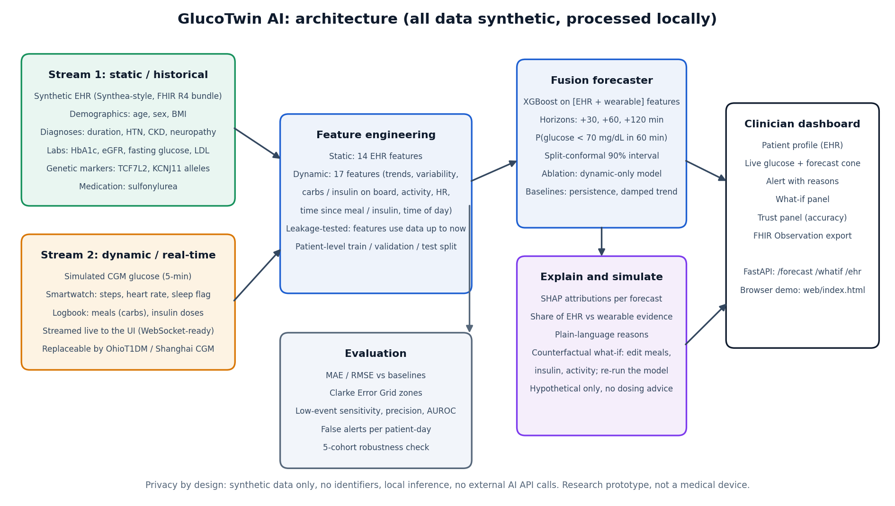
System architecture
Notes:
TIMING 7:00-9:00. Trace the flow left to right: two streams, feature engineering, fusion forecaster, then explain-and-simulate and evaluation, ending in the clinician dashboard and API. Point out privacy by design: synthetic data, local inference, no external AI API calls.

Slide 7
Data and privacy: built for the sandbox rules
Need | What we used | Status
EHR | Synthetic Type 2 diabetes cohort (60 patients), FHIR R4-style bundles | Generated
Sensor data | Simulated CGM, steps, heart rate, meals, insulin | Generated
Real datasets | OhioT1DM, Shanghai CGM, Synthea, MIMIC-IV: licences to confirm | Planned
No real patient data and no identifiers anywhere
Models and explanations run locally; no data sent to external AI APIs
Designed in the spirit of DPDP Act 2023 and HIPAA-style limits (not a compliance certification)
Caution: OhioT1DM is Type 1 data and must not be presented as Type 2 validation
Notes:
TIMING 9:00-10:00. Be explicit about the sandbox rules: every record here is generated. We list real open datasets as the next step and note that each licence must be checked first. Be upfront that synthetic data does not by itself make a system compliant.

Slide 8
The AI model and how we tested it
Model
Honest testing
XGBoost forecaster per horizon: +30, +60, +120 minutes
Classifier: chance of glucose below 70 mg/dL in 60 minutes
Inputs: fused EHR + wearable features (trends, carbs and insulin on board, activity, heart rate, time of day)
Split-conformal 90% intervals show uncertainty
SHAP explains each forecast; what-if re-runs the model
Patient-level split: 36 train, 8 validation, 16 unseen test patients
Features use data up to now only; a unit test checks for leakage
Baselines: no change, damped linear trend
Ablation: same model without EHR data
Metrics: MAE, RMSE, Clarke Error Grid, sensitivity, precision, AUROC
Notes:
TIMING 10:00-12:00. Explain gradient-boosted trees in one line: many small decision trees that learn from both streams together. Stress the honest test design: whole patients are held out, baselines and an ablation are included. Mention the roadmap to LSTM or Temporal Fusion Transformer with cross-attention, which we have not built yet.

Slide 9
Results on 16 unseen synthetic patients
14 vs 34
mg/dL average error at 60 min, fused vs no change
0.97
AUROC for spotting a low in 60 min
90%
of outcomes fell inside the 90% interval
Notes:
TIMING 12:00-14:00. Both learned models far outperform the baselines. At 60 minutes the fused model is off by about 14 mg/dL versus 34 for assuming no change. The 90 percent interval really contains about 90 percent of outcomes. These numbers come from synthetic data, so treat them as proof the pipeline works, not as clinical accuracy.

Slide 10
What the results do and do not show
What works
What is modest
Not proven
Beats simple baselines clearly
Intervals are well calibrated (about 90%)
Reasons are explainable per forecast
Pipeline is reproducible and tested (7 tests)
EHR fusion gain is small: about 0.6 mg/dL at 60 min, better in 5 of 5 cohorts
EHR carries 9% of SHAP importance
Alert rule: 74% sensitivity, 70% precision, about 9 false-alert readings per patient-day
Clinical validity: all data is synthetic
Gain depends on assumed EHR-physiology links
Real CGM data is noisier
No patient or clinician study yet
Notes:
TIMING 14:00-16:00. Be candid; judges value honesty. The fusion gain is modest because in our simulator the EHR affects physiology only through assumed links such as kidney function slowing insulin clearance. Low detection at our chosen threshold needs improvement to reduce false alerts before any real use.

Slide 11
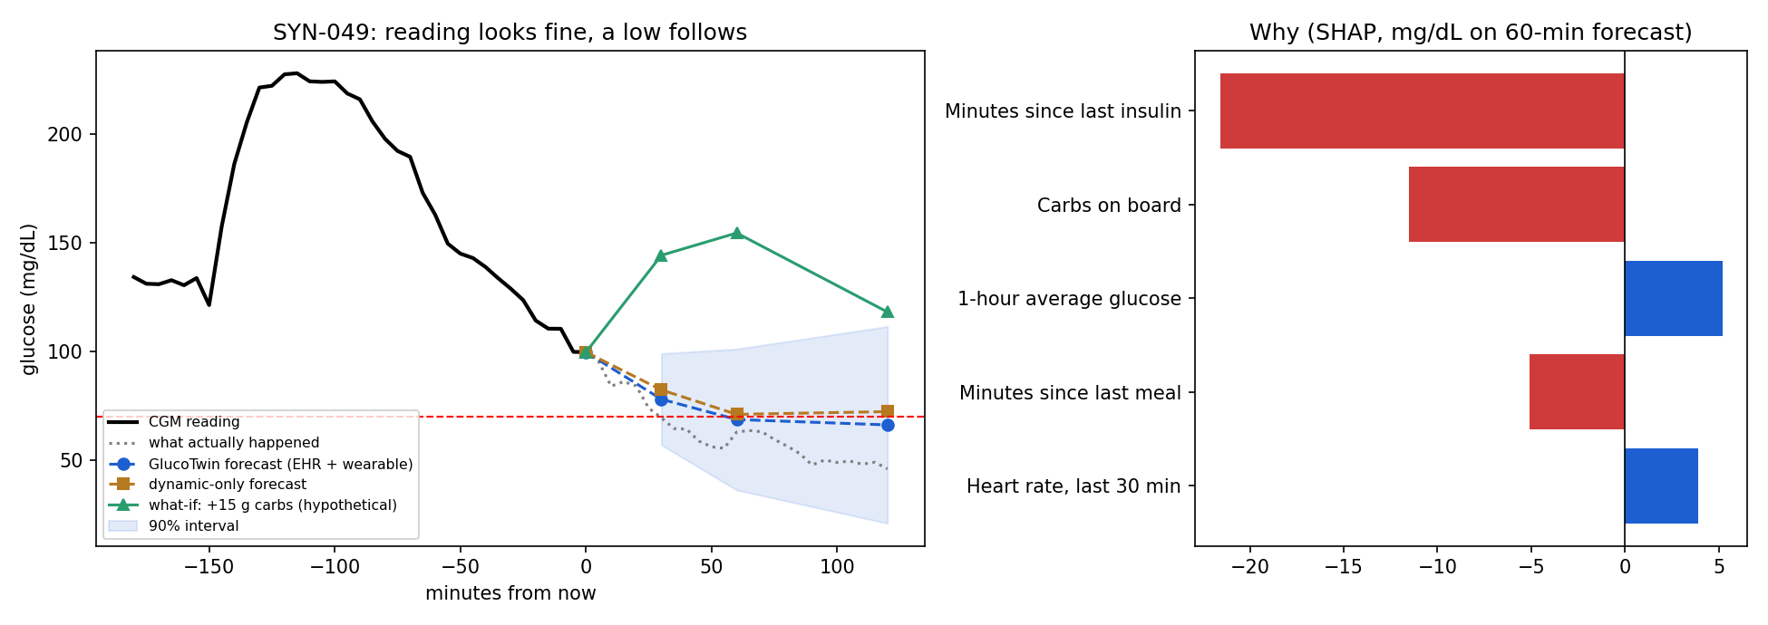
Demo: a normal reading, a low is coming
Held-out patient SYN-049: glucose 100 mg/dL now, actual 63 an hour later. Fused forecast 69 warns; the dynamic-only model says 71 and stays quiet. Bars show why. The green line is a labelled what-if: 15 g of carbs.
Notes:
TIMING 16:00-17:30. Switch to the live dashboard here (web/index.html). Press play, let the audience watch the forecast move, then skip to the next low warning. Use this static figure as a backup if the demo fails. Point to the shaded interval, the SHAP reasons on the right, and the hypothetical what-if line.

Slide 12
The clinician and patient dashboard
1. Play the live stream
2. Read the warning
Readings arrive every 5 minutes. The gauge, trend and forecast cone update live.
Plain-language headline, time to predicted low, and the 1-hour range.
3. See what is driving it
4. Try a what-if
Reasons such as insulin still active or recent food, with mg/dL impact.
Snack, meal, half the active insulin, or a walk. The model recalculates; labelled hypothetical.
Also: load your own CSV, see time in range today, a trust panel with accuracy, FHIR export, and a REST API.
Notes:
TIMING 17:30-19:00. Narrate the live screen recording: play, warning, drivers, what-if, then the trust panel which tells a layperson how accurate the forecast has been on unseen data. Mention the CSV upload so a clinic could try its own CGM export.

Slide 13
Responsible by design
R1 Explain every alert
R2 Show uncertainty
SHAP drivers and plain-language text on each forecast.
Calibrated 90% interval; wide band means low confidence.
R3 Never advise doses
R4 Work without real data
What-if is hypothetical and says so. Clinician decides.
Synthetic EHR and sensors; local processing.
Notes:
TIMING 19:00-19:40. These were our four design requirements from the start. Each is implemented, not just promised.

Slide 14
Impact and roadmap
Readiness: TRL 4, an integrated prototype tested on synthetic data in a lab setting
Next 3 months
6 to 12 months
Before any patient use
Train on open CGM data (licences first)
LSTM / Temporal Fusion Transformer with cross-attention
Reduce false alerts; per-patient thresholds
Retrospective validation on authorised clinical data
Clinician usability study with diabetologists
Remote-monitoring pilot for primary centres
Regulatory review as software as a medical device
Security and consent audit
Prospective clinical evaluation
Notes:
TIMING 19:40-20:30. Close with the benefit: earlier warning, fewer unexpected lows, clearer reasons for clinicians and low-cost remote monitoring. State that these benefits are goals to be measured, not yet proven. Be clear that a clinical pathway needs real data, usability studies and regulatory review.

Slide 15
Thank you
GlucoTwin AI: predict, explain, and let the doctor decide.
Code, README, architecture and results: github.com/AnnuAnshu26/Powerpuff-IGDTUW
Open-source licence: MIT
Team Powerpuff Girls: Anushka Aggarwal, Anshu Yadav, Aarti | IGDTUW
Notes:
TIMING 20:30 onward. Thank the panel and invite questions. The repository link is on the slide; mention that the README, architecture diagram and results are all in the repo.

