Slide 1
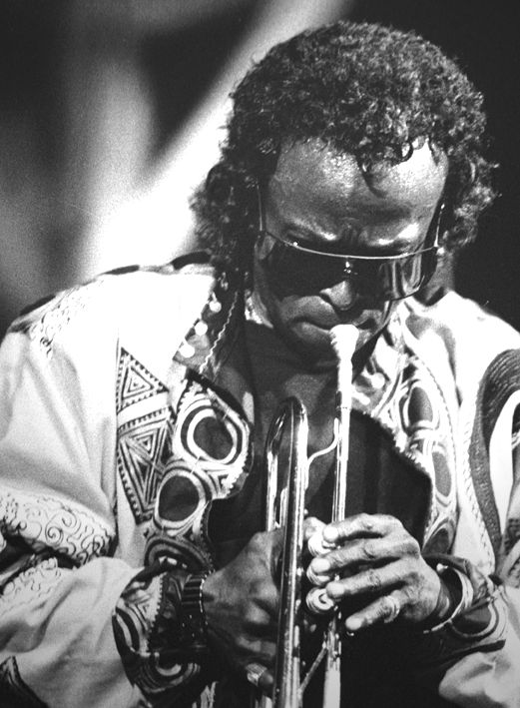

By George R. Crisp
About Miles Davis

Slide 2
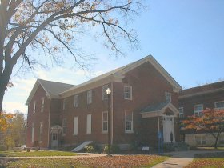
Miles Dewey Davis III
Born on May 26, 1926 to father Miles Dewey Davis II (also known as Doc Davis) and mother Cleota Henry Davis.
Born in Alton, Illinois.

Slide 3
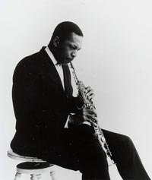
What was going on at the time?
In September of 1926, John Coltrane was also born. He was destined to meet Miles.
John would go on to be part of Miles’ permanent quintet in the 50s that included Red Garland, "Philly Joe" Jones, and Paul Chambers. Unfortunately, most of them would acquire an addiction to heroin.

Slide 4
Family
Miles had no siblings, just a mother and father.
His mother, Cleota, was strongly against him being a musician, and wanted him to get a real job. She was the discipline giver.
His father, Doc, let Miles make his own decisions and take responsibility for them. Doc was there to support Miles in his darkest times, when Miles was doing lots of drugs. He had the biggest impact on Miles.
They lived in the middle class of East St. Louis, where Miles was fairly spoiled.

Slide 5
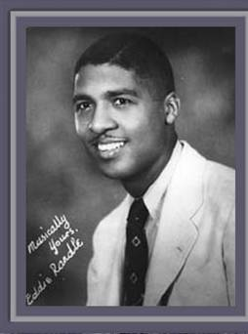
1943 – Eddie Randle’s Blue Devils
The Blue Devils were a territory based band in St. Louis. They would perform live for the WEW radio station, and the band was popular for its hot jazz music.
Eddie Randle hired many up and coming jazz stars, including Clark Terry, Jimmy Forrest, Willie Akins, and of course, Miles Davis.

Slide 6
1944 - Juilliard
Miles Davis left the Midwest to attend the Institute of Musical Art in New York City, since renamed Juilliard. He did so to follow bebop, the new sound of the day. He would leave one year later, because the pace of learning was just too slow for him.
Juilliard has become a major dance, drama, and musical school since Miles’ departure.

Slide 7
1955 – Columbia Records
With a strong performance of the song “Round Midnight” at the Newport Jazz Festival in July of 1955, major label Columbia Records signed Miles to a contract. This was a major moment for him, since he had just kicked a huge heroin addiction not long before, with the help of his father Doc Davis. This signing enabled him to start up the aforementioned quintet, with the likes of saxophonist John Coltrane, pianist Red Garland, bassist Paul Chambers, and drummer Philly Joe Jones.

Slide 8
1972 – Car Crash
Miles broke his ankles in a car accident and became much less active in the 70s, giving up recording entirely in 1975 because of a subsequent illness. Then, he had to go in for a hip replacement later in the year, detaching him more from the music world. He would not return to the recording scene until 1980, creating The Man With the Horn. He would finally start touring again one year later.

Slide 9

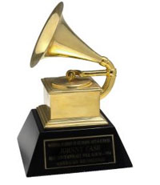
1993 – 7th Grammy
Two years after his death, the album “Miles & Quincy Live at Montreux” won Miles his final Grammy award. He had won his previous awards in such categories as Best Rhythm & Blues Instrumental Performance, Best Jazz Instrumental Performance, and Best Jazz Performance by a Group. It was around this time that his restless approach to jazz music began to die out.

Slide 10

Mistaken Identity
Miles was a perfect fit for the Mistaken Identity archetype. The young Miles Davis would try too hard to be like his idols, and one of his band teachers finally reprimanded him one day after class, telling him to stop playing all those fancy notes in the middle of songs. This got Miles started on the right track, and he realized that he had to develop his own unique style. It took him a while, but people finally started recognizing Miles as an artist with an individual flavor, not just some backup kid.
Anyone who has ever struggled to break out of the crowd and be special can relate to Miles.

Slide 11
Magic takes time.
Miles didn’t play his biggest hits when he was a kid. It took years of listening to the best Jazz musicians of his time, and a lot of practice, before his greatest songs could come to reality. But he eventually made magic with his first great album, “Birth of the Cool,” in February of 1957, at 30 years old.

Slide 12
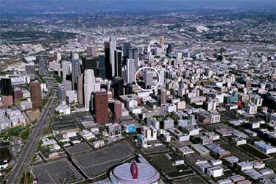
Miles Davis died on October 28, 1991, in Los Angeles, California.

Slide 13
Works Cited
Crisp, George R. Miles Davis. New York: Franklin Watts, 1997.
http://www.greatriverroad.com/Cities/Alton/AltonMuseum.htm
http://home.ica.net/~blooms/stafindex.html
http://www.allaboutjazz.com/php/musician.php?id=6144
http://www.milesdavis.com/bio.asp
http://www.allaboutjazz.com/jazz1926.htm
http://www.universal-music.co.jp/jazz/artist/john_coltrane/bio.html
http://www.allaboutjazz.com/php/musician.php?id=5851
http://www.siue.edu/~tdickma/EddieRandle1.htm
http://www.juilliard.edu/
http://www.columbiarecords.com/
http://orthoinfo.aaos.org/fact/thr_report.cfm?Thread_ID=169

Slide 14
Created by
Michael Tarpey
Block 4-1
03-12-2007

