Slide 1
Predicting MLB Career Salaries
Stephanie Aube
Mike Tarpey
Justin Teal

Slide 2
Objective
To determine the best model for estimating how much a given Major League Baseball player will make in salary throughout his career, based on current batting and fielding statistics.
It’s relatively clear that Major League Baseball and other professional sports pay for performance. The idea is to come up with a way to statistically forecast a career salary, and what variables are best for this task.

Slide 3

Obtaining data
Primary Source: Lahman Baseball Database
Sean Lahman
Compiled every major baseball statistic including salaries for players between 1985-2012
Database won awards from baseball and sporting magazines

Slide 4
Variables
PlayerID – Name of player (the ID key)
SumOfSalary – The sum of a player’s salary over their career
Weight
Height
Bats (right, left, switch)
Throws (right, left)
SumOfAB – Career At Bats
SumOfR – Career Runs Scored
SumOfH – Career Hits
SumOf2B, SumOf3B, SumOfHR – Career doubles, triples, and homeruns
SumOfRBI – Career Runs Batted In
SumOfSB – Career Stolen Bases
SumOfSO – Career Strike Outs
SumOfPO – Career Put Outs (defensive)
SumOfA – Career Assists (devensive)
SumOfE – Career Errors (defensive)
SumOfDP – Career Double Plays (defensive)
SumOfCS – Career Times Caught Stealing (baserunning)
Country of Birth
State of Birth (if born in US)
Hall of Fame (binary, 1=admitted)
School (binary, 1=played in college)

Slide 5
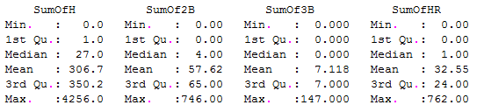
Data summary
4,512 total players considered
56.69% played in college
7.402% eventually voted into HOF
Average player size: 196.8 pounds, just under 6’2”
62.97% of the sample bats right handed

Slide 6
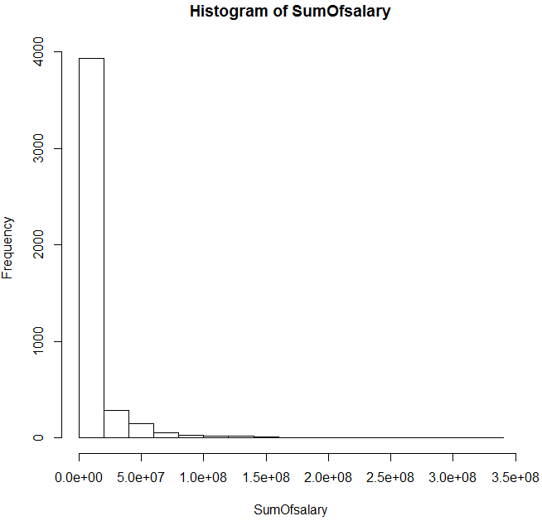
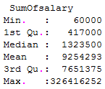
Data structure
Our response variable is heavily skewed to the right, so during model selection transformation was considered and eventually implemented

Slide 7
Explanatory variables
Because most explanatory variables are career sum variables, nearly every one is right skewed. This can be attributed to two factors:
Very few major league players start in almost every game for their team; it’s only those that do that rack up large statistics. Some players may only be called up from lower leagues for a few games to substitute in for a hurt superstar.
Specialty players (home run hitters, better fielders)
This will be further considered during model selection.

Slide 8
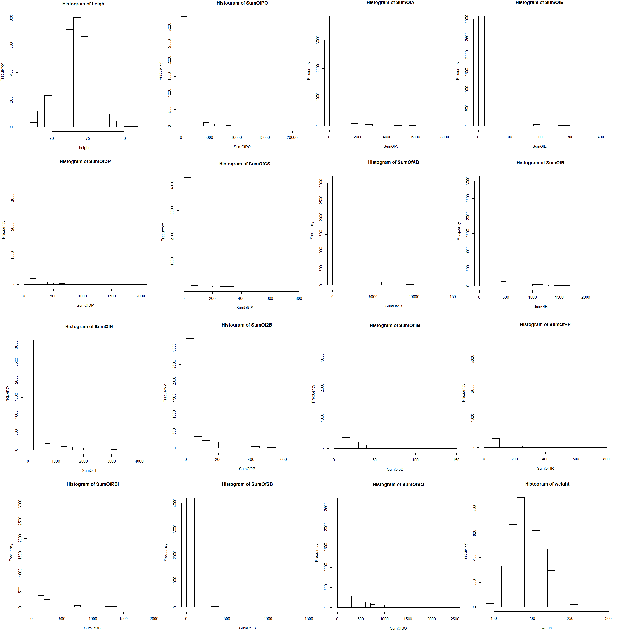

Slide 9
Model selection
Full model used as a starting point
Includes every variable with the exception of state and country of birth

Slide 10
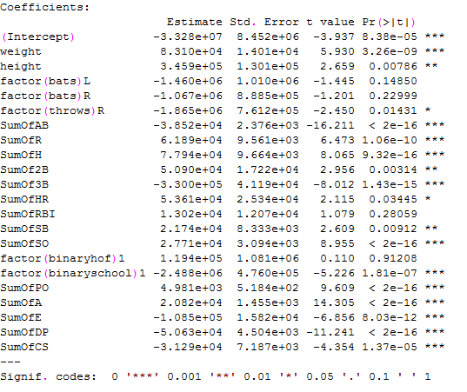

Full model

Slide 11
Full model flaws
Only about 43% of the response variable, career salary, is explained by the model
Some coefficients are thrown off by heavy collinearity. More AB = less money should not be an expected result of the model
Log transformations on the many right-skewed variables can help model fit
Can advanced statistics help to build a better model?

Slide 12
SABrmetrics
Society of American Baseball Research
Statistics that provide better indication of player output
Now widely used in MLB

Slide 13
Created variables
Batting Average on Balls in Play (BABIP)
BABIP = (SumOfH – SumOfHR)/(SumOfAB – SumOfSO – SumOfHR)
Player Runs Percentage Adjusted (PRPA)
PRPA = (SumOfRBI – SumOfSO)/(SumOfAB)
Slugging Percentage (SLUG)
SLUG = (SumOfH + 2*SumOf2B + 3*SumOf3B + 4*SumOfHR)/(SumOfAB)

Slide 14

New full model
Includes all 20 variables from original model plus 3 SABRmetrics
BAPIP significant at .01 level
SLUG significant at .001 level
8/9 offensive variables significant
RBI not significant
4/4 defensive variables significant

Slide 15

Model narrowing
StepAIC both from full to reduced and reduced to full selected same model
From 23 variables, removed Bats (left, right, switch), BinaryHOF, PRPA

Slide 16
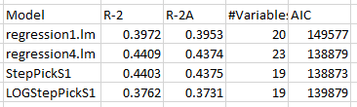
Salary transformation
SumOfSalary is right skewed
Ran same model on log(SumOfSalary)
4/10 offensive variables significant
4/4 defensive variables significant

Slide 17
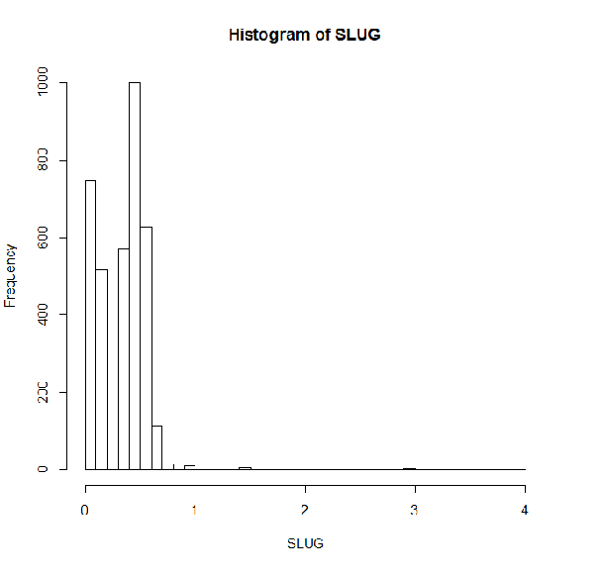
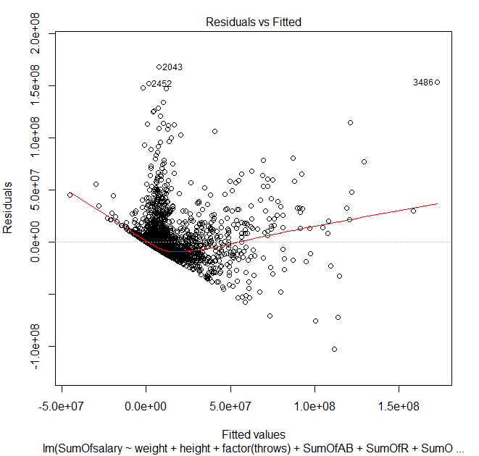
Saber transformation

Slide 18
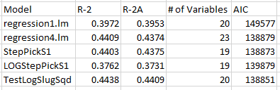
Saber transformation
Chose log(SLUG + 1) to replace SLUG
Added SLUG² to model

Slide 19
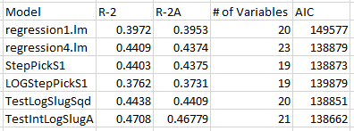
Interaction variables
Players with multiple skills should be paid more
SLUG and SumOfA
SumOfHR and SumOfSB
Only interaction between SLUG and SumOfA deemed significant

Slide 20
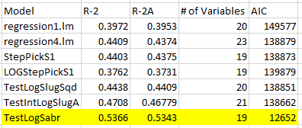
Dealing with skewness
All variables were at least slightly skewed
Took natural log of every explanatory variable and SumOfSalary (dependent variable)
Did not transform variables Weight, Height, Throws, HOF, School, BABIP

Slide 21
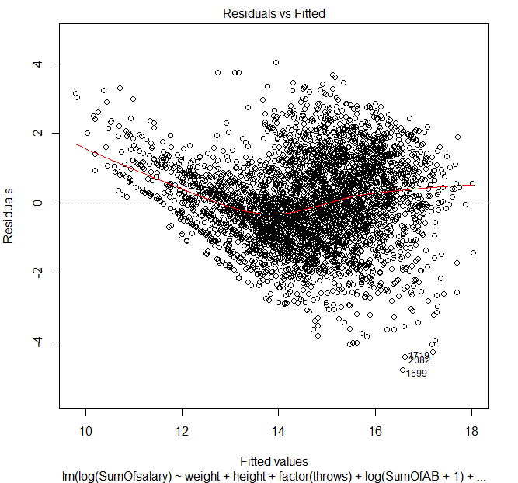
Residuals vs. fitted for new best model

Slide 22
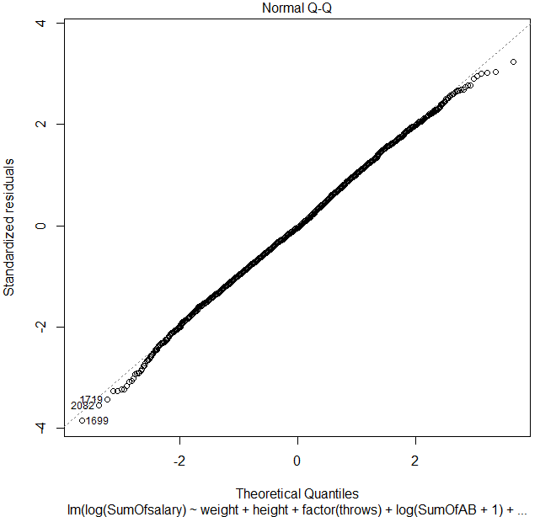
QQ Plot of new best model

Slide 23
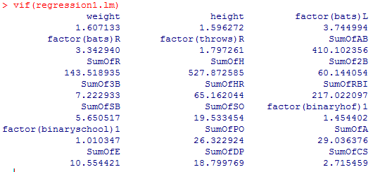
Collinearity – initial full model

Slide 24
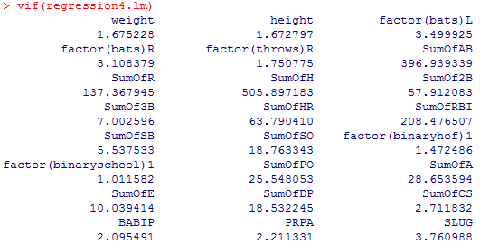
Collinearity – full model plus saber

Slide 25
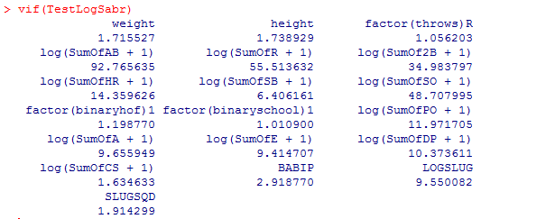
Collinearity – Final model

Slide 26
Interesting findings
RBIs had no statistical significance
Advanced statistics proved to be significant in player salary analysis, but not team analysis
Weight much more significant than height
Many variables in final model
All defensive statistics are significant, but not all offensive

Slide 27
Future investigations
How do variables other than player statistics influence salary?
Team
Years in League
Year with Team
Age

Slide 28
Summary
Career salaries are predictable using various batting and fielding statistics
Many player statistics are vital in predicting salaries – higher valued players are well rounded

Slide 29
Questions?

