Slide 1
Tinn-R
Method
Small Presentation
Mike Tarpey
February 5th, 2013

Slide 2
Introduction to Tinn-R
“Tinn Is Not Notepad.” It’s a fully-featured text editor designed to work smoothly with R.
Lines of code can be edited easily in Tinn-R and sent across to R one line at a time for easy troubleshooting.
Tinn-R intelligently highlights code it recognizes in the language R uses.
Tinn-R only works with Windows.

Slide 3
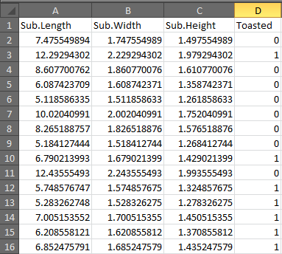
Dataset Used
Length, width, and height of sub sandwiches;
Bernoulli variable (toasted or untoasted).

Slide 4
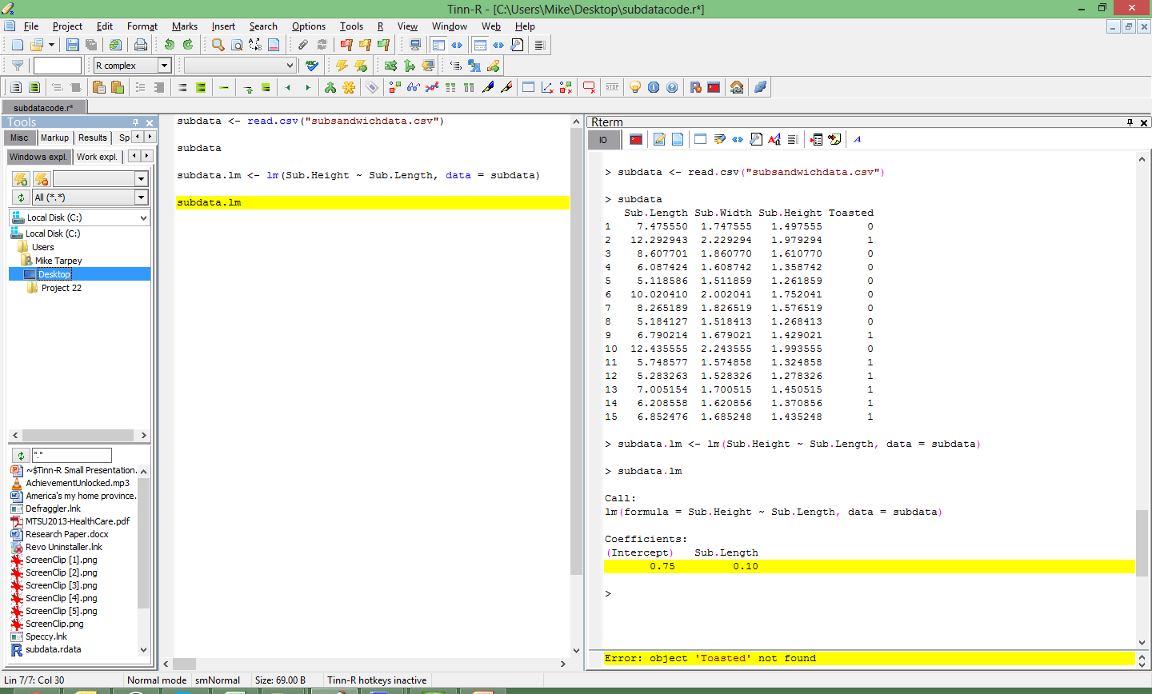
This is what a typical
Tinn-R window looks like.
This middle pane is the main window of Tinn-R. This is where you write and format your code.
The right pane is a built in R terminal;
no need to open a second window
for R. (You still need to have R installed
on your computer.)
The left pane contains tools you
can use to locate and organize
files relevant to Tinn-R.

Slide 5
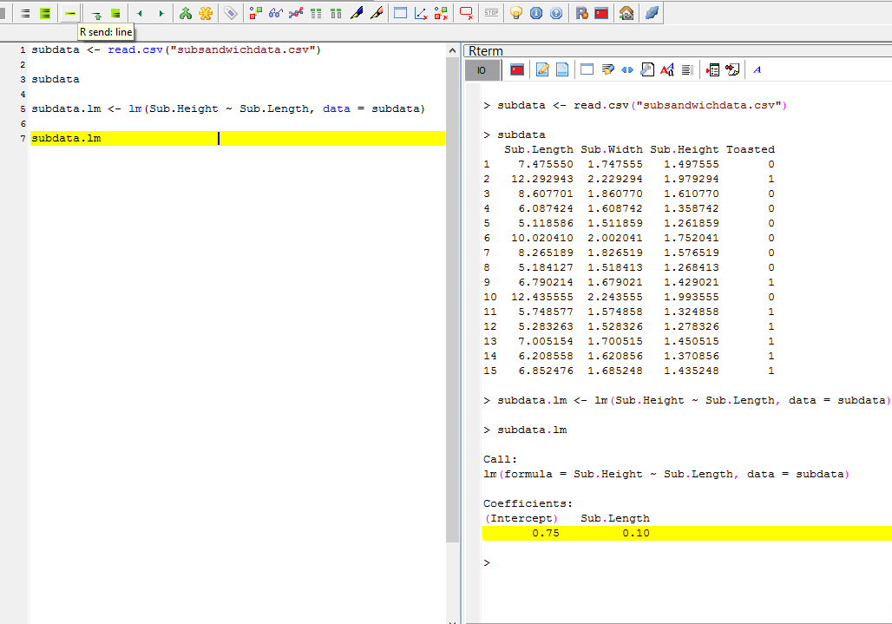
Simple Linear Regression
Using the R send button highlighted at the top sends the selected line of code to R. →
In line 1, the dataset is imported from Excel using read.csv.
Line 3 displays the data.
Line 5 contains the linear regression code.
Y=Sub.Height (response)
X=Sub.Length (explanatory)
Line 7 displays the resulting regression.
For every inch of sub length, the expected value of the sub’s height increases by .10 inches.

Slide 6
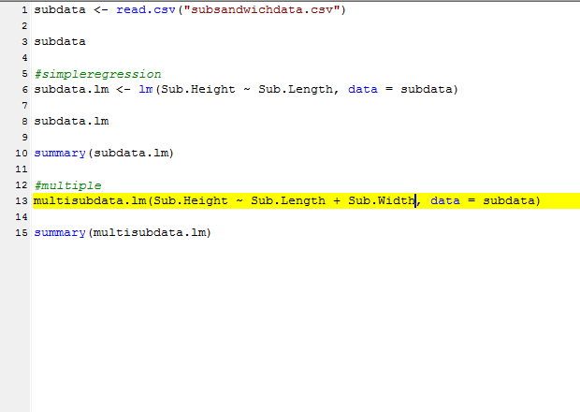
Multiple regression is similar; simply list the
explanatory variables together.
The summary command allows you to view a number of statistics regarding the regression results, including r, p, and F-values.

Slide 7
Creating Data Plots
Again, Tinn-R is simply a high-end text editor, but this is especially useful when you want to compare different data plots. You can construct multiple plot types beforehand, then send all of them to R one after another to contrast them.

Slide 8
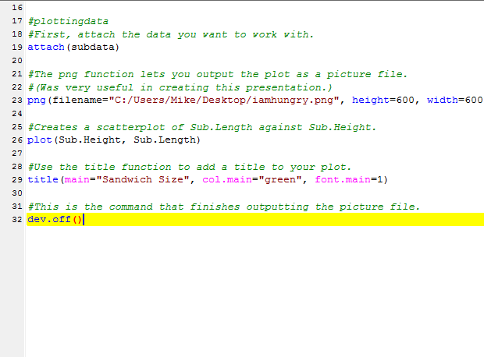

Slide 9
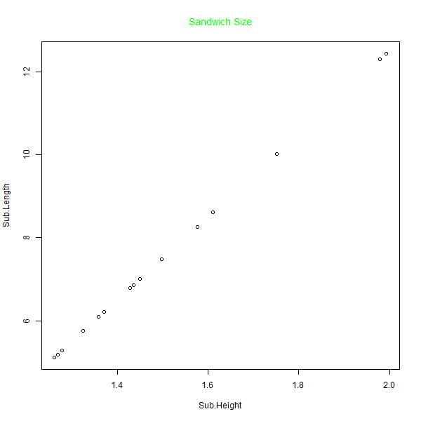

Slide 10
Other Plotting Commands
The lines() function lets you specify what kind of line you want connecting your data points in the plot (accepts arguments for line type, point type, and color).
Barplot() → Bargraph.
Hist() → Histogram.
Pie() → Pie chart.

Slide 11

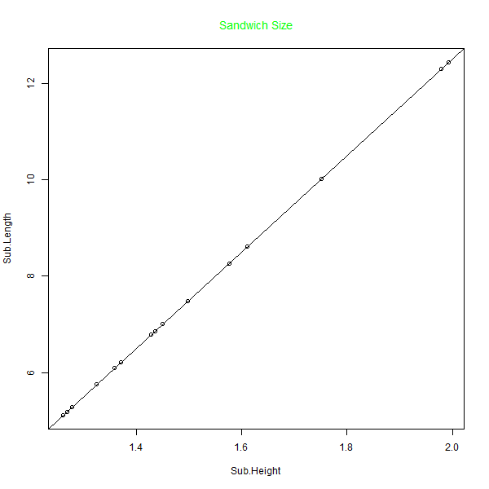

Slide 12
In creating this presentation,
I found myself making many, MANY mistakes with code syntax, and was forced to appreciate how useful Tinn-R is.
Instead of reworking a line of code three or four times directly in R, I could write an entire block of code for what I wanted to do, then fix all of the mistakes in one go.

Slide 13
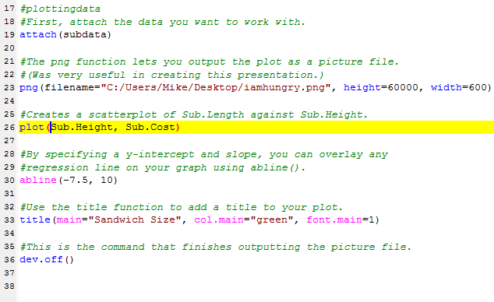
Plot may have been slightly too tall.
Not an actual field.

Slide 14
Thank you!
References
http://www.harding.edu/fmccown/r/
http://cran.r-project.org/web/packages/IPSUR/vignettes/IPSUR.pdf
http://www.statmethods.net/stats/regression.html
http://www.burns-stat.com/documents/tutorials/impatient-r/
http://www.ats.ucla.edu/stat/r/faq/scatter.htm

