Slide 1
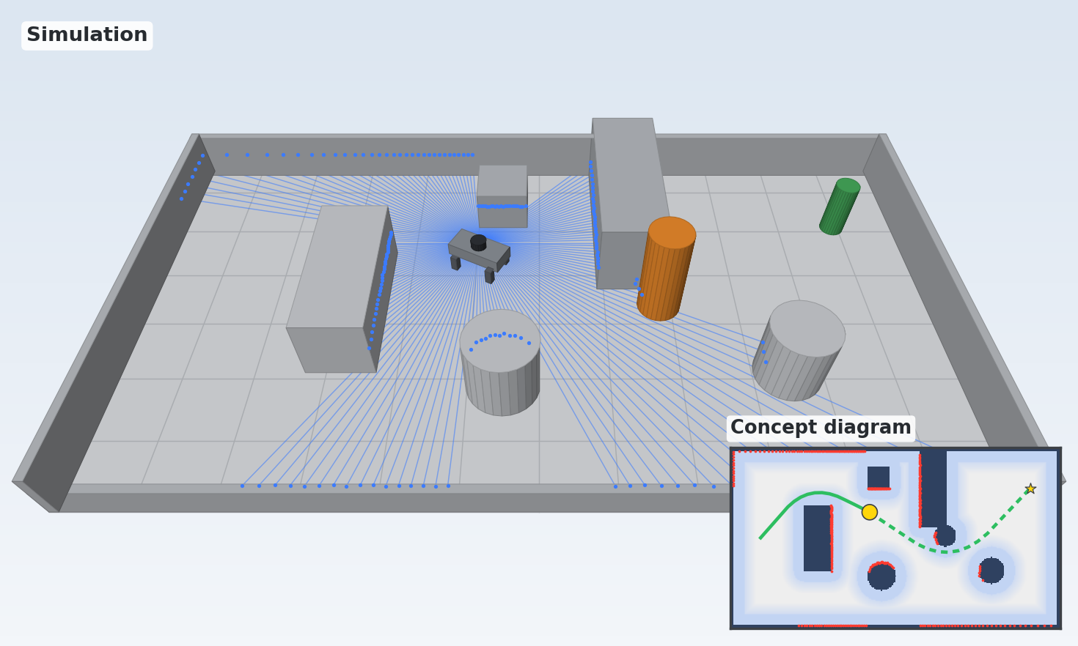
Project 3
Scenario
Autonomous Obstacle Avoidance for a Quadruped Robot｜Team Leader: Anny
Goals
Avoid obstacles on its own
Reach the goal position autonomously
Target Result
The robot dog uses the added LiDAR to detect obstacles, then walks to a goal position by itself and goes around anything in its way.
Simulated obstacle field — target path around obstacles to the goal
國立臺灣科技大學（NTUST） · 自主移動機器人實驗室
13

Slide 2
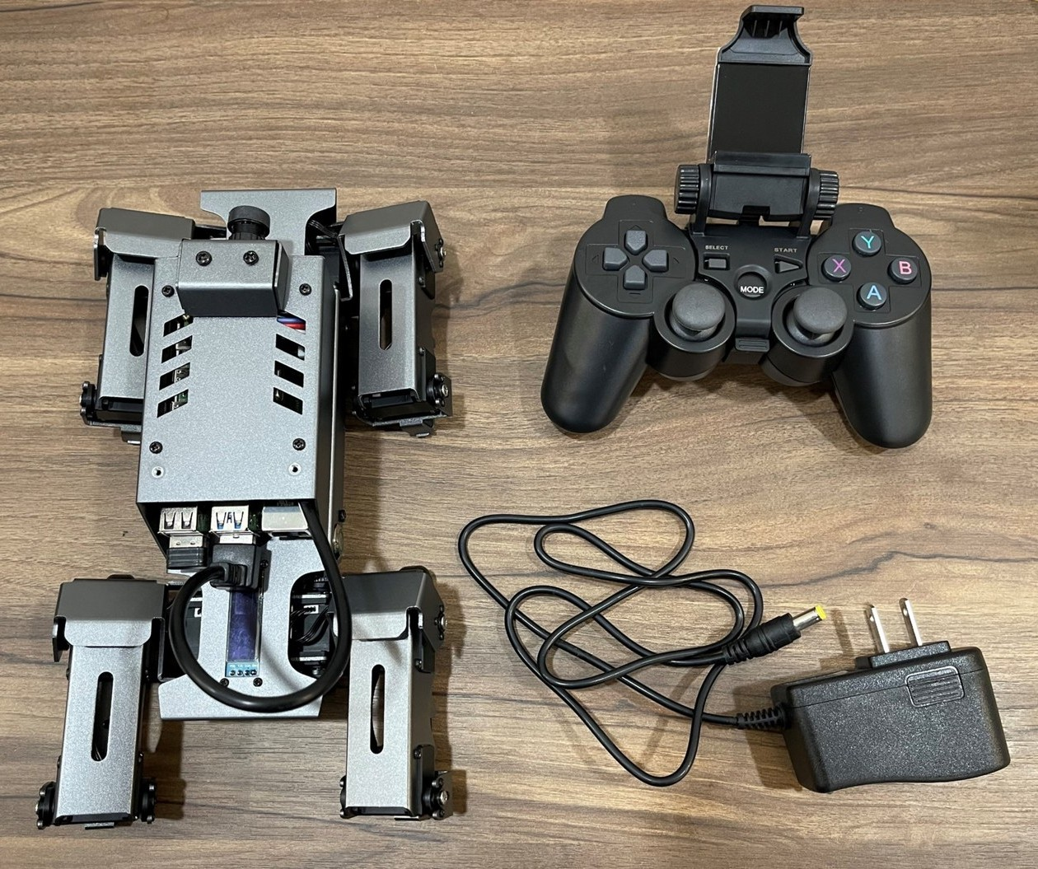
Project 3
Scenario
Hardware & System｜Team Leader: Anny (許雅倪)
Hardware
DOGZILLA S1 — 12-DOF robot dog with Raspberry Pi 4B and camera
LiDAR to be added for obstacle sensing
Software / Control (ROS 2)
Mapping
Path planning
Obstacle avoidance
Motion control
DOGZILLA S1 with control hardware
Data flow: LiDAR scan data → Raspberry Pi plans a path → commands sent to the robot dog
國立臺灣科技大學（NTUST） · 自主移動機器人實驗室
14

Slide 3
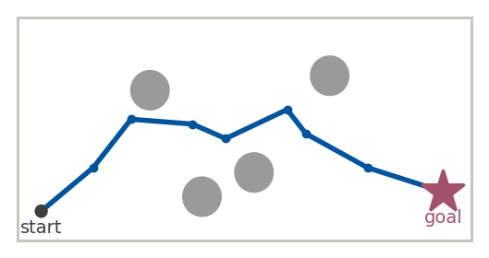
Project 3
Scenario
System Flow — Hardware Overview｜Team Leader: Anny (許雅倪)
System Architecture · Hardware Overview
Path Planning & Obstacle Avoidance
Raspberry Pi 4B · ROS 2
Mapping → Path Planning → Obstacle Avoidance → Motion Control
scan data
video
commands
LiDAR
Obstacle sensing (to be added)
Camera
On the robot
DOGZILLA S1 Body
12 servos + IMU
The LiDAR scans the surroundings; the Raspberry Pi plans a path and sends motion commands back to the robot dog.
國立臺灣科技大學（NTUST） · 自主移動機器人實驗室
15

Slide 4
Project 3
Scenario
System Flow— Software Pipeline｜Team Leader: Anny (許雅倪)
System Architecture · Software Pipeline
Perception & Planning
ROS 2
Topics
Decision & Control
(Raspberry Pi 4B · ROS 2)
(Communication)
(Raspberry Pi 4B · ROS 2)
LiDAR Sensing
distance to obstacles
Reinforcement Learning
sensing
Obstacle Avoidance
Environment
SLAM
map + robot pose
action
Motion Control
Nav2 Path Planning
walk commands
route to goal
國立臺灣科技大學（NTUST） · 自主移動機器人實驗室
15

