Slide 1
DOGZILLA

Slide 2
Outline
  Boot
  SSH connect
  Python Code to Control
  ROS2

Slide 3
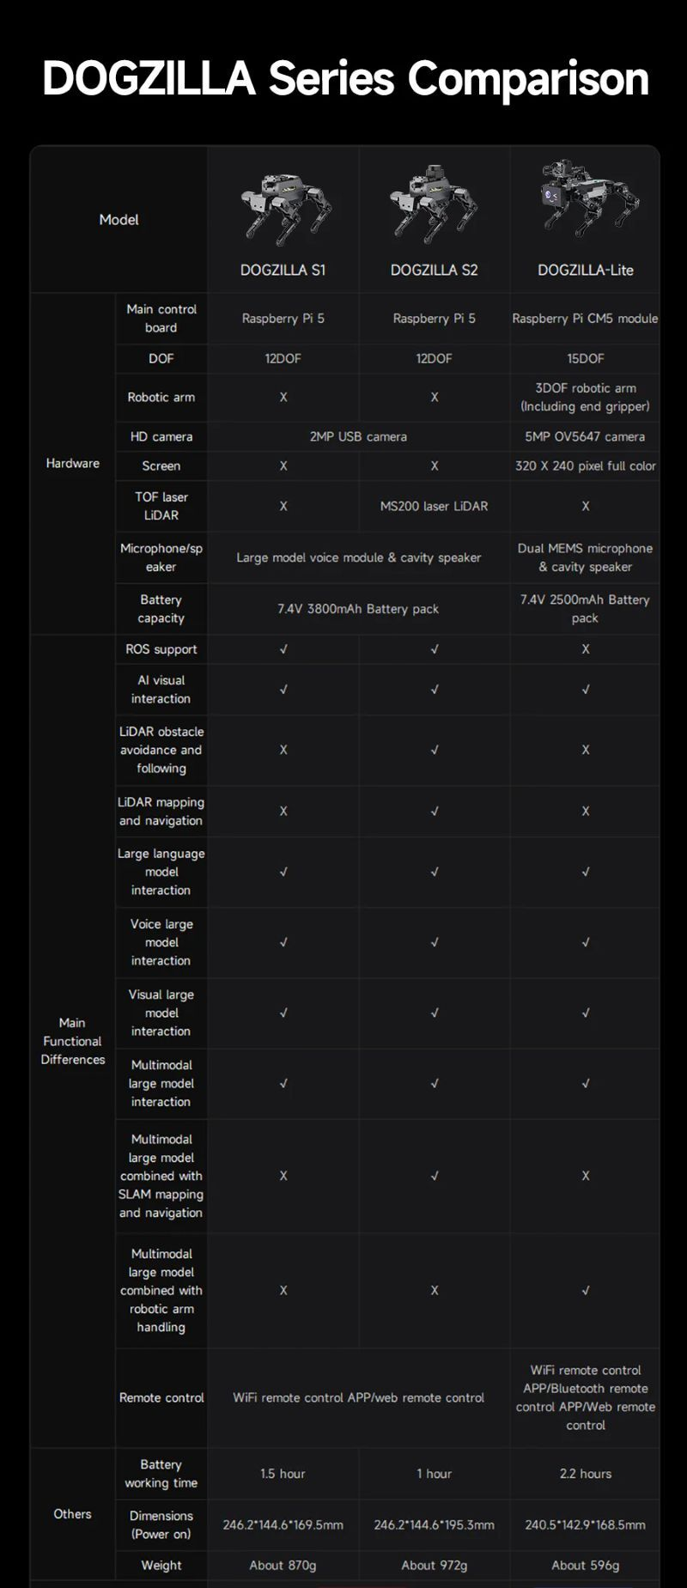
Specification

Slide 4
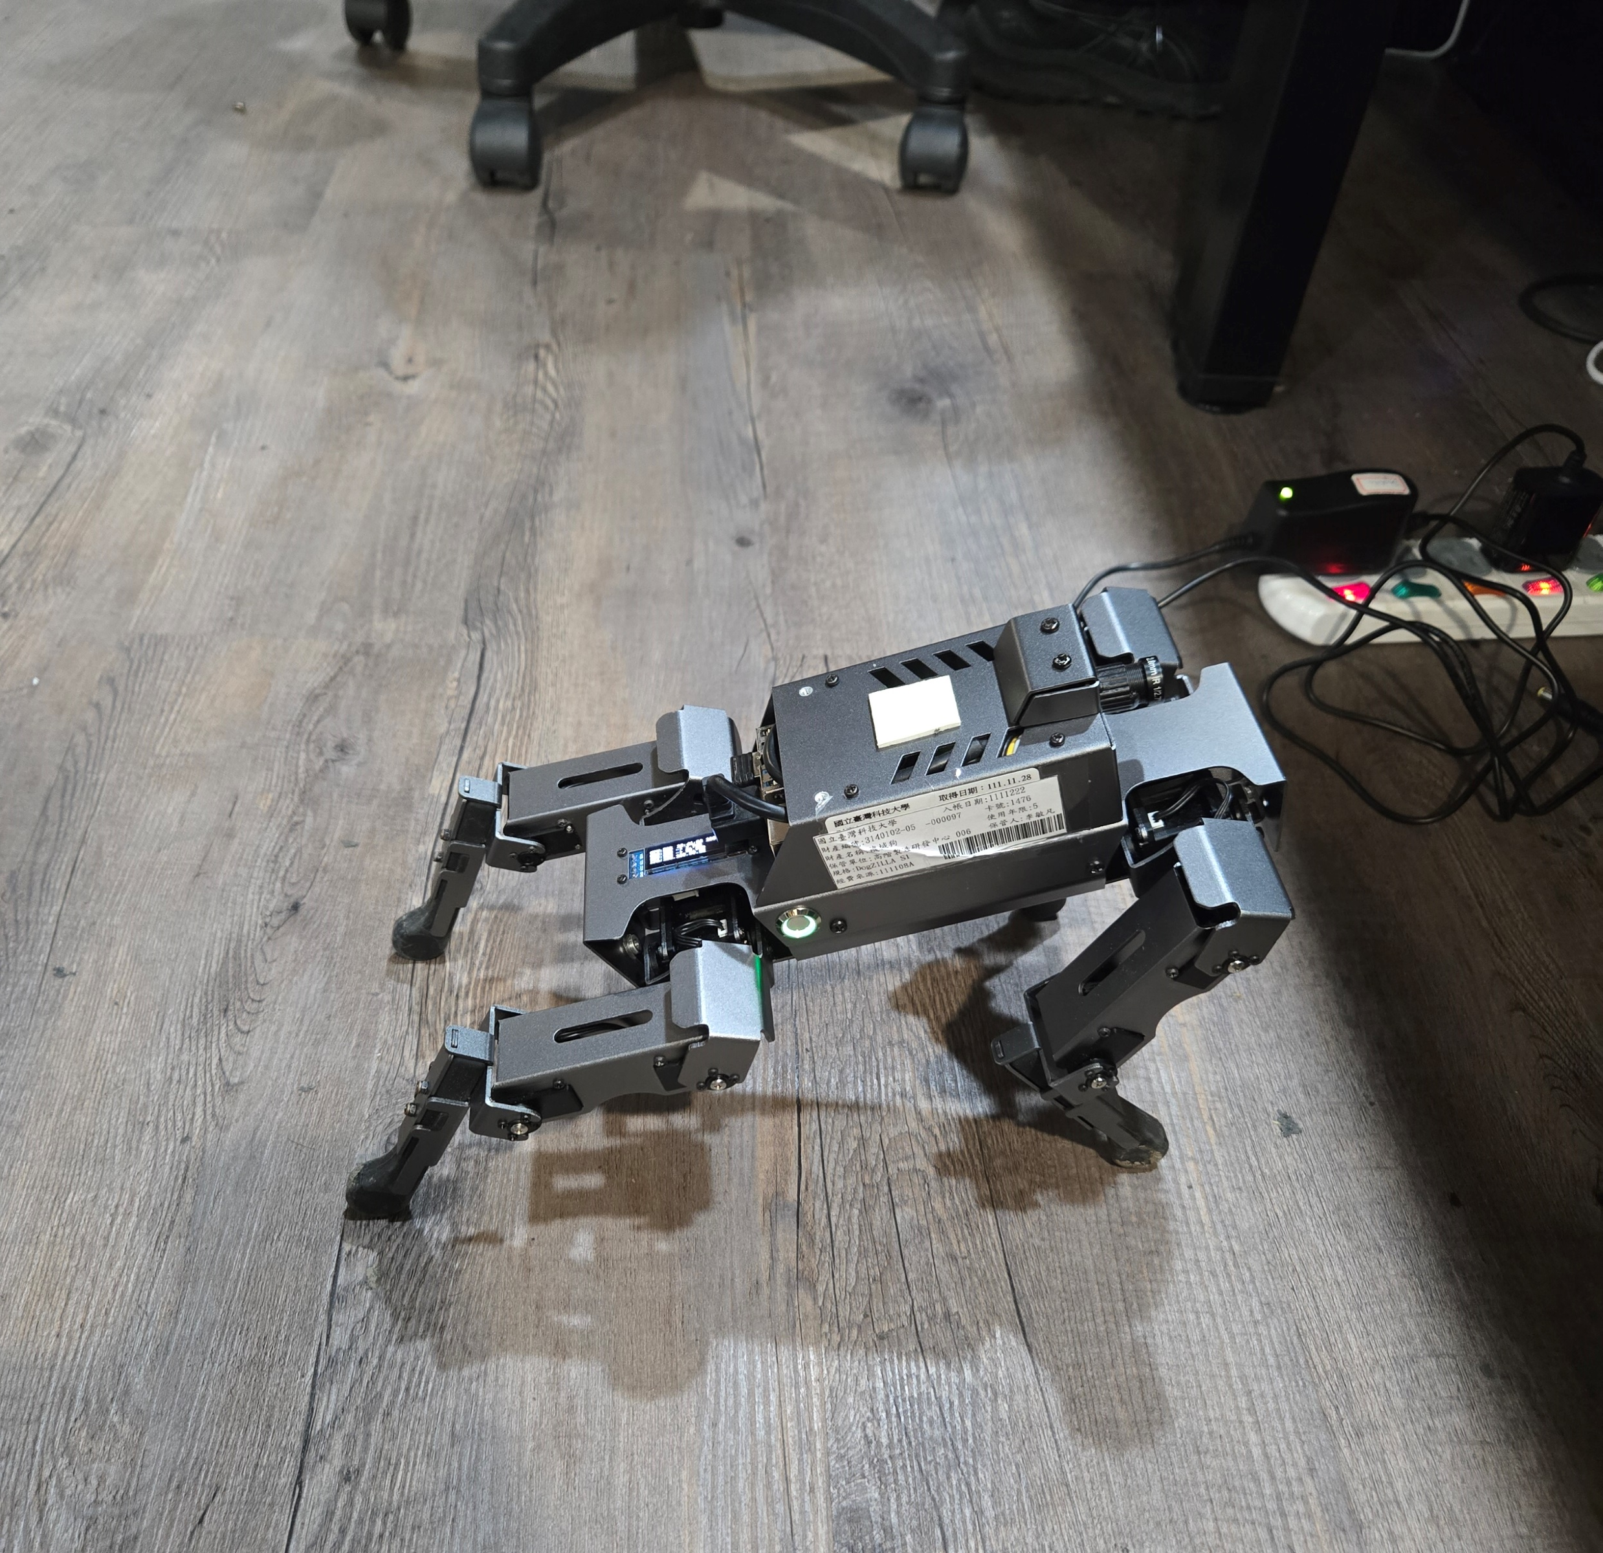
Boot
Press switch
Waiting for the robot dog to initialize until it stretches
When robot back to the normal attitude, and you can connect
Press

Slide 5
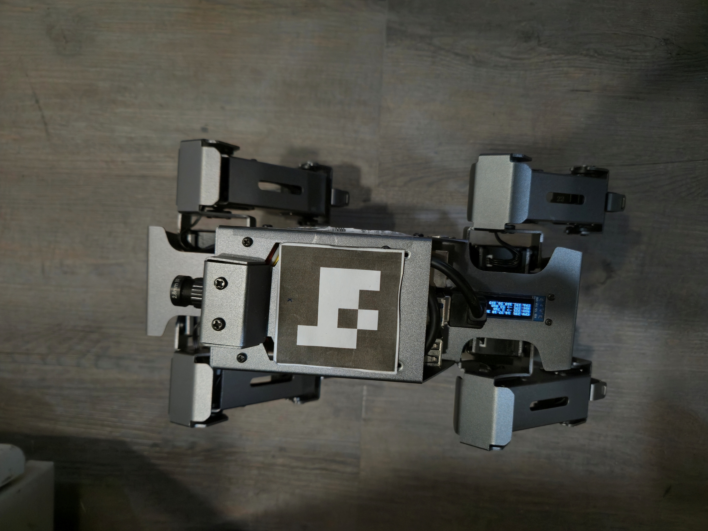
SSH Remote Control
IP Adress: See on the Robot screen
Username: pi
Password: yahboom
Make sure your network is in the same domain as the robot
IP

Slide 6
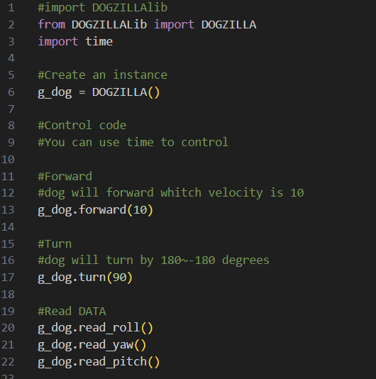
Python Code to Control

Slide 7
ROS2 Control- Node
Core Hardware Node (driver_node)
  This node talks directly to the robot dog's hardware.
  It runs in the background, receives your commands, and changes them into real movements (move forward, backward, left, right, or turn).
How to Control
  Topic: /cmd_vel
  Message Type: geometry_msgs/msg/Twist
  Your Task: Just publish (send) a Twist message to the /cmd_vel topic in your code, and the robot dog will move!

Slide 8
ROS2 Control- Movement Commands
Move Forward / Backward (linear.x)
  linear.x > 0 : Move Forward
  linear.x < 0 : Move Backward
Move Left / Right (linear.y)
  linear.y > 0 : Move Left
  linear.y < 0 : Move Right

Slide 9
ROS2 Control- Movement Commands
Turn Left / Right (angular.z)
  angular.z > 0 : Turn Left
  angular.z < 0 : Turn Right
Stop the Robot
  All values = 0 : Stop moving

Slide 10
相關的Path
Python鍵盤控制
  /home/pi/Course/example/keyboard_ctrl.py
Python相機開啟與錄影
  /home/pi/Course/example/camera.py
其他可參考
  /home/pi/DOGZILLA
  註記:裡面的東西，不保證每個都可以動，但可以拿來參考

