Slide 1
DOGZILLA

Slide 2
Outline
  Boot
  SSH connect
  Python Code to Control
  Charge

Slide 3
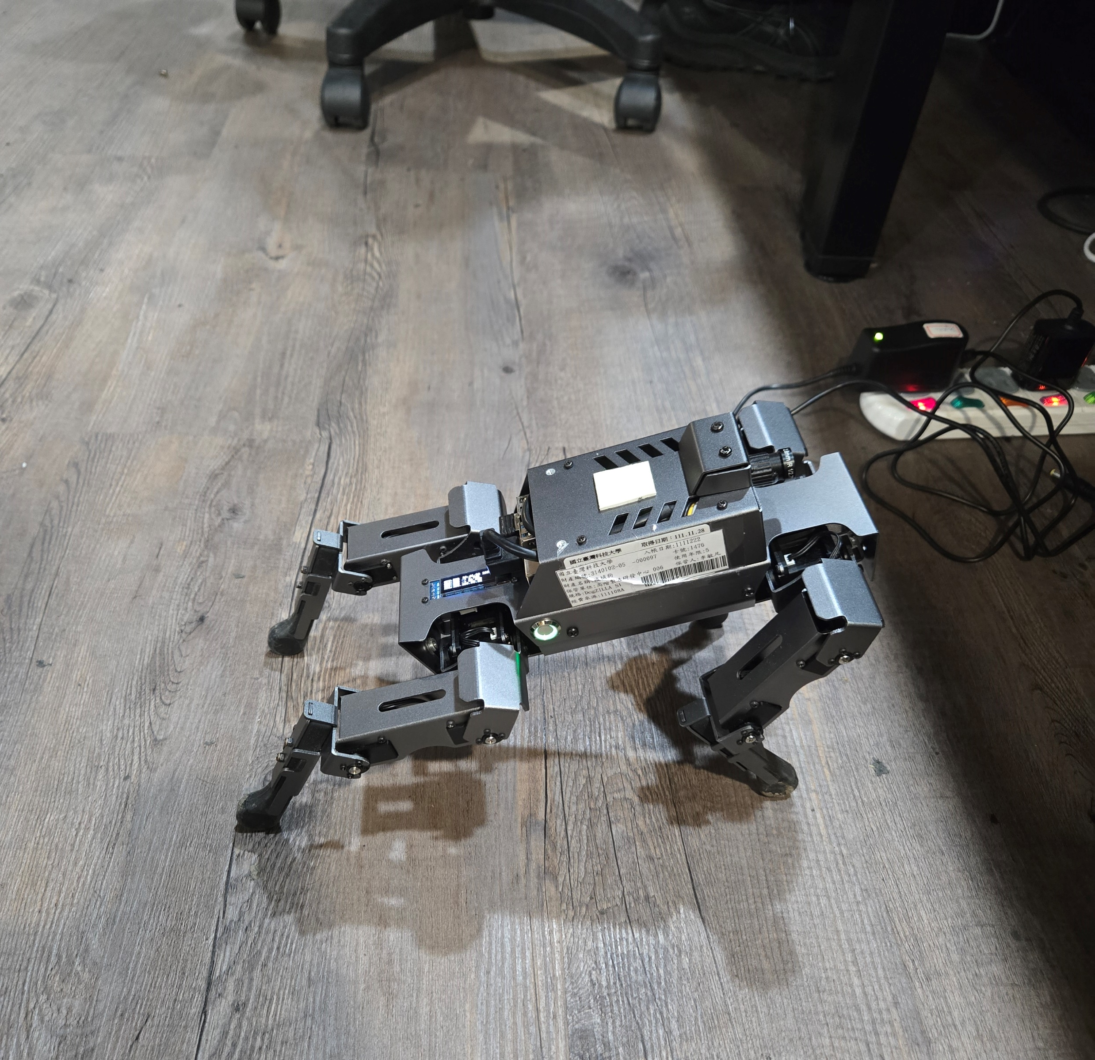
Boot
Press switch
Waiting for the robot dog to initialize until it stretches
When robot back to the normal attitude, and you can connect
Press

Slide 4
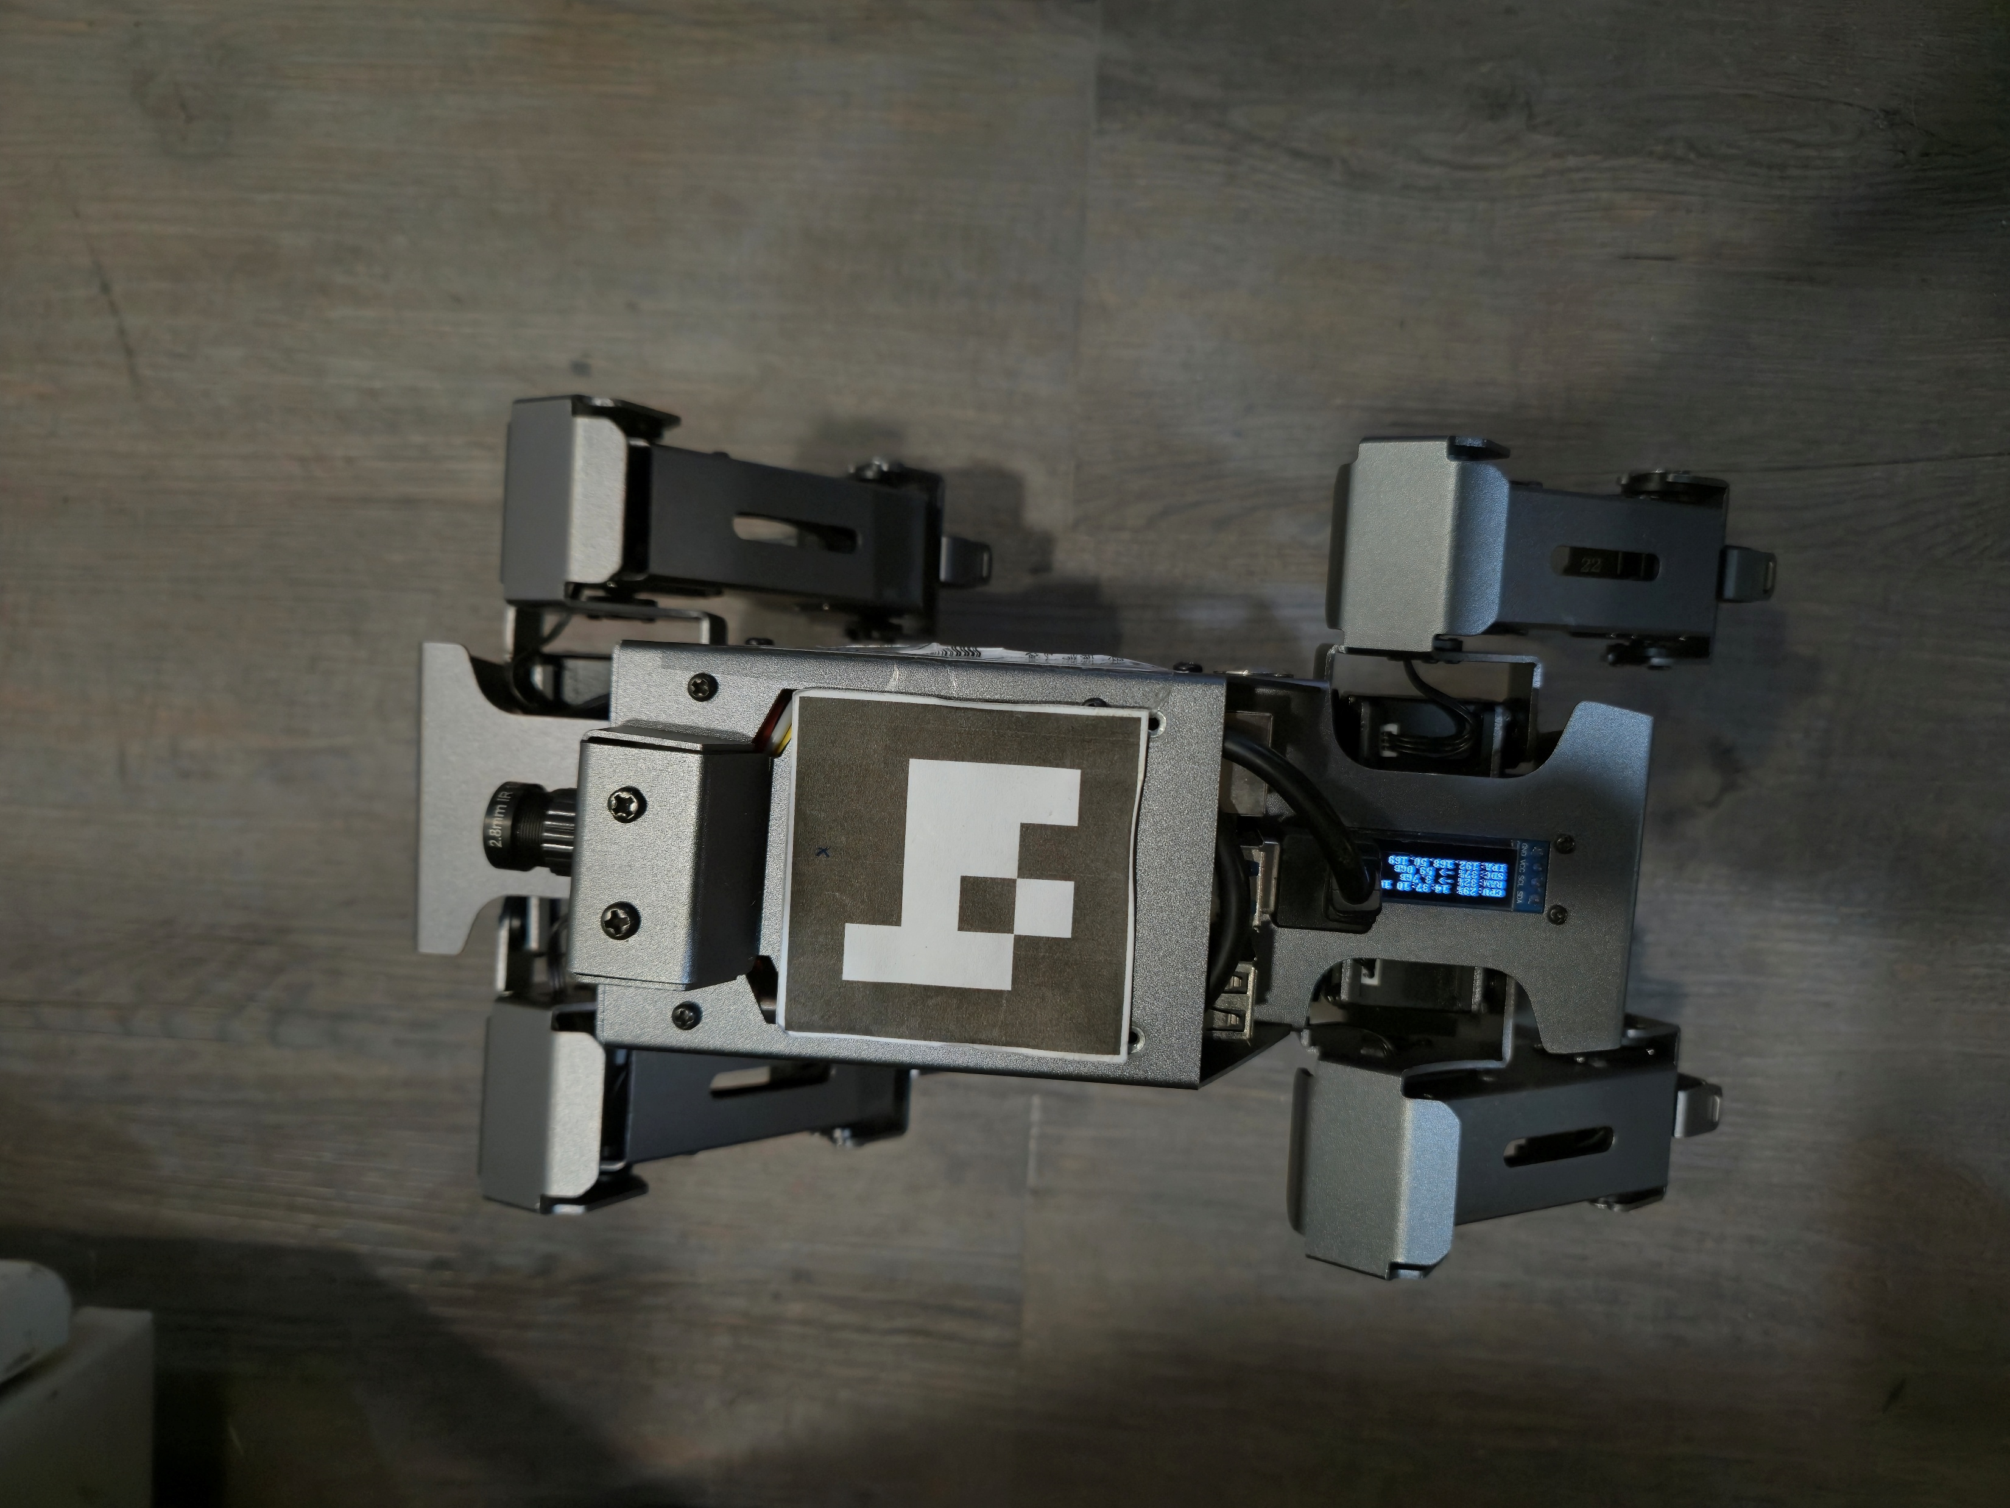
SSH Remote Control
IP Adress: See on the Robot screen
Username: pi
Password: yahboom
Make sure your network is in the same domain as the robot
IP

Slide 5
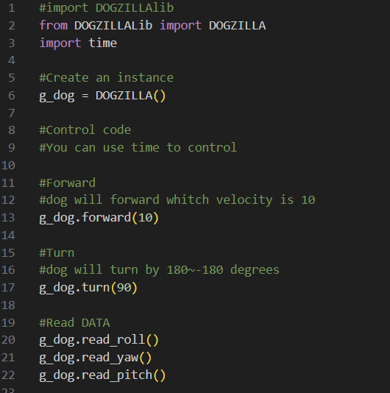
Python Code to Control

