Slide 1

SECTION
FUNDAMENTAL
JAVASCRIPT
HSTU WEB DEV
LECTURE
Compiled and Interpreted Languages
by Sayeed Afridi

Slide 2
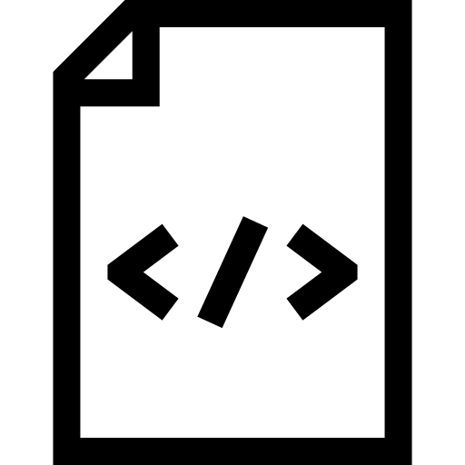



Compiler
Executables
Hello
Interpreter

Slide 3
PROS AND CONS
Compiled |  | Interpreted
Ready to run | Not cross-platform | Cross-platform | Interpreter required
Often Faster | inflexible | Simpler to test | Often slower
Source code is private | Extra step | Easier to debug | Source code is public

Slide 4
LANGUAGE EXAMPLES
Compiled
C, C++, Objective-C
Interpreted
PHP, Javascript
Hybrid
Java, Python, VB.NET, C#

