Slide 1

SECTION
ADVANCED
JAVASCRIPT
HSTU WEB DEV
LECTURE
How our code is executed:
JS Engine & Execution Context and Stack
by Sayeed Afridi

Slide 2
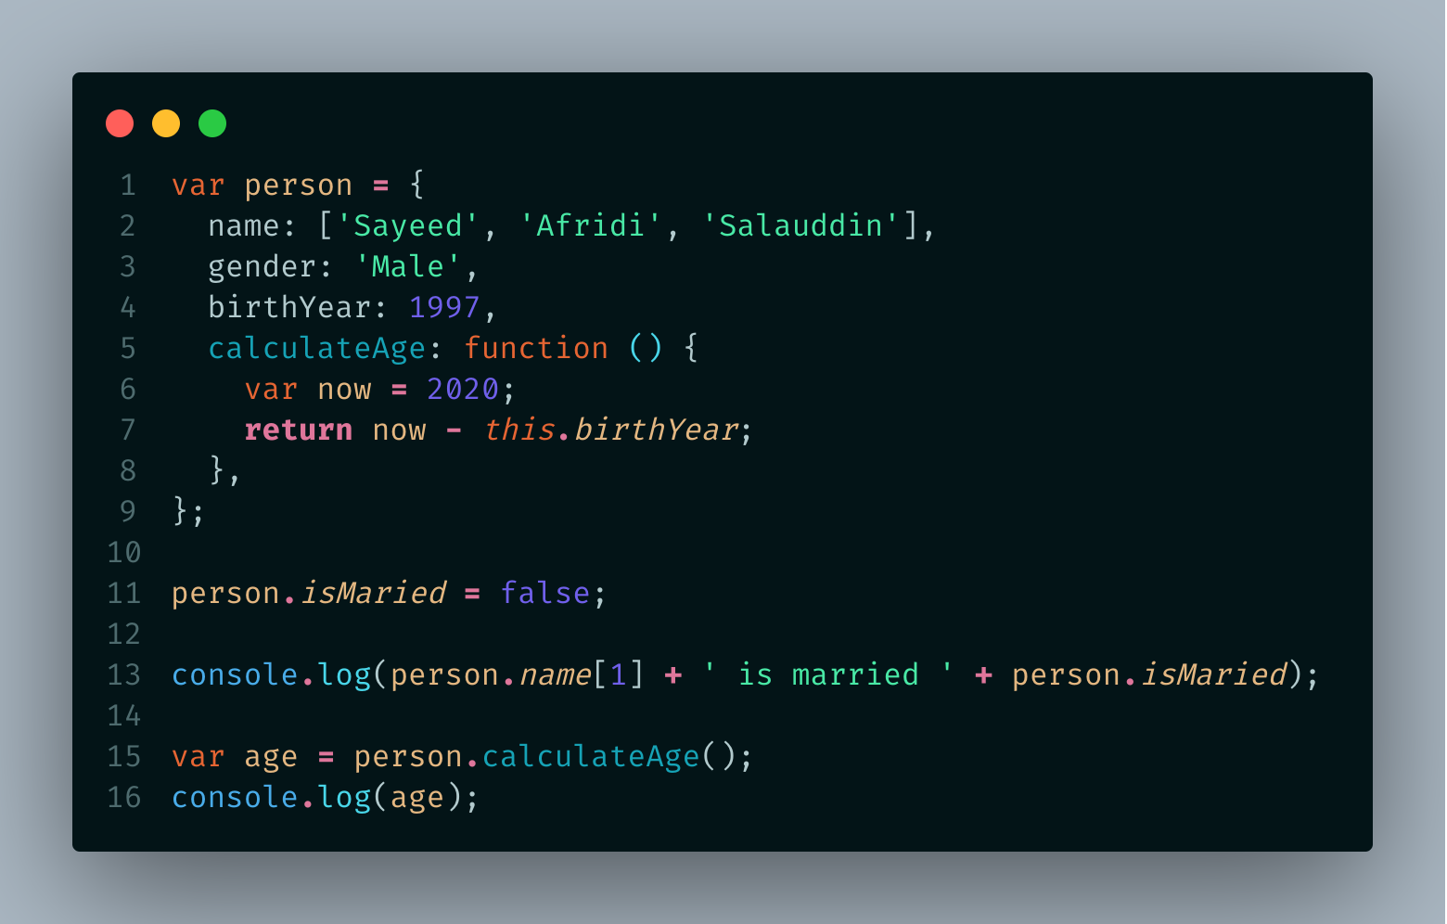
What happens to our code?
Javascript Engine
Our Code
Conversion to Machine Code
Parser
Code Runs
Abstract Syntax Tree
Machine Code

Slide 3
Execution Contexts
The Default
Execution Context
A box, a container, or a wrapper which stores variables and in which our code is evaluated and executed
Global Execution Context
Code that is not inside any function
Associated with the global object
In Browser that’s the window object
name === window.name
//true

Slide 4
var name = ‘Afridi’;
function first() {
var a = ‘Hello!’;
second();
var x = a + name;
}
function second() {
var b = ‘Hi!’;
third();
var y = b + name;
}
function third() {
var c = ‘Hey!’;
var z = c + name;
}
first();
Execution Context
third()
Execution Context
second()
Execution Context
first()
Global Execution
Context
Execution Stack

Slide 5
Execution Context in Detail
Execution Context Object
1. Creation phase
A) Creation of Variable Object (VO)
B) Creation of scope chain
Variable Object (VO)
C) Determine value of the “this” variable
Scope chain
2. Execution phase
The code of the function that generated the current execution context is ran line by line
“this” variable

Slide 6
Variable Object (VO)
Execution Context
Object
Variable Object (VO)
The argument object is created, containing all the arguments that were passed into the function
Scope chain
“this” variable
Code is scanned for function declarations: for each function, a property is created in the Variable Object, pointing to the function
HOISTING
Code is scanned for variable declarations: for each variable, a property is created in the Variable Object, set to undefined.

Slide 7
Scoping in JS
Execution Context
Object
Variable Object (VO)
Scoping answers the question “where can we access a certain variable?”
Scope chain
Each new function creates a scope: the space/environment, in which the variables it defines are accessible.
“this” variable
Lexical scoping: a function that is lexically within another function gets access to the scope of the outer function.

Slide 8
Global scope
[VO_{GLOBAL}]
var a = ‘Hello!’;
first();
function first() {
var b = ‘Hi!’;
second();
function second() {
var c = ‘Hey!’;
console.log(a + b + c);
}
}
SCOPE CHAIN
first() scope
[VO₁] + [VO_{GLOBAL}]
1
second() scope
[VO₂] +[VO₁] + [VO_{GLOBAL}]
2
Execution Context
Object
Variable Object (VO)
Scope chain
“this” variable

Slide 9
The ‘This’ Variable
Execution Context
Object
Variable Object (VO)
Regular function call: the this keyword points at the global object, (the window object in the browser)
Scope chain
“this” variable
Method call: the this keyword points to the object that is calling the method.
The this keyword is not assigned a value until a function where it is defined is actually called.

