Slide 1

SECTION
FUNDAMENTAL
JAVASCRIPT
HSTU WEB DEV
LECTURE
Object Oriented Programming
by Sayeed Afridi
Notes:
1. Many of today's most popular programming languages are object oriented
2.Object oriented kothay ebong kno use korte hobe setar idea thakte hobe

Slide 2
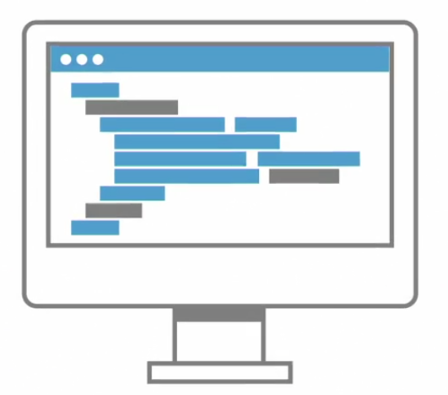
A
B
Notes:
3.Procedural way te long series of code. from point a to b
4. straight forward like cooking something

Slide 3




Notes:
01. Mix the ingridients
02. pour it to pan
03. bake in the oven
04. the cake
05. new programmers tendency and easier to write small program and thinking in sequential steps

Slide 4
Mixer
Pan
Oven
mix()
add()
bake()
Notes:
01. baking cake in oop manner
02. describe the object
03 several mini program
04. similar like real world
05. not superior to other
06. oop code reusablity
07. not a language but set of ideas that supported by many languages.

Slide 5
Functional Programming Language
Logic Programming Language
Haskell
Prolog
Notes:
01. other paradigm

Slide 6

Object-Oriented Programming Language
C#, C++, Go, Java, JavaScript, Perl, PHP, Python, R, Ruby, Swift, VB.NET etc.
Notes:
01 practical use and development, desktop, mobile, app games use oop
02. supports multiple paradigms
03. so many code to write in oop
04. thinking about the real world... next

Slide 7
To ask what’s an object in computer programming, try asking what’s an object in real world...!!!
Notes:
01. next the mug examples
02. object characteristics

Slide 8



Notes:
01. full, empty
01 next world mug

Slide 9

Notes:
01. object state is independent to others
02 other properties
03. properties next

Slide 10
Attributes, properties,
characteristics, state, fields, variables
Notes:
01. complexz object
02 next objects have

Slide 11
Objects
All objects have...
Identity: Sayeed’s coffee mug
Properties/Attributes: color, size
Methods/Behaviors: fill(), empty(), clean()
Notes:
01. characteristics
02. not a real world thing and idea
03. next bank account

Slide 12
number: B3512
balance: $75,000
deposite()
withdraw()
number: A7512
balance: $750
deposite()
withdraw()
Bank Account Object
Bank Account Object
Notes:
01. identity,
02. properties
02. behaviour
04 figuring out what can be an object

Slide 13
Objects = Nouns
Things
People
Places
Ideas
Concepts
Notes:
01. all nouns can be object
02. the the the next

Slide 14
“The”
The mug
The person
The document
The bank account
The time
Notes:
all that can be the
next verb example

Slide 15
Behaviours/Methods = Verbs
The texting
Try putting the in front
Notes:
identify the verbs
program without behaviours is not usefull
next class obj not appear in magically

Slide 16
Class
Code-template for creating program objects
Notes:
A class is detailed definitions, the description, the template of what an object will be but it is not the object itself
next class

Slide 17
Object
Class
Object
Object
Notes:
once we have written a class we can create as many object as we want based on that class
different class let us create different types of object
next class components

Slide 18
Class Components
Name: What is it?
RoundCookie
Properties: What describes it?
weight, color
Behaviour: What can it do?
decorate(), consume()
type
attributes, data
operations
Notes:
Three class component
interchangable names
next method and behaviour

Slide 19
Method
A program procedure that can return a value
Defined as part of a class
Can only access data known to its object
Notes:
Behaviour called method

Slide 20


roundCookie
weight
color
icing
16 grams
red
true
decorate()
consume()
12 grams
brown
true
decorate()
consume()
decorate()
consume()
class
object (instance)
creating objects = instantiaion

Slide 21
Classes in OO Languages
At a minimum...
Strings
Networking
Dates
Many more...
Collections
File I/O

Slide 22
Frameworks and Libraries
Java Class Library
.Net Framework BCL
C++ Standard Library
Ruby Standard Library
Python Standard Library

Slide 23
The Four Fundamentals
Abstraction
Polymorphism
Inheritance
Encapsulation
A-P-I-E ------> A-PIE

