Slide 1

Lecture-1
Coding and Programming
Types of languages
Difference of the languages
Example
HTML and CSS

Slide 2
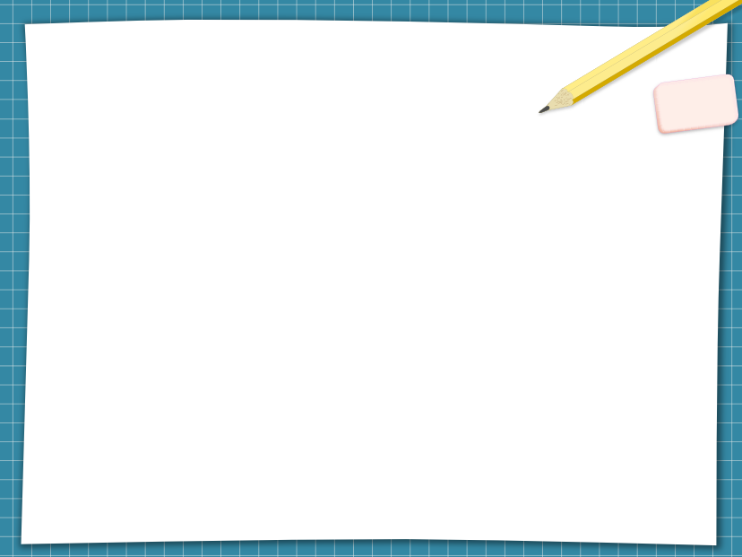
Programming vs Coding
What does a computer understand?
- Only 0 and 1
Why do we need programming?
- Programming involves providing a finished set of instructions for computers to perform so that computer understands our language.
Why do we need coding?
- Coding is the act of translating from a human language to a machine-based one.

Slide 3
What does “Human language” mean by?
Is this English, bengali or any other language?
- No. There are two types of languages.
Markup Language-HTML,CSS etc.
Programming language- Low level language, Assembly language and High level language.
In this course, we will learn HTML, CSS as Markup language and Java as High level language.

Slide 4
What is Mark-up Language?
A markup language is a computer language that uses tags to define elements within a document. It is human-readable, meaning markup files contain standard words, rather than typical programming syntax. While several markup languages exist, the two most popular are HTML (Hypertext Markup Language) and CSS (Cascading Style Sheets).

Slide 5
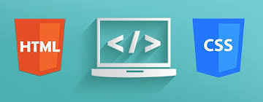
Why shall we use HTML and CSS?
HTML and CSS are used for building and designing a website.
Body of the website
Beauty of the website

Slide 6
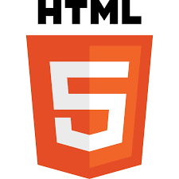
Role of HTML
Full form- Hypertext Markup Language
Basically a standard markup language for giving a static skeleton to web applications and websites
Well standardized system

Slide 7

Role of CSS
Full form- Cascading Style Sheets
Basically a stylesheet language to handle the presentation of webpage containing HTML
It makes website beautiful and modern looking.

