Slide 1
Lecture-4
Inline & Block Elements
Ids & Classes
Entities
Semantic Tags

Slide 2
Inline & Block Elements
Inline elements are those elements which only occupy the space bounded by the tags defining the element, instead of breaking the flow of element.
Block-level elements take up the entire space of its parent element.
Example: <div> is a block element and <span> is an inline element.
When border is used around inline elements border is filling around the text only but in case of block elements border is filled throughout the block and it takes full line.
Try with <em>, <strong>, <li> and <img> tags and check wheteher these tags are block or inline elements.

Slide 3
Inline & Block Elements
For giving border use “style:border” attribute within the tag and mention the border width,style and color.
Example:
<div style="border: 2px solid red;">this is a paragraph</div>
<a style="border: 2px solid blue;">this is also a paragraph</a>
<span style="border: 2px solid red;">this is a span</span> <span style="border: 2px solid red;">this is also a span</span>

Slide 4
Ids & Classes
The ID is an identifier which must be unique in the whole HTML document. It is used to find an element while linking, scripting, or styling.
Classes allow CSS to select and access specific elements. Classes can have same name, no uniqueness is required.
Example:
<div id= “mainBox” class= “redBG”>
<span id= “mainSpan” class= “redBG”>

Slide 5
What is the need for an ID in HTML?
The answer is, while using CSS, we can target one full element and can make the necessary changes in it. In the same way, we can grab the full element and change the border or width or many more things through CSS.
Let us now understand what are classes with an example. Assume that I am having 100 elements in my HTML and I want to give a red background to all the 100 elements. To do this, we have two options. Either we have to select each element and assign a red background to it or we can create a class redBG and assign a red background to it. Then we can give this class to the elements in which we want a red background color. To avoid confusion, I am assuming that the class redBG is already defined.

Slide 6
HTML Entities
An entity is a piece of text (“string”) that begins with an ‘&’ and ends with a ‘;’. These are frequently used to display reserved characters, and invisible characters.
Example:
HTML treats all the extra spaces as a single space only and automatically removes all of them. Therefore, if you want to use extra spaces or any special characters, then you have to use HTML entities. To get extra space we can use &nbsp (non-breaking space) after that particular text.
<div class= “container”>
<p>This is another &nbsp; Paragraph</p>
</div>
HTML Entities refernce: https://dev.w3.org/html5/html-author/charref

Slide 7
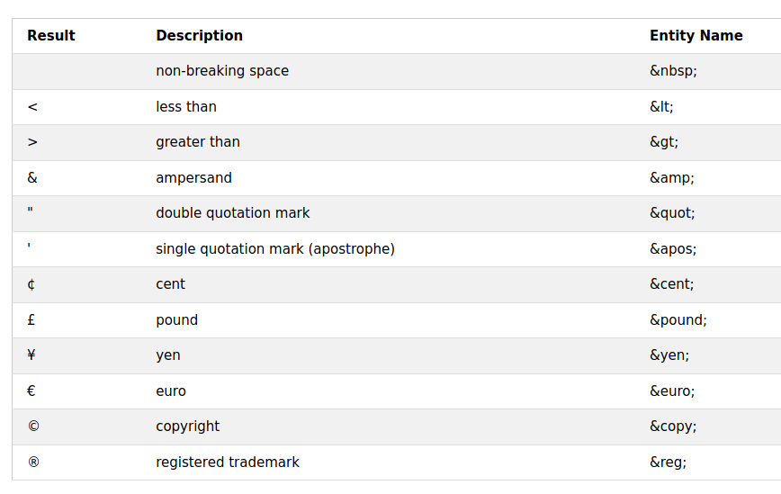
HTML Entities
Some important entities:

Slide 8
Semantic Tags
Semantics are used to give proper meaning to the websites and help search engines to analyze it properly. Also, we can get help in return from different search engines in recognizing the original tags and their uses.
For example, there are different tags used for the headers, navigation bars, body, and footers. So to analyze each and every tag properly, we have to use Semantics.
The better the use of Semantics in a website, the more is the number of chances that it is being crawled by the search engines. It will also help in the better ranking of a website.

Slide 9
Semantic Tags
There are many examples of Semantics. You can take the reference of the internet to view all. Here are some of the important semantic elements-
<header>
<nav>
<section>
<article>
<footer>
<details>
<details>
<summary>Coding</summary>
I love coding. I am writing code in HTML and CSS. I’ll learn more soon.
</details>

