Slide 1
Petri-Nets and Other Models

Slide 2
Summary
Petri-Net Models
  Definitions
  Modeling protocols using Petri-Nets
  Modeling Queueing Systems using Petri-Nets
Max-Plus Algebra

Slide 3
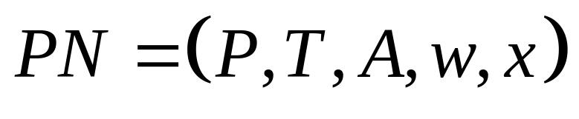
Marked Petri Net Graph
A Petri net graph is a weighted bipartite graph
P is a finite set of places, P={p₁,…,p_{n}}
T is a finite set of transitions, T={t₁,…,t_{m}}
A is the set of arcs from places to transitions and from transitions to places
  (p_{i}, t_{j}) or (t_{j}, p_{i}) represent the arcs
w is the weight function on arcs
x is the marking vector x =[x₁,…,x_{n}] represents the number of tokens in each place.

Slide 4
Petri Net Example
Arc with w=1
Arc
Transition 0
Place
Place 0
Place 1
Token
Transition 1
Transition
I(t_{j}) = {p_{i} ∈P : (p_{i}, t_{j}) ∈A}
O(t_{j}) = {p_{i} ∈P : (t_{j}, p_{i}) ∈A}
I(p_{i}) ={t_{j} ∈T : (t_{j}, p_{i}) ∈A}
O(p_{i}) ={t_{j} ∈T : (p_{i}, t_{j}) ∈A}

Slide 5
Petri Net Marking
A transition t_{j} ∈T is enabled when each input place has at least a number of tokens equal to the weight of the arc, i.e.,
x_{i} ≥ w(p_{i}, t_{j}) for all p_{i} ∈ I(t_{j})
When a transition fires it removes a number of tokens (equal to the weight of each input arc) from each input place and deposits a number of tokens (equal to the weight of each output arc) to each output place.
t₁
p₁
p₂
t₂

Slide 6
Petri Net Dynamics
The state transition function f of a Petri net is defined for transition t_{j} if and only if
x_{i} ≥ w(p_{i}, t_{j}) for all p_{i} ∈ I(t_{j})
If f(x, t_{j}) is defined, then we set
x’_{i} = x_{i} + w(t_{j}, p_{i}) - w(p_{i}, t_{j}) for all i=1,…,n
Define
  u_{j}=[0,…0,1,0,…0] where all elements are 0 except the j-th one.
  Also define the matrix A=[a_{ji}] where
  a_{ji} = w(t_{j}, p_{i}) - w(p_{i}, t_{j})
In vector form
x’= x + u_{j}A

Slide 7
Example: Computer Basic Functions
Design a Petri-net that imitates the basic behavior of a computer, i.e., being down, idle or busy
a
I
B
c
r
f
f
D

Slide 8
Modeling Protocols Using Petri Nets (Stop and Wait Protocol)
The transmitter sends a frame and stops waiting for an acknowledgement from the receiver (ACK)
Once the receiver correctly receives the expected packet, it sends an acknowledgement to let the transmitter send the next frame.
When the transmitter does not receive an ACK within a specified period of time (timer) then it retransmits the packet.
Transmitter
Receiver
Frame 0
Timer
ACK 0
Frame 1
Timer
ACK 1
Frame 0
ACK 0

Slide 9
Stop and Wait Protocol: Normal Operation
pkt 0
Send Pkt 0
Get Pkt 0
Ack 0
Wait Ack 0
Wait Ptk 1
pkt 1
Get Pkt 1
Send Pkt 1
Wait Ack 1
Ack 1
Wait Pkt 0
Transmitter State
Receiver State
Channel State

Slide 10
Stop and Wait Protocol: Normal Operation
pkt 0
Send Pkt 0
Get Pkt 0
Ack 0
Wait Ack 0
Wait Ptk 1
pkt 1
Get Pkt 1
Send Pkt 1
Wait Ack 1
Ack 1
Wait Pkt 0
Transmitter State
Receiver State
Channel State

Slide 11
Stop and Wait Protocol: Deadlock
pkt 0
Send Pkt 0
Get Pkt 0
loss
Ack 0
Wait Ack 0
Wait Ptk 1
loss
pkt 1
Get Pkt 1
Send Pkt 1
Wait Ack 1
loss
Ack 1
Wait Pkt 0
loss
Transmitter State
Receiver State
Channel State

Slide 12
Stop and Wait Protocol: Deadlock Avoidance Using Timers
pkt 0
Send Pkt 0
Get Pkt 0
loss
Ack 0
Wait Ack 0
timer
Wait Ptk 1
loss
pkt 1
Get Pkt 1
Send Pkt 1
timer
Wait Ack 1
loss
Ack 1
Wait Pkt 0
loss
Transmitter State
Receiver State
Channel State

Slide 13
Stop and Wait Protocol: Loss of Acknowledgements
pkt 0
Send Pkt 0
Get Pkt 0
loss
Ack 0
Reject 0
Wait Ack 0
timer
Wait Ptk 1
loss
pkt 1
Get Pkt 1
Send Pkt 1
timer
Wait Ack 1
loss
Ack 1
Reject 1
Wait Pkt 0
loss
Transmitter State
Receiver State
Channel State

Slide 14
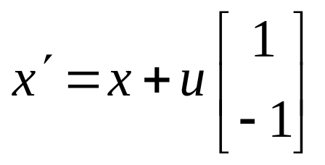
Example: Queueing Model
What are some possible Petri nets that can model the simple FIFO queue
a
d
t₁=a
p₁
t₂=d

Slide 15
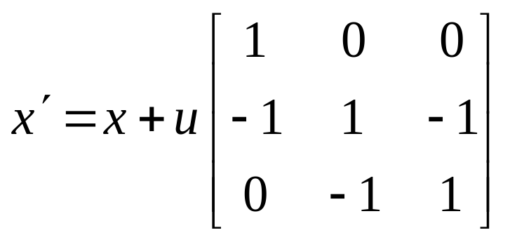
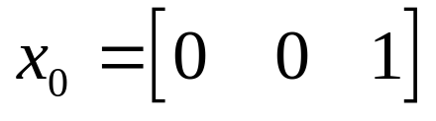
Example: Queueing Model
A “richer” Petri-net model
t₁=a
a
d
p₁=Q
p₃=I
t₂=s
p₂=B
t₃=d

Slide 16
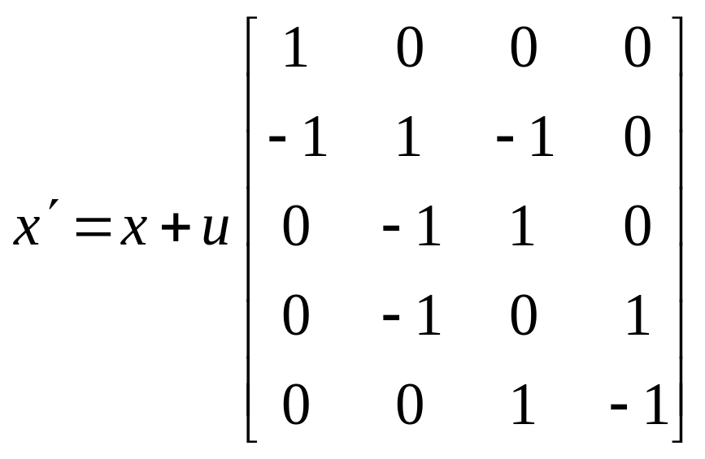
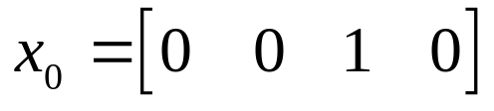
Example: Queueing Model with Server Breakdown
How does the previous model change if server may break down when it serves a customer?
t₁=a
p₁=Q
p₃=I
t₂=s
t₅=r
t₄=b
p₂=B
p₄=D
t₃=d

Slide 17
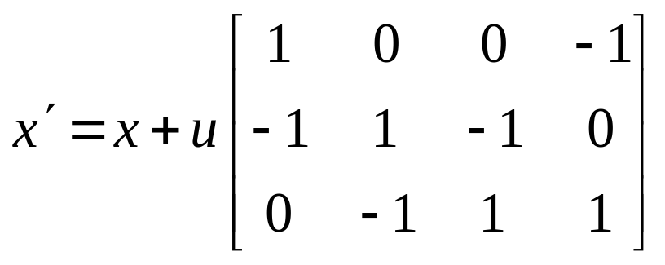
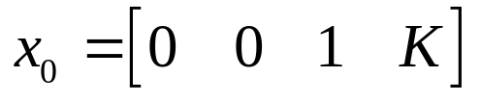
Example: Finite Capacity Queueing Model
What is a Petri net model for a finite capacity queue?
t₁=a
p₁=Q
p₃=I
p₄=K
t₂=s
p₂=B
t₃=d

Slide 18
Other Petri Net Variations
Inhibitor Arcs: A transition with an inhibitor arc is enabled when
  All input places connected to normal arcs (arrows) have a number of tokens at least equal to the weight of the arcs and
  All input places connected to inhibitor arcs (circles) have no tokens.
p₁
p₂
p₁
p₂
p₁
p₂
t
t
t
DISABLED
ENABLED
DISABLED

Slide 19
Other Petri Net Variations
Colored Petri Nets
  In this case, tokens have various properties associated with them. This can be an attribute or an entire data structure. For example,
    Priority
    Class
    Etc.

Slide 20
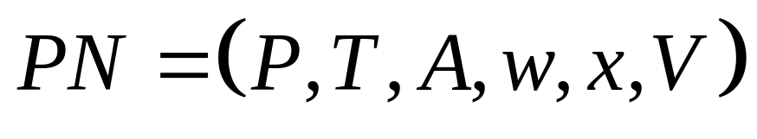
Timed Petri Net Graph
In the previous discussion, the Petri net models had no time dimension. In other words, we did not consider the time when a transition occurred.
Timed Petri nets are similar to Petri nets with the addition of a clock structure associated with each timed transition
A timed transition t_{j} (denoted by a rectangle) once it becomes enabled fires after a delay v_{jk}.

Slide 21
Example: Timed Petri Net
t₁=a
a
d
p₁=Q
p₃=I
t₂=s
Transitions t₁ and t₃ fire after a delay given by the model clock structure
Transition t₂ fires immediately after it becomes enabled
p₂=B
t₃=d

Slide 22
Petri Net Timing Dynamics
Notation
  x is the current state
  e is the transition that caused the Petri net into state x
  t is the time that the corresponding event occurred
  e’ is the next transition to fire (firing transition)
  t’ is the next time the transition fires
  x’ is the next state given by x’ = f(x, e’).
  N’_{i} is the next score of transition i
  y’_{i} is the next clock value of transition i (after e’ occurs)

Slide 23
The Event Timing Dynamics
Step 1: Given x evaluate which transitions are enabled
Step 2: From the clock value y_{i} of all enabled transitions (denoted by Γ(x)) determine the minimum clock value
y*= min_{i∈Γ(x)}{y_{i}}
Step 3: Determine the firing transition
e’= arg min_{i∈Γ(x)}{y_{i}}
Step 4: Determine the next state
x’ = f(x, e’)
  where f() is the state transition function.

Slide 24
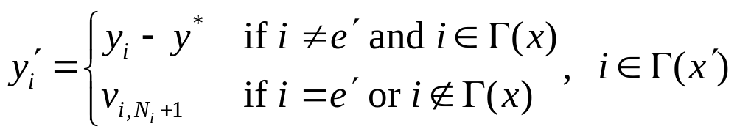
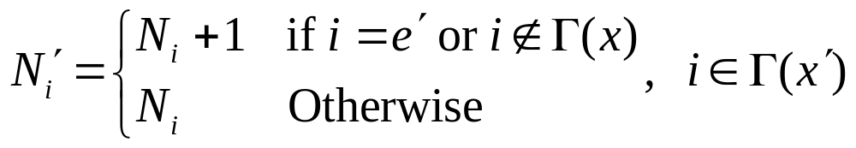
The Event Timing Dynamics
Step 5: Determine
t’= t + y*
Step 6: Determine the new clock values
Step 7: Determine the new transition scores

Slide 25
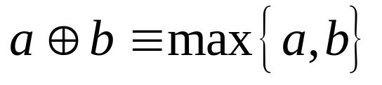
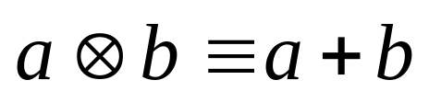
Two Operation (Dioid) Algebras
The operation of timed automata or timed Petri nets can be captured with two simple operations:
  Addition
  Multiplication
This is also called the max-plus algebra

Slide 26
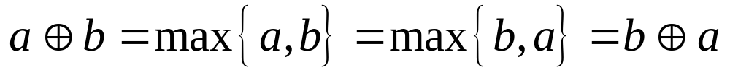
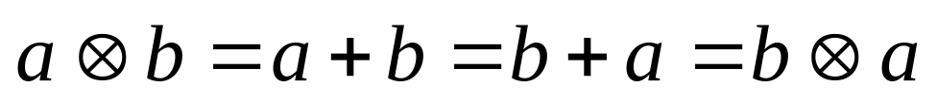

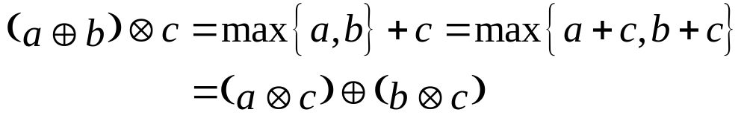
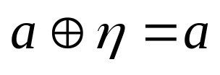
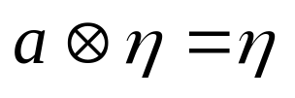
Basic Properties of Max-Plus Algebra
Commutativity
Associativity:
Distribution of addition over multiplication
Null element
For example let η= -∞

Slide 27
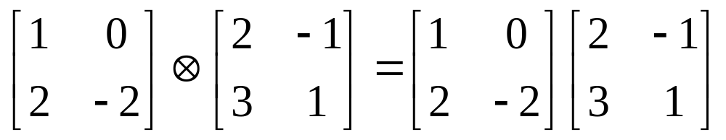
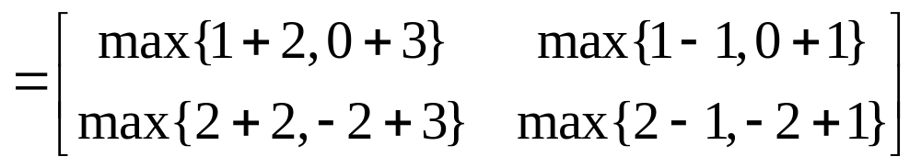
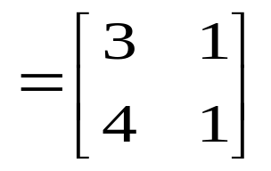
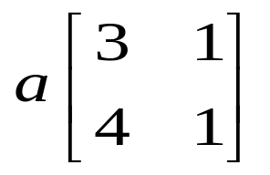
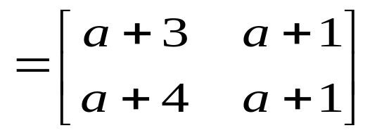
Example

Slide 28
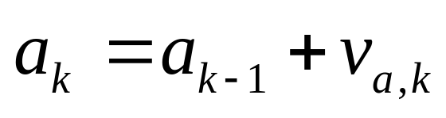
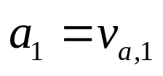
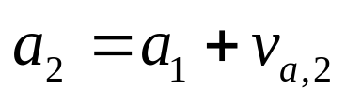
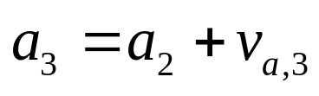
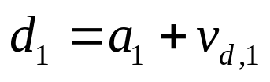
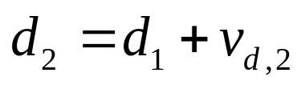
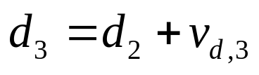
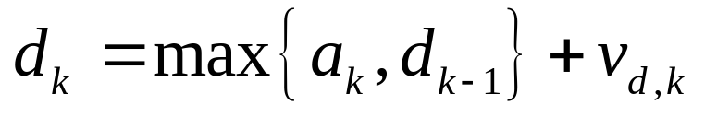
Queueing Models and Max-Plus Algebra
time
t=0
t=0.5
t=1
t=1.5
t=2
t=2.5
t=3
t=3.5
t=4
t=4.5
t=5
a
0.5
0.5
1
0.5
2
0.5
b
1
1.5
0.5
0.5
1

Slide 29

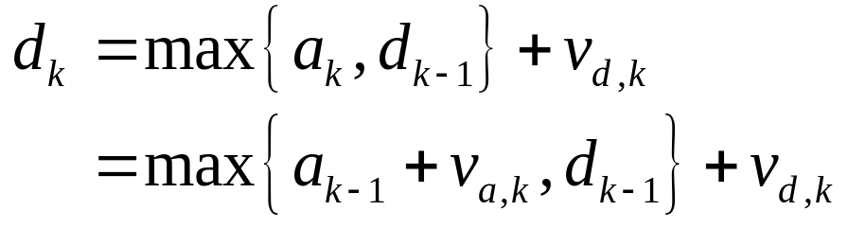
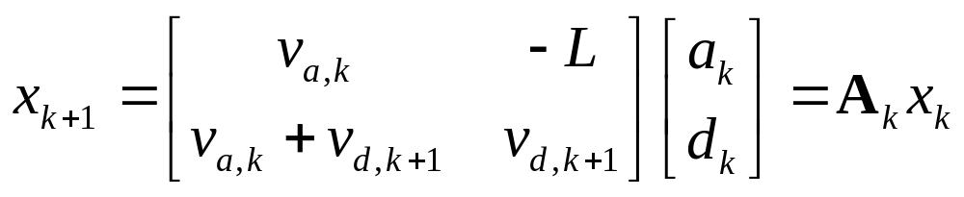
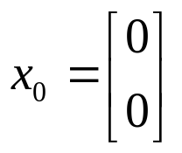
Queueing Dynamics
Let a_{k} be the arrival time of the k-th customer and d_{k} its departure time, k=1,…,K, then
k=1,2,…, a₀=0, d₀=0
In matrix form, let x_{k}=[a_{k}, d_{k}]^{T} then
where –L is sufficiently small such that max{a_{k}+v_{ak}, d_{k}-L}=a_{k}+v_{ak}

Slide 30
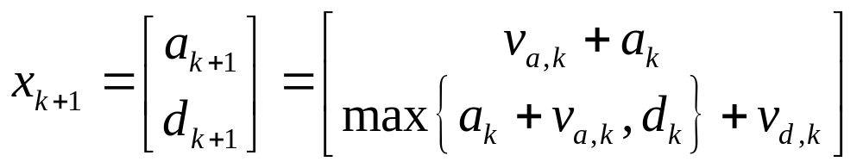
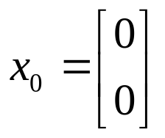
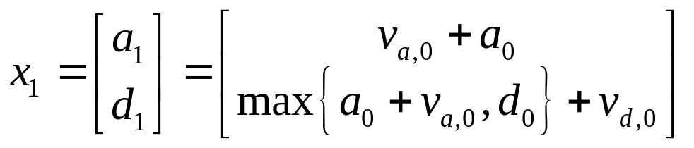
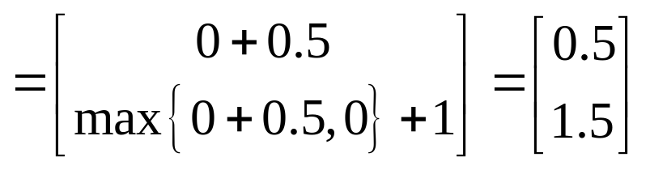
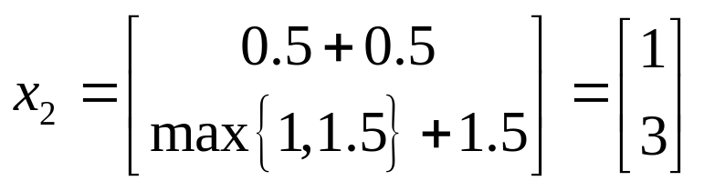
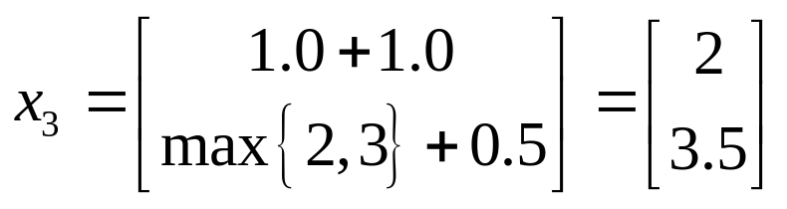
Example
Determine the sample path of the FIFO queue when
  v_{a}={0.5, 0.5, 1.0, 0.5, 2.0, 0.5, …}
  v_{d}={1.0, 1.5, 0.5, 0.5, 1.0, …}
…

Slide 31
Communication Link
t₁=a
How would you model a transmission link that can transmit packets at a rate G packets per second and has a propagation delay equal to 100ms?
p₁=Q
p₃=I
t₂=s
p₂=B
t₃=d
t₄=tx
p₄=C

