Slide 1
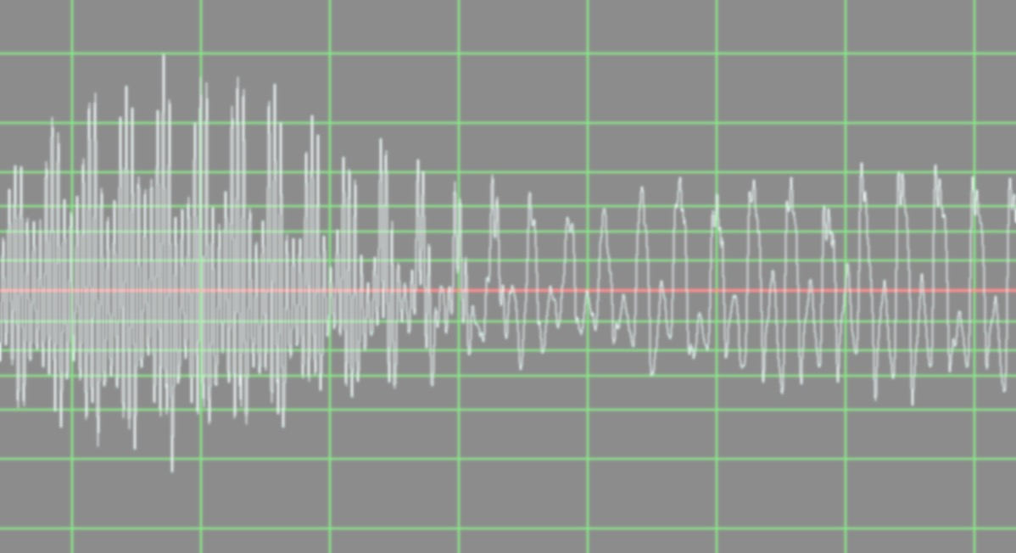
Automatic Elimination of Saxophone Squeaks
Anny Zhao
anzhao2@illinois.edu
Notes:
Today I am going to talk about my project about automatic elimination of Saxophone squeaks

Slide 2
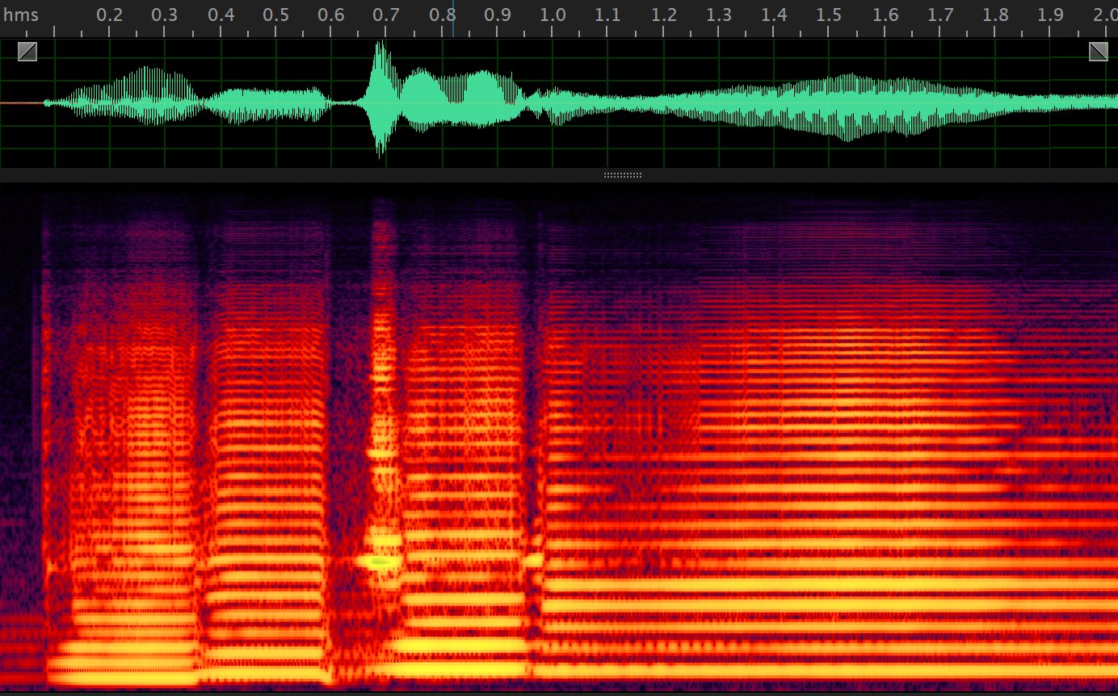

Motivation
Squeaks!
Notes:
started with bad sound and a lot of editing. Wanted to change into automatic. recorded the sound from the player and then worked with it

Slide 3
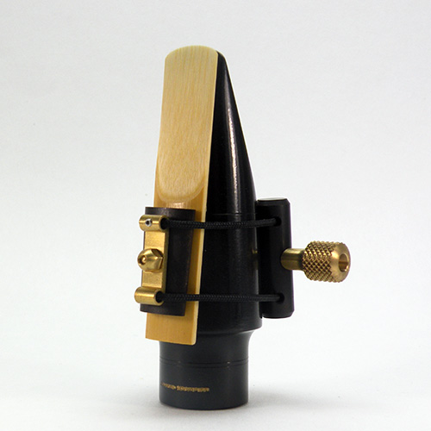
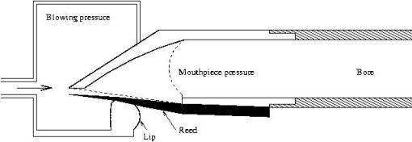
How reed works
Notes:
How did this happen? saxophone is reed instruments. [piecture1] the reed to secured on one side and free on the other side which is thinner. [picture 2 & 3] The air flow across this thin piece of wood to make it vibrates, so there comes the sound. when this vibration is caused by too much pressure, squeak happens.

Slide 4
Procedure
Do STFT
(freq domain)
Find windows that contain squeak
Read in samples
Join samples before and after the squeak
Delete squeak in time domain

Slide 5
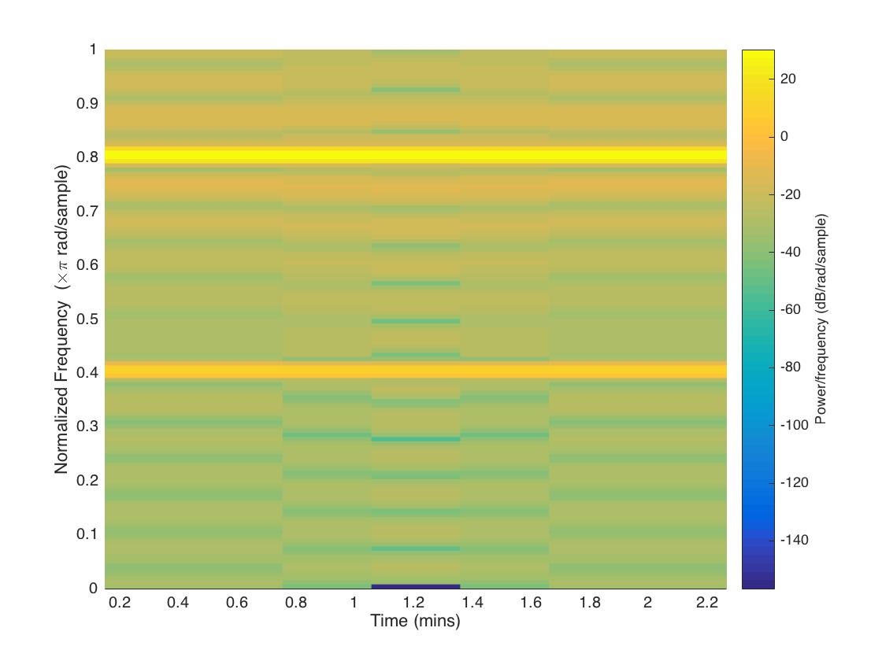
STFT implementation
Window Size?
3/220*48000(sr) = 655
time detail vs. frequency detail
Limit of frequency for length n?
Each bin is sr/n = 48000/655 ~ 73 hz
Short Time Fourier Transform
Notes:
To analyze the squeak, we need to look into the frequency thus I did FT on the sound I recorded. Explain FT. Then explain STFT. here is a spectrum.

Slide 6
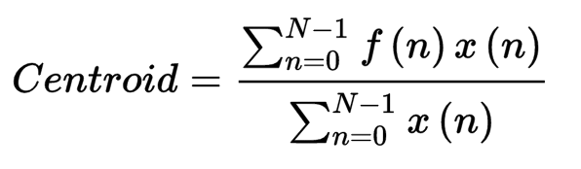
Find out which time is the squeak
Overall maximum amplitude
Spectral centroid
~ Brightness
didn’t work
Notes:
Attempts I tried

Slide 7
Find out which time is the squeak
Time average of fft magnitude in the frequency range of 1900- 2200 hz
Time average :
sum over 1900-2200hz over entire duration / the number of windows
Time average is the threshold
Sum over 1900-2200hz this time compare to threshold
Any time any window from 1900-2200hz exceeds this threshold, it is marked as a squeak
Notes:
Attempts I tried

Slide 8
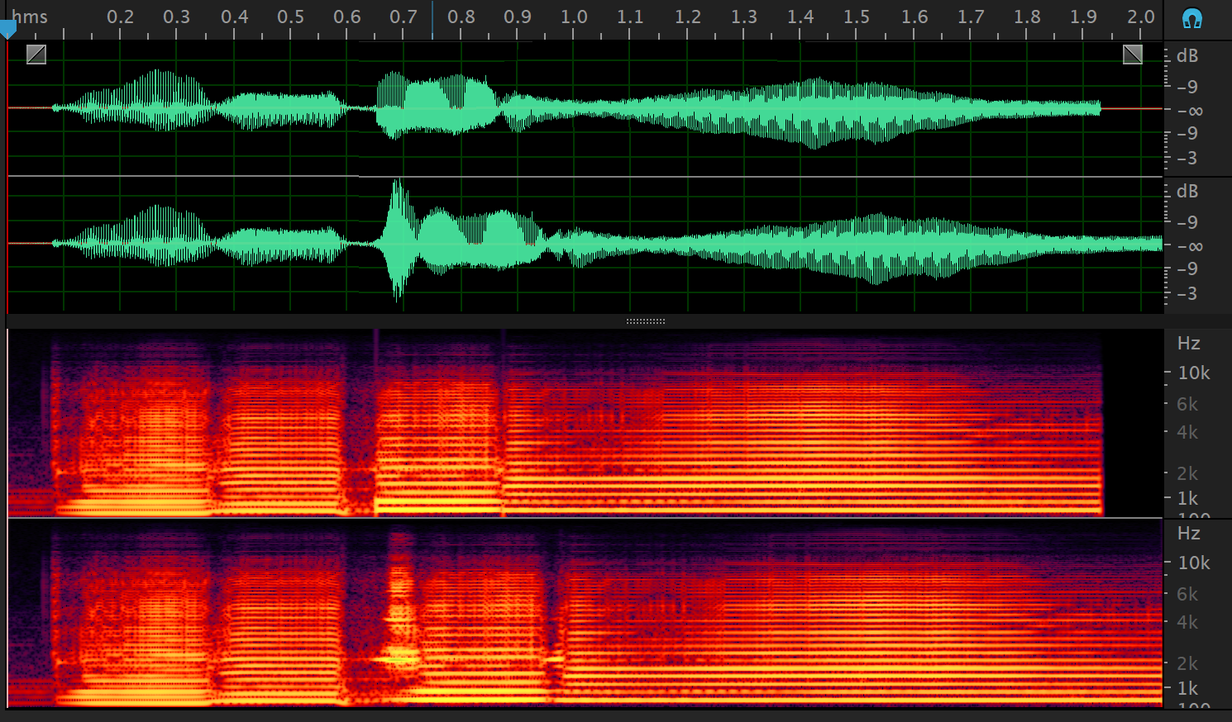
After
Before

Slide 9
Conclusion
Problems:
Only work for track that has few squeak content.
Future approach:
Replace the deleted time with saxophone sound that can connect the track smoothly

