Slide 1
2011 US Agricultural Exports by States - Sheet1 Project

Slide 2

categories
2

Slide 3
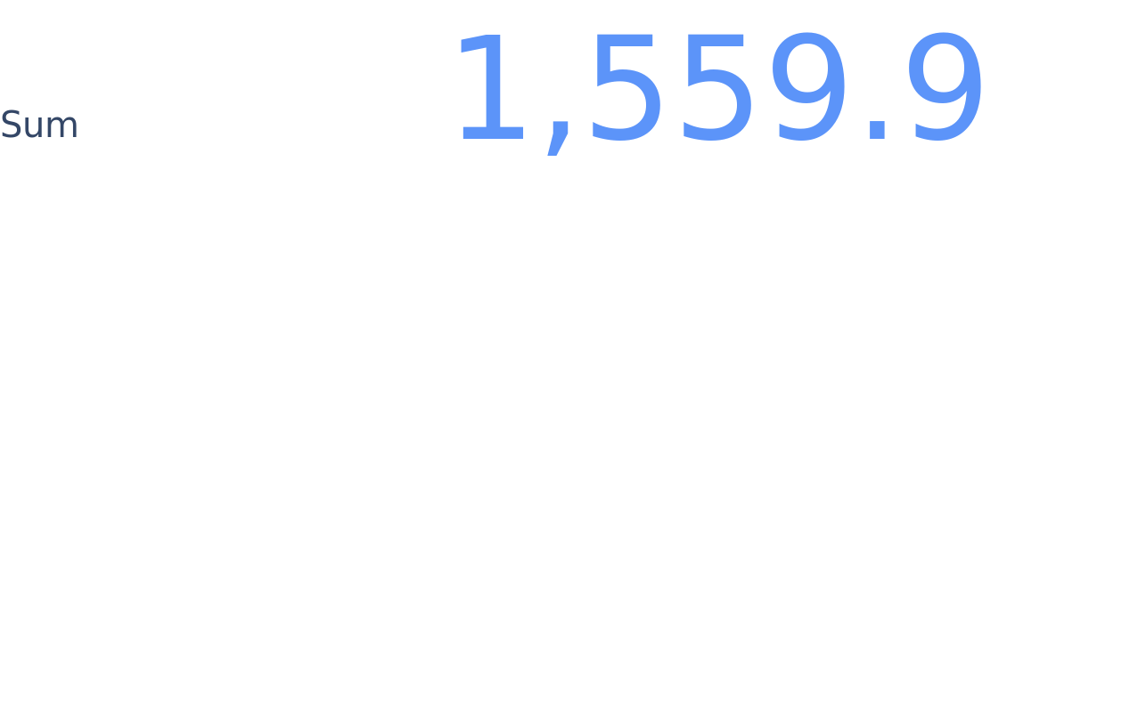
total veggies
3

Slide 4

total fruits
4

Slide 5

cottons
5

Slide 6
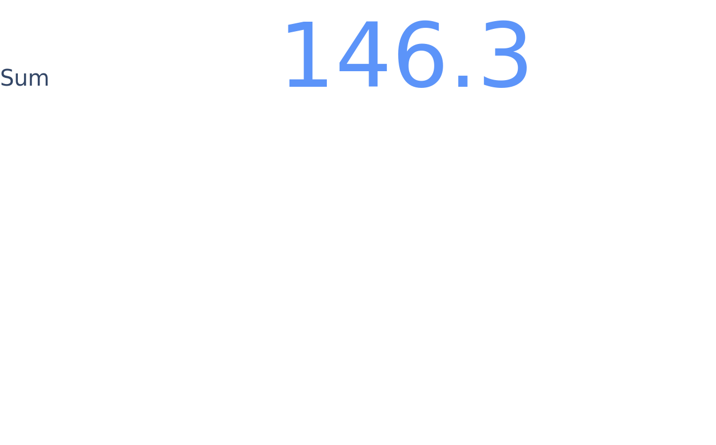
wheats
6

Slide 7

corns
7

Slide 8

veggies proc
8

Slide 9
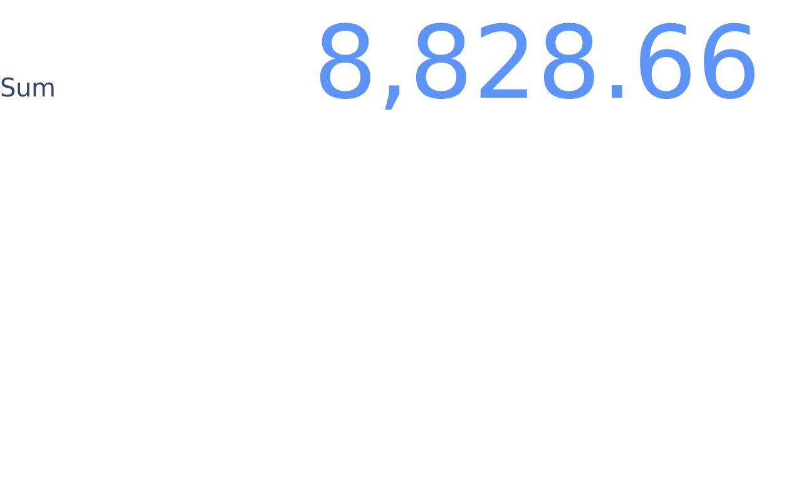
veggies fresh
9

Slide 10
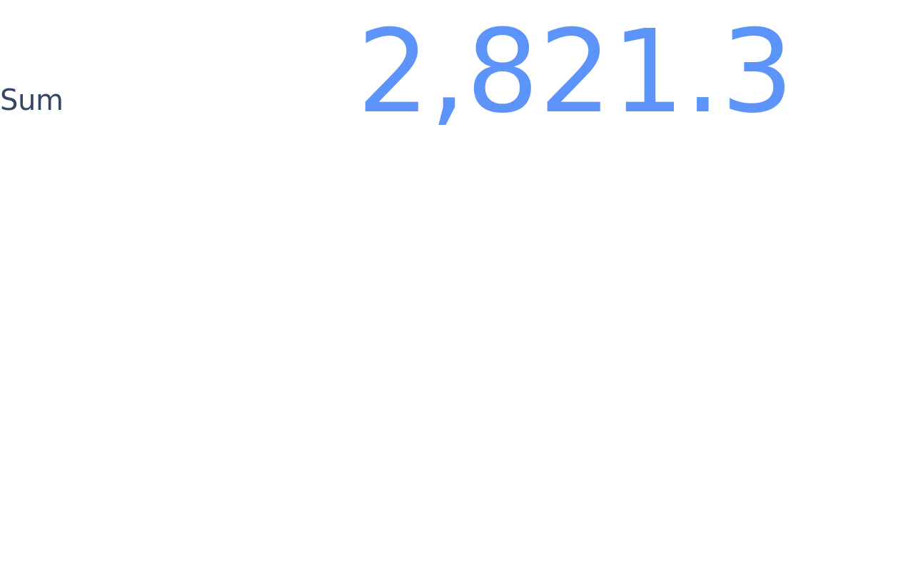
fruits proc
10

Slide 11
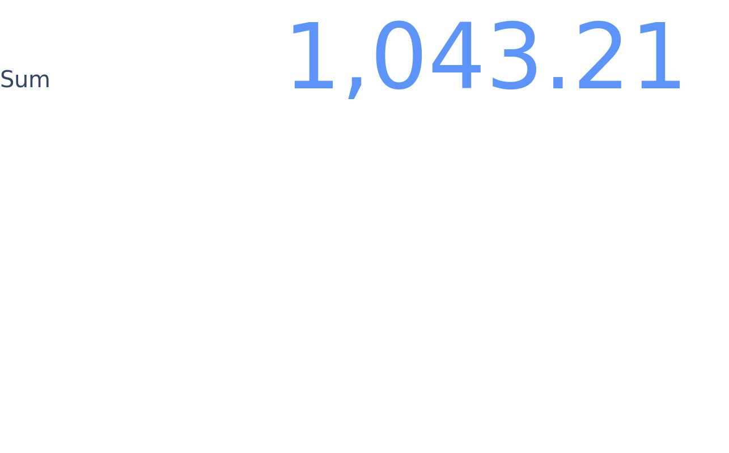
fresh fruits
11

Slide 12
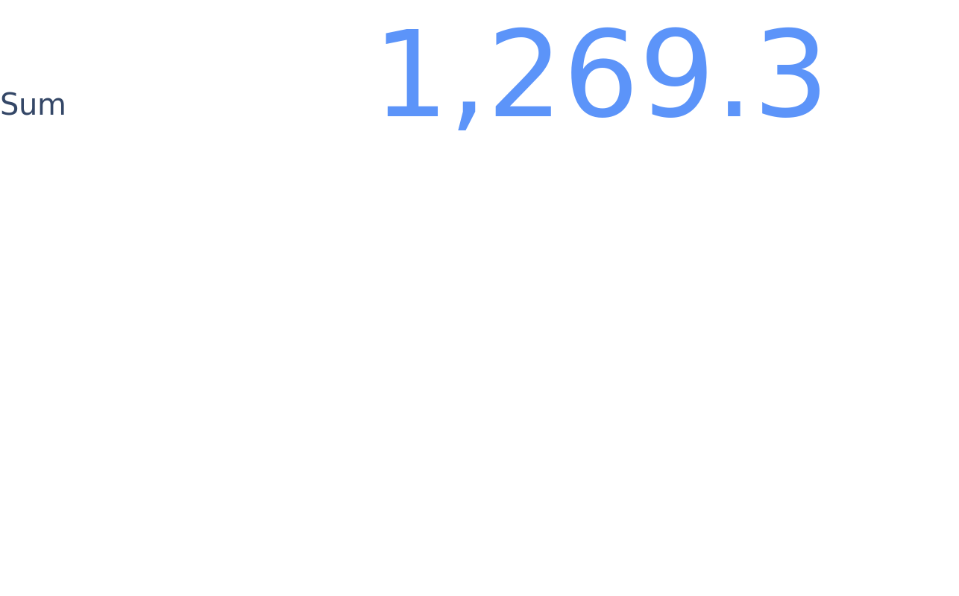
dairies
12

Slide 13

poultries
13

Slide 14

porks
14

Slide 15
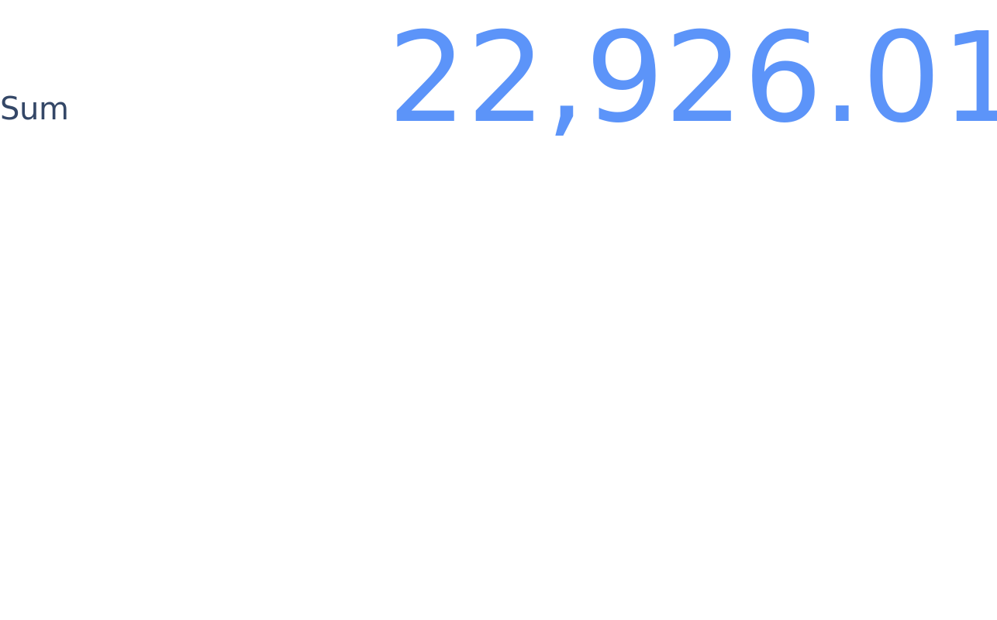
beefs
15

Slide 16
states
16

Slide 17

total exports
17

Slide 18
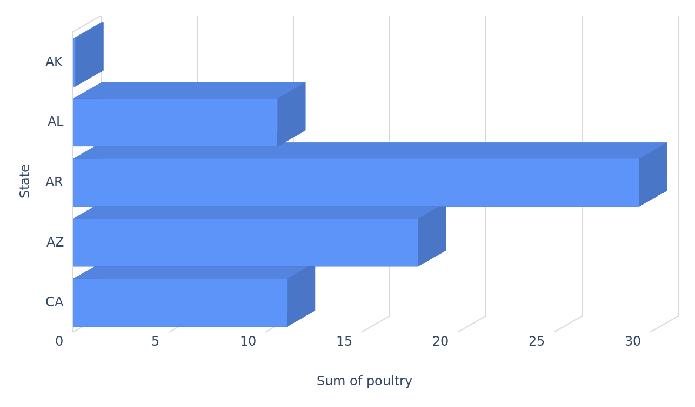
Comparing poultry quantities across states
poultry per state
18

Slide 19
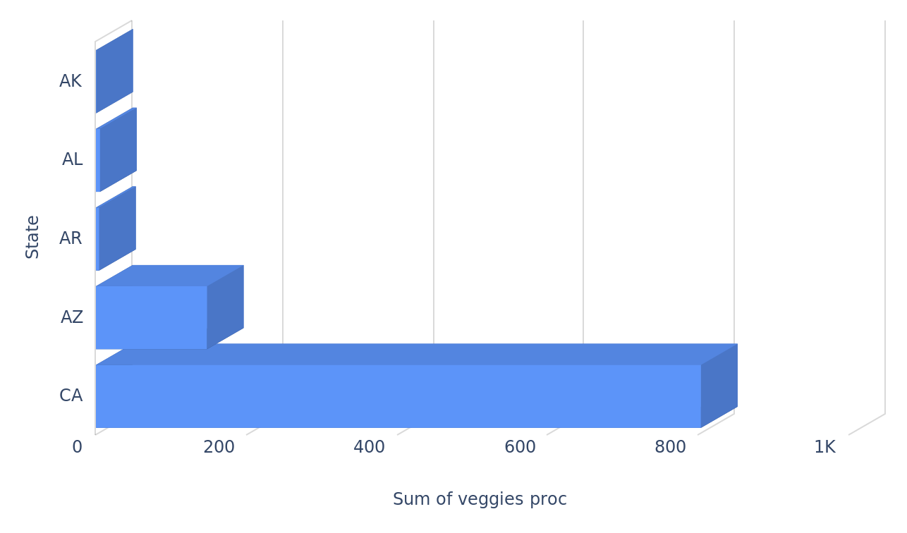
Comparing processed veggies quantities across states
veggies proc per state
19

Slide 20
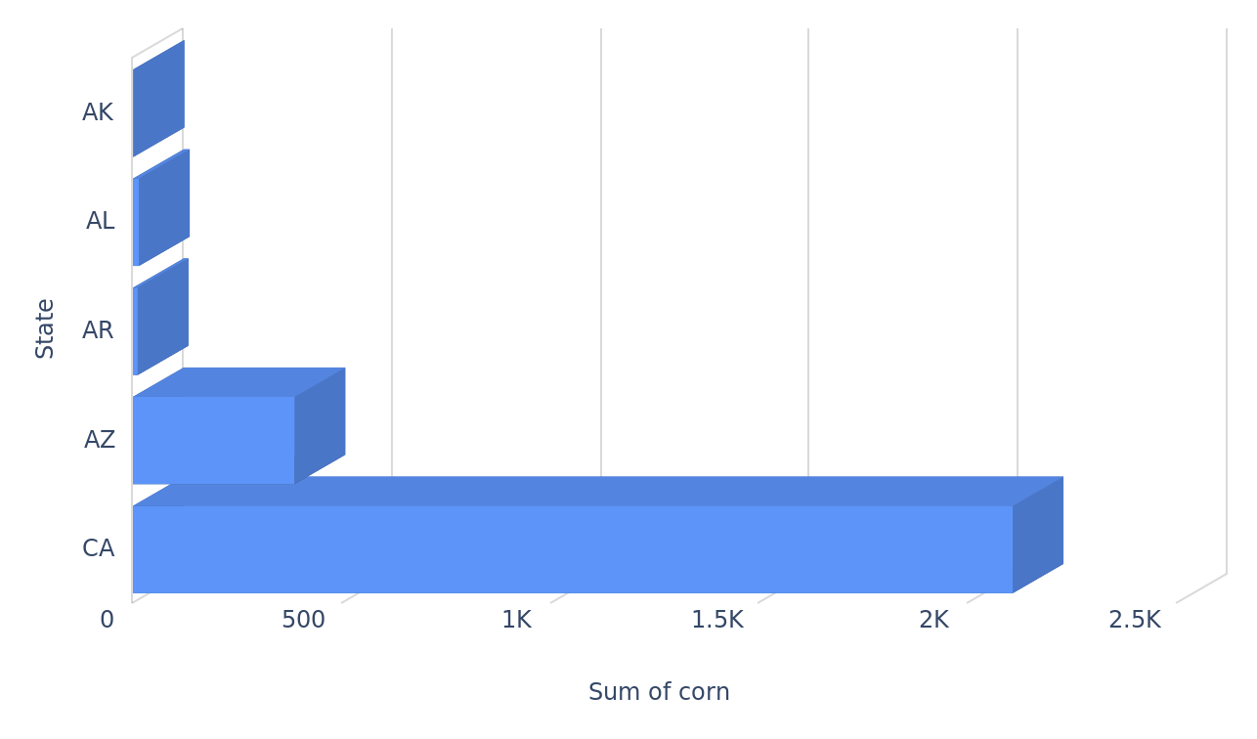
Comparing corn quantities across states
corn per state
20

Slide 21
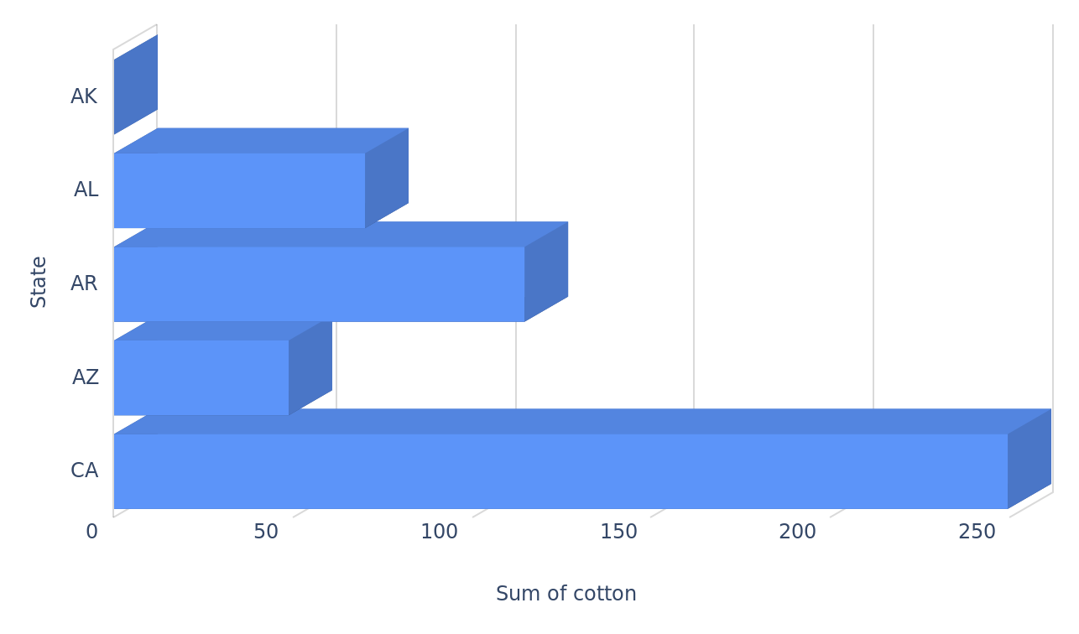
Comparing cotton quantities across states
cotton per state
21

Slide 22
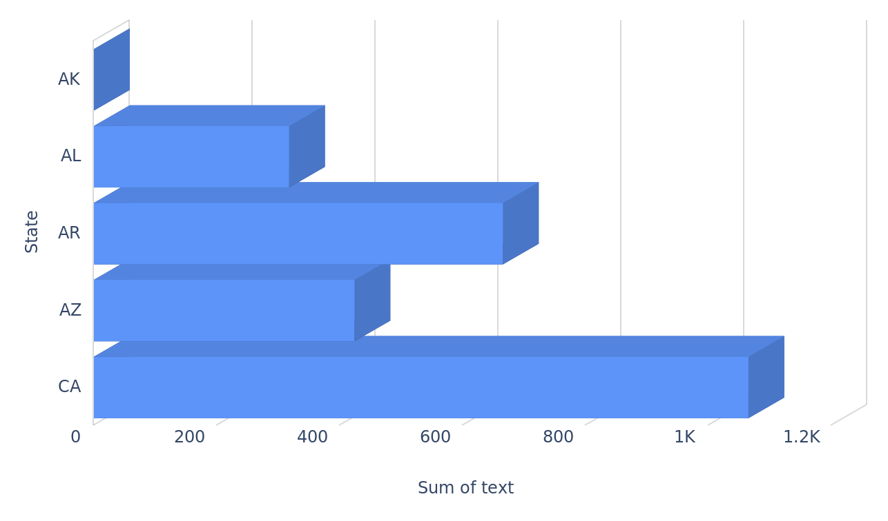
Comparing text quantities across states
text per state
22

Slide 23
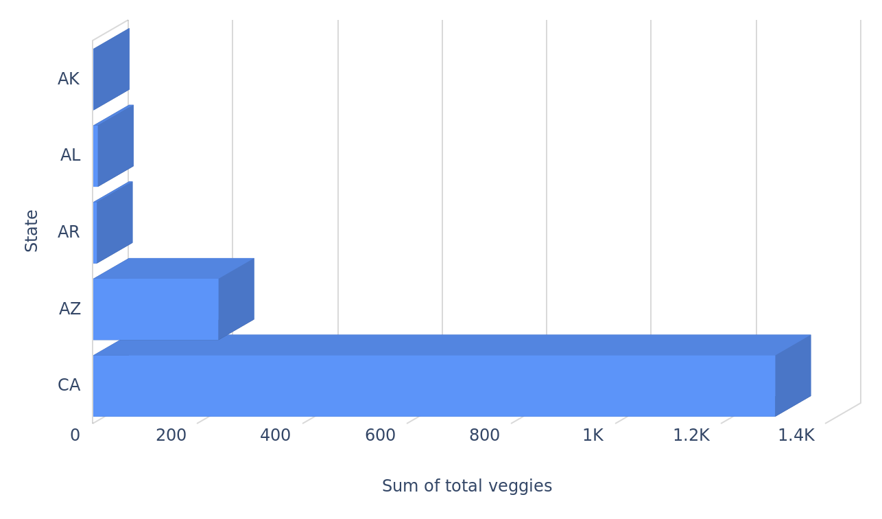
Comparing total veggies quantities across states
total veggies per state
23

Slide 24
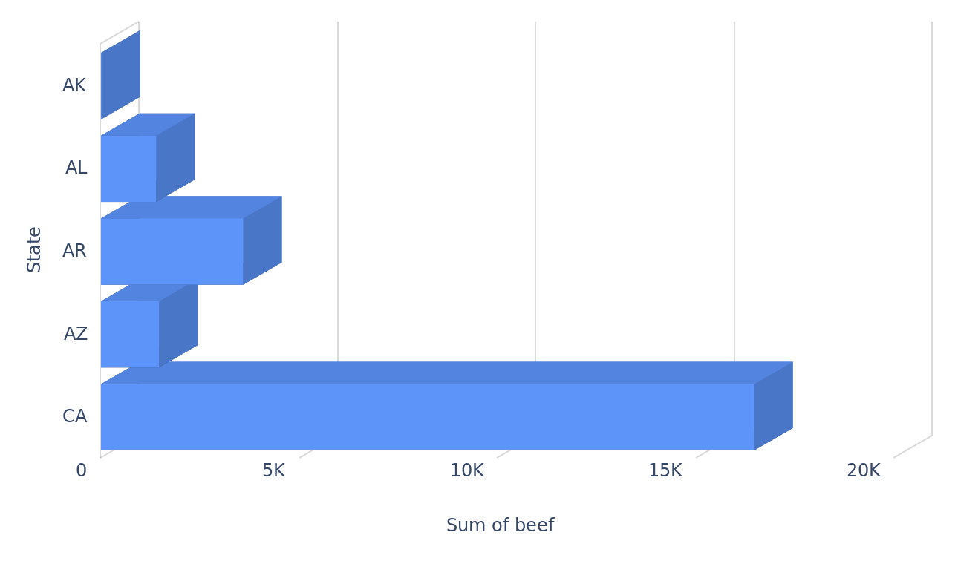
Comparing beef quantities across states
beef per state
24

Slide 25
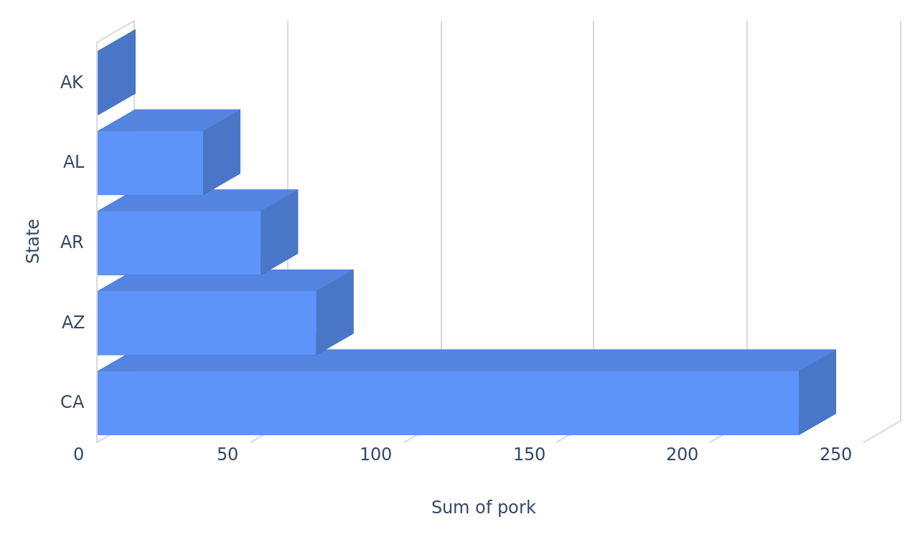
Comparing pork quantities across states
pork per state
25

Slide 26
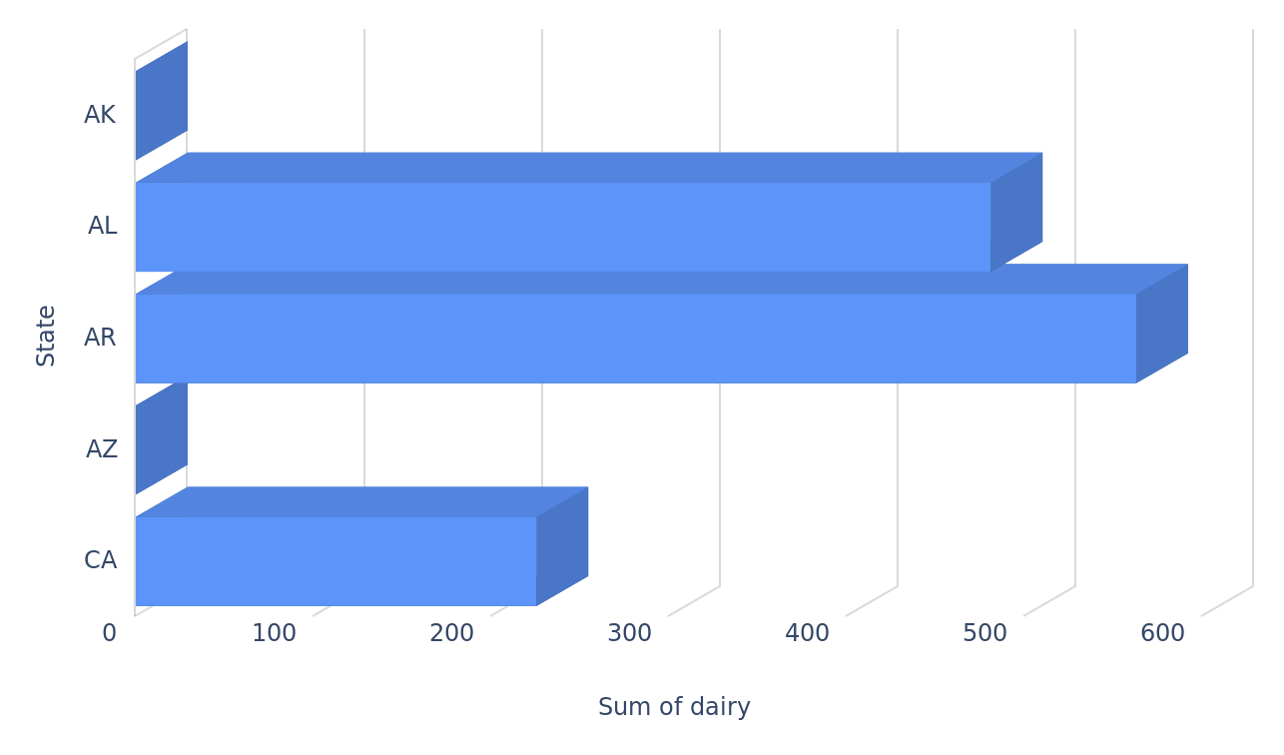
Comparing dairy quantities across states
dairy per state
26

Slide 27
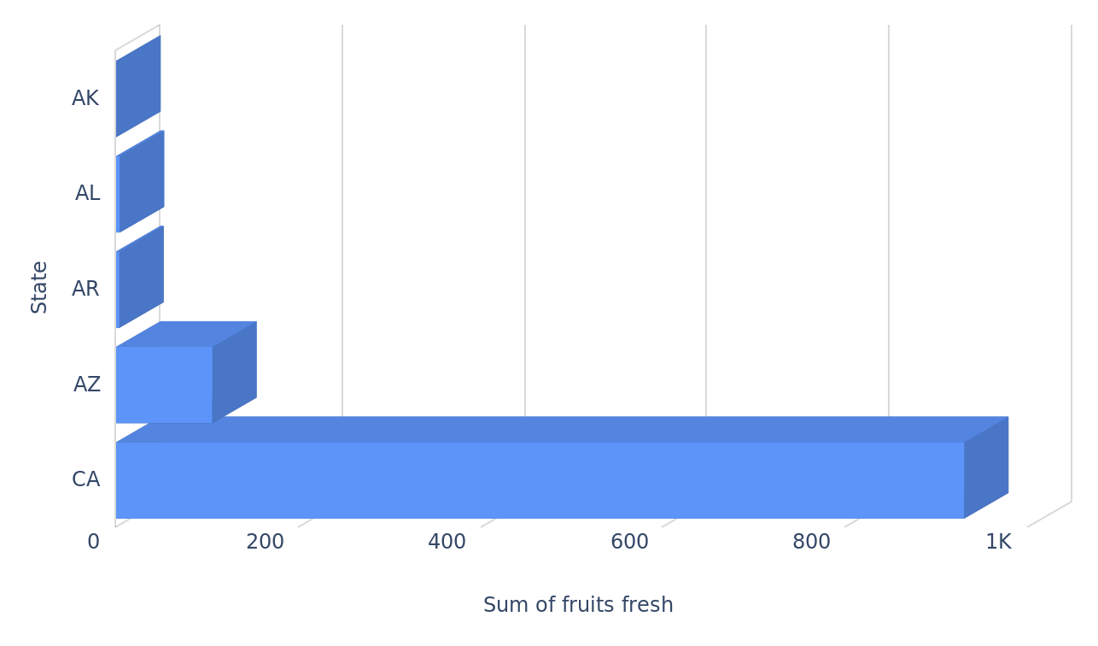
Comparing fresh fruits quantities across states
fresh fruits per state
27

Slide 28
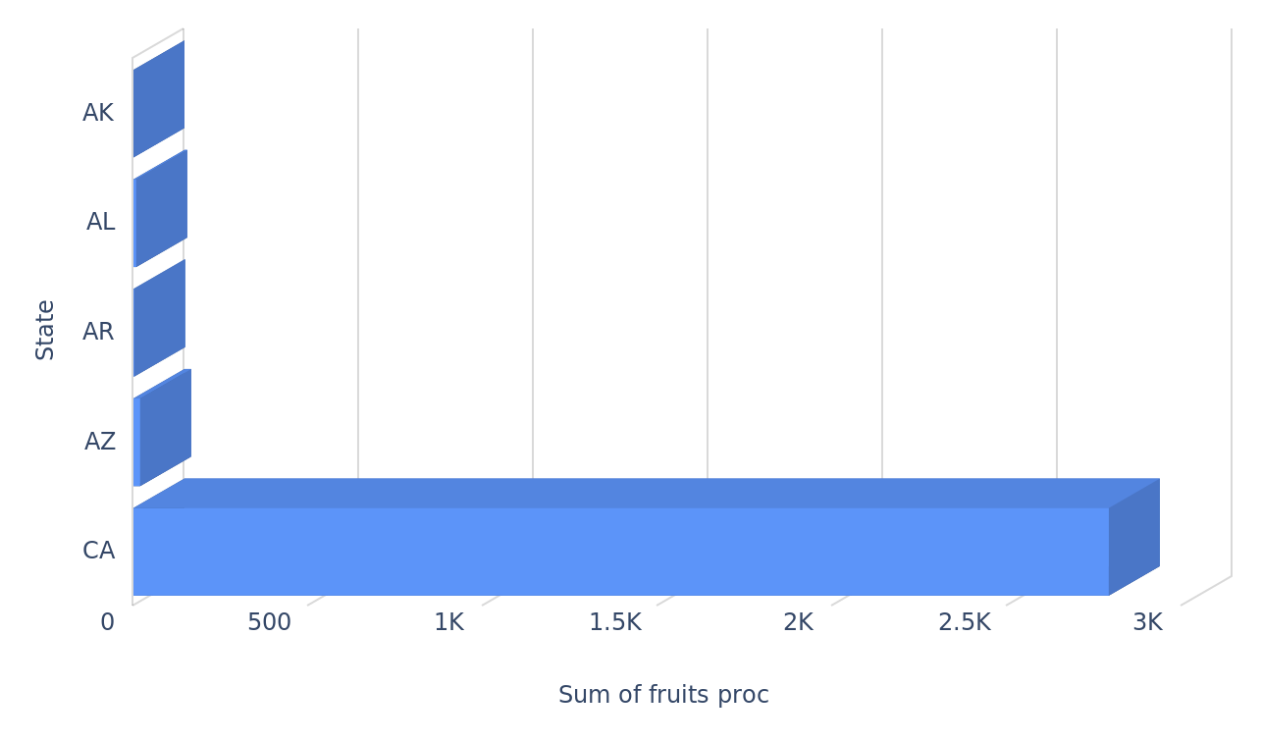
Comparing processed fruits quantities across states
fruits proc per state
28

Slide 29
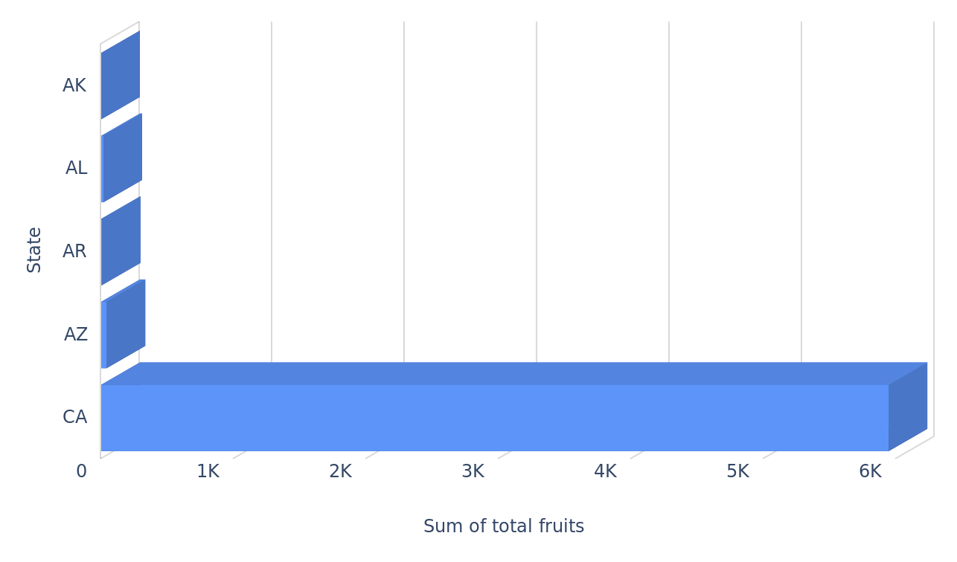
Comparing total fruits quantities across states
total fruits per state
29

Slide 30
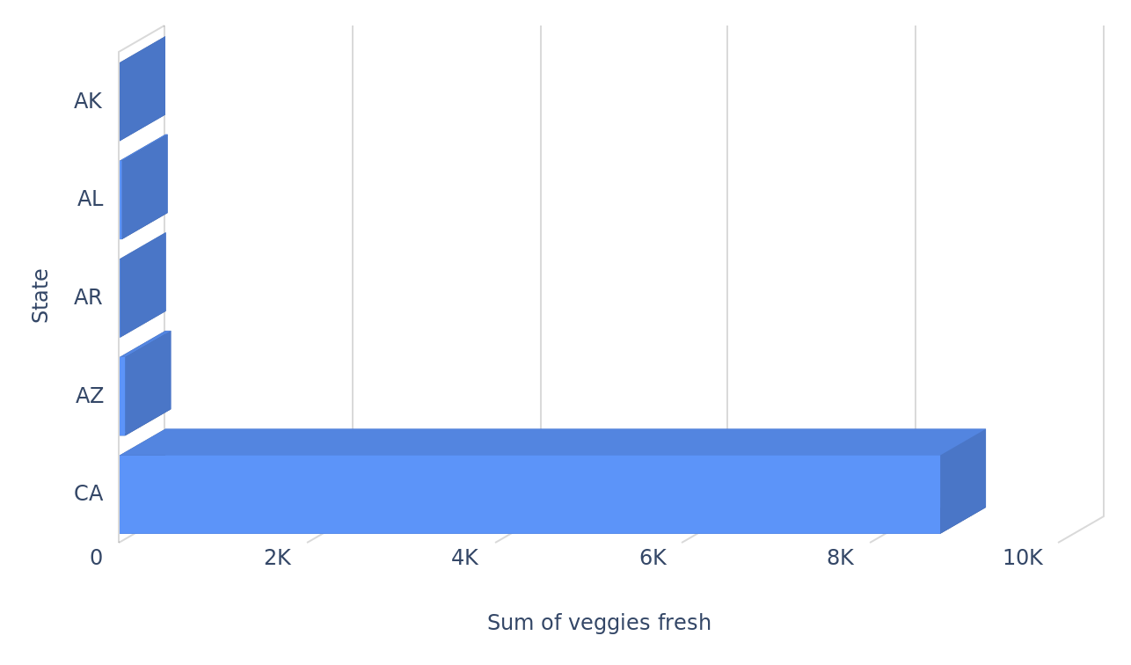
Comparing fresh veggies quantities across states
veggies fresh per state
30

Slide 31
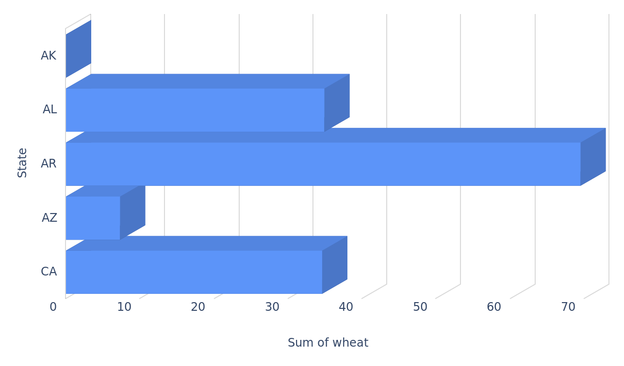
Comparing wheat quantities across states
wheat per state
31

Slide 32
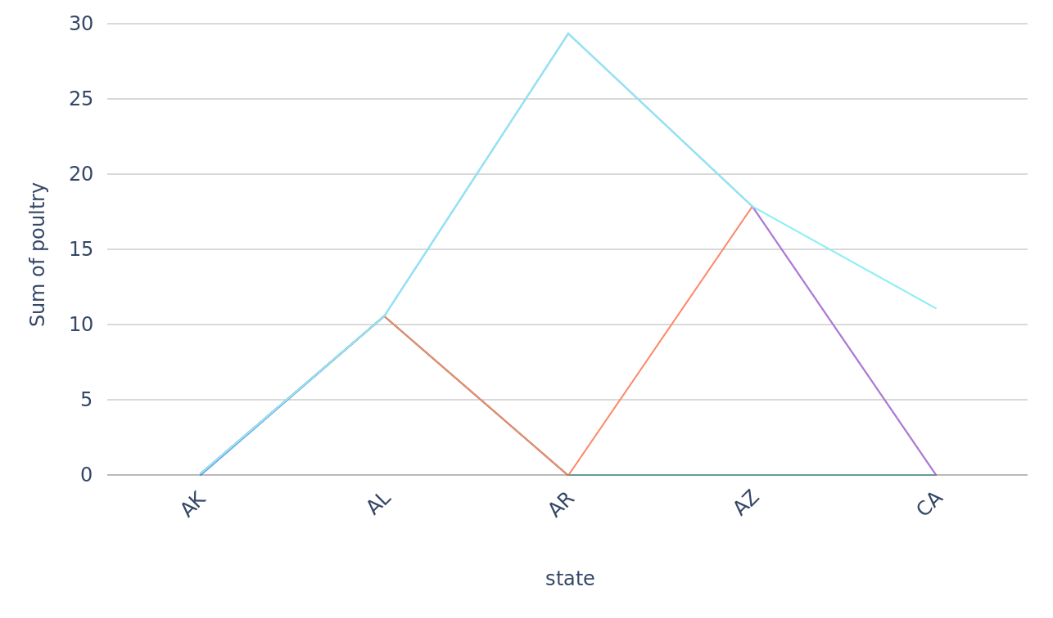
Tracking poultry quantities over states grouped per category
Arkansas has the highest poultry quantity, with a value of 29.4. Alaska has the lowest non-zero poultry quantity, with a value of 0.1. The average poultry quantity across all states is 13.82. Poultry quantities within each state vary significantly, with a standard deviation of 10.79. The median poultry quantity is 11.1, indicating that half of the states have poultry quantities below this value.poultry per state, grouped by category
32

Slide 33
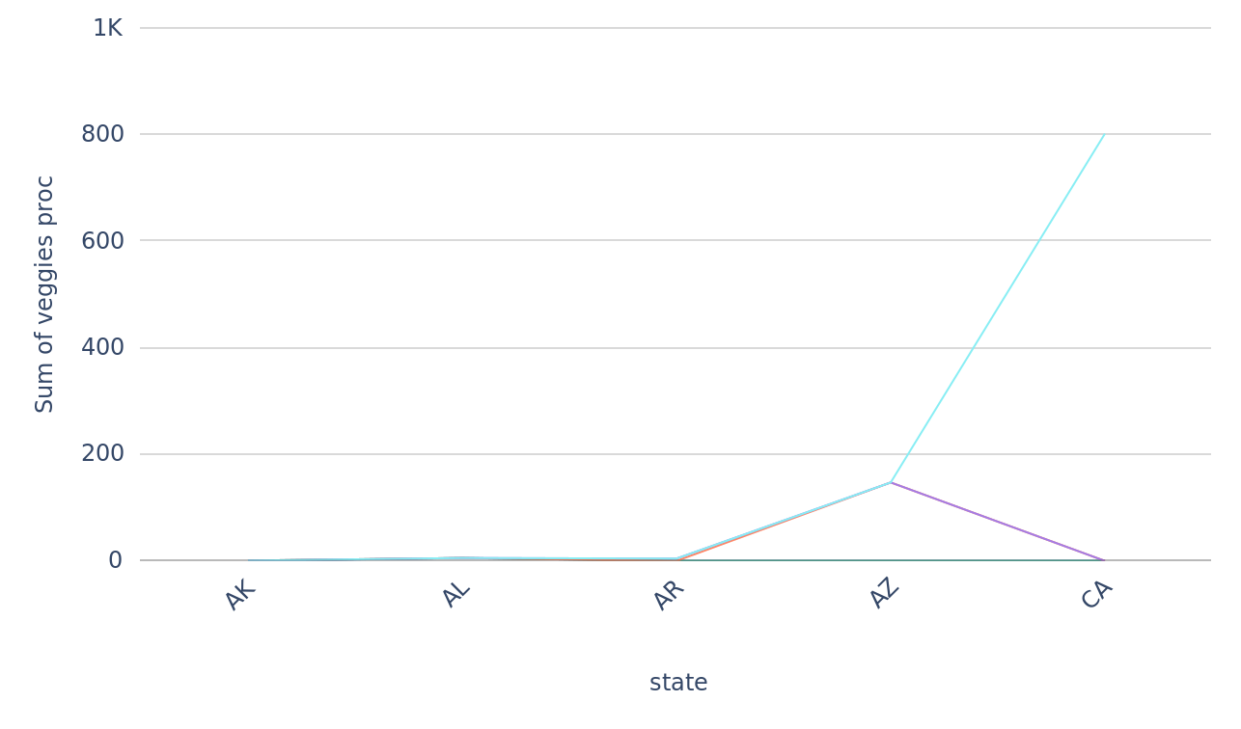
Tracking processed veggies quantities over states grouped per category
veggies proc per state, grouped by category
33

Slide 34
Created By: Anifat Adeshina
Created At: Fri 06 Dec 2024 12:23 AM UTC

