Slide 1
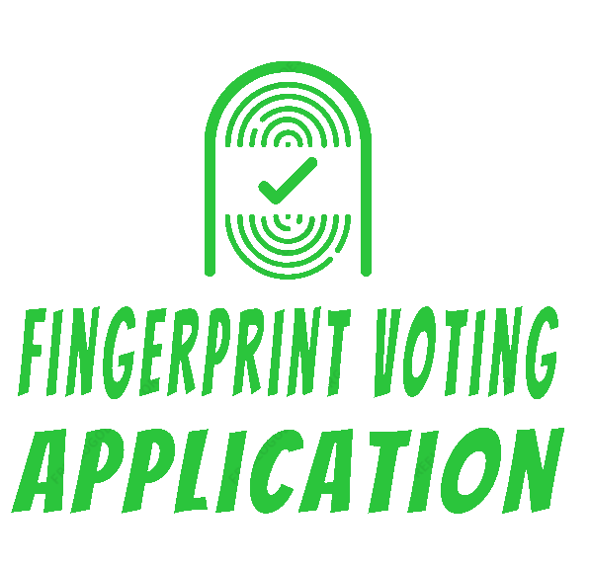
NAME:
Alaa
Mohammed
Salem
ID:
201816115
Fingerprint Voting Application
SUPERVISOR:
Abdullah Al-Barbari

Slide 2
Problems
Fingerprint Voting Application

Slide 3

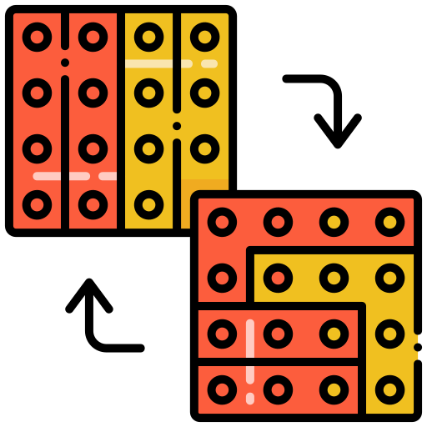


Fingerprint Voting Application
Authentication
Gerrymandering
Privacy
Unable to discuss

Slide 4
Objectives
Fingerprint Voting Application

Slide 5
01
02
03
Provide to who interested in collecting people’s opinions for statistical or informational purposes to post a question
Encouraging users to vote with their real opinion without fear of knowing their identity to get real results
Get real votes representing users’ points of view in a reliable, easy, and fast process by fingerprint
Fingerprint * Voting * Application

Slide 6
Summary Related Works
Fingerprint Voting Application

Slide 7
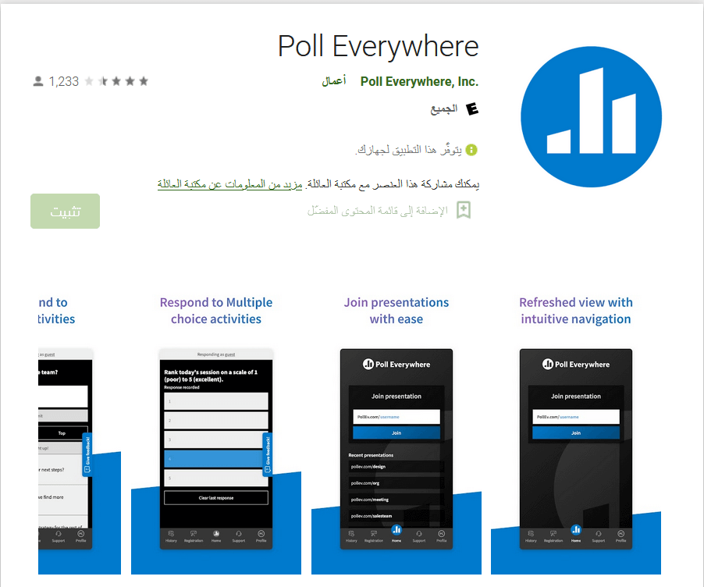
Poll Everywhere
VoxVote is a web application and mobile application that aims to gather users' opinions. It allows users to post-survey with the ability to put different types of questions. The system provides multiple types of questions, such as single (radio button), multiple (checkboxes), open-ended (free text), widget average, and ranked (Rank with numbers to indicate numbers).

Slide 8
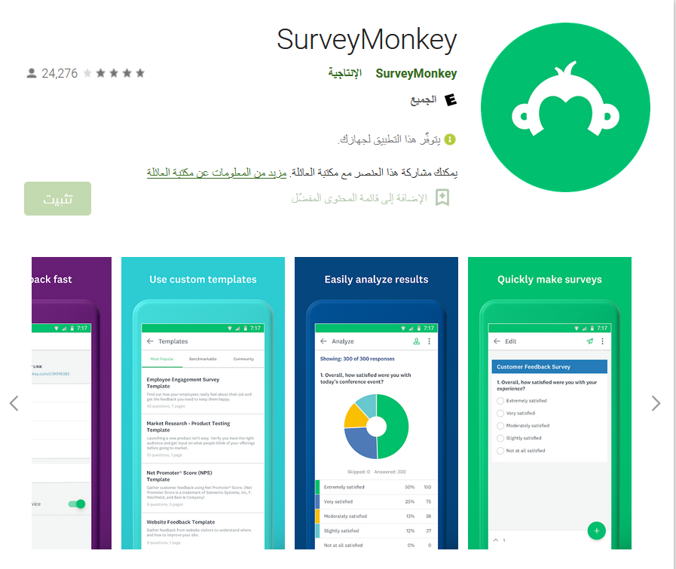
SurveyMonkey
Survey Monkey Application provides a service to make a survey page with multiple questions types, such as multiple choices, a question bank, and a rating. The application provides an analysis answer feature for the user. This application is suitable for re-searchers and marketing department employees.

Slide 9
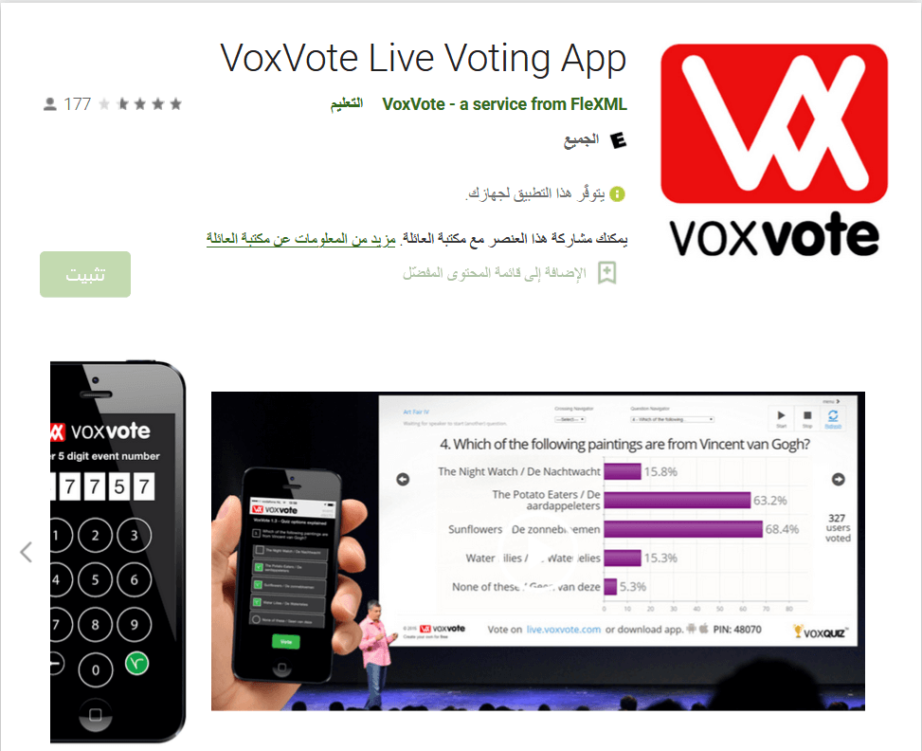
VoxVote Live Voting App
VoxVote is a web application and mobile application that aims to gather users' opinions. It allows users to post-survey with the ability to put different types of questions. The system provides multiple types of questions, such as single (radio button), multiple (checkboxes), open-ended (free text), widget average, and ranked (Rank with numbers to indicate numbers).

Slide 10
Solutions
Fingerprint Voting Application

Slide 11




Fingerprint Voting Application
Fingerprint
Precise
Privacy
Discussion

Slide 12
Diagrams
Fingerprint Voting Application

Slide 13
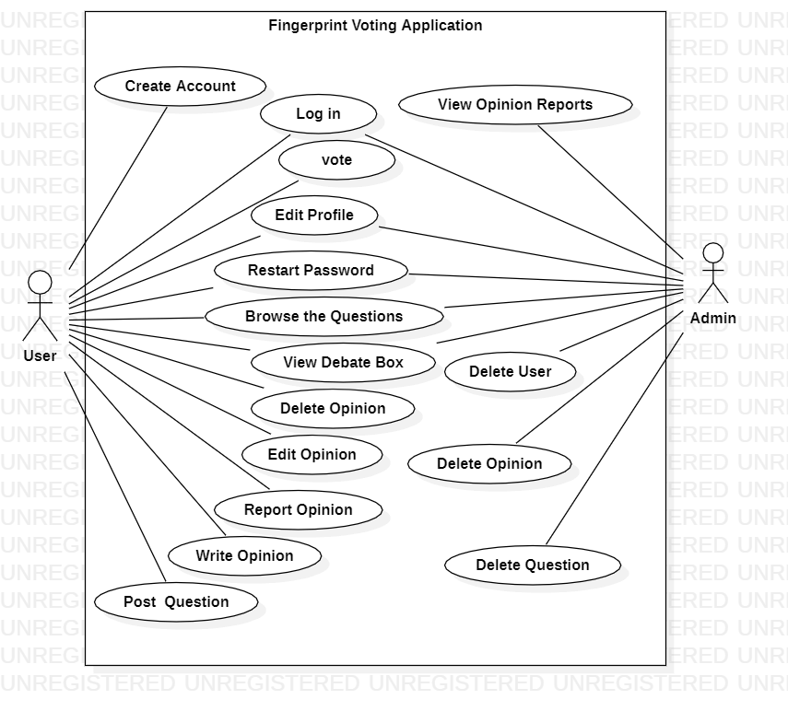
Use case Diagram

Slide 14
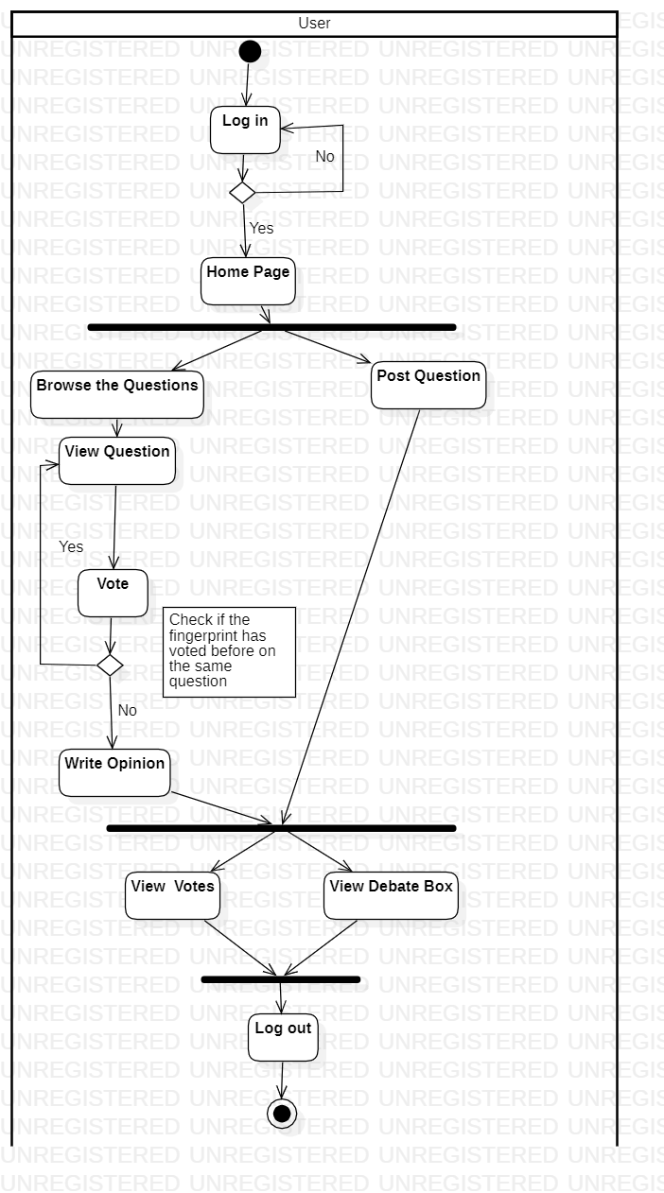
Activity Diagram for User

Slide 15
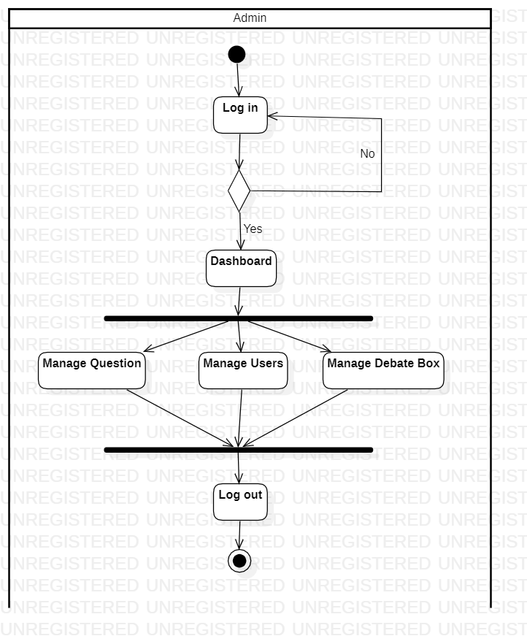
Activity Diagram for Admin

