Slide 1



MBSTU
Mawlana Bhashani Science & Technology University
Dept. of ICT
MBSTU
Data Communication Lab (ICT3102)
Department of ICT, Mawlana Bhashani Science and Technology University
DHCP: Dynamic Host Configuration Protocol
Presentation topic: DHCP
COURSE
Data Communication Lab (ICT3102)
SUBMITTED BY
Pritom Kumar Sen Anom | ID: IT24061
Dept. of ICT, MBSTU
SUBMITTED TO
Associate Prof. Dr. Nazrul Islam
Dept. of ICT, MBSTU

Slide 2
MBSTU
Mawlana Bhashani Science & Technology University
Dept. of ICT
MBSTU
Presentation Outline
01
Basics
The problem and what DHCP is
02
How it works
Ports, DORA and leases
03
In practice
Allocation, relay agents and messages
04
Trade-offs and security
Advantages, attacks and comparisons
DHCP: Dynamic Host Configuration Protocol
ICT3102 | ID: IT24061
02

Slide 3
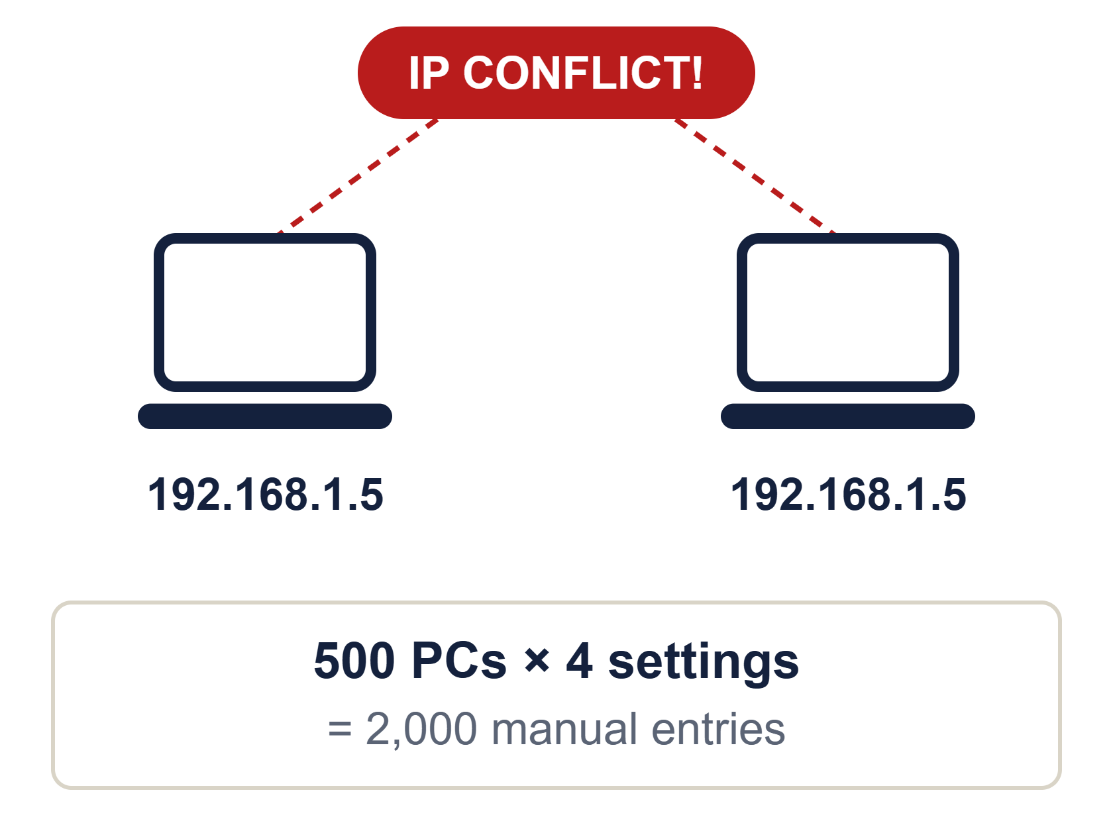
MBSTU
Mawlana Bhashani Science & Technology University
Dept. of ICT
MBSTU
The Problem: Manual IP Configuration
01
Every device needs a unique IP, mask, gateway and DNS
02
Typing them by hand for hundreds of devices is slow
03
One typo creates a duplicate IP and a conflict
04
Moving a device to another network means redoing it
DHCP: Dynamic Host Configuration Protocol
ICT3102 | ID: IT24061
03

Slide 4
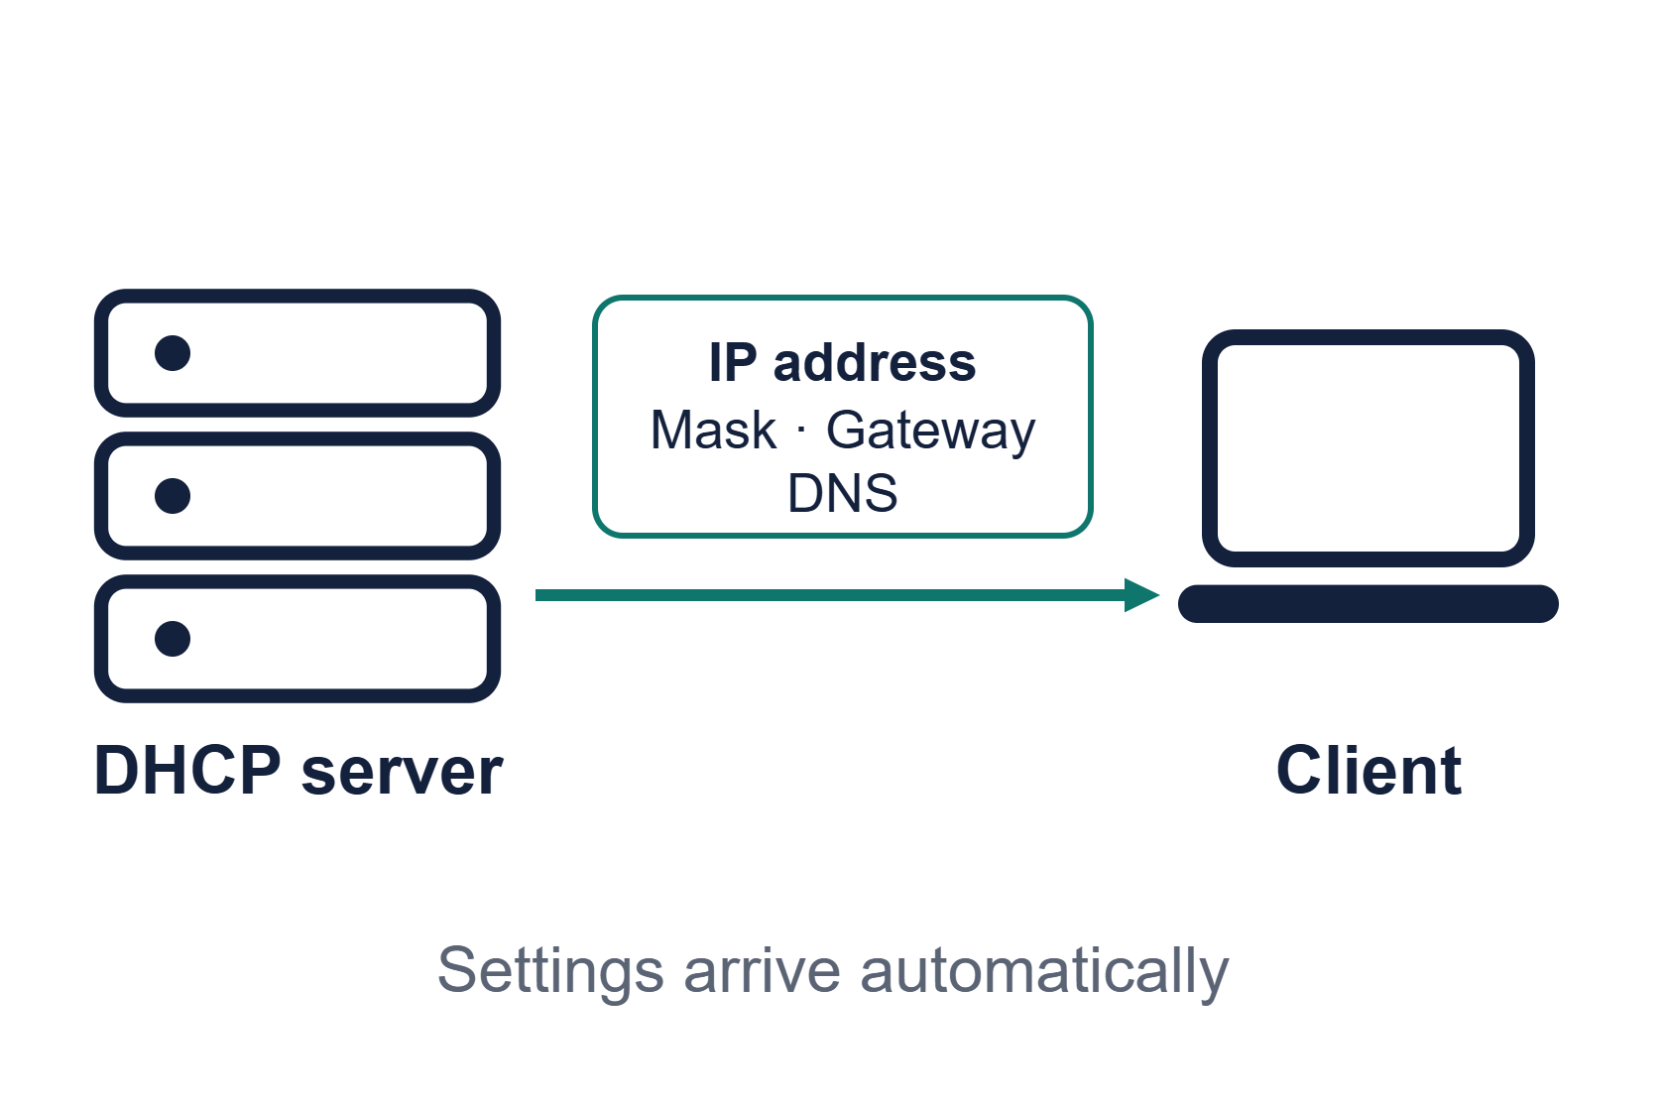
MBSTU
Mawlana Bhashani Science & Technology University
Dept. of ICT
MBSTU
What is DHCP?
DHCP is an application-layer client-server protocol that automatically assigns IP configuration to hosts joining a network.
A central server replaces manual setup on every device.
DHCP: Dynamic Host Configuration Protocol
ICT3102 | ID: IT24061
04

Slide 5
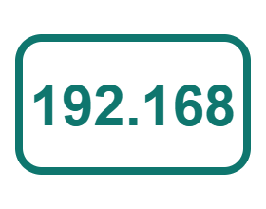



MBSTU
Mawlana Bhashani Science & Technology University
Dept. of ICT
MBSTU
What DHCP Assigns
IP address
Subnet mask
Gateway
DNS server
Unique identity, leased for a limited time
Shows the size of the local network
Router used to leave the network
Turns names into IP addresses
DHCP: Dynamic Host Configuration Protocol
ICT3102 | ID: IT24061
05

Slide 6
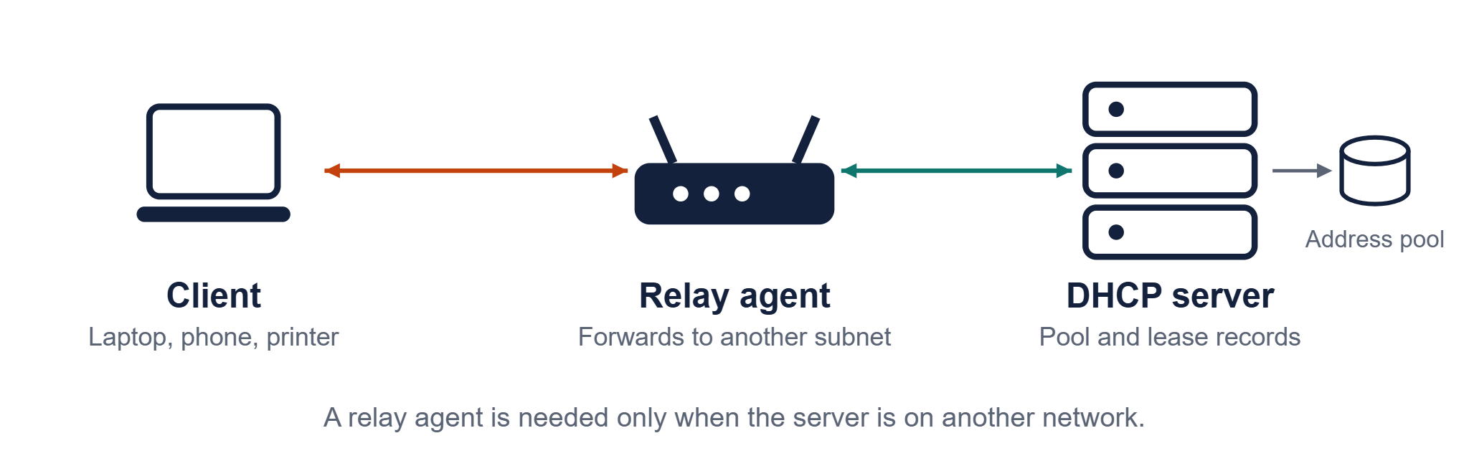
MBSTU
Mawlana Bhashani Science & Technology University
Dept. of ICT
MBSTU
Client-Server Architecture
DHCP: Dynamic Host Configuration Protocol
ICT3102 | ID: IT24061
06

Slide 7
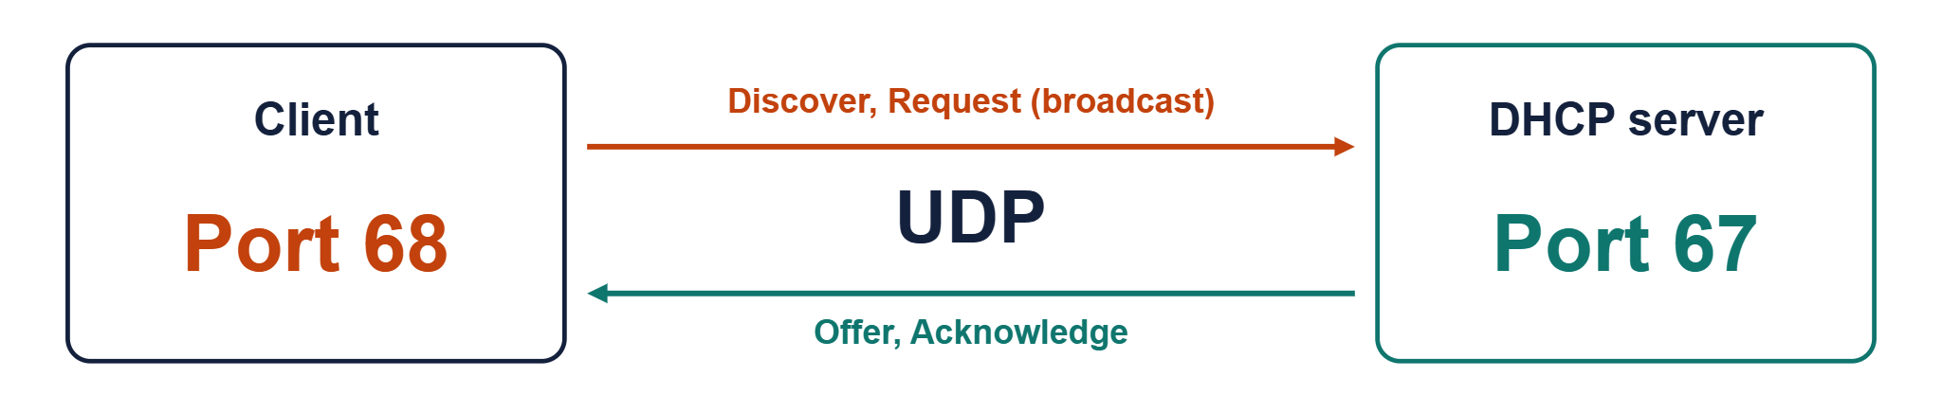
MBSTU
Mawlana Bhashani Science & Technology University
Dept. of ICT
MBSTU
Ports and Transport
Why UDP? The client has no IP address yet, so it cannot open a TCP connection. UDP lets it simply broadcast.
DHCP: Dynamic Host Configuration Protocol
ICT3102 | ID: IT24061
07

Slide 8
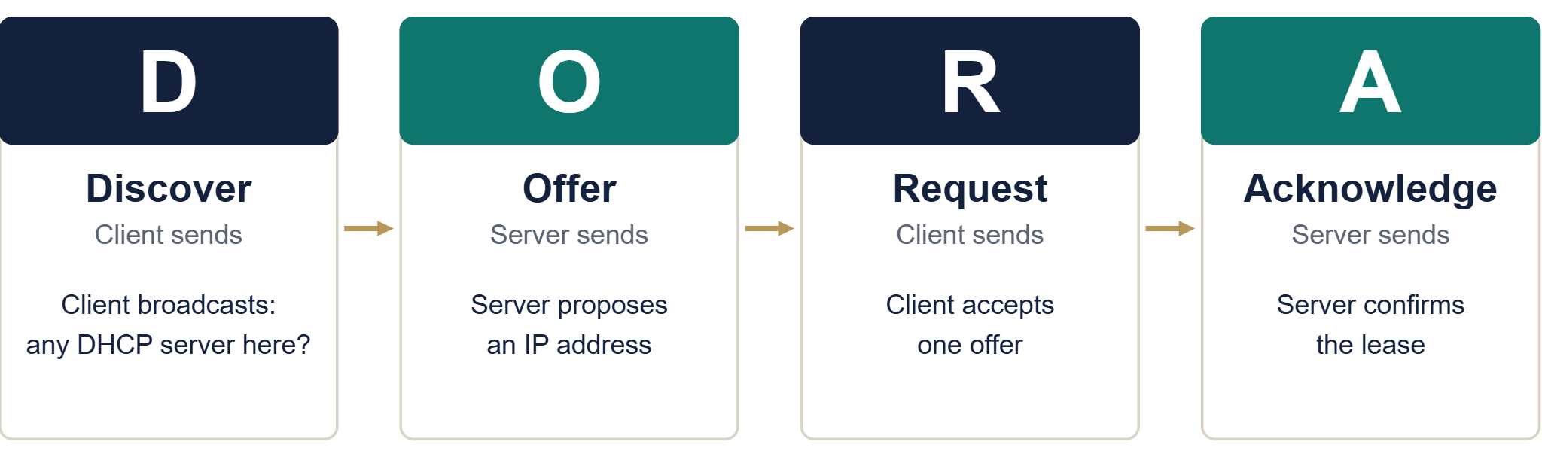
MBSTU
Mawlana Bhashani Science & Technology University
Dept. of ICT
MBSTU
The DORA Process
DHCP: Dynamic Host Configuration Protocol
ICT3102 | ID: IT24061
08

Slide 9
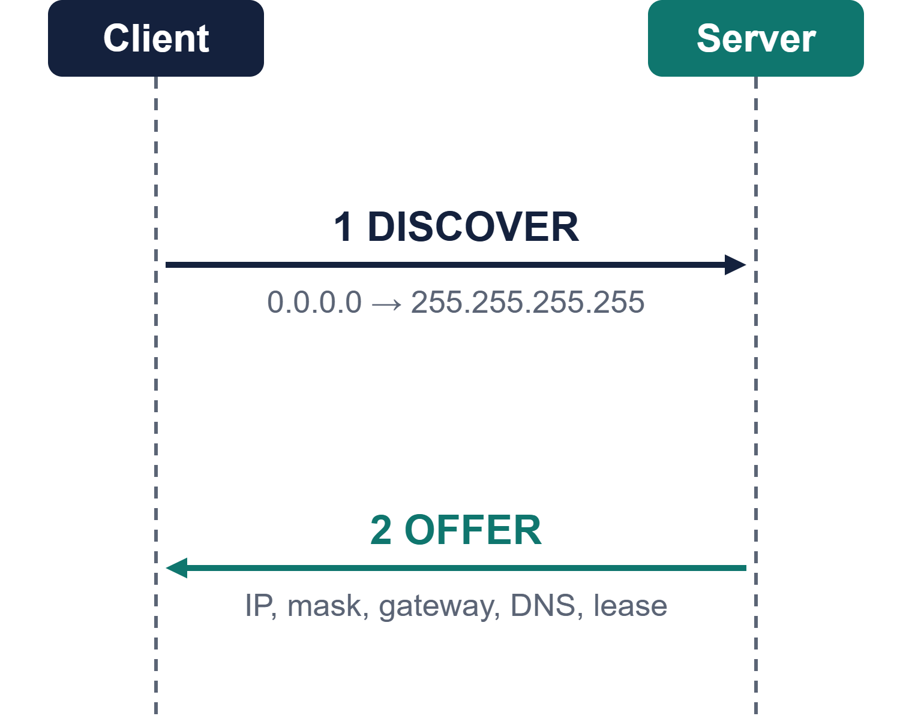
MBSTU
Mawlana Bhashani Science & Technology University
Dept. of ICT
MBSTU
Discover and Offer
Discover
The client broadcasts from 0.0.0.0 because it has no address yet.
Offer
The server replies with a free IP address and a lease time.
DHCP: Dynamic Host Configuration Protocol
ICT3102 | ID: IT24061
09

Slide 10
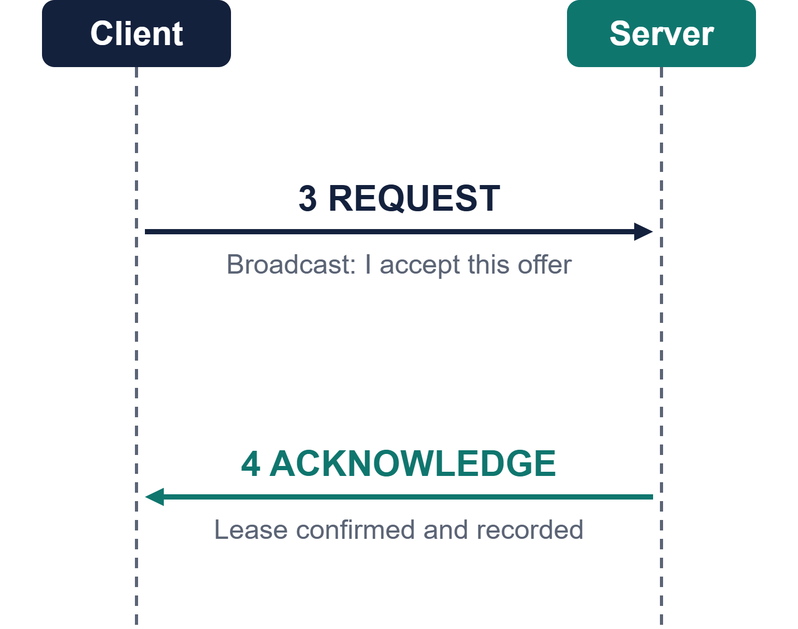
MBSTU
Mawlana Bhashani Science & Technology University
Dept. of ICT
MBSTU
Request and Acknowledge
Request
The client broadcasts its choice, so other servers drop their offers.
Acknowledge
The server confirms the lease and the client configures itself.
DHCP: Dynamic Host Configuration Protocol
ICT3102 | ID: IT24061
10

Slide 11
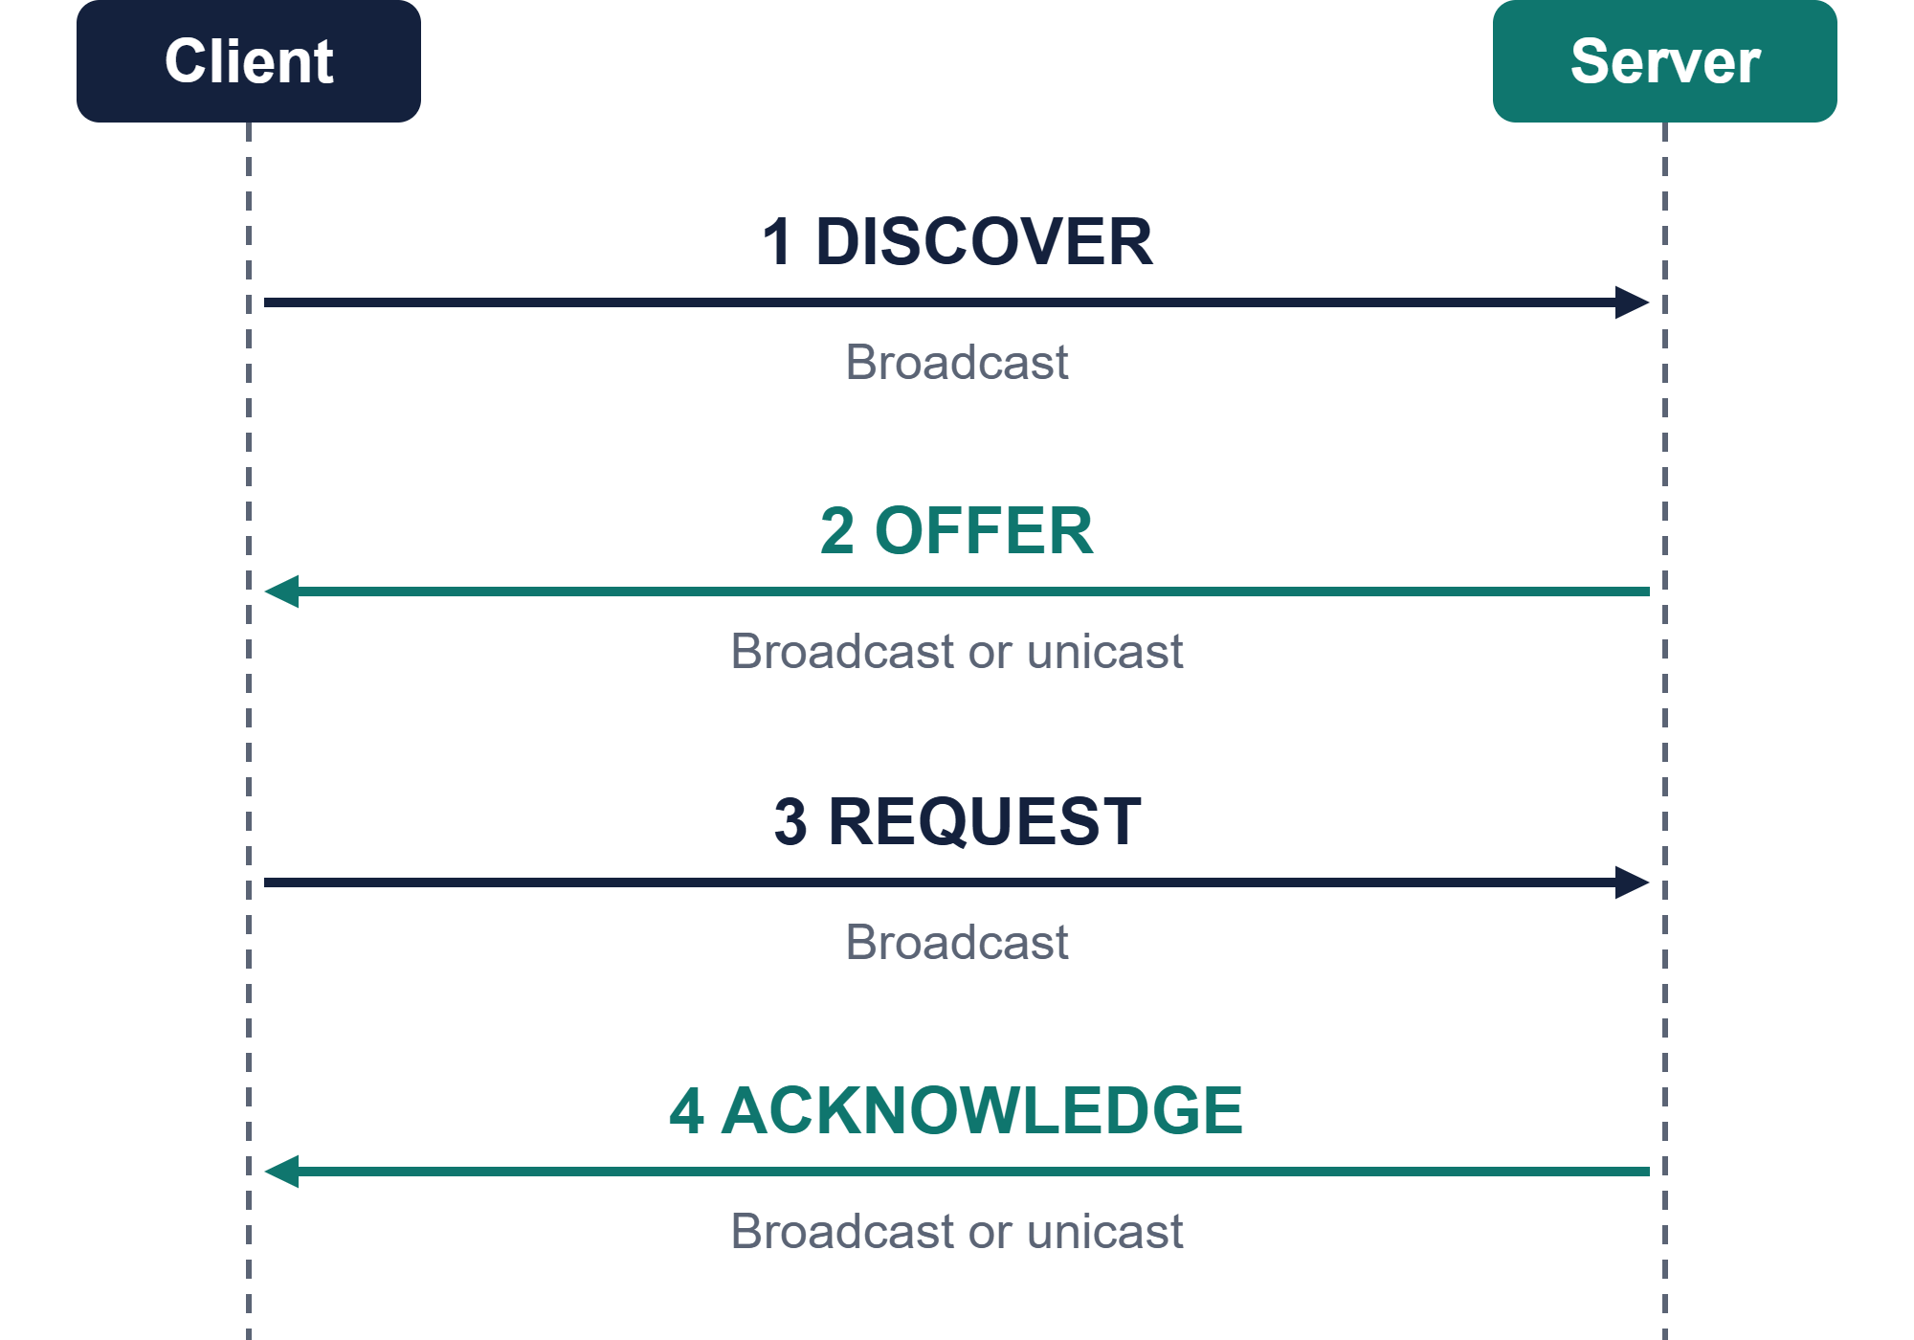
MBSTU
Mawlana Bhashani Science & Technology University
Dept. of ICT
MBSTU
DORA Packet Flow
Client sends
Steps 1 and 3
Server sends
Steps 2 and 4
Broadcast vs unicast
Broadcast goes to all hosts. Unicast goes to one host.
DHCP: Dynamic Host Configuration Protocol
ICT3102 | ID: IT24061
11

Slide 12
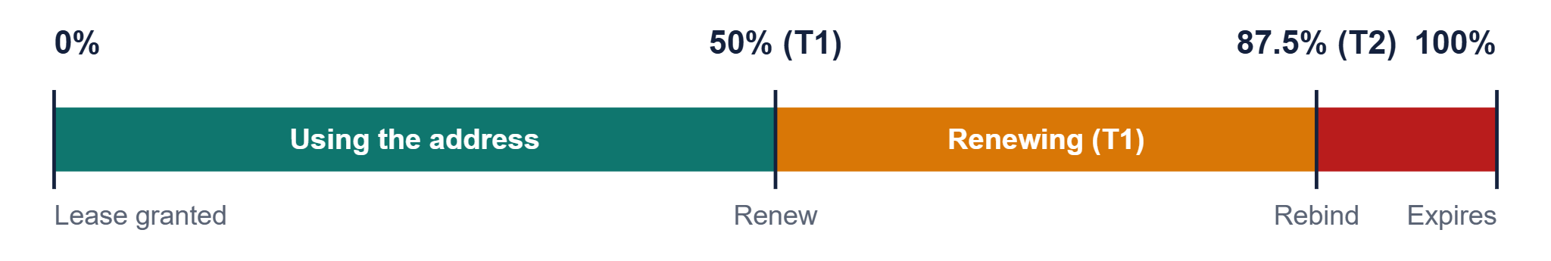
MBSTU
Mawlana Bhashani Science & Technology University
Dept. of ICT
MBSTU
Lease Time and Renewal
T1 at 50%
T2 at 87.5%
100%
The client asks the same server to renew the lease.
The client asks any server to rebind.
The lease expires. The address returns to the pool.
DHCP: Dynamic Host Configuration Protocol
ICT3102 | ID: IT24061
12

Slide 13



MBSTU
Mawlana Bhashani Science & Technology University
Dept. of ICT
MBSTU
Allocation Types
Dynamic
Automatic
Manual
Address from the pool for a limited lease.
Address from the pool, kept for a long time.
Fixed IP tied to a MAC address (reservation).
Best for: Laptops, phones
Best for: Stable hosts
Best for: Servers, printers
DHCP: Dynamic Host Configuration Protocol
ICT3102 | ID: IT24061
13

Slide 14
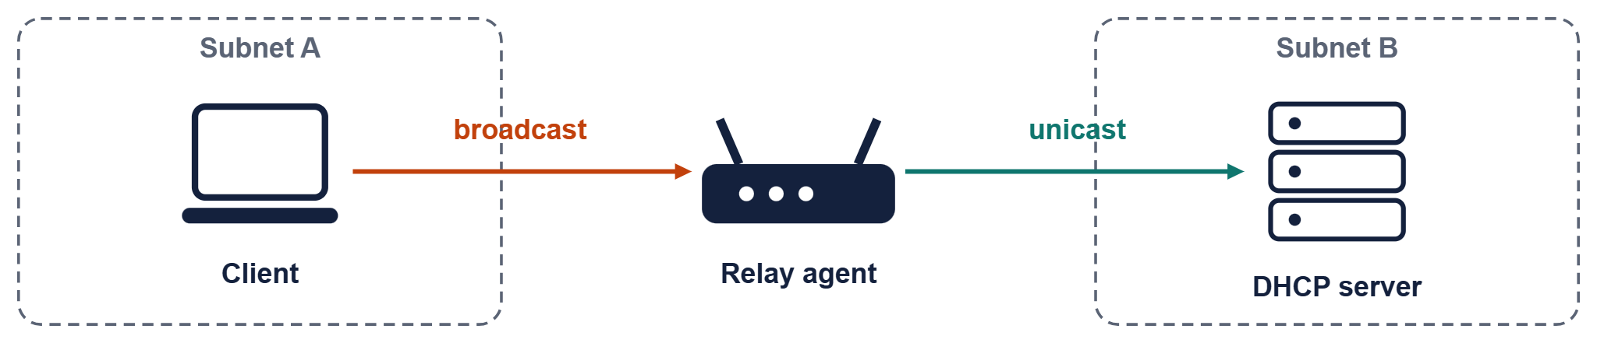
MBSTU
Mawlana Bhashani Science & Technology University
Dept. of ICT
MBSTU
DHCP Relay Agent
01
Routers do not forward broadcasts by default
02
The relay catches the client broadcast and sends it as unicast
03
One central server can then serve many subnets
DHCP: Dynamic Host Configuration Protocol
ICT3102 | ID: IT24061
14

Slide 15
MBSTU
Mawlana Bhashani Science & Technology University
Dept. of ICT
MBSTU
Other DHCP Messages
SENT BY CLIENT
SENT BY SERVER
Decline
NAK
The offered address is already in use.
Request refused, so the client restarts DORA.
SENT BY CLIENT
SENT BY CLIENT
Release
Inform
Gives the address back before the lease ends.
Already has an IP and asks only for extra settings.
DHCP: Dynamic Host Configuration Protocol
ICT3102 | ID: IT24061
15

Slide 16
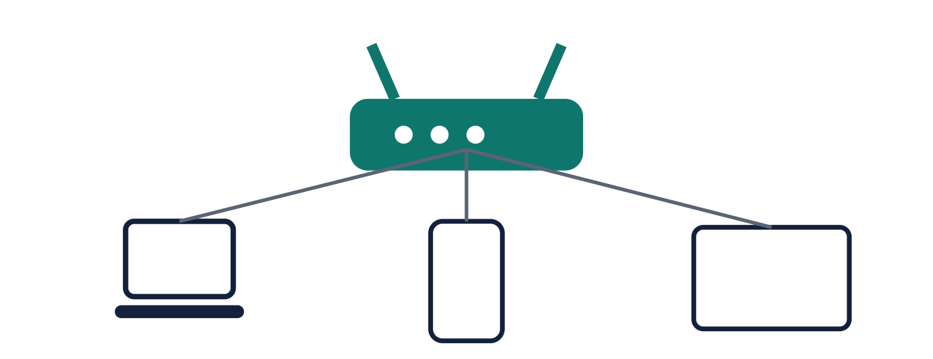
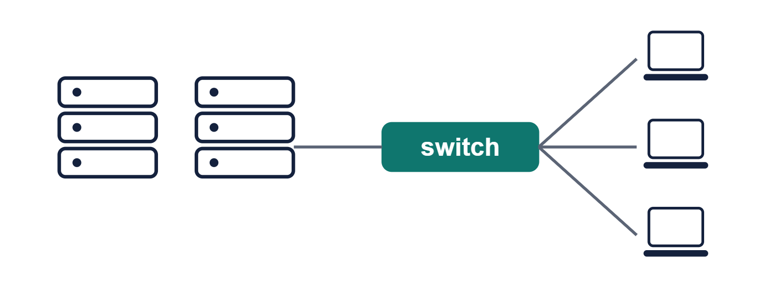
MBSTU
Mawlana Bhashani Science & Technology University
Dept. of ICT
MBSTU
Home Router vs Enterprise
Home router
Enterprise
Built-in server, one small pool, defaults rarely changed.
Dedicated servers, many scopes and VLANs, redundancy and reservations.
DHCP: Dynamic Host Configuration Protocol
ICT3102 | ID: IT24061
16

Slide 17


MBSTU
Mawlana Bhashani Science & Technology University
Dept. of ICT
MBSTU
Advantages and Disadvantages
Advantages
Disadvantages
Less admin work
Single point of failure without a backup server
No duplicate IP addresses
Rogue servers can mislead clients
Settings changed from one place
Starvation can exhaust the pool
Efficient reuse of addresses
DHCP: Dynamic Host Configuration Protocol
ICT3102 | ID: IT24061
17

Slide 18
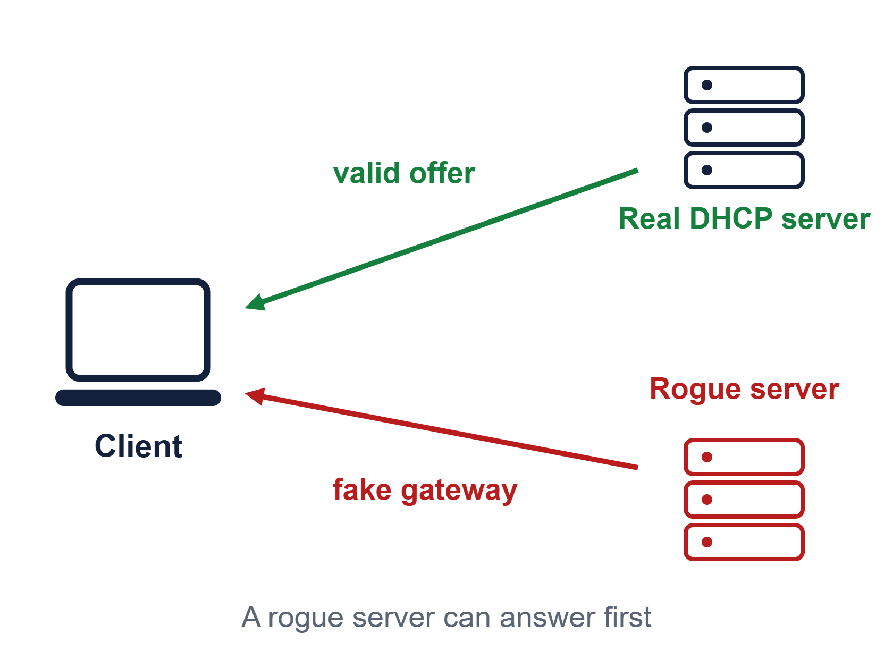
MBSTU
Mawlana Bhashani Science & Technology University
Dept. of ICT
MBSTU
Security Threats and Defenses
Threats
Rogue DHCP server
Starvation attack
Defenses
DHCP snooping on switches
Port security
Rate limiting
Backup DHCP servers
DHCP: Dynamic Host Configuration Protocol
ICT3102 | ID: IT24061
18

Slide 19
MBSTU
Mawlana Bhashani Science & Technology University
Dept. of ICT
MBSTU
DHCP vs Static IP vs APIPA
Feature | DHCP | Static IP | APIPA
Setup | Automatic | Manual | Automatic
Range | Any network | Any network | 169.254.0.0/16
Conflicts | Avoided | Possible | Possible
Gateway, DNS | Provided | Set by hand | Not provided
Tip An address starting with 169.254 usually means the DHCP server could not be reached.
DHCP: Dynamic Host Configuration Protocol
ICT3102 | ID: IT24061
19

Slide 20

MBSTU
Mawlana Bhashani Science & Technology University
Dept. of ICT
MBSTU
Summary and Q&A
DHCP automates IP configuration
Thank you
Questions?
Pritom Kumar Sen Anom
ID: IT24061
Dept. of ICT, MBSTU
it24061@mbstu.ac.bd
DORA: Discover, Offer, Request, Acknowledge
Leases renew at 50% and 87.5%
Relay agents let one server serve many subnets
DHCP snooping protects against rogue servers
DHCP: Dynamic Host Configuration Protocol
ICT3102 | ID: IT24061
20

