Slide 1
Software City Visualization
Mon, 04.12.2023
Architecture
Demo
Data Formats

Slide 2

Architecture – Non-functional Requirements
1
Modifiability
Change business logic without having to change adapters or infrastructure. Replace / introduce different infrastructure elements.
2
Adaptability
Code Analysis based on 3rd party libraries.
3
Extensibility
Maybe more services will be implmented that can interoperate with the application.
4
Usability
The application is about visualization.

Slide 3
Service Granularity & Data Access & Coupling
Service Functionality
Data Access
Visualization and Data Analysis
Interservice Communication pattern,
No data persisted for now
Extensibility
Data Relationship
Separating the services by functionality enables easier extensibility
Maintaining a target data format for different kinds of input data

Slide 4
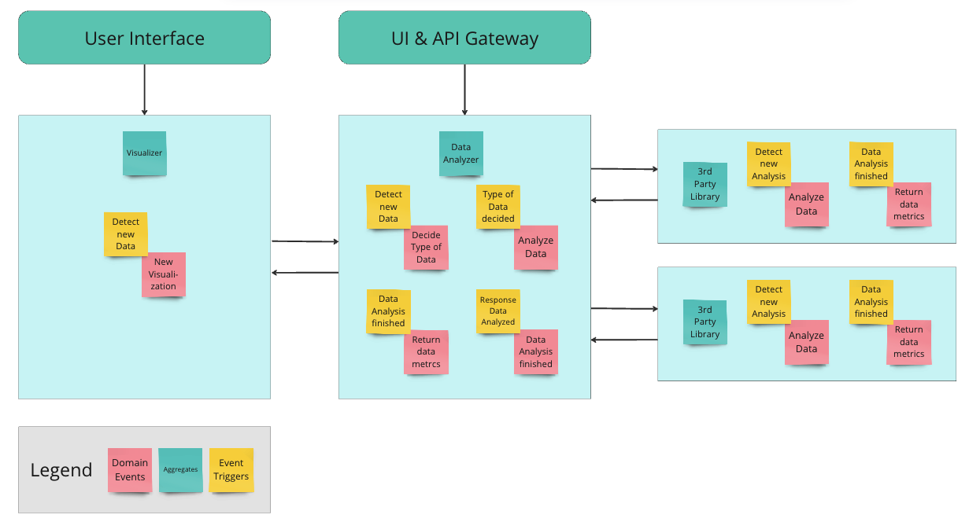
Architecture – Bounded Context

Slide 5

OUR COMPANY
Demo
Data-Analyzer workflow
Visualizer workflow

Slide 6

Data Formats
id
name
groupId
shape
length
to identify the element
name of the element
to group elements (e.g. by package name)
round, rectangular, etc.
length of the element
width
height
color
relationships
width of the element
height of the element
color of the element
relationship to other elements (e.g. dependencies)

Slide 7
Open Questions & Outlook
Does separate service for analyzing data even make sense?
Data Analyzer is only an interface without functionality
Is the current project direction as intended?
How should the different formats of raw data be parsed / how will they look like?
For now, Data Analyzer has a datastore:
History of uploaded data?
Remove it?
A datastore can be assigned to a specific user or use case?

Slide 8

THANK YOU
https://github.com/jonaslanzlinger/software-city-project/tree/main

