Slide 1
Covid-19 detection from lung X-Ray images using CNN model, Tensorflow and Keras
Submitted By:
Shikhar Saxena
Akash Rawat
Abhishek Chauhan

Slide 2
Contents
Introduction
Motivation & Objective
Brief Survey / Related works
Method details
Employed Dataset
Experiments & Results
Conclusion
References

Slide 3
INTRODUCTION
Most people in the world right now are genuinely concerned about COVID-19. Everyone is finding themselves constantly analysing their personal health and wondering if/when they will contract it. As humans, there is nothing more terrifying than the unknown. But thanks to the ever working health professionals, researchers and other related agencies, situation has definitely improved, if not totally resolved.
The present report on the topic, “Detecting COVID-19 in X-Ray images using Deep Learning, Keras and Tensorflow”, is an attempt to design a way for identifying COVID positive individuals from the rest of the people.
It uses basis Convolution Neural Network Model, with different techniques applied to optimize and give better accuracy and results.
Though the model presented here gives fairly good results, but in no case can be considered as a substitute or as a valid health certified test among many tests that are available today. This automatic COVID-19 detection is for educational purposes only. It is not meant to be a reliable, highly accurate COVID-19 diagnosis system, nor has it been professionally or academically vetted.

Slide 4
MOTIVATION AND OBJECTIVE
Though the current scenario of the COVID pandemic has definitely gotten better, but now everyone realises how small details and carelessness can lead to terrible consequences. Thanks to those hardworking health experts, researchers, workers, and other such involved individuals, we are in a much better space now and still preparing to better deal with it.
Our goal is simply to inspire people and open their eyes to how studying computer vision/deep learning and then applying that knowledge to the medical field can make a big impact on the world.
We decided to do what we do best — focus on the overall CV/DL community by writing code, running experiments, and educating others on how to use computer vision and deep learning in practical, real-world applications.
The methods and datasets used would not be worthy of publication. But they serve as a starting point for those who need to feel like they’re doing something to help. It is about caring about the people and community and helping in a way we know.

Slide 5
BRIEF SURVEY/RELATED WORK
For the purposes of this mini-project, we thought to explore X-ray images as doctors frequently use X-rays and CT scans to diagnose pneumonia, lung inflammation, abscesses, and/or enlarged lymph nodes.
Since COVID-19 attacks the epithelial cells that line our respiratory tract, we can use X-rays to analyse the health of a patient’s lungs.
And given that nearly all hospitals have X-ray imaging machines, it could be possible to use X-rays to test for COVID-19 without the dedicated test kits.
A drawback is that X-ray analysis requires a radiology expert and takes significant time — which is precious when people are sick around the world.
Therefore developing an automated analysis system is required to save medical professionals valuable time.

Slide 6
Method Details
Since the dataset included images, we decided to use Convolutional Neural Network model, since it works very well with image data, with initial layers detecting essential features like edges, corners, background and the later layers dealing with more general information to classify the images.
After that a basic CNN model with filters and max-pooling layers was implemented with relu activation function in the intermediate layers, followed by flattening into dense layers at the end and a sigmoid activation unit to finally classify the images into the two classes.
To get better results we then tried several techniques on this basic CNN which included applying dropouts to avoid overfitting or high variance, batch normalization to handle internal covariance shift, learning rate decay to ensure smooth reaching of gradient descent.
We were able to obtain much better results with these basic implementations.
Finally we tried using transfer learning which is basically applying a pre-trained model’s parameters which are already well trained and optimized on a huge dataset to our model.

Slide 7
EMPLOYED DATASET
The COVID-19 X-ray image dataset we’ll be using for this tutorial was curated by Dr. Joseph Cohen, a postdoctoral fellow at the University of Montreal.
Collecting CoVID-19 X-Ray images:
Thanks to API provided in the GitHub repo, we were able to load the entire dataset in a python notebook. But the challenge was to sample the CoVID X-Rays from the other bacterial/pneumonia, MERS, SARS, and ARDS cases. After the indices were obtained it was easy to plot and save images into the google drive folder using Python’s matplotlib.pyplot library.
Collecting normal X-ray images:
To do so, I used Kaggle’s Chest X-Ray Images (Pneumonia) dataset and sampled 25 X-ray images from healthy patients. There are a number of problems with Kaggle’s Chest X-Ray dataset, namely noisy/incorrect labels, but it served as a good enough starting point for this proof of concept COVID-19 detector.

Slide 8
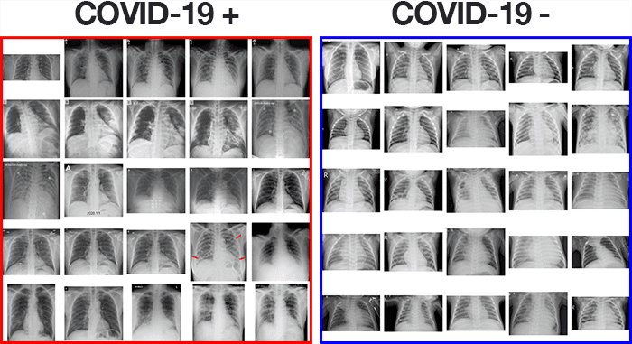
Organising Dataset:
The total number of images obtained from the CoVID positive X-Ray was 146. Another 146 normal X-Ray were taken from the Kaggle Dataset.
Fig1: Corona-Virus (COVID-19) chest X-ray image data. On the left we have positive (i.e., infected) X-ray images, whereas on the right we have negative samples.

Slide 9
EXPERIMENTS AND RESULTS
Experiment 1
Train-Validation split: 3:1 or 194 images in train set and 66 images in validation set.
Pre-processing:
Image Augmentation: Artificially boosting the number of images in our training set by applying random image transformations to the existing images in the training set.
Data normalization: is an important step which ensures that each input parameter (pixel, in this case) has a similar data distribution
Model:
Convolutions: When working with RGB/grayscale images we convolve each colour channel (only one in grayscale) with its own convolutional filter.
Max Pooling: Max pooling helps reduce image size after each CNN layer without increasing number of learnable parameters.
ReLu Activation: With RELU activation, even if the gradients coming from some neurons can be zero, there will always be others giving a clear non-zero gradient and training can continue at a good pace.

Slide 10
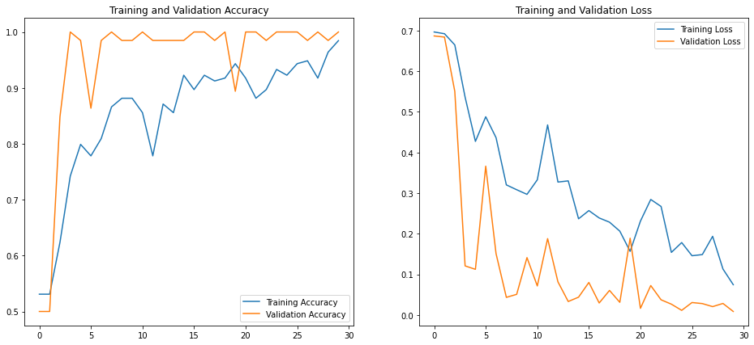
Result
Validation accuracy of upto 98% was achieved after training 30 epochs. However test accuracy of about 96% was obtained on unseen test data.
Fig 2: Plots for accuracy vs epochs and loss vs epochs

Slide 11
Experiment 2
Train-Validation split & Pre-processing: Same as Experiment 1
Model:
Overfitting and Dropouts: The learning algorithm works on training data only and optimises the training loss accordingly. It never sees validation data so it is not surprising that after a while its work no longer has an effect on the validation loss which stops dropping and sometimes even bounces back up.
The dropout technique shoots random neurons at each training iteration.
Dropout is one of the oldest regularization techniques in deep learning. At each training iteration, it drops random neurons from the network with a probability p (typically 25% to 50%)

Slide 12
Result
Validation accuracy of upto 98% was achieved after training 30 epochs. However test accuracy of about 96% was obtained on unseen test data.
Fig 3: Plots for accuracy vs epochs and loss vs epochs

Slide 13
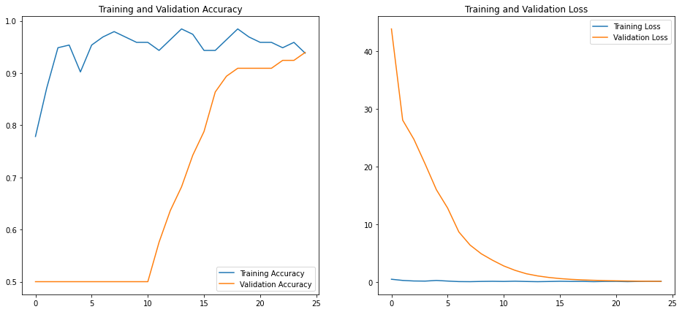
Experiment 3
Train-Validation split & Pre-processing: Same as Experiment 1
Model:
Learning Rate Decay
The good solution is to start fast & decay the learning rate exponentially.
Batch Normalization: In a nutshell batch norm tries to address the problem of how neuron output are distributed relatively to the neuron activation function.
Results:
Validation accuracy of upto 94% was achieved after training 25 epochs. However test accuracy of about 96% was obtained on unseen test data.
Fig 4: Plots for accuracy vs epochs and loss vs epochs

Slide 14
Expriment 4
Train-Validation split & Pre-processing: Same as Experiment 1
Model:
Transfer Learning: A technique that reuses a model that was created by machine learning experts and that has already been trained on a large dataset
VGG 16: VGG-16 is a convolutional neural network that is 16 layers deep. We can load a pretrained version of the network trained on more than a million images from a database.
Hyper parameters and functions involved:
Batch size: 15
Image Size: 224 X 224 X 1
Number of Epochs: 25
Optimizer function: Adam
Loss function: Binary Cross entropy

Slide 15
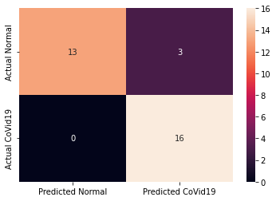
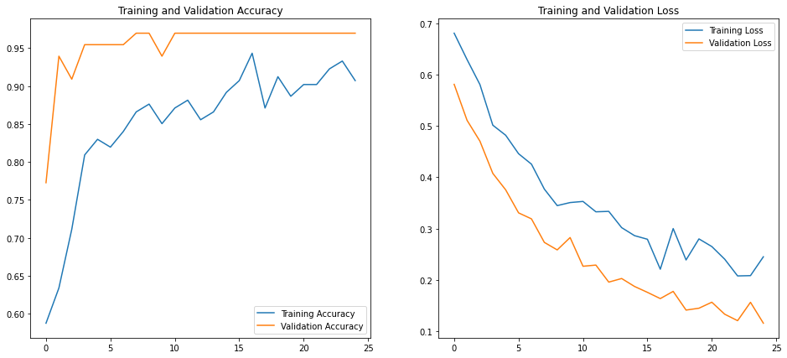
RESULTS
Fig 6: Plots for accuracy vs epochs and loss vs epochs
Fig 5: Confusion Matrix

Slide 16
Conclusion
As seen from the above experiments we can conclude that our model was able to achieve 90-95% accuracy most of the time.
Apart from the first basic model we were able to identify those who had COVID most of the time as seen from the confusion matrix. Though there were times when those who did not had COVID were falsely identified as positive, but if all people (including actually positive or not) take precautionary quarantine, then also it is not bad.
Another positive result was, we did not encounter the problem of overfitting, despite limited dataset, thanks to data augmentation and other techniques like dropout which handled overfitting if any.
One of the major problem which we faced was the limited dataset. Thanks to such educational and research repositories that we were able to gather some images. We imagine in the next 12-18 months, we’ll have more high-quality COVID-19 image datasets.
For the COVID-19 detector to be deployed in the field, it would have to go through rigorous testing by trained medical professionals, working hand-in-hand with expert deep learning practitioners.

Slide 17
References
https://www.pyimagesearch.com/2020/03/16/detecting-covid-19-in-x-ray-images-with-keras-tensorflow-and-deep-learning/
https://github.com/ieee8023/covid-chestxray-dataset
Intro to TensorFlow for Deep Learning - Udacity
Chest X-Ray Images (Pneumonia) | Kaggle
A Comprehensive Guide to Convolutional Neural Networks — the ELI5 way | by Sumit Saha | Towards Data Science
Memorizing is not learning! — 6 tricks to prevent overfitting in machine learning. | Hacker Noon

Slide 18
Thank You!

