Slide 1
Unit 3:Weak slot and filler structures : Semantic nets, Frames
Weak slot and filler structures are frameworks used in artificial intelligence (AI) and knowledge representation to model the organization and processing of knowledge in a structured way.
These structures are considered "weak" because they offer a flexible and less formal way to represent knowledge, as opposed to more rigid and mathematically strict methods like logic-based systems.
Two of the most common types of weak slot and filler structures are semantic networks (semantic nets) and frames.
1. Semantic Nets
Semantic networks (or semantic nets) are a form of knowledge representation that uses a graph-based structure to capture relationships between concepts or objects. In a semantic net:

Slide 2
Weak slot and filler structures: Semantic nets, Frames
Nodes represent concepts or objects (e.g., "dog," "mammal," "tail").
Edges (arcs) represent relationships between the concepts or objects (e.g., "is a," "has," "owns").
Characteristics of Semantic Nets:
Hierarchical structure: They often have a hierarchical nature, where more general concepts (like "animal") are connected to more specific ones (like "dog" or "cat").
Inheritance: Concepts can inherit properties from more general categories. For example, if "dog" is connected to "animal" with an "is a" relationship, it might inherit properties such as "can breathe" from "animal.“
Associative network: Semantic nets emphasize associations between nodes, representing knowledge as interconnected facts or pieces of information.

Slide 3
Weak slot and filler structures: Semantic nets, Frames
Example:
A simple semantic net could represent the following knowledge:
"A dog is a mammal."
"A dog has a tail."
"John owns a dog."
This could be visualized as a graph where:
There is a node for "Dog," "Mammal," "Tail," and "John."
The "Dog" node is connected to the "Mammal" node with an edge labeled "is a."
The "Dog" node is connected to the "Tail" node with an edge labeled "has."
The "John" node is connected to the "Dog" node with an edge labeled "owns."

Slide 4
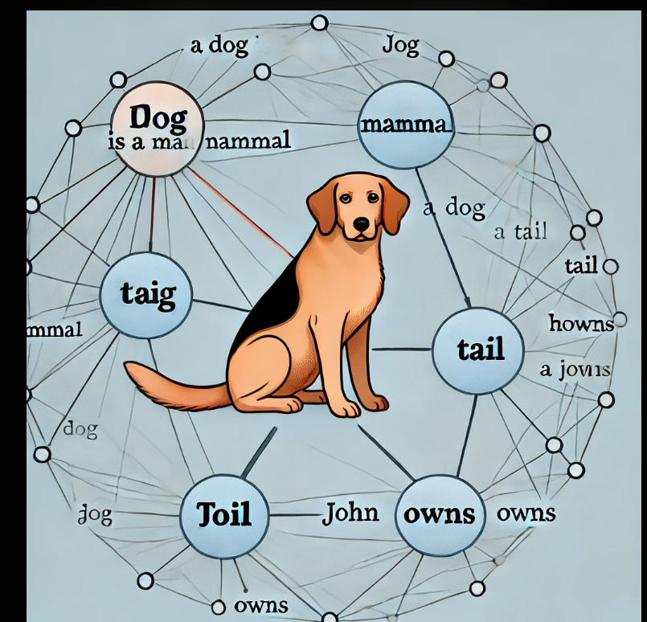
Weak slot and filler structures: Semantic nets, Frames

Slide 5
Weak slot and filler structures: Semantic nets, Frames
2. Frames
Frames are another structure used for knowledge representation that is designed to capture stereotypical situations or concepts. A frame is a data structure that represents an object or a concept along with its associated attributes (slots) and values (fillers).
Characteristics of Frames:
Slots and Fillers: Each frame consists of slots that represent attributes or properties, and each slot has a filler that represents the value of that attribute.
Slots can be simple properties (like color or size) or more complex (like relations to other frames).
Fillers can be specific values, ranges, functions, or even other frames.
Default values: Frames can provide default values for slots, which can be overridden if specific information is available.
Inheritance: Similar to semantic nets, frames can be organized in a hierarchy where more specific frames inherit slots and fillers from more general frames.
Procedural attachments: Slots can also have associated procedures (called "if-needed" or "if-added" procedures) that are triggered when a slot value is required or when a new value is added.

Slide 6
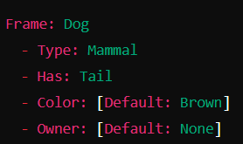
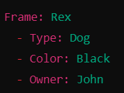
Weak slot and filler structures: Semantic nets, Frames
Weak slot and filler structures: Semantic nets, Frames
Example:
A frame representing the concept of a "dog" might look like this:
If a specific dog, "Rex," is introduced:
Here, "Rex" inherits properties from the "Dog" frame, but overrides the default color with "Black" and specifies an owner, "John."

Slide 7
Weak slot and filler structures: Semantic nets, Frames
Key Differences between Semantic Nets and Frames:
Representation: Semantic nets are graph-based structures that focus on representing relationships between concepts, while frames are object-based structures that encapsulate detailed information about a specific concept or situation.
Flexibility: Frames are typically more detailed and structured, allowing for complex slot definitions and procedural attachments, whereas semantic nets provide a more straightforward, associative form of knowledge representation.
Use Cases: Semantic nets are often used to model simple associative relationships and inheritance hierarchies. Frames are used to represent more complex, structured knowledge such as stereotypes or typical scenarios in reasoning and problem-solving tasks.

Slide 8
Strong slot and filler structures: Conceptual dependency, Scripts
Strong slot and filler structures are frameworks in artificial intelligence (AI) and knowledge representation that are more rigid and formal than "weak" slot and filler structures like semantic nets and frames.
These structures are designed to represent knowledge in a way that facilitates understanding, reasoning, and inferencing by machines, often in more specific and constrained contexts. Two common types of strong slot and filler structures are Conceptual Dependency (CD) and Scripts.
Characteristics of Conceptual Dependency:
Primitive Actions (ACTs): CD uses a limited set of primitive actions (such as "PTRANS" for physical transfer, "ATRANS" for abstract transfer, "MTRANS" for mental transfer, etc.) to describe all possible actions.
Conceptual Case Roles: Each action is associated with certain roles (like agent, object, direction, instrument, etc.) that define who or what is involved in the action and how.
Dependencies: Relationships between actions and entities are captured using dependency links that specify how actions and entities are connected (e.g., who is performing an action, what is being acted upon).
Language Independence: CD focuses on the underlying meaning, not the specific words or syntax, so the same CD structure can represent equivalent sentences in different languages.

Slide 9
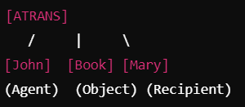
Strong slot and filler structures: Conceptual dependency, Scripts
Example of Conceptual Dependency:
Consider the sentence: "John gave a book to Mary."
In CD, this could be represented as:
Action: ATRANS (Abstract Transfer)
Agent: John
Object: Book
Recipient: Mary
The conceptual dependency diagram might look like this:
This representation captures the key elements of the action (transfer of possession) and the roles involved (John as the giver, the book as the object being transferred, and Mary as the recipient).

Slide 10
Strong slot and filler structures: Conceptual dependency, Scripts
2. Scripts
Scripts are another form of strong slot and filler structure used for knowledge representation, particularly in natural language understanding. A script represents a stereotypical sequence of events in a particular context or situation, capturing the typical roles, objects, and actions involved. Scripts are used to model common scenarios or routines, such as going to a restaurant, visiting a doctor, or attending a meeting.
Characteristics of Scripts:
Structured Sequences: Scripts describe a sequence of actions or events that typically occur in a specific situation.
Slots and Fillers: Scripts consist of slots that represent the different roles, actions, or events that can occur within the scenario, and fillers that provide specific details (e.g., the name of the restaurant, the type of food ordered).
Default Values: Scripts often include default values or expectations for what normally happens (e.g., after ordering food, the customer waits for it to be served).
Causal and Temporal Relations: Scripts capture not just the order of events but also the causal relationships between them (e.g., you need to order food before it can be served).

Slide 11
Strong slot and filler structures: Conceptual dependency, Scripts
Example of a Script:
Consider a script for the stereotypical scenario of "Going to a Restaurant":
Script Name: Restaurant Script
Slots and Fillers:
Entry: Customer enters the restaurant.
Order: Customer orders food from the waiter.
Payment: Customer pays for the food.
Exit: Customer leaves the restaurant.
How to Draw the Script:
The script could be visualized as a flowchart showing the sequence of events:

Slide 12
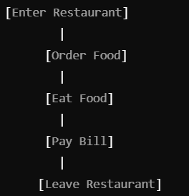
Strong slot and filler structures: Conceptual dependency, Scripts
This script captures the typical sequence of events that occur when a person goes to a restaurant, along with the possible variations or alternatives at each step.

Slide 13
Game playing: Evaluation function
Game playing in artificial intelligence (AI) involves developing programs that can play games, often with the goal of competing against human players or other AI programs. A crucial component in building these programs is the evaluation function.
What is an Evaluation Function?
An evaluation function is a mathematical function used in AI game-playing algorithms to assess the desirability of a particular game state. The function assigns a numerical value, or "score," to a game state, representing how favorable that state is for the player making the move. This score guides the AI in making decisions about which moves to consider or prioritize.
Key Characteristics of an Evaluation Function:
Heuristic-based: Evaluation functions are usually heuristics that provide an approximation of the actual value or quality of a game state since computing the exact value is often infeasible due to the complexity of the game.
Player-centric: The function is designed to favor one player over the other, meaning it evaluates states in terms of the advantage or disadvantage to a specific player.

Slide 14
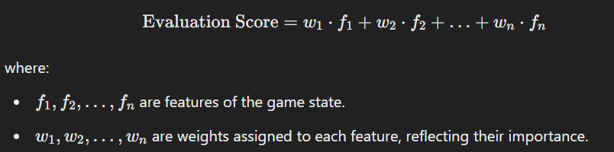
Game playing: Evaluation function
How Evaluation Functions Work
1. Components of an Evaluation Function:
An evaluation function for a game typically considers several features of the game state. For example, in chess, it might consider:
Material balance: The total value of pieces each player has on the board.
Positional factors: Control of key squares, piece activity, pawn structure, etc.
Mobility: The number of legal moves available to a player.
King safety: Protection of the king from immediate threats.
2. Weighted Sum of Features:
An evaluation function often takes the form of a weighted sum of these features:

Slide 15
Minmax Problem
The Minimax problem is a decision-making strategy commonly used in game theory and artificial intelligence, particularly for two-player, zero-sum games. The objective of the Minimax strategy is to minimize the possible loss for a worst-case scenario. When dealing with gains, it maximizes the minimum gain (hence "Minimax").
What is the Minimax Algorithm?
The Minimax algorithm is a recursive method used to determine the optimal move for a player, assuming that both players will play optimally. It is widely used in AI for games like chess, tic-tac-toe, checkers, and other two-player games where players take turns.
Key Principles of the Minimax Algorithm:
Two Players:
Maximizer (Max): The player trying to maximize their score (often the AI or the player we are programming).
Minimizer (Min): The opponent trying to minimize the Maximizer’s score (often assumed to play optimally).
Zero-Sum Game:
The total gain of one player is exactly the total loss of the other player. If one player wins, the other loses an equivalent amount.
Complete Knowledge:
The game is deterministic and fully observable, meaning that both players have complete knowledge of the game state at all times.

Slide 16
Minmax Problem
Properties of the Minimax Algorithm
Optimality:
The Minimax algorithm is optimal if both players play perfectly, meaning it guarantees the best possible outcome for the Maximizer.
Completeness:
The algorithm is complete for finite game trees, as it will explore all possible moves within the depth limit.
Time Complexity:
The time complexity is O(b^d), where:
b is the branching factor (the average number of legal moves per position).
d is the depth of the game tree being explored.
This can become computationally expensive, especially in games with high branching factors and deep game trees.
Space Complexity:
The space complexity is O(b⋅d) as it needs to store the game tree nodes up to depth d.

Slide 17
Minmax Problem
Optimizations for Minimax
Alpha-Beta Pruning:
A technique to reduce the number of nodes evaluated in the game tree by "pruning" branches that will not affect the final decision. This allows the Minimax algorithm to run faster by ignoring less promising branches.
Iterative Deepening:
Combines depth-first search with increasing depth limits, allowing the search to explore deeper parts of the game tree progressively.
Heuristic Evaluation Functions:
For games with large search spaces, using heuristic evaluation functions to estimate the value of non-terminal nodes allows the algorithm to make decisions without reaching terminal nodes.

Slide 18
The min-max search procedure
Min-Max Search Procedure
The Min-Max Search is a decision-making algorithm used in artificial intelligence for two-player, zero-sum games (like chess, tic-tac-toe, or checkers). The goal of the Min-Max search is to determine the best possible move for the player currently taking a turn (called the "Maximizer") assuming that the opponent (called the "Minimizer") will also play optimally.
The algorithm works by recursively simulating all possible moves and counter-moves, evaluating the resulting game states, and choosing the move that maximizes the chances of winning (or minimizes the chance of losing) for the Maximizer.
Steps in the Min-Max Search Procedure
Here is a step-by-step explanation of how the Min-Max search procedure works:
Construct the Game Tree:
The game tree represents all possible moves and outcomes from the current state.
The root node represents the current state of the game.
Child nodes represent possible moves, alternating between levels representing the Maximizer's and Minimizer's moves.

Slide 19
The min-max search procedure
Recursive Exploration of the Game Tree:
Start at the root node (current state of the game).
Recursively explore all possible moves for both the Maximizer and Minimizer up to a certain depth or until a terminal node (end state of the game, such as a win, loss, or draw) is reached.
Evaluate Terminal Nodes:
Use an evaluation function to assign a score to each terminal node.
For example, in a game like tic-tac-toe:
A win for the Maximizer might be assigned a score of +1.
A loss for the Maximizer might be assigned a score of -1.
A draw might be assigned a score of 0.

Slide 20
The min-max search procedure
Backpropagate Values Up the Tree:
After evaluating the terminal nodes, propagate these values back up the tree:
For Min nodes (representing the Minimizer's move), select the minimum score from its child nodes. This simulates the opponent's strategy of minimizing the Maximizer's score.
For Max nodes (representing the Maximizer's move), select the maximum score from its child nodes. This simulates the strategy of maximizing the score for the Maximizer.
Choose the Optimal Move:
At the root node (the current state), the optimal move for the Maximizer is the move that leads to the child node with the highest Min-Max value.
This move is then executed in the actual game.

Slide 21
The min-max search procedure
Properties of the Min-Max Search Procedure
Optimality:
The Min-Max algorithm is optimal if both players play perfectly, ensuring the best possible outcome for the Maximizer.
Completeness:
The algorithm is complete for finite games with a limited number of moves, as it explores all possible game states up to a certain depth.
Time Complexity:
The time complexity is O(b^d), where:
b is the branching factor (the average number of legal moves per position).
d is the depth of the game tree being explored.
This complexity can become significant for games with large search spaces (like chess).
Space Complexity:
The space complexity is O(b⋅d) due to the need to store the game tree nodes up to the maximum search depth.

Slide 22
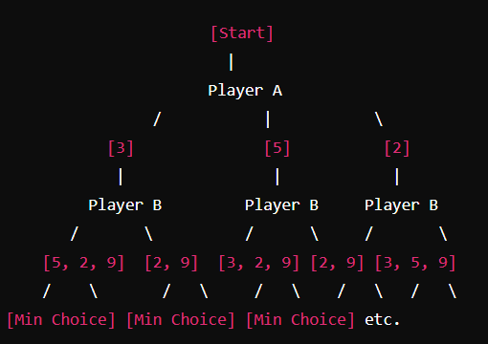
Example: Simple Two-Player Game
Imagine a game where two players, Player A (Max) and Player B (Min), take turns choosing a number from a list. The goal for Player A is to maximize the score, while the goal for Player B is to minimize Player A's score.
Game Setup: Initial list of numbers: [3, 5, 2, 9]
Player A's (Max) Goal: Choose numbers to maximize the score.
Player B's (Min) Goal: Choose numbers to minimize Player A's score.
The decision tree for this game would look something like this:

Slide 23
Example: Simple Two-Player Game
Step-by-Step Explanation
Player A (Max) starts.
Player A has three choices to start with: 3, 5, or 2. Let's consider one of the branches.
Player A picks 3.
Player B (Min) chooses next.
Remaining choices for Player B are: 5, 2, 9.
Player B's strategy is to minimize Player A's score. So, Player B will pick 2, since it's the smallest number available.
Back to Player A (Max).
Remaining choices for Player A are: 5, 9.
Player A will choose 9 to maximize the score.
Evaluating the Total Scores:
Player A's total score: 3 (first pick) + 9 (second pick) = 12.
Player B's choice forces Player A to end up with the smallest possible maximum score.

Slide 24
Example: Simple Two-Player Game
Calculating Min-Max for All Moves
Now, apply this to all possible moves:
If Player A chooses 3:
Player B can pick 2 (minimize A's score).
Player A then picks 9.
Total score for A: 3 + 9 = 12.
If Player A chooses 5:
Player B can pick 2 (minimize A's score).
Player A then picks 9.
Total score for A: 5 + 9 = 14.
If Player A chooses 2:
Player B can pick 3 (next lowest number).
Player A then picks 9.
Total score for A: 2 + 9 = 11.

Slide 25
Example: Simple Two-Player Game
Optimal Strategy for Player A (Max)
To maximize the minimum possible score, Player A should choose 5 initially. This ensures that the worst-case scenario gives a total score of 14, which is higher than the worst-case total scores if they choose 3 (12) or 2 (11).
Summary
Player A (Max) starts by selecting the number that gives the highest possible minimum score.
Player B (Min) responds by selecting the number that minimizes Player A's score.
By using the min-max algorithm, Player A ensures they make the optimal move to maximize their score, assuming that Player B also plays optimally to minimize Player A's score.

Slide 26
Alpha-beta pruning
Alpha-Beta Pruning is an optimization technique for the Minimax algorithm used in two-player, zero-sum games (like chess or tic-tac-toe). It reduces the number of nodes evaluated in the search tree by eliminating branches that cannot affect the final decision. This significantly speeds up the Minimax search, allowing deeper searches within the same time constraints.
What is Alpha-Beta Pruning?
Alpha-Beta pruning is a method that "prunes" or cuts off parts of the search tree that do not need to be explored because they cannot influence the final decision. It does this by keeping track of two values:
Alpha (α): The best value (highest score) that the Maximizer (the player trying to maximize the score) can guarantee at that point or above.
Beta (β): The best value (lowest score) that the Minimizer (the player trying to minimize the score) can guarantee at that point or below.
During the search, if the algorithm discovers that a particular branch cannot possibly improve the current best outcome (either for the Maximizer or Minimizer), it will "prune" or ignore that branch, reducing the number of nodes it needs to examine.

Slide 27
Alpha-beta pruning
How Alpha-Beta Pruning Works
Alpha-Beta pruning works by maintaining two values, alpha and beta, during the traversal of the Minimax tree:
Alpha (α): Represents the maximum score that the Maximizer can guarantee so far. It starts at negative infinity and increases as better options are found.
Beta (β): Represents the minimum score that the Minimizer can guarantee so far. It starts at positive infinity and decreases as better options are found.
The Pruning Conditions
Prune at Max Node (Maximizer's Turn):
At a Max node (where it is the Maximizer's turn), the search stops and the branch is pruned if the value of any child node is greater than or equal to β.
This is because the Minimizer will choose a move that minimizes the score, so if the current score is already worse than or equal to the best guaranteed option for the Minimizer, there is no point in further exploring that branch.
Prune at Min Node (Minimizer's Turn):
At a Min node (where it is the Minimizer's turn), the search stops and the branch is pruned if the value of any child node is less than or equal to α.
This is because the Maximizer will choose a move that maximizes the score, so if the current score is already worse than or equal to the best guaranteed option for the Maximizer, there is no point in further exploring that branch.

Slide 28
Alpha-beta pruning
Benefits of Alpha-Beta Pruning
Efficiency:
Reduces the number of nodes explored, potentially cutting the search time in half.
Allows deeper searches within the same time constraints, improving the quality of decision-making.
Optimality:
Preserves the optimal decision of the Minimax algorithm.
Ensures that no possible winning move is missed while pruning irrelevant branches.
Best-Case and Worst-Case Performance
Best Case: The pruning achieves its maximum efficiency when the best moves are always considered first, leading to a reduction in the search tree size to O(bd/2) instead of O(b^d).
This is called the perfect ordering scenario.
Worst Case: If the moves are not ordered optimally, Alpha-Beta pruning may still explore almost all nodes in the tree, resulting in a complexity O(b^d) ,similar to the standard Minimax algorithm.

Slide 29
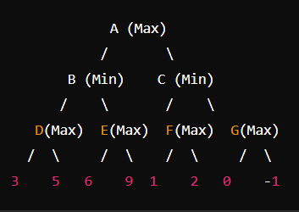
Example
Consider a simple two-player game (Player A and Player B) represented by the following game tree. Player A (Max) tries to maximize the score, and Player B (Min) tries to minimize it. Each node in the tree represents a possible game state, and the leaves represent the final score of that state.
Initial Setup: Alpha (α) starts at -∞ and represents the best value Max can guarantee.
Beta (β) starts at +∞ and represents the best value Min can guarantee.

Slide 30
Example
Starting at Node A (Max):
We traverse to B (Min).
Node B (Min):
We traverse to D (Max).
Node D (Max):
Evaluate the left child of D, which is 3.
Update α = 3 (best for Max so far).
Evaluate the right child of D, which is 5.
Update α = 5 (since 5 > 3).
Return 5 (Max chooses the best value for itself from D's children).
Node B (Min):
We now go to Node E (Max).
Node E (Max):
Evaluate the left child of E, which is 6.
Update α = 6.
Evaluate the right child of E, which is 9.
Update α = 9.
Return 9 (Max chooses 9, the best value for itself from E's children).

Slide 31
Example
Node B (Min):
Since it's Min's turn, it chooses the minimum of 5 (from D) and 9 (from E).
Return 5 to A (B chooses the minimum value for itself).
Node A (Max): Go to Node C (Min).
Node C (Min): Traverse to Node F (Max).
Node F (Max): Evaluate the left child of F, which is 1.Update α = 1.
Evaluate the right child of F, which is 2. Update α = 2.
Return 2 (Max chooses the best value for itself from F's children).
Node C (Min): Now, traverse to Node G (Max).
Node G (Max): Evaluate the left child of G, which is 0.Update α = 0.
Evaluate the right child of G, which is -1.Since -1 < 0, no update to α (Max would not pick -1).
Return 0 (Max chooses 0, the best value for itself from G's children).

Slide 32
Example
Node C (Min):
Since it's Min's turn, it chooses the minimum of 2 (from F) and 0 (from G).
Return 0 to A (C chooses the minimum value for itself).
Final Decision:
At Node A (Max):
Max chooses the maximum of 5 (from B) and 0 (from C).
Max selects 5.
In this process, we avoided evaluating some parts of the tree by applying alpha-beta pruning. For example: After evaluating the value of D (5) for Min at Node B, there was no need to fully evaluate the right child (9) of Node E. We already knew that Min would not choose a value higher than 5 (because Min's goal is to minimize).

Slide 33
Alpha-Beta Cutoffs
Alpha-Beta cutoffs occur during the Alpha-Beta pruning process in the Minimax algorithm. When evaluating a game tree for a two-player, zero-sum game, the algorithm uses cutoffs to eliminate branches that will not influence the final decision. This allows the algorithm to avoid unnecessary calculations, making it more efficient.
To understand Alpha-Beta cutoffs, let's revisit the two main concepts: Alpha (α) and Beta (β).
Alpha (α): The maximum score that the Maximizer (the player trying to maximize the score) is assured of at that point or higher.
Beta (β): The minimum score that the Minimizer (the player trying to minimize the score) is assured of at that point or lower.
What Are Alpha-Beta Cutoffs?
Alpha-Beta cutoffs occur when the algorithm determines that further exploration of a particular branch cannot affect the final decision because it will not improve the current best guaranteed outcomes (either for the Maximizer or the Minimizer). When such a situation is identified, the algorithm "cuts off" the remaining branches from further consideration.

Slide 34
Alpha-Beta Cutoffs
How Alpha-Beta Cutoffs Work
Pruning at a Max Node:
At a Max node (where it's the Maximizer's turn), the node is pruned (cut off) if the current value of the node is greater than or equal to Beta (β).
Why? The Minimizer has already found a better or equally good option elsewhere, so there's no need to continue exploring this branch.
Pruning at a Min Node:
At a Min node (where it's the Minimizer's turn), the node is pruned if the current value of the node is less than or equal to Alpha (α).
Why? The Maximizer has already found a better or equally good option elsewhere, so further exploration of this branch is unnecessary.

